Slide 1
Outline
outline-style
outline-color
outline-width
outline-offset
outline

Slide 2
Icons
CDN link add
Icons name add

Slide 3
Link
a:link - a normal, unvisited link
a:visited - a link the user has visited
a:hover - a link when the user mouses over it
a:active - a link the moment it is clicked Icons name add
background-color

Slide 4
List
Unordered Lists <ul> </ul>
Ordered Lists <ol> </ol>
List style
list-style-type ( circle , square , upper-roman , none)
list-style-image: url('sqpurple.gif’);
list-style-position: outside; (inside )
list-style: square inside url("sqpurple.gif");

Slide 5
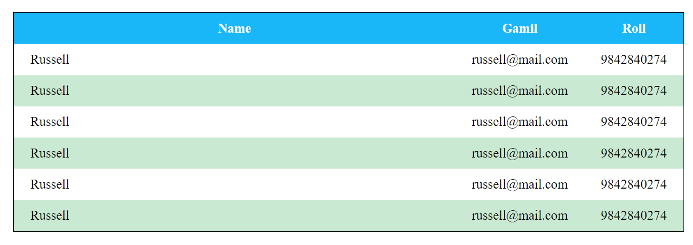
Table Style
Border
border-collapse
width and height properties
text-align
TR style => tr:nth-child(even) {
background-color: #f2f2f2;}
Responsive => overflow-x:auto;

Slide 6
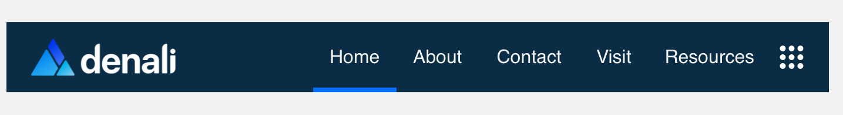
NavBar
Log
Brand name
Menu etc.

