Slide 1
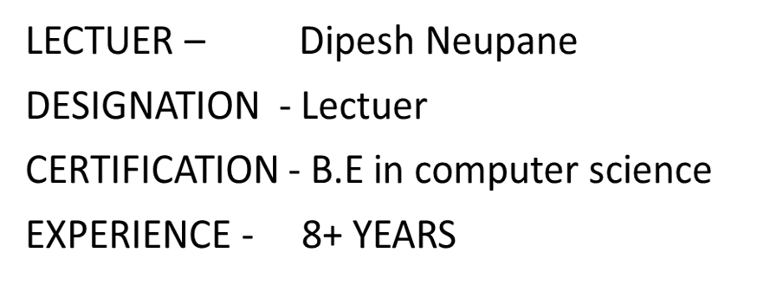

INDUSTRIAL MANAGEMENT

Slide 2
CHAPTER -7
QUALITY MANAGEMENT

Slide 3
PLO
Better understand the concept of scanning the potential barriers to successful controlling.

Slide 4
Quality Management
Quality management is about ensuring that an organization’s products or services meet consistent standards. It involves:
Quality Planning: Setting quality goals and determining the processes required to achieve them.
Quality Assurance: Implementing systematic activities to ensure that quality requirements are met.

Slide 5
Quality Control: Monitoring and inspecting processes and outputs to identify defects and ensure standards are maintained.
Continuous Improvement: Regularly evaluating and enhancing processes to improve quality over time.
It's all about maintaining high standards and continually improving to meet customer expectations.

Slide 6
Evolution of Quality Management
The evolution of quality management has progressed through several stages:
Inspection Era: Focused on identifying defects after production.
Quality Control Era: Introduced statistical methods to control production processes.
Quality Assurance Era: Emphasized preventive measures to ensure quality throughout the production process.

Slide 7
Total Quality Management (TQM): Promoted a company-wide approach to quality, involving all employees.
Continuous Improvement: Focused on ongoing efforts to improve products, services, and processes.
Lean and Six Sigma: Combined methodologies to eliminate waste and improve quality and efficiency.
It's about moving from simply detecting defects to a comprehensive approach that integrates quality into every aspect of the organization.

Slide 8
Quality - Definitions
Quality is about meeting or exceeding expectations. It includes:
Fitness for Purpose: Ensuring that a product or service does what it is supposed to do.
Conformance to Requirements: Meeting specific standards and specifications.
Customer Satisfaction: Fulfilling or exceeding customer expectations.
Consistency: Delivering the same high standard every time.
Continuous Improvement: Always seeking to enhance products, services, and processes.
It's all about ensuring that what you offer meets the highest standards and keeps getting better

Slide 9
Total Quality Management (TQM)
Total Quality Management (TQM) is an approach that seeks to improve quality and performance in an organization through ongoing refinements. It includes:
Customer Focus: Putting customer needs and satisfaction at the forefront.
Continuous Improvement: Constantly seeking ways to improve products, services, and processes.
Employee Involvement: Encouraging all employees to take part in quality improvement.
Process Approach: Focusing on improving processes to achieve better results.

Slide 10
Total Quality Management (TQM) Contd…
Integrated System: Aligning all aspects of the organization towards achieving quality objectives.
Data-Driven Decision Making: Using data and analysis to guide decisions.
Communication: Ensuring effective communication across all levels of the organization.
It's all about creating a culture where everyone is committed to improving quality in every aspect of the business.

Slide 11
Forecasting and Forecasting Techniques
Forecasting is about predicting future events to make informed decisions. It involves:
Data Analysis: Examining historical data to identify trends and patterns.
Modeling: Using statistical and mathematical models to forecast future outcomes.
Expert Judgment: Consulting experts for insights and predictions.
Scenario Analysis: Considering different scenarios and their potential impacts.
Monitoring and Adjusting: Continuously tracking actual outcomes and refining forecasts as needed.

Slide 12
Forecasting Techniques
Qualitative Methods: Based on expert opinions and market research. Examples include Delphi method and market surveys.
Quantitative Methods: Using mathematical models and historical data. Examples include time series analysis and regression analysis.
Trend Analysis: Identifying and projecting trends based on past data.
Moving Averages: Smoothing out data to identify underlying trends.
Exponential Smoothing: Giving more weight to recent data points for more responsive forecasts.
It’s all about using a mix of data, expertise, and models to anticipate what’s coming next.

Slide 13
Forecast Errors
Forecast errors are the differences between predicted and actual outcomes. Understanding these errors helps improve future forecasts. Key points include:
Types of Errors: Common types include Mean Absolute Error (MAE), Mean Squared Error (MSE), and Mean Absolute Percentage Error (MAPE).
Causes: Errors can arise from incorrect data, unforeseen events, or flaws in the forecasting model.
Measurement: Quantifying errors to understand their magnitude and impact.
Analysis: Analyzing errors to identify patterns and potential improvements.
Adjustments: Refining forecasting models and techniques based on error analysis.
It’s all about learning from mistakes to make better predictions in the future.

Slide 14
ISO 9001:2000 Quality Management System Standard
ISO 9001:2000 sets out the criteria for a quality management system and is based on a number of quality management principles, including a strong customer focus, the involvement of top management, a process approach, and continual improvement

Slide 15
ISO 14001:2004 Environmental Management System Standard
ISO 14001:2004 focuses on environmental management. It provides a framework that an organization can follow, rather than establishing environmental performance requirements. Its aim is to help organizations minimize how their operations negatively affect the environment, comply with applicable laws, and continually improve in these areas.
In essence, ISO 9001:2000 is about quality management, while ISO 14001:2004 is about environmental management. Both standards guide organizations to better processes and continual improvement.

Slide 16
ISO 14001:2004 Environmental Management System Standard
ISO 14001:2004 provides a framework for an effective environmental management system (EMS). It helps organizations minimize their environmental impact, comply with legal requirements, and strive for continuous improvement in environmental performance.

Slide 17
ISO 27001:2005 Information Security Management System Standard
ISO 27001:2005 focuses on information security management. It provides a systematic approach to managing sensitive company information, ensuring its confidentiality, integrity, and availability. The standard includes implementing security controls and risk management processes to protect data.
In summary, ISO 14001:2004 is about environmental management, while ISO 27001:2005 is about safeguarding information security.

Slide 18
TEACHING MATERIALS
https://www.managementstudyguide.com/human-resource-management.htm#google_vignette
https://asq.org/quality-resources/quality-management-system

Slide 19
THANK YOU

