Slide 1
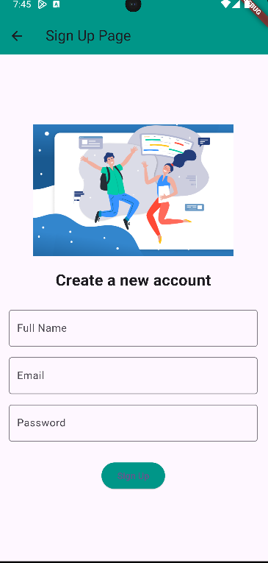
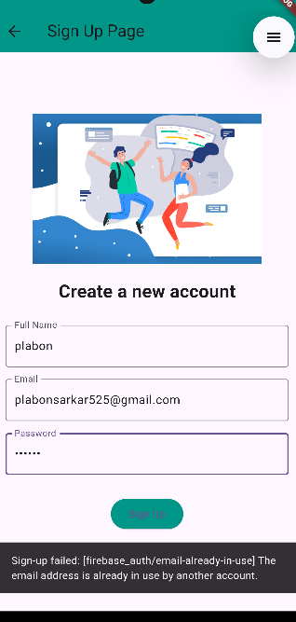
Registration Screen
Use Case: User can register to the app using the following information.
Normal Flow:
User provides the required information.
Clicks on register button.
User is registered to the app.
Exception:
If user provides an email that is already registered in the app, user will get appropriate error message as shown in the rightmost picture.

Slide 2
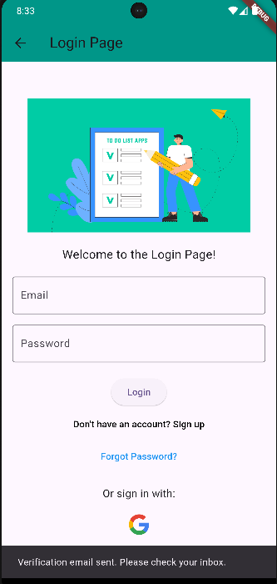
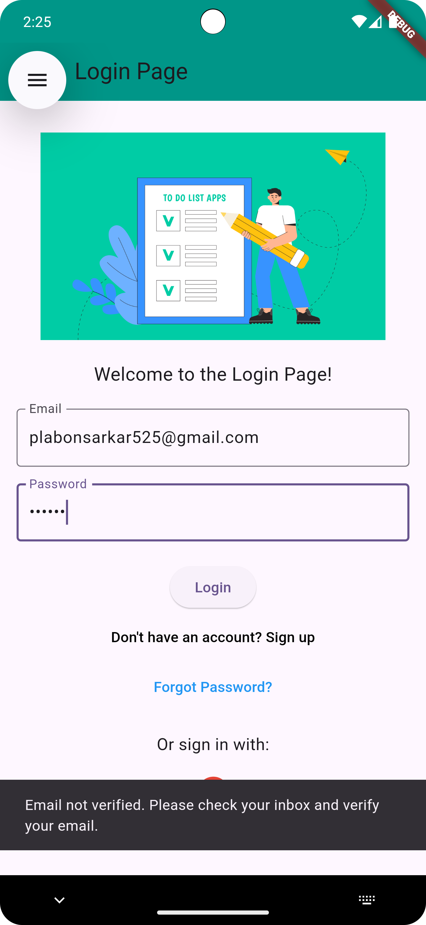
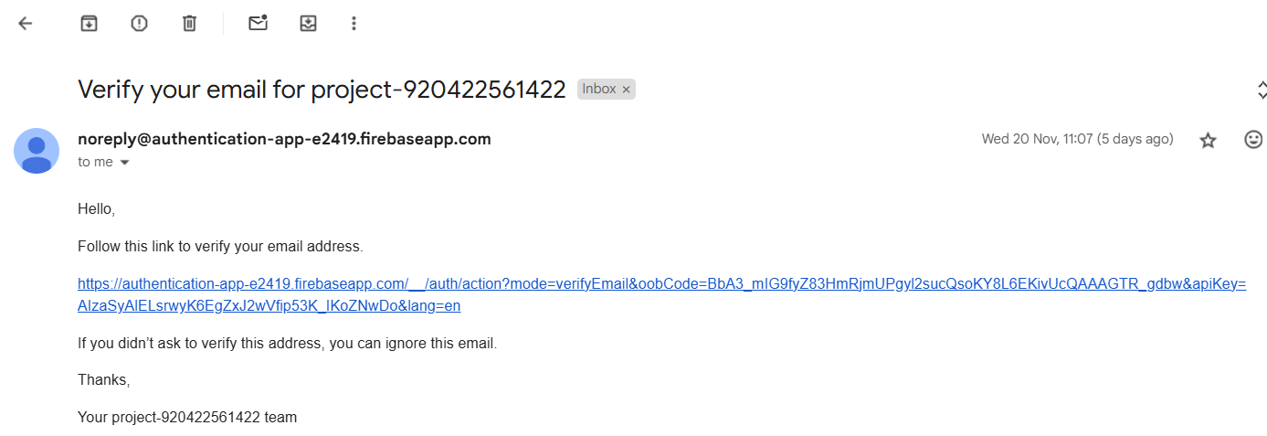
Email Verification
Use Case: User can verify their email address on this screen.
Normal Flow:
User clicks on the verify button
User gets an email on the provided email address
User clicks the link.
The user is verified and the verify button on the screen converted to continue button
Exception:
If the user has not verified their email, an error message appears: "Email not verified. Please verify your email to log in."

Slide 3
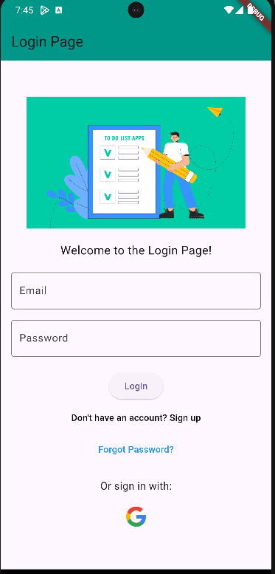
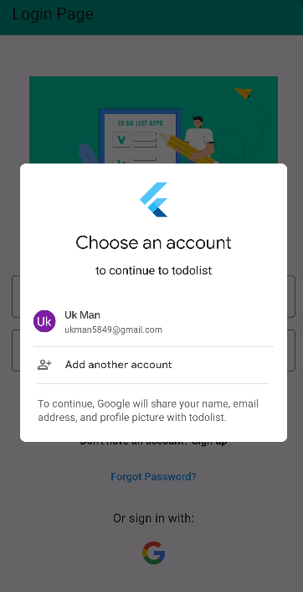
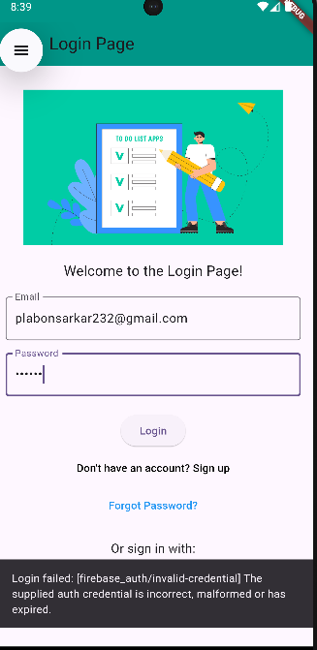
Login Screen
Use Case: User can login to the app by entering required their email and password.
Normal Flow:
User provides their email and password.
User clicks on the login button
User login to the app.
User can login through google.
Exception:
If user provides wrong email or password user will get appropriate error message.

Slide 4
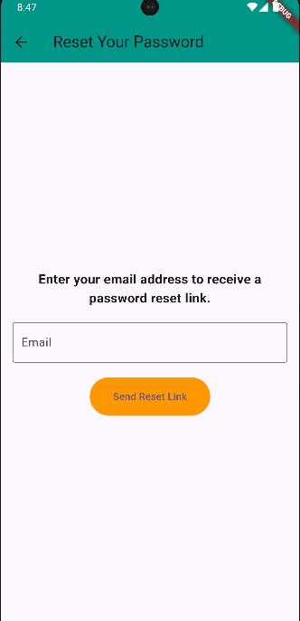
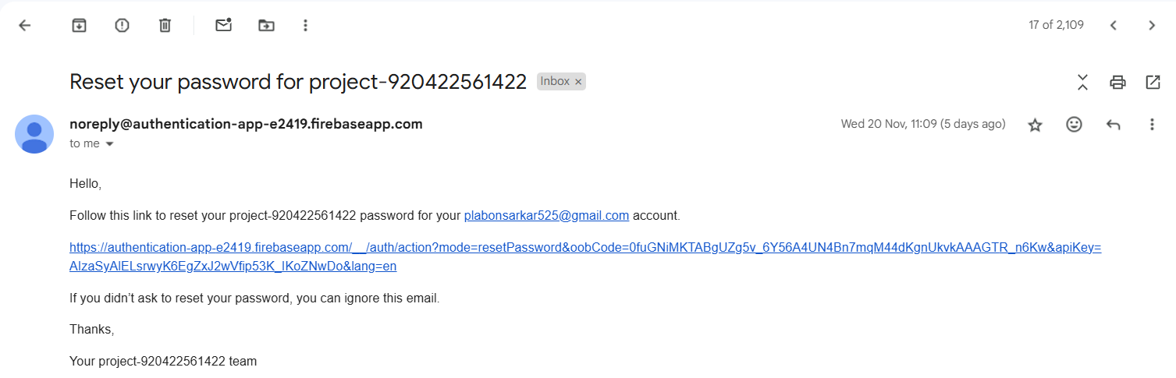
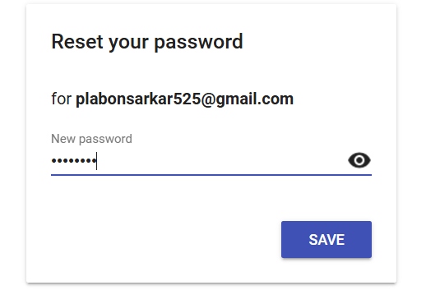
Forgot Password Screen
Use Case: User can reset their password on this screen.
Normal Flow:
User provides their email address.
User clicks on the Send Email button.
A password reset email is sent to the provided email address
After clicking the link user can type in their new password and click on save to reset their password

Slide 5

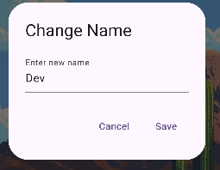
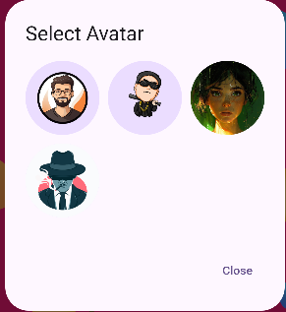

Profile Screen
Use Case: User can manage their profile on the profile screen, including selecting a profile picture, changing their name, and viewing their current level.
Normal Flow:
1. The user clicks on the profile picture area to upload or select a profile picture.
2. The user edits their name by typing into the name input field.
3. The user views their current level displayed on the screen.
4. Changes made are saved automatically or by clicking the "Save" button.
Exception:
If the user does not upload a profile picture, a default avatar will be displayed.

Slide 6
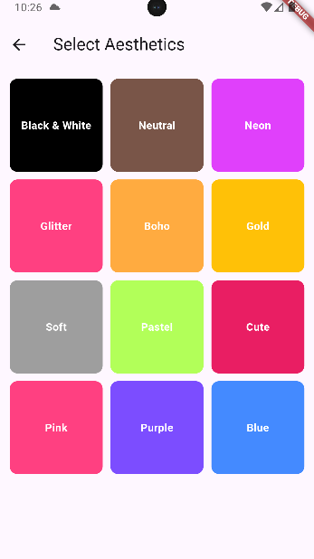
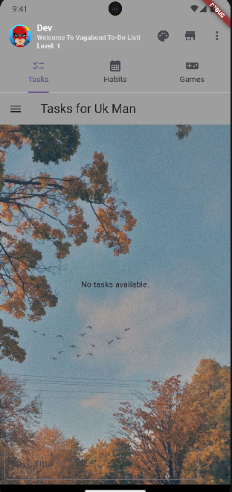
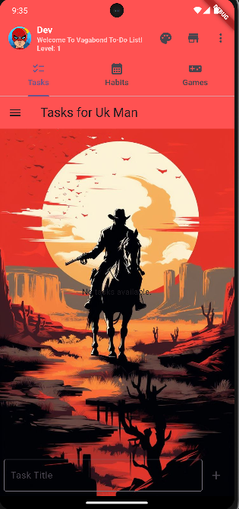
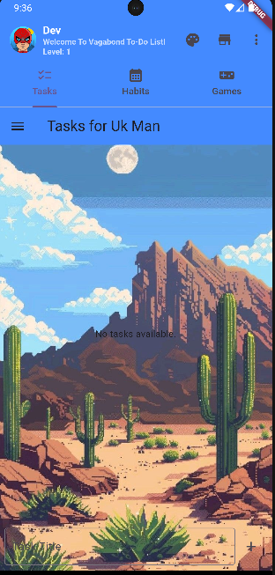
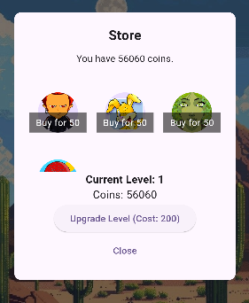
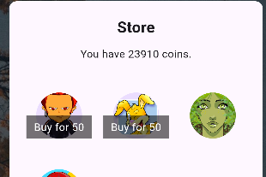
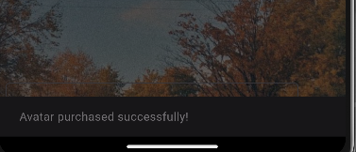
Theme and Store
Use Case: User can customize the app theme and purchase items from the store, including profile pictures and level upgrades.
Normal Flow:
The user selects a preferred theme from the available options to change the app's appearance.
The user visits the store and browses available items.
The user purchases a new profile picture using coins by selecting the desired picture.
The user upgrades their level by spending coins on the level-up option.
Purchases are instantly reflected in the user's profile and app.

Slide 7
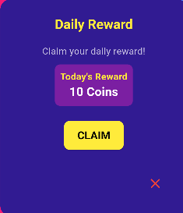
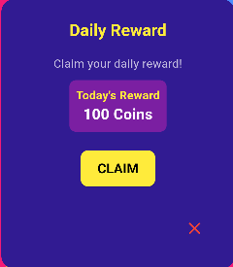
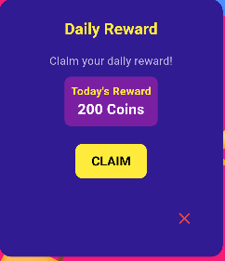
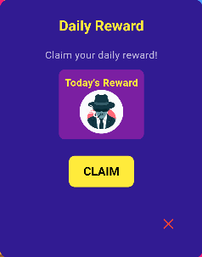
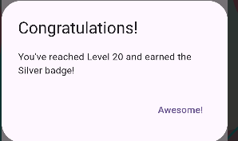
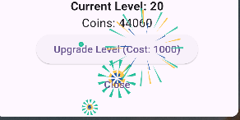
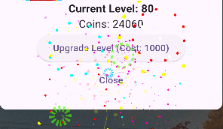



Rewards
Use Case: User can claim daily rewards, level up, and earn badges Normal Flow:
The user logs into the app and sees a "Daily Rewards" popup.
The user claims the daily reward, which may include coins, profile picture.
Rewards grow each day for seven days, then the user earns 200 coins daily.
When a level is completed, the user levels up and earns a milestone badge.
A popup with fireworks appears to celebrate each level milestone.

Slide 8
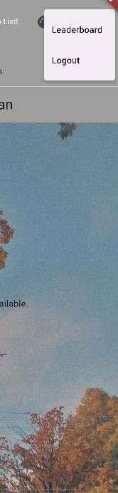
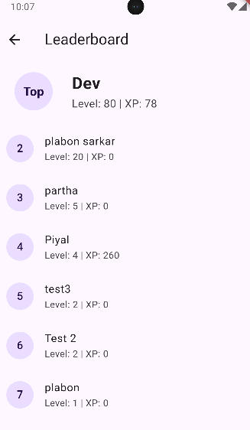
Leaderboard
Use Case: Users can view the leaderboard to see the top performers in the app.
Normal Flow:
The leaderboard displays the top users based on their levels and achievements. The leaderboard updates in real-time as users progress in the app.

Slide 9
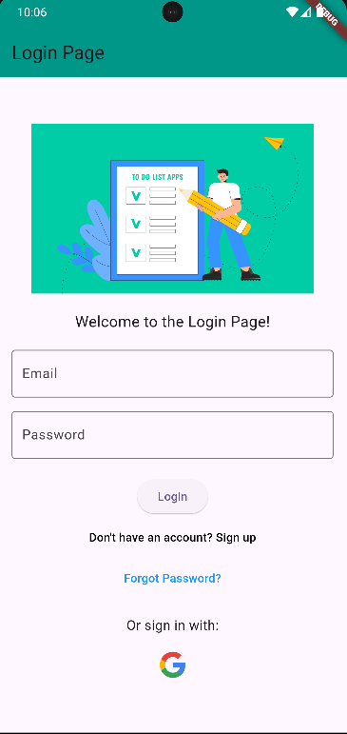
Logout
Use Case: User can logout from the app through this icon.
Normal Flow:
User clicks on the logout icon
User logged out of the system and redirected to login screen

Slide 10
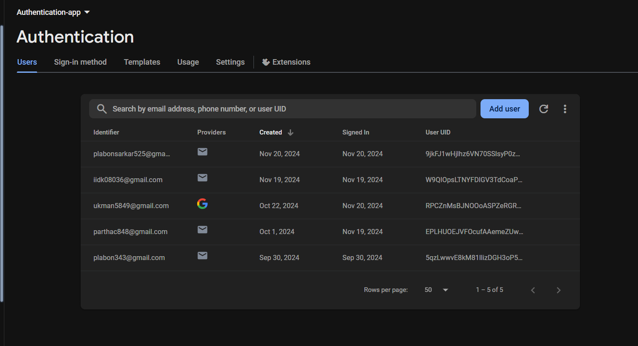
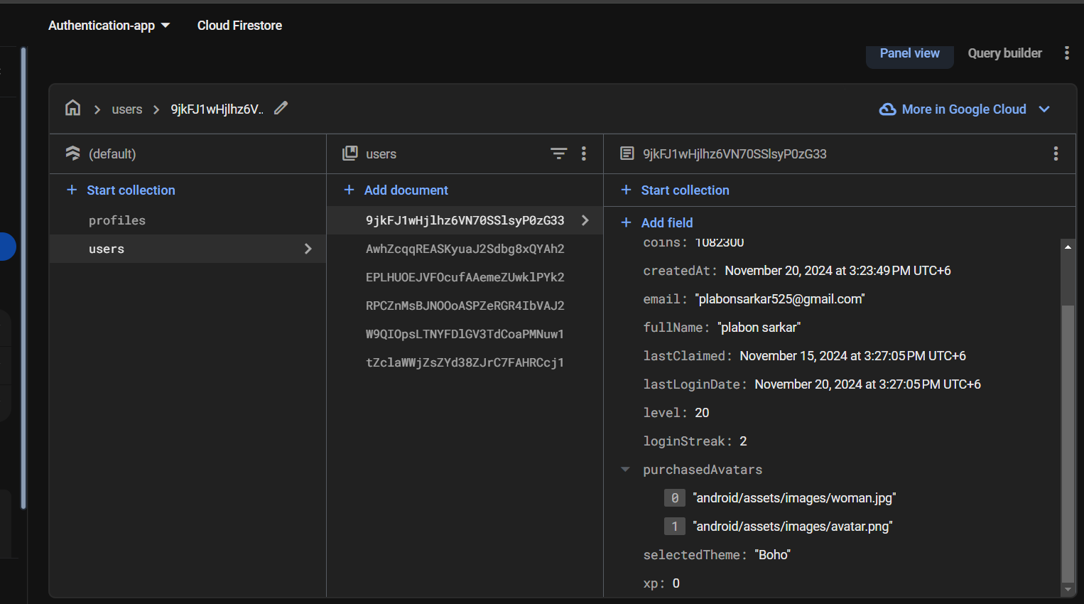
Backend
Overview

