Slide 1
NETWORK TRANSMISSION MEDIA
Types of communication media
Fiber optic communication
Twisted pair cable and Coaxial cable
Wireless propagation and Network
LAN Technologies (Ethernet, token ring, Gigabit Ethernet, FDDI, Wi-Fi/WLAN, ZigBee, Bluetooth)

Slide 2
NETWORK TRANSMISSION MEDIA
For communication to take place, a source, channel, and destination must be present. A transmission medium in communication is the path traveled by the communication signal from the transmitter to the receiver. Several design factors relating to the transmission medium and the signal determine the data rate and distance.
For each transmitter-receiver pair, the bit is sent by propagating electromagnetic waves, electrical pulses, or optical pulses across a medium. The physical medium can take many shapes and forms and does not have to be of the same type for each transmitter-receiver pair along the path.
The transmission media that are used to convey information can be classified as guided or unguided. Cables are commonly used to carry communication signals within LAN. With guided media, the waves are guided along a solid medium, such as a fiber-optic cable, a twisted-pair copper wire, or a coaxial cable. With unguided media, the waves propagate in the atmosphere and in outer space, such as in a wireless LAN or a digital satellite channel.

Slide 3
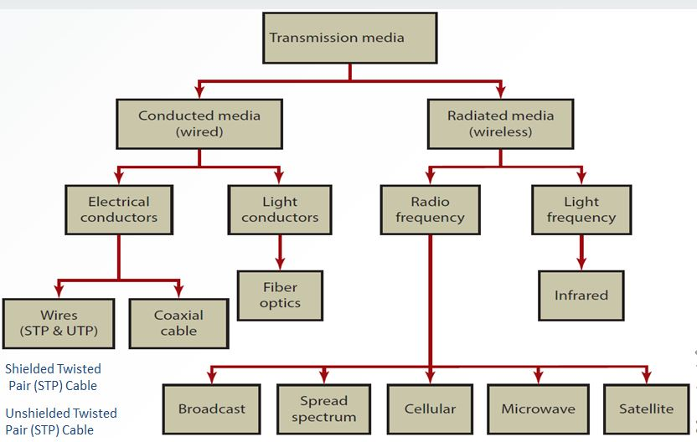
TYPES OF TRANSMISSION MEDIA
The greater the bandwidth of a signal, the higher the data rate that can be achieved. Impairments, such as attenuation, limit the distance. For guided media, twisted pair generally suffers more impairment than coaxial cable, which in turn suffers more than optical fiber.
Figure 1: Types of Transmission Media

Slide 4
OPTICAL FIBER
Fiber optic cables use pulses of light instead of electric signals to send and receive data. An optical fiber consists of an extremely thin cylinder of glass, called the core, surrounded by a concentric layer of glass, known as the cladding. Light is kept in the core of the optical fiber. This is because the refractive index of the core is slightly larger than the cladding causing total internal reflection at the interface of the core and cladding. Buffer coat acts as a shock absorber to protect the core and cladding from damage.
Fiber optic cables are made of glass or plastic. They have a very high bandwidth, which enables them to carry very large amounts of data. Optical fiber cable is a high-speed data transmission medium. The capacity of fiber optic transmission capacity is over a thousand times more than copper’s. It is capable of transmitting large amounts of data.
It is cylindrical, dielectric, low loss, and usually made of fused silica (SiO₂). The optical fiber is a device that works on the principle of Total Internal Reflection (TIR) by which light signals can be transmitted from one place to another with a negligible loss of energy.

Slide 5
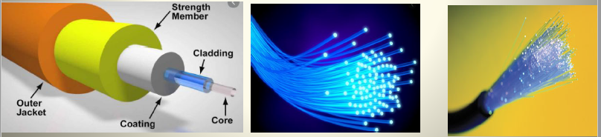
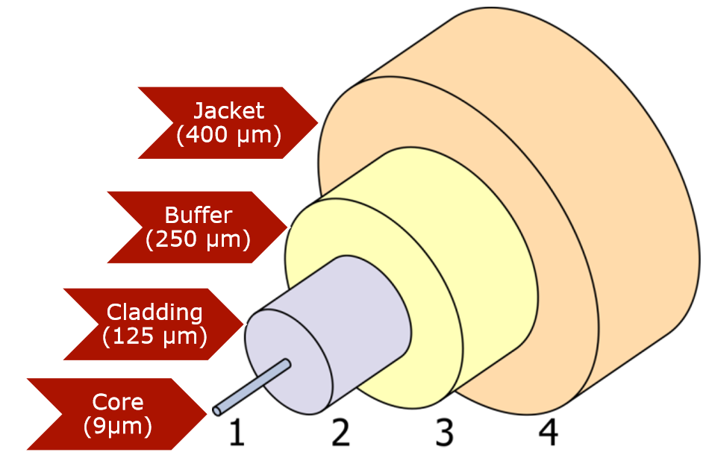
OPTICAL FIBER
Optical Fiber is used in backbone networks, large enterprise environments, and large data centers. It is also used extensively by telephone companies.
Optical fiber backbones are found in many corporations and are also used to connect ISPs on the internet.
Figure 2: Images of Optical Fiber

Slide 6
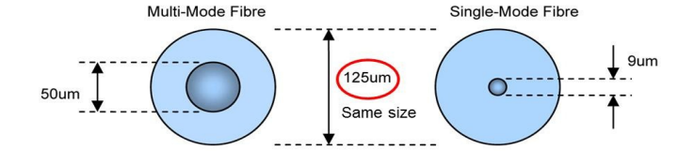
TYPES OF OPTICAL FIBER
There are two types of optical fiber cables namely single-mode fiber (SMF) cable and multi-mode fiber (MMF) cable. The small diameter glass core of SMF has very low signal attenuation and thus single mode fiber can carry more signals over long distances when compared with MMF.
A single-mode fiber has a smaller core diameter and can support only one mode of propagation. A multimode fiber has a larger core diameter and supports several modes. The main structural difference between a single-mode fiber and a multi-mode fiber is the diameter of the glass core. The diameter of the multimode fiber cable is larger than the single-mode fiber. It is impossible to differentiate between SMF/SSMF and MMF with the naked eye. There is no difference in the outward appearances; both are 125 microns in size. Only the core size differs.

Slide 7
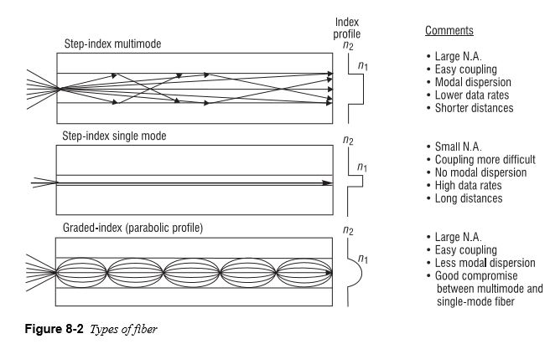
TYPES OF OPTICAL FIBER
SMF uses a single ray of light to carry data transfer over long distances. The light source is usually a laser, which is significantly more expensive and more intense than ordinary LEDs. Due to the intensity of the laser, much higher data rates and longer ranges can be obtained.
MMF uses multiple rays of light simultaneously, each carrying data, being transmitted through the cable simultaneously. Each ray of light takes a separate path through the multimode core. Multimode fiber is less expensive. The light source that produces the pulses of light is usually an LED.
Figure 3: Optical Fiber Transmission Modes

Slide 8
BASIC FIBER PROPERTIES SMF
It is used in all long-haul applications (supports long-distance transmission)
Has a core diameter of 9 microns
Its numerical aperture is very small
It supports only one mode in which the entire light energy is concentrated.
The single-mode fibers carry higher bandwidth than multimode fibers.
It requires a monochromatic and coherent light source (laser diodes)
Less attenuation

Slide 9
ADVANTAGES OPTICAL FIBER
Fiber cables are smaller than conducting cables and weigh much less
Fibers are strong and flexible, enabling them to go around corners. Glass fibers have a very high tensile strength
Fiber can carry more signals than a conducting cable
Fibers are not affected by (current, radiation, chemicals, etc.)
Long distance transmission due to low attenuation(Optical fiber loss can be as low as 0.2 dB/km)
Lower system cost (fewer repeaters due to low attenuation of fibers)
Fibers reject interference. The following forms of interference do not affect fiber systems. (RFI, EMI, EMP, etc.)
Fiber systems are difficult to tap. (banking, computer networks, military systems)
Thousands of channels can be multiplexed together over one strand of fiber
Fibers are compatible with conventional electronics
Corrosion resistant: Fiber, as opposed to wire systems, resist corrosion.
Large temperature range: Glass melts at high temperatures

Slide 10
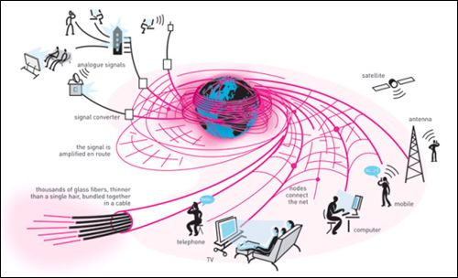
APPLICATIONS OF FIBER
Telecommunication applications
Fiber-optic sensors
Medical applications
Networking applications
Computer network (LA N, WAN)
Cable TV
Military applications such as tactical communications and fiber-guided missiles.
CCTV
Other video applications such as remote monitoring and surveillance.
Aircraft, ship and automobile, and Industrial applications

Slide 11
TWISTED PAIR CABLE
The least expensive and most commonly used guided transmission medium is twisted-pair copper wire. For over a hundred years it has been used by telephone networks. Twisted-pair cabling consists of copper wires that are twisted into pairs.
Twisted pair consists of two insulated copper wires, each about 1 mm thick, arranged in a regular spiral pattern. The wires are twisted together to reduce the electromagnetic and crosstalk interference from similar pairs close by. Out of these two wires, only one carries the actual signal and another is used for ground reference.
Because Ethernet is the foundation for most local networks, twisted pair is the most commonly encountered type of network cabling. A twisted pair cable is susceptible to electromagnetic interference (EMI), a type of noise. A source of interference, known as crosstalk, occurs when cables are bundled together for long distances. To eliminate this, pairs of wires carry signals in opposite directions so that the two magnetic fields also occur in opposite directions and cancel each other out. This process is known as cancellation. The number of twists per unit length affects the amount of resistance that the cable has to interference.

Slide 12
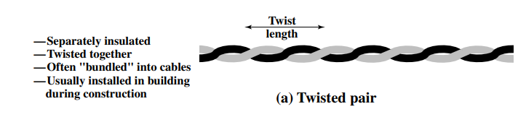
TWISTED PAIR CABLE
CAT-3 has 3-4 turns per foot making it less resistant to interference. CAT-5 has 3-4 turns per inch, making it more resistant to interference. There are two types of twisted-pair cables namely shielded twisted pair (STP) and unshielded twisted pair (UTP). UTP cable is the most common networking media. UTP cable is inexpensive, offers high bandwidth, and is easy to install.
Figure 4: Image of a Twisted Pair Cable

Slide 13
TWISTED PAIR CABLE
Twisted pair cable is most commonly used in network installations. The Telecommunications Industry Alliance/Electronic Industries Association (TIA/EIA) organization defines two different patterns, or wiring schemes, called T568A and T568B. Each wiring scheme defines the pinout, or order of wire connections, on the end of the cable.
The two schemes are similar except two of the four pairs are reversed in the termination order. On a network installation, one of the two wiring schemes (T568A or T568B) should be chosen and followed. It is important that the same wiring scheme is used for every termination. If you are working on an existing network, use the wiring scheme already employed.
SHIELDED TWISTED PAIR CABLES (STP)
It has a conducting metallic shield covering individual twisted pairs. This will block out electromagnetic interference to prevent unwanted noise from the communication circuit. Drain wires are also used in STP cables together with metallic shields for grounding purposes. The main purpose of the drain wire is to carry away unwanted interference noise to the ground.

Slide 14
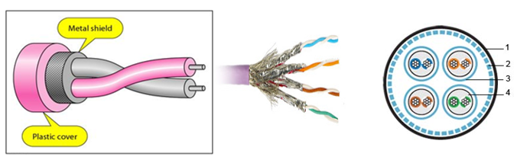
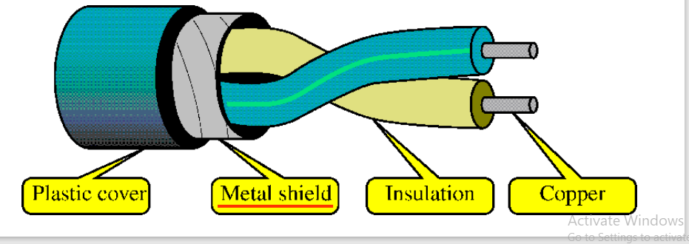
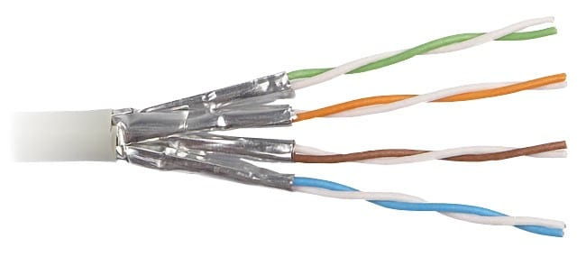
SHIELDED TWISTED PAIR CABLES (STP)
STP cabling is twisted-pair cabling with additional shielding to reduce crosstalk and other forms of electromagnetic interference (EMI). The outer insulating jacket contains an inner braided copper mesh to shield the pairs of twisted cables, which themselves are wrapped in foil. STP is a way of improving the characteristics of UTP to reduce interference. This shielded twisted pair provides better performance at higher data rates. However, it is more expensive and more difficult to work with than unshielded twisted pairs.
STP cables are similar to UTP cables, except there is a metal foil or braided-metal-mesh cover that encases each pair of insulated wires
Figure 5: Image of Shielded Twisted Pair Cable

Slide 15
UNSHIELDED TWISTED PAIR CABLES
Unshielded twisted pair (UTP) is commonly used for computer networks within a building, that is, for LANs. Data rates for LANs using twisted pairs today range from 10 Mbps to 10 Gbps. The data rates that can be achieved depend on the thickness of the wire and the distance between the transmitter and receiver. UTP has seven categories, each suitable for specific use. In computer networks, Cat-5, Cat-5e, and Cat-6 cables are mostly used.
This type of cable is used to connect workstations, hosts, and network devices. It comes with many different numbers of pairs inside the jacket, but the most common number of pairs is four. Each pair is identified by a specific color code. The wire pairs are then covered with a plastic outer jacket. UTP cables are of small diameter and it doesn’t need grounding. Since there is no shielding for UTP cabling, it relies only on "cancellation" to avoid noise.
They have no metallic shield. This makes the cable small in diameter but unprotected against electrical interference. The twist helps to improve its immunity to electrical noise and EMI. All Categories of data-grade UTP cable are traditionally terminated into an RJ-45 connector.

Slide 16
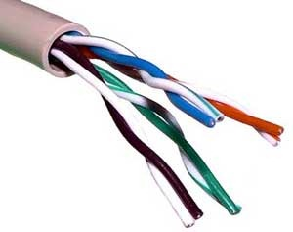
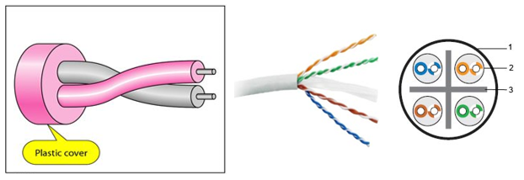
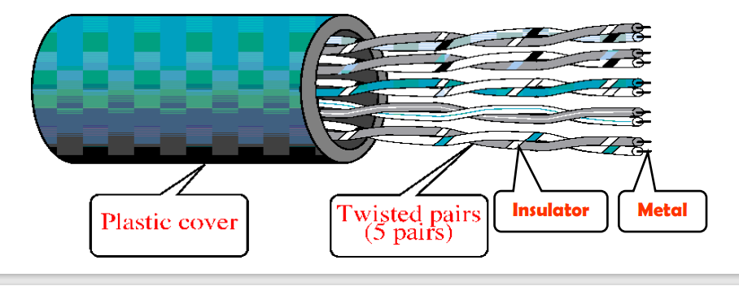
UNSHIELDED TWISTED PAIR CABLES
Figure 6: Image of Unshielded Twisted Pair Cable

Slide 17
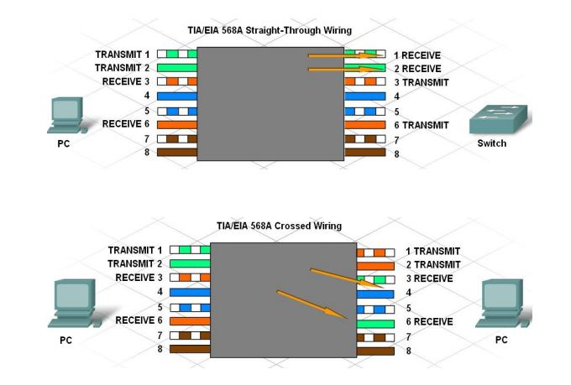
UNSHIELDED TWISTED PAIR CABLES
Using the T568A and T568B wiring schemes, two types of cables can be created: a straight-through cable and a crossover cable. These two types of cable are found in data installations.
Straight-through Cables: Straight-through cable is the most common cable type. It maps a wire to the same pins on both ends of the cable. In other words, if T568A is on one end of the cable, T568A is also on the other. If T568B is on one end of the cable, T568B is on the other. This means that the order of connections (the pinout) for each color is the same on both ends.

Slide 18
UNSHIELDED TWISTED PAIR CABLES
Crossover Cable: A crossover cable uses both wiring schemes. T568A on one end of the cable and T568B on the other end of the same cable. This means that the order of connections on one end of the cable does not match the order of connections on the other. The type of cable needed to connect two devices depends on which wire pairs the devices use to transmit and receive data.

Slide 19
UTP CABLES

Slide 20
UNSHIELDED TWISTED PAIR CABLES
Specific pins on the connector are associated with a transmit function and a receive function. The transmit pin versus the receive pin is determined based on the device. Two devices directly connected and using different pins for transmit and receive are known as unlike devices. They require a straight-through cable to exchange data. Devices that are directly connected and use the same pins for transmit and receive are known as like devices. They require the use of a crossover cable to exchange data.

Slide 21
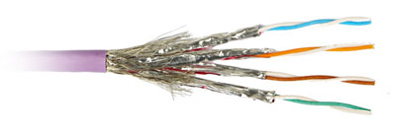
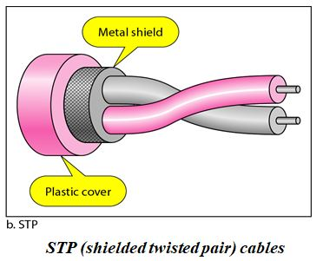
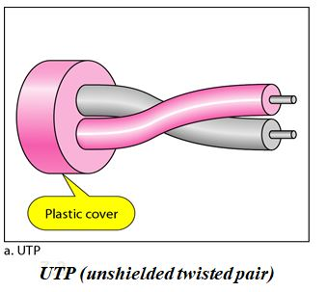
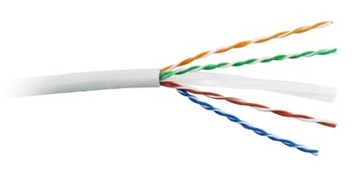
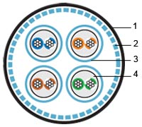
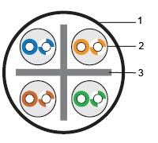
SHIELDED AND UNSHIELDED TWISTED PAIR CABLES
SHIELDED TWISTED PAIR CABLES
UNSHIELDED TWISTED PAIR CABLES
The pair is wrapped with metallic foil to insulate the pair from electromagnetic interference. It is more expensive and harder to work with.
Each wire is insulated with only plastic wrap, but the pairs are encased in an outer covering. It has no cover to protect the wires. There are two types of UTP. 3 UTP and 5 UTP.
The 3 UTP data rate is up to 16 Mbps.
The 5 UTP rate is up to 100 Mbps. It is more expensive and has a better performance. More tightly twisted than Category 3 cables
Figure 7a: Shielded Twisted Pair Cables
Figure 7b: Unshielded Twisted Pair Cables
1 – Jacket 2 – Shield-braid 3 – Shield-foil 4 – Stranded twisted pair
1 – Jacket 2 – Solid twisted pair 3 – Spacer

Slide 22
LIKE DEVICES
If a PC is directly connected to another PC, pins 1 and 2 on both devices are transmit pins, and pins 3 and 6 are receive pins.
A crossover cable would ensure that the green wire connected to pins 1 and 2 (transmit pins) on one PC connects to pins 3 and 6 (receive pins) on the other PC.
If a straight-through cable were used, the wire connected to pin 1, the transmit pin, on PC1 would be connected to pin 1, the transmit pin, on PC2. It is not possible to receive data on a transmit pin.
Other examples of like devices that require a crossover cable include:
Switch port to switch port
Switch port to hub port
Hub port to hub port
PC to router port
5. Some devices can automatically sense which pins are used for transmit and receive and will adjust their internal connections accordingly.

Slide 23
CABLE TESTING
When a new or repaired cable run is terminated, it is important to verify that the cable operates correctly and meets connectivity standards. This can be done through a series of tests.
The first test is a visual inspection, which verifies that all wires are connected according to T568A or B. 3 In addition to visual examination, check the cable electrically in order to determine problems or flaws in a network cabling installation. The following are tools that can be used for cable diagnostics:
Cable testers
Cable certifiers
Multimeters
The cable tester is used to perform initial diagnostics. The first test usually is called a continuity test and it verifies that there is end-to-end connectivity. It can also detect common cabling faults such as opens and shorts.
An open circuit occurs when the wire is not properly pushed into the connector and there is no electrical contact. An open can also occur if there is a break in the wire.
A short occurs when the copper conductors touch each other. As the electric pulse travels down the wire, it will cross onto the touching wire. This creates an unintended path in the flow of the signal to its destination.
If any of these faults are detected, the easiest way to correct them is to re-terminate the cable.

Slide 24
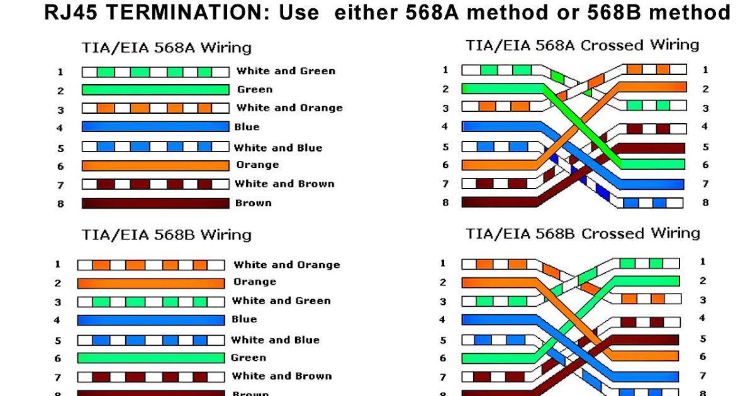
NETWORK CABLE

Slide 25
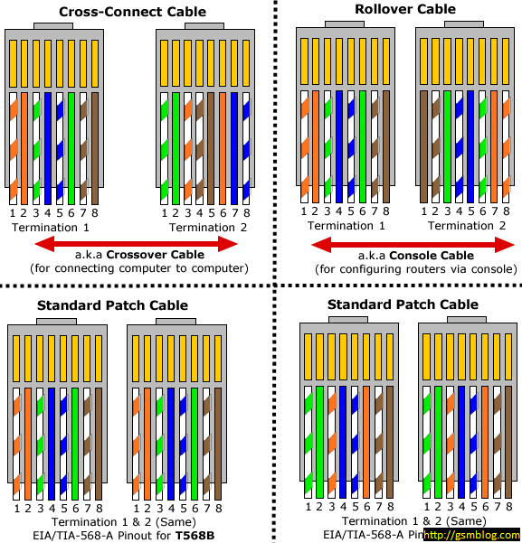
NETWORK CABLE

Slide 26
COAXIAL CABLE
Coaxial cable is widely used for cable television systems, office buildings, and other work sites for local area networks, long-distance telephone transmission, etc. The cables consist of copper or aluminum wire wrapped with an insulating layer. Coaxial cable has a central core conductor (copper) surrounded by a braided mesh. Both conductors share a common center axial, hence the term “co-axial”.
It is used to carry high-frequency electrical signals with low losses. The dimensions of the cable and connectors are controlled to give precise, constant conductor spacing, which is needed for it to function efficiently as a transmission line. It is used by cable television companies to provide services. It is also used for connecting the various components that makeup satellite communication systems.
Coaxial cable also carries data in the form of electrical signals. It provides improved shielding compared to UTP, so it has a lower signal-to-noise ratio and can therefore more carry data. Coaxial cables provide high bandwidth rates. There are three categories of coaxial cables namely, RG-59 (Cable TV), RG-58 (Thin Ethernet), and RG-11 (Thick Ethernet). RG stands for Radio Government.

Slide 27
COAXIAL CABLES
It has a solid-core copper wire conductor which runs down the middle of the cable. The coaxial cable has two wires of copper. The core wire lies in the center and it is made of a solid conductor. The core is enclosed in an insulating sheath. The second wire is wrapped around over the sheath and that too in turn encased by an insulator sheath. They are all covered by a plastic cover.
Because of its structure, the coaxial cable is capable of carrying high-frequency signals than that twisted pair cable. It is often used to connect a TV set to the signal source, be it a cable TV outlet, satellite TV, or conventional antenna. Although coaxial has improved data-carrying characteristics, twisted pair cabling has replaced coaxial in local area networking uses. Among the reasons for the replacement is that, compared to UTP, coaxial is physically harder to install, more expensive, and harder to troubleshoot

Slide 28
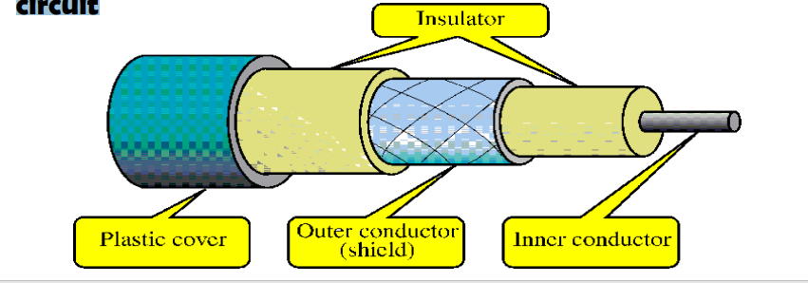
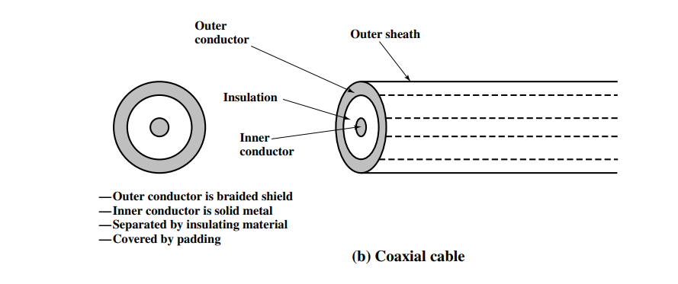
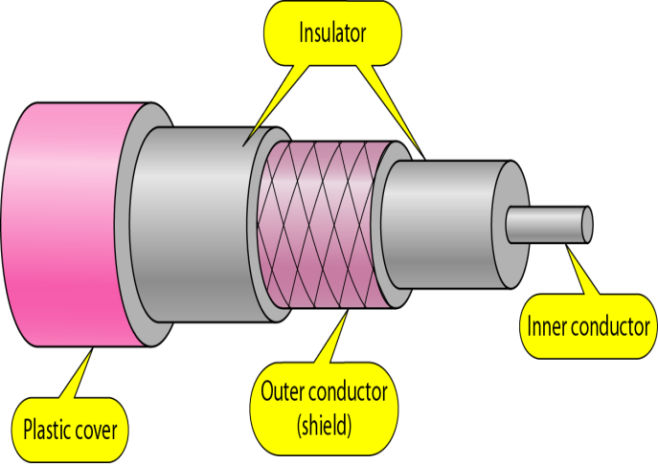
COAXIAL CABLE
Although coaxial has improved data-carrying characteristics, twisted pair cabling has replaced coaxial in local area networking uses. Among the reasons for the replacement is that, compared to UTP, coaxial is physically harder to install, more expensive, and harder to troubleshoot.
In general, coaxial cables carry signals of higher frequencies (100KHz–500MHz) than UTP cables. The outer metallic wrapping serves both as a shield against noise and cross-talk and as the second conductor that completes the circuit
Figure 8: Image of Coaxial Cable

Slide 29
TYPES OF COAXIAL CABLES
There are two types of coaxial cables. These are thick coaxial and thin coaxial. Thin coaxial cable is also referred to as thinnet. 10Base2 refers to the specifications for thin coaxial cables carrying Ethernet signals. The 2 refers to the approximate maximum segment length being 200 meters. The maximum segment length is 185 meters. Thin coaxial cable has been popular in school networks, especially linear bus networks.
10Base5 refers to the specifications for thick coaxial cable carrying Ethernet signals. The 5 refers to the maximum segment length being 500 meters. Thick coaxial cable has an extra protective plastic cover that helps keep moisture away from the center conductor. This makes thick coaxial a great choice when running longer lengths in a linear bus network. One disadvantage of thick coaxial is that it does not bend easily and is difficult to install.

Slide 30
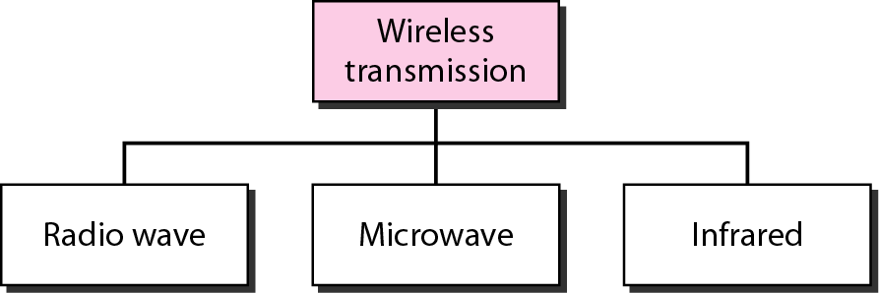
WIRELESS TRANSMISSION
Radio waves are used for multicast communications, such as radio and television, and paging systems. They can penetrate through walls. They are highly regulated. Use omnidirectional antennas. Microwaves are used for unicast communication such as cellular telephones, satellite networks, and wireless LANs. Higher frequency ranges cannot penetrate walls. Use directional antennas – point-to-point line-of-sight communications. Infrared signals can be used for short-range communication in a closed area using line-of-sight propagation.

Slide 31
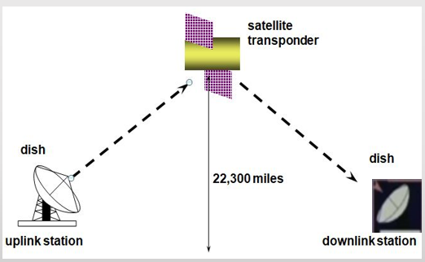
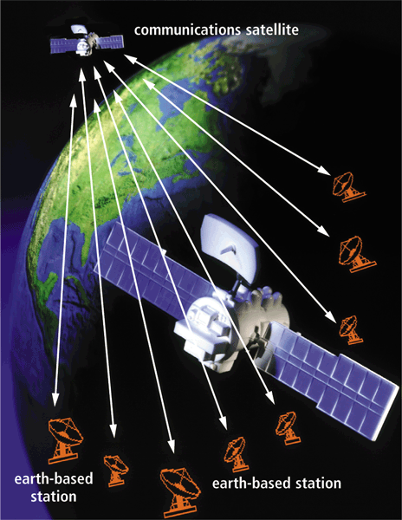

SATELLITE COMMUNICATIONS
The satellites use microwave radio signals as their telecommunications medium which are not deflected by the Earth’s atmosphere. The satellites are stationed in space above the equator. These Earth-orbiting systems are capable of receiving and relaying voice, data, and TV signals.
A communications satellite receives microwave signals from an earth-based station, amplifies them, and broadcasts the signal over a wide area. When using a satellite for long-distance communications, the satellite acts as a repeater. An earth station transmits the signal up to the satellite (uplink), which in turn retransmits it to the receiving earth station (downlink). Different frequencies are used for uplink/downlink.
Figure 9: Image of Satellite Communication

Slide 32
WIRELESS NETWORKS
Wireless network refers to two or more computers communicating using standard network rules or protocols, but without the use of cabling to connect the computers together. Wireless networks use radio waves to communicate instead of twisted pairs, and coaxial and fiber cables. The computers use wireless radio signals to send information from one to the other.
Wireless network components include network interface cards or network adapter cards, a wireless LAN PC card, and an access point.
Laptop and desktop computers can be connected to a wireless network if a wireless network card is inserted into one of its internal Peripheral Component Interconnect (PCI) slots. An access point (AP) has a similar function to the hub in wired networks. It broadcasts and receives signals to and from the surrounding computers via their adapter card. It is also a point where a wireless network can be connected to an existing wired network. The number of devices on a Wireless network can be increased without any additional cabling.

Slide 33
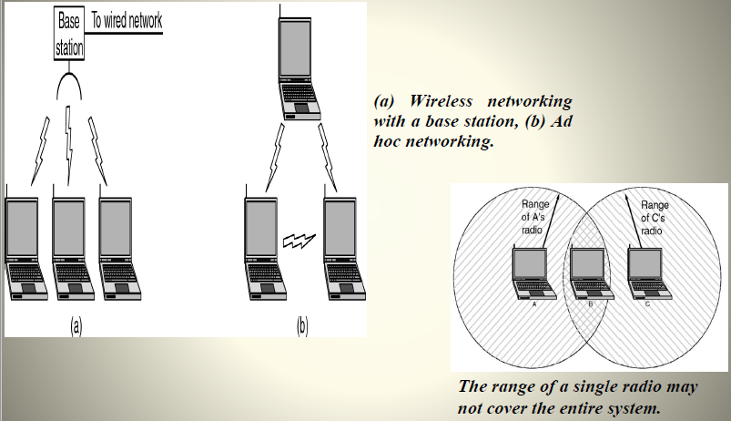
WIRELESS NETWORKS
A wireless local area network (WLAN) consists of two key components: an access point (AP) and a device (base station) that connects wireless devices together. Wireless AP receives data from wired Ethernet LAN and converts those data into wireless signals. Wireless AP sends and receives those wireless signals and connects wireless clients to the wired Ethernet network. Information can be transmitted between these two components as long as they are fairly close together.
Roaming users can be handed off from one access point to another like a cellular phone system. Laptops use wireless network cards that plug into an existing Personal Computer Memory Card International Association (PCMCIA) slot or that are self-contained on PC cards, while stand-alone desktops and servers use plug-in cards (PCI, etc.)
(a) Wireless networking with a base station, (b) Ad hoc networking.
The range of a single radio may
not cover the entire system.
Figure 10: Wireless Networks

Slide 34
AD HOC WIRELESS TOPOLOGY
Wireless Ad hoc network topology is used to create a small wireless network, consisting of a small number of wireless capable devices. It is similar to a peer-to-peer LAN network analogy.
Ad hoc topology-based networks are also known as Independent Basic Service Set configurations (IBSS).
A computer within the range of the transmitting computer can connect to it. However, if several computers are networked in this way, they must remain within range of each other. Even though this configuration has no real administration overhead, it should only be a consideration for very small installations.
In wireless Ad hoc network topology, the devices in the network communicate exclusively over the wireless channel, without requiring any connecting network infrastructure device like a wireless Access Point (AP).
Figure 25: A simple Ad hoc wireless topology based network

Slide 35
ADVANTAGES OF WIRELESS NETWORKS
A wireless LAN will make it simple to add or move workstations, and to install access points to provide connectivity in areas where it is difficult to lay cable.
Temporary or semi-permanent buildings that are within the range of an access point can be wirelessly connected to a LAN to give these buildings connectivity.
Installation can be fast and easy and can eliminate the need to pull cable through walls and ceilings
The number of devices in a wireless network can be increased without any additional cabling.
Installation expenses can be significantly lower (reduces expenditure on copper cabling).
Long-term benefits can be found in dynamic environments requiring frequent moves and changes (employees can change their desks easily without any additional cabling).

Slide 36
DISADVANTAGES OF WIRELESS NETWORKS
Higher levels of data encryption are necessary for wireless networks.
Wireless LAN networks are less reliable than cabled networks.
There may be disturbances in communication due to interferences.
As the number of computers using the network increases, the data transfer rate to each computer will decrease accordingly
Lower wireless bandwidth means some applications such as video streaming will be more effective on a wired LAN
Devices will only operate at a limited distance from an access point, with the distance determined by the standard used and buildings and other obstacles between the access point and the user
A wired LAN is most likely to be required to provide a backbone to the wireless LAN: a wireless LAN should be a supplement to a wired LAN and not a complete solution
It is easier to make a wired network ‘future proof’ for high data transfer

Slide 37
WIRELESS NETWORK COMPONENTS
Network interface card or network adapter cards
A wireless LAN PC card, which contains an in-built antenna, is used to connect notebook computers to a wireless network. Desktop computers can also connect to a wireless network if a wireless network card is inserted into one of its internal PCI slots.
Access point, has similar a function to the hub in wired networks. It broadcasts and receives signals to and from the surrounding computers via their adapter card. It is also a point where a wireless network can be connected to an existing wired network.
Wireless networks can be configured in an ad hoc/peer-to-peer arrangement or as a local area network. Ad Hoc/Peer-to-Peer Configuration is the most basic wireless network configuration. It relies on the wireless network adaptors installed in the computers that communicate with each other. A computer within range of the transmitting computer can connect to it. However, if several computers are networked in this way, they must remain within range of each other. Even though this configuration has no real administration overhead, it should only be a consideration for very small installations.

Slide 38
LOCAL AREA NETWORK TECHNOLOGIES
Ethernet
Ethernet is a widely deployed LAN technology. This technology was invented by Bob Metcalfe and D.R. Boggs in the year 1970. It was standardized in IEEE 802.3 in 1980.
Ethernet shares media. A network that uses shared media has a high probability of data collision.
Ethernet uses Carrier Sense Multi Access/Collision Detection (CSMA/CD) technology to detect collisions. On the occurrence of collision in Ethernet, all its hosts roll back, wait for some random amount of time, and then re-transmit the data.
An Ethernet connector is a network interface card equipped with a 48-bit MAC address. This helps other Ethernet devices to identify and communicate with remote devices in Ethernet. Traditional Ethernet uses 10BASE-T specifications. The number 10 depicts 10Mbps speed, BASE stands for baseband, and T stands for thick Ethernet. 10BASE-T Ethernet provides transmission speeds up to 10Mbps and uses coaxial cable or Cat-5 twisted pair cable with RJ-5 connector.
Ethernet follows Star topology with a segment length of up to 100 meters. All devices are connected to a hub/switch in a star fashion.

Slide 39
LOCAL AREA NETWORK TECHNOLOGIES
Ethernet
It uses the bus topology. The most widely used technologies to construct an Ethernet LAN are shared cables and hubs. Systems communicating over Ethernet divide a stream of data into individual packets called frames. Each frame contains source and destination addresses and error-checking data so that damaged data can be detected and re-transmitted.
Ethernet has survived as the major LAN technology because its protocol has the following characteristics:
it is easy to understand, implement, manage, and maintain
allows low-cost networking implementations
provides extensive topological flexibility for network installation
guarantees successful interconnection and operation of standards-complaint products, regardless of manufacturer.

Slide 40
LOCAL AREA NETWORK TECHNOLOGIES
Fast-Ethernet
After being introduced in 1995, Fast-Ethernet retained its high-speed status only for three years till Giga-Ethernet was introduced. Giga-Ethernet provides speeds up to 1000 Mbits/seconds. IEEE 802.3ab standardizes Giga-Ethernet over UTP using Cat-5, Cat5e, and Cat-6 cables. IEEE 802.3ah defines Giga-Ethernet over Fiber.
To encompass the need for fast-emerging software and hardware technologies, Ethernet extends itself as Fast-Ethernet. It can run on UTP, optical fiber, and wirelessly too. It can provide speeds up to 100Mbps. This standard is named 100BASE-T in IEEE 803.2 using Cat-5 twisted pair cable. It uses CSMA/CD technique for wired media sharing among the Ethernet hosts and CSMA/CA technique for wireless Ethernet LAN.
Fast Ethernet on fiber is defined under the 100BASE-FX standard which provides speeds up to 100Mbps on fiber. Ethernet over fiber can be extended up to 100 meters in half-duplex mode and can reach a maximum of 2000 meters in full-duplex over multimode fibers.

Slide 41
TOKEN PASSING LOCAL AREA NETWORKS
A token-passing ring consists of several stations interconnected in the form of a ring through point-to-point links. Each station acts as a repeater and regenerates the signals it receives on one link and sends them to the next link after a delay of at least one bit. It is a local area network technology. It is the second most widely-used protocol on local area networks. In these LANs, access to media is controlled by circulating a token among the stations connected to a LAN. A station that holds tokens is authorized to use the media for transmitting its frame. Token passing LANs can have ring or bus topologies.
The IBM Token Ring protocol led to a standard version, specified as IEEE 802.5 Both protocols are used and are very similar. The IEEE 802.5 Token Ring technology provides data transfer rates of either 4 or 16 Mbps.
It uses a special three-byte frame called a token that travels around the ring. Token possession grants the possessor permission to transmit on the medium. Token ring frames travel completely around the loop.

Slide 42
TOKEN PASSING LOCAL AREA NETWORKS
Brief working principle:
empty information frames are continuously circulated on the ring
when a computer has a message to send, it inserts a token in an empty frame - this may consist of simply changing a 0 to a 1 in the token bit part of the frame and inserting a message and a destination identifier in the frame.
the frame is then examined by each successive workstation. If the workstation sees that it is the destination for the message, it copies the message from the frame and changes the token back to 0
when the frame gets back to the originator, it sees that the token has been changed to 0 and that the message has been copied and received. It removes the message from the frame. The frame continues to circulate as an “empty” frame, ready to be taken by a workstation when it has a message to send
The ring is unidirectional. All the stations share the interconnecting media for exchanging the data frames.

Slide 43
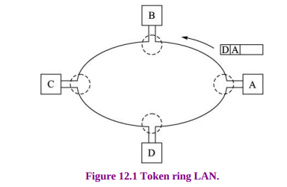
TOKEN PASSING LOCAL AREA NETWORKS
Suppose station A in Figure 10 wants to send a frame to station D. It breaks the ring and inserts its frame with the destination (D) and source (A) addresses.
The frame passes through stations B and C which act as repeaters and forward the frame to the next link. They do not copy the frame as the frame is not addressed to them. Station D finds its address on the frame and copies it. The frame continues its journey anti-clockwise and returns to station A. The frame does not circulate again around the ring as the ring is broken at station A. Station A removes the frame from the ring.
Figure 10: The Setup of a Wide Area Network

Slide 44
FIBER DISTRIBUTED DATA INTERFACE (FDDI)
Fiber Distributed Data Interface (FDDI) LAN standard is based on optical fiber as a transmission medium. This standard was developed by the American National Standards Institute (ANSI). It operates under IEEE 802.2 LLC sublayer allowing it to be integrated easily with other IEEE LANs. FDDI was originally conceived as a back-end network interconnecting several hosts and high-speed peripherals. It can also be used as a backbone network interconnecting several front-end LANs. As a backbone LAN, FDDI has built-in fault-tolerant features that make it resilient to faults.
An FDDI local area network can support thousands of users. It contains two token rings, one for possible backup in case the primary ring fails.
The primary ring offers up to 100 Mbps capacity. If the secondary ring is not needed for backup, it can also carry data, extending capacity to 200 Mbps
It uses optical fiber as a standard underlying medium, although it can use copper cable, in which case it may be referred to as CDDI.

Slide 45
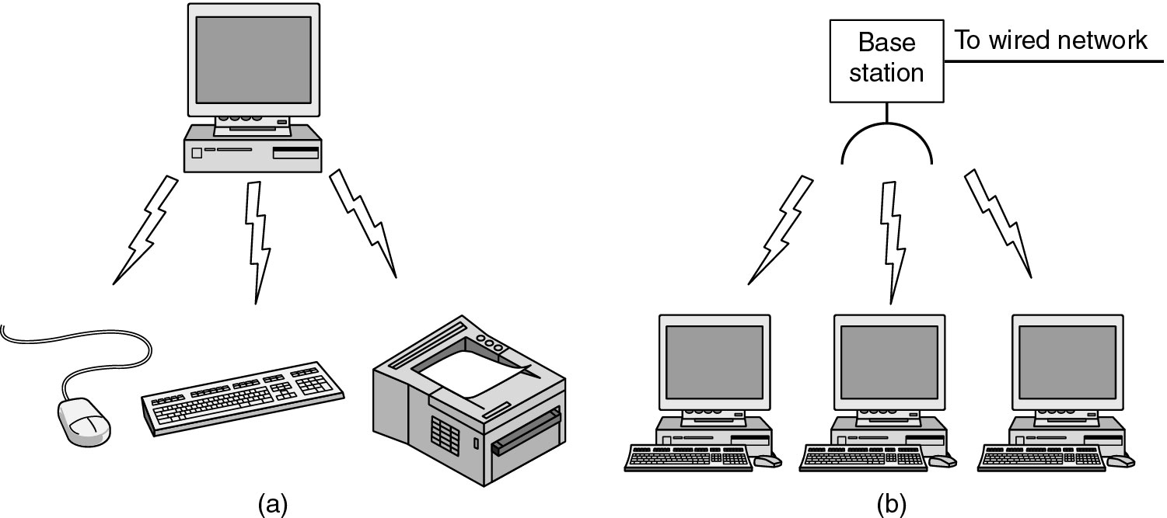
Wi-Fi/WLAN/BLUETOOTH –READING ASSIGNMENT
(a) Bluetooth configuration
(b) Wireless LAN
Figure 11: Bluetooth Configuration

Slide 46
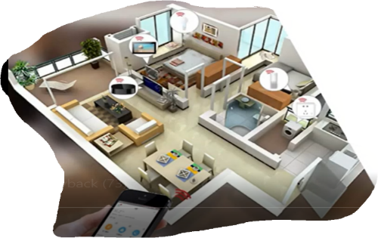
THE ZIGBEE PROTOCOL
It is a wireless technology standard that defines a set of communication protocols for short-range communications. ZigBee operates on top of the IEEE 802.15.4 standard to address issues in the upper protocol layers and application profiles by adding logical network, security, and application software.
It is widely used for low-powered devices such as smart home centers that do not need large bandwidth. Devices made with ZigBee use the 2.4 GHz standard frequency to communicate.
ZigBee defines modules for quality assessment, receiver energy detection, and clear channel assessment. CSMA is used to determine which node may transmit to avoid collisions. The maximum distance between nodes is up to 100 meters.
An important feature is that ZigBee incurs low latency. A node that is powered down can wake up and transmit a packet in about 15 ms. This feature is important for time-critical messages. For example, sensors operating in a nuclear plant need their messages transmitted immediately.

Slide 47
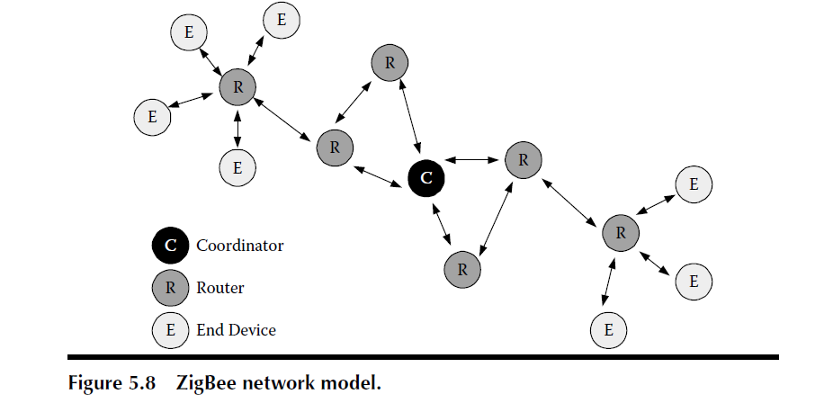
THE ZIGBEE PROTOCOL
A ZigBee network consists of nodes that may act as a coordinator (FFD), a router (FFD), or an end device (FFD or RFD) as shown in Figure 17 below. A network node searches for available networks transfers data from its application or environment, determines whether data is pending, and requests data from the network coordinator.
Figure 17: ZigBee network model

Slide 48
THE ZIGBEE PROTOCOL
The coordinator is the most capable device. With the coordinator, you can set permission, allow users access, coordinate personal area networks, and link devices with the web and Apps. It performs the following tasks:
Sets up a network/Channel selection
Assign a unique ID to the network
manages network nodes and stores network node information
Allocates unique address to each device
routes messages between paired networks.
A coordinator requires extra random-access memory (RAM) for the node database, transaction table, and pairing table. Typically, it operates in the receiving state.

Slide 49
THE ZIGBEE PROTOCOL
Why do we need a ZigBee when we already have Wi-Fi and Bluetooth as Standards for short-range Communication?
ZigBee standard is specially built for control and sensor networks. The objective of this technology is to monitor and control devices. ZigBee technology is a standard that addresses the need for very low-cost implementation of low-power devices with low data rates for short-range wireless communication. Wi-Fi uses a lot of power which is not good for devices where low power consumption is required. Wi-Fi uses a high data rate. Bluetooth networks can only support a maximum of seven devices in a network.

Slide 50
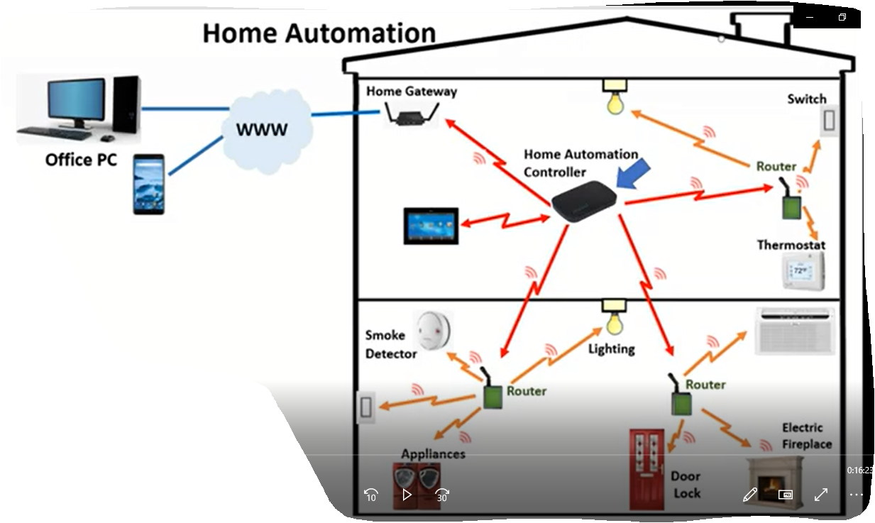
ZigBee HOME AUTOMATION
In a ZigBee home automation:
There is a house automation controller (hub) with a software application that controls smart devices
The gateway is the interface between the ZigBee network and the web. The gateway is connected to the internet, and this will allow the home owner to control his/her smart home from virtually anywhere
Figure 19: ZigBee Home Automation

Slide 51
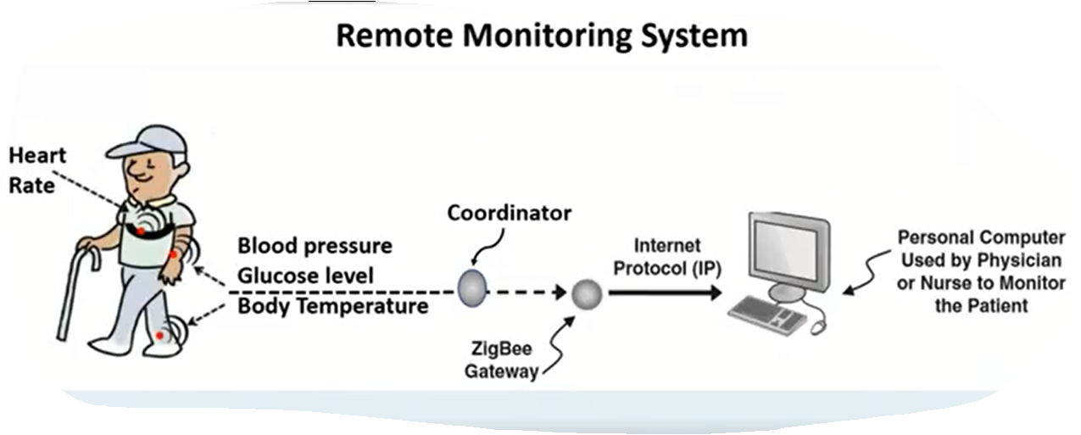
REMOTE MONITORING SYSTEM
Figure 21: Remote Monitoring System
A patient can be wearing a ZigBee sensor that can collect information such as blood pressure, body temperature, heart rate, etc. This information will be sent through the ZigBee gateway over the internet to a personal computer in a hospital so that a physician or a nurse can monitor the patient.

Slide 52
GENERAL CHARACTERISTICS OF ZigBee STANDARD
Low power consumption: Devices can typically operate for several years on a single battery.
Low data rate: 20 kbps-250 kbps (Transmits packets of data), Wi-Fi (11 Mbps (devices can stream videos, audio, and pictures)), Bluetooth (1 Mbps (devices can transmit audio and pictures)
Short-range communications: 75-100 meters indoors, up to 300 meters for a line of sight
Network join time: 30 msec. (Wi-Fi-up to 3 secs, Bluetooth up to 10 secs
Supports small and large networks: up to 240 devices in practice, (Wi-Fi: up to 32 devices, Bluetooth: up to 7 devices)
Low cost of products
Cheap to implement (Simplicity of the technology)
Uses AES cryptographic algorithm for data encryption and data authentication

Slide 53
BLUETOOTH
Bluetooth: Bluetooth is a short-range wireless technology designed for low-power, short-distance communication between devices, such as connecting wireless headphones to a smartphone or pairing a keyboard with a computer.

