Slide 1
Bipolar Junction Transistor
Dr. Nii Longdon

Slide 2
BJTs
Transistors are used when it is necessary to amplify voltage, current, and power.
With a small signal applied to the transistor ampliﬁer, the transistor and its associated circuitry can produce an ampliﬁed version of the input signal
A transistor can be used as an electronic switch
A transistor has three doped regions
The base is a narrow region sandwiched between the larger collector and emitter regions.
The emitter region of a transistor is heavily doped. Its job is to emit or inject current carriers into the base.
The collector region is moderately doped and is the largest of all three regions.
The collector region attracts the current carriers that are injected into the thin and lightly doped base region

Slide 3
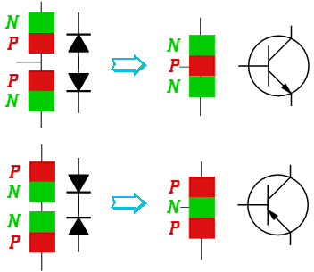
Basic structure
npn transistor
Diode
Diode
pnp transistor
Diode
Diode

Slide 4
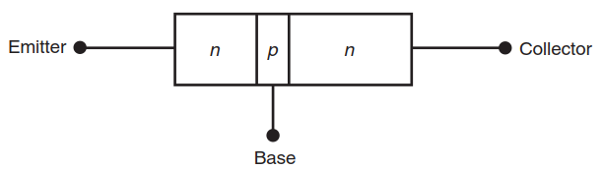
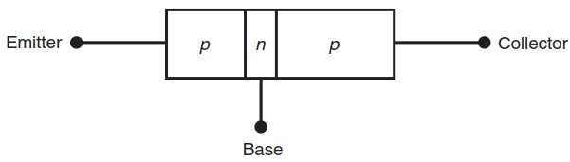
Basic structure
In npn transistors, the majority current carriers are free electrons in the emitter and collector, whereas the majority current carriers are holes in the base.
The opposite is true in a pnp transistor where the majority current carriers are holes in the emitter and collector, and the majority current carriers are free electrons in the base

Slide 5
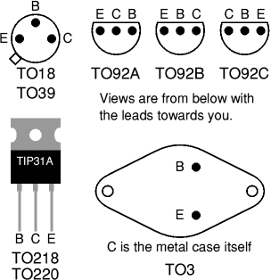
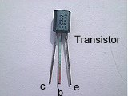

BJT
Heat sink

Slide 6
BJT Characteristics
The emitter region is heavily doped. Its job is to emit or inject current carriers into the base region. For npn transistors, the n -type emitter injects free electrons into the base. For pnp transistors, the p –type emitter injects holes into the base.
The base is very thin and lightly doped. Most of the current carriers injected into the base region cross over into the collector side and do not flow out the base lead.
The collector region is moderately doped. It is also the largest region within the transistor. Its function is to collect or attract current carriers injected into the base region.

Slide 7
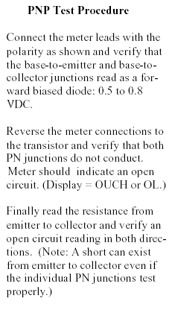
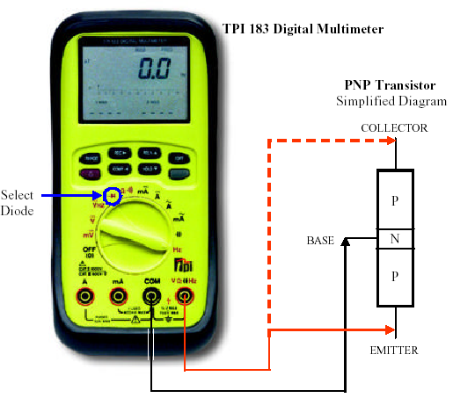
BJT Testing

Slide 8
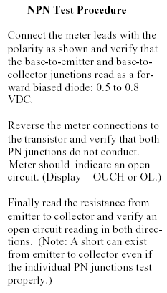
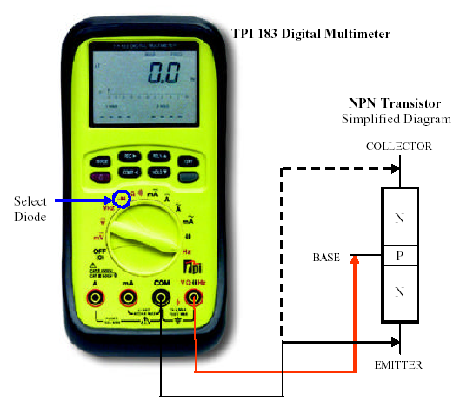
BJT Testing

Slide 9
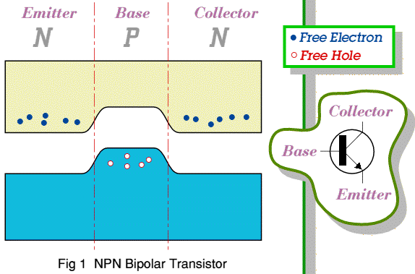
A little bit of physics…

Slide 10
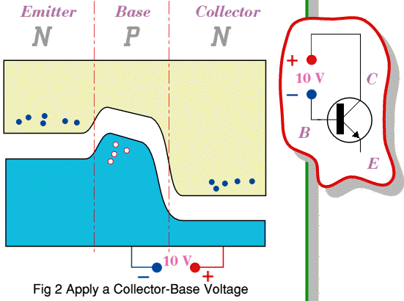
A little bit of physics…

Slide 11
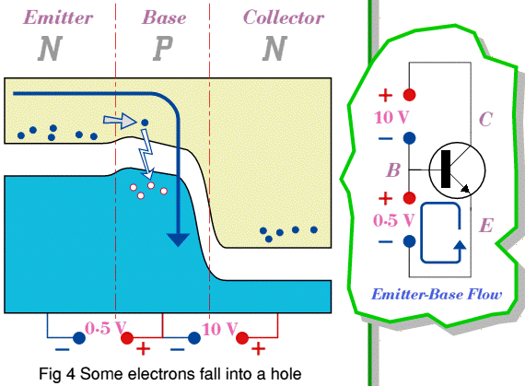
A little bit of physics…

Slide 12
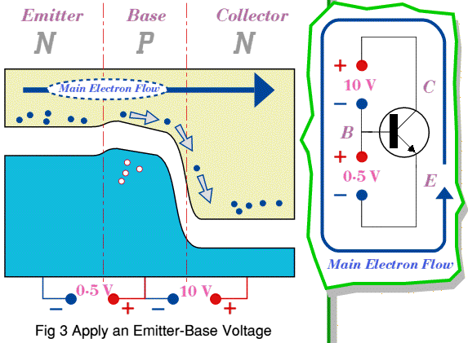
A little bit of physics…

Slide 13
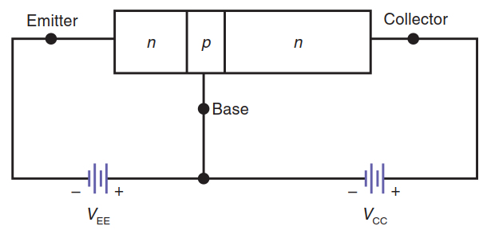
Transistor Currents
F or a transistor to function properly as an amplifier, the emitter-base junction must be forward-biased, and the collector-base junction must be reverse-biased

Slide 14
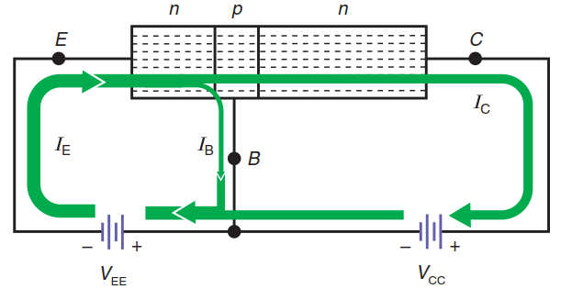
Transistor Currents
Few holes are available for recombination in the base.
The positive collector-base voltage attracts the free electrons in the p -type base over to the collector side before they can recombine with holes in the base
In most transistors, the collector current, IC , is nearly identical to the emitter current, IE

Slide 15
Examples
A transistor has the following currents: IB = 20 mA and
IC =4.98 A. Calculate IE .
A transistor has the following currents: IE =100 mA, IB = 1.96 mA. Calculate IC .

Slide 16
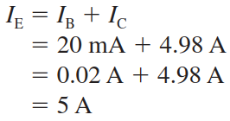
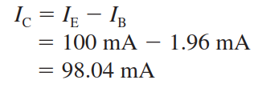

Slide 17
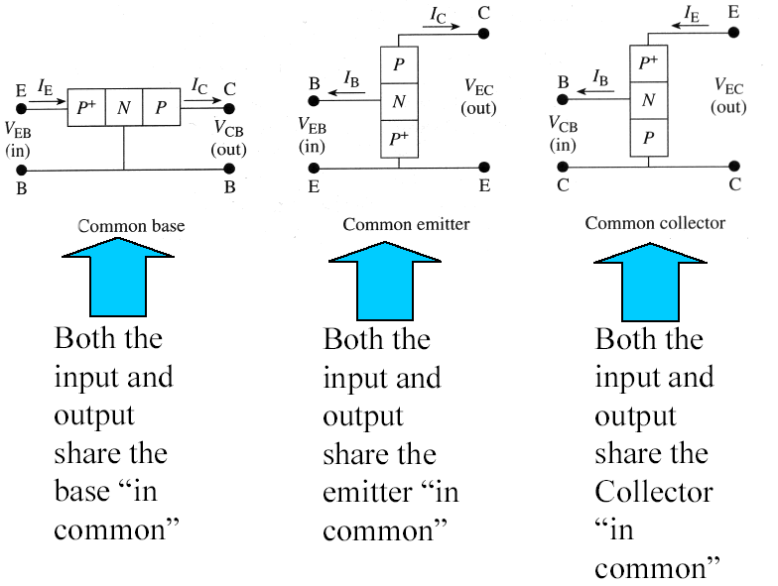
BJT Basic Configuration

Slide 18
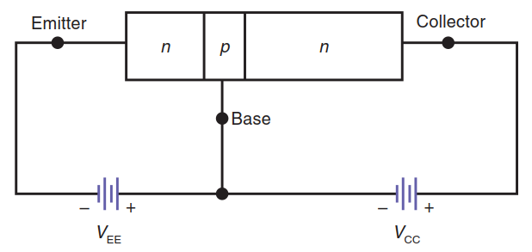


DC Alpha
The circuit shown is called a common-base (CB) connection because the base lead is common to both the input and output sides of the circuit.
A characteristic that describes how closely the emitter and collector currents are in a common base circuit is called the dc alpha, designated
the dc alpha is so close to one, 0.99, that we ignore the small difference that exists.

Slide 19
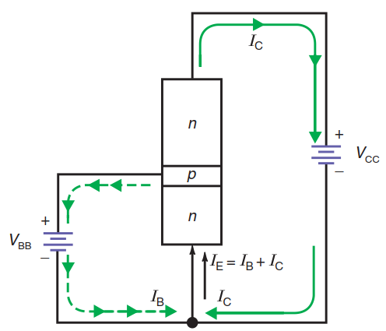

DC Beta
The common-emitter (CE) connection since the emitter lead is common to both the input and output sides of the circuit
The dc beta is expressed as

Slide 20


Alpha and Beta
The relationship between alpha and beta dc is given as

Slide 21
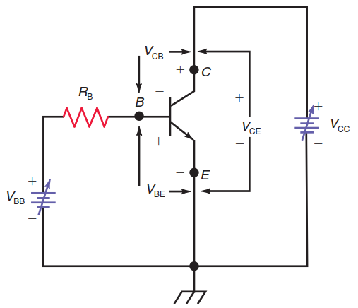
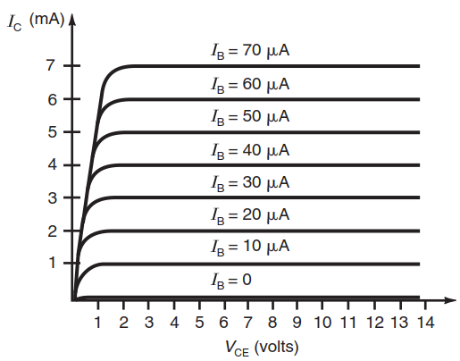
Transistor Operating Regions
We show an npn transistor in a CE connection where the base supply voltage, VBB , and the collector supply voltage, VCC , are variable
VBB can be adjusted to provide a wide range of base and collector current values

Slide 22
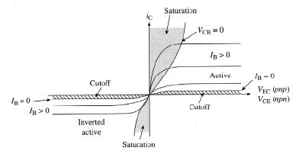
Saturation Region
As can be seen, when VCE is zero, IC is zero because the collector-base function is not reverse-biased when VCE = 0.
Without a positive voltage at the collector, it cannot attract electrons from the base. When VCE increases from zero, however, IC increases linearly.
The vertical portion of the curves near the origin is called the saturation region.
When a transistor is saturated, the collector current, IC , is not controlled solely by the base current, IB .

Slide 23
Breakdown Region
When the collector-base voltage is too large, the collector-base diode breaks down, causing a large, undesired collector current to flow.
This is the breakdown region.
This area of operation should always be avoided in transistor circuits

Slide 24
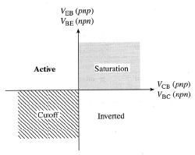
Cutoff Region
Notice the IB = 0 curve nearest the horizontal axis
This is called the cutoff region because only a small collector current, IC , flows.
For silicon transistors, this current is very small and is therefore usually ignored.
A transistor is said to be cut off when its collector current, IC , is zero.

Slide 25

Active Region
The active region of a transistor is where the collector curves are nearly horizontal.
When a transistor operates in the active region, the collector current, IC , is greater than the base current, IB , by a factor of beta or
In the active region, the collector circuit acts like a current source.

Slide 26




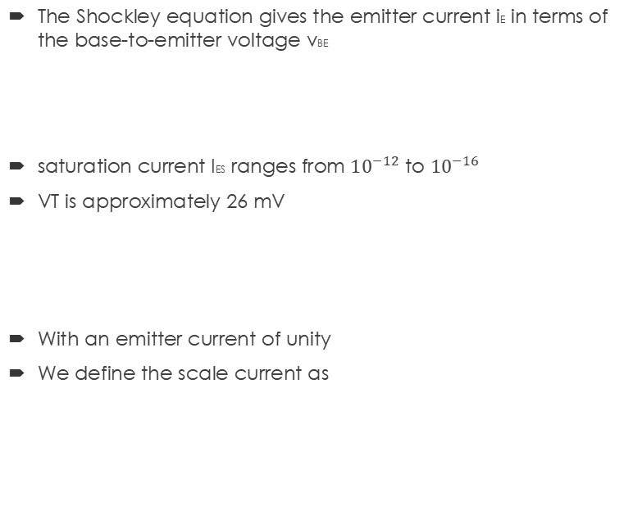
Shockley equation
The Shockley equation gives the emitter current iE in terms of the base-to-emitter voltage vBE
saturation current IES ranges from ${10}^{−12}$ to ${10}^{−16}$
VT is approximately 26 mV
With an emitter current of unity
We define the scale current as

Slide 27
Shockley equation examples

Slide 28


Slide 29
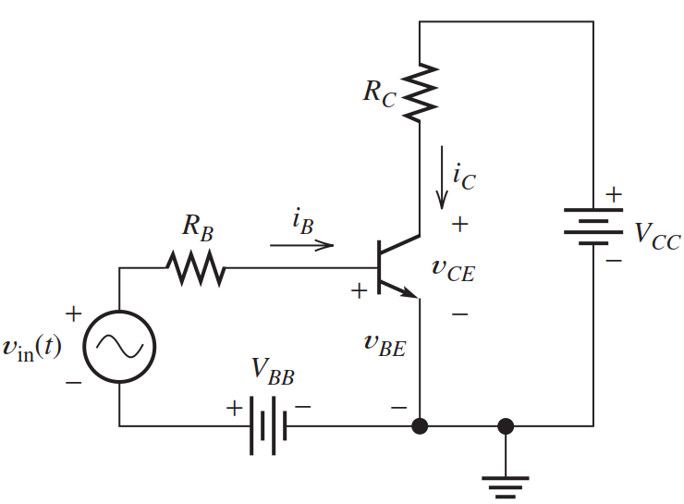

LOAD-LINE ANALYSIS OF A COMMON-EMITTER AMPLIFIER
The dc power-supply voltages VBB and VCC bias the device at an operating point for which ampliﬁcation of the ac input signal vin(t) is possible
if we apply Kirchhoff’s voltage law to the loop consisting of VBB, vin(t), and the base–emitter junction, we obtain

Slide 30
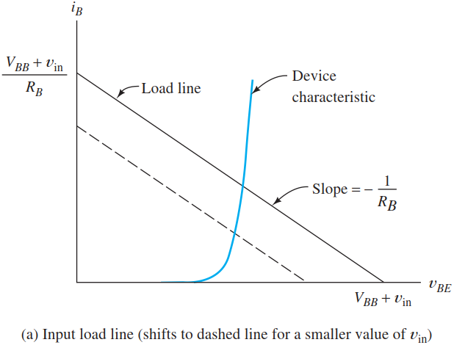
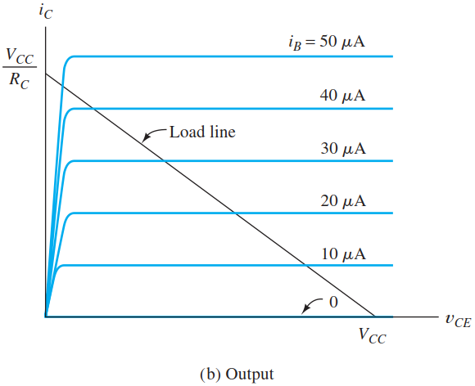
Analysis of the Input Circuit
iB and vBE must fall on the device characteristic
The quiescent operating point, or Q point, corresponds to vin(t) = 0
Thus, the load line shifts position but maintains a constant slope as vin changes in value

Slide 31

Analysis of the Output Circuit
we can write a voltage equation for the loop through VCC, RC, and the transistor from collector to emitter given as:
with the values of iB found by prior analysis of the input circuit, we can locate the intersection of the corresponding output curve with the load line to ﬁnd values for iC and vCE
as vin(t) swings positive, the input load line moves upward and to the right, and the value of iB increases
the common-emitter circuit is an inverting ampliﬁer

Slide 32
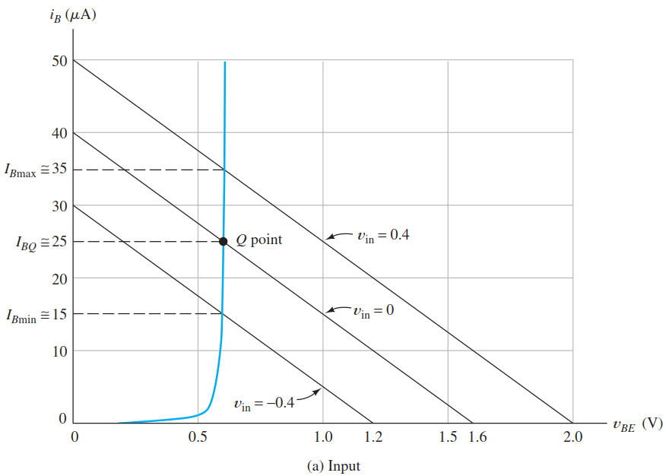

Slide 33
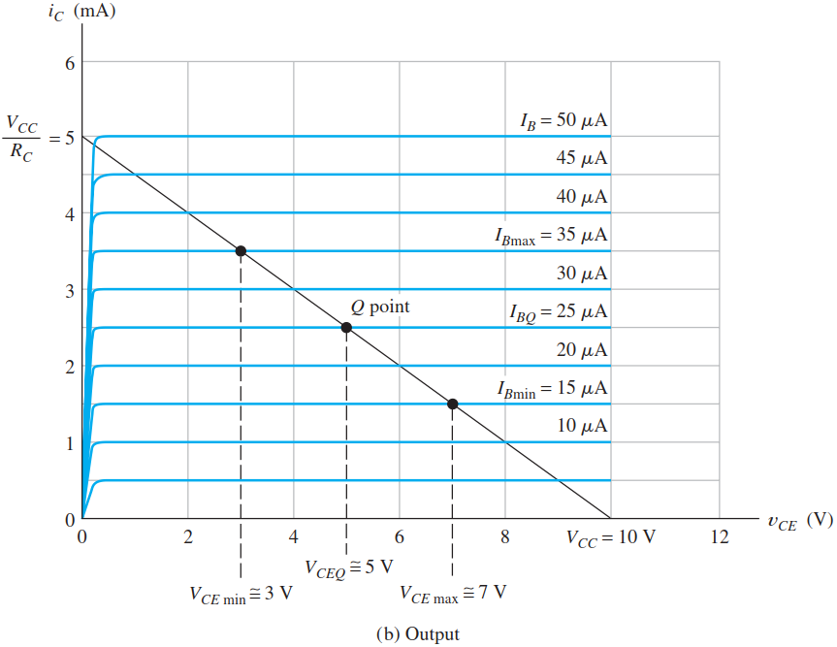

Slide 34
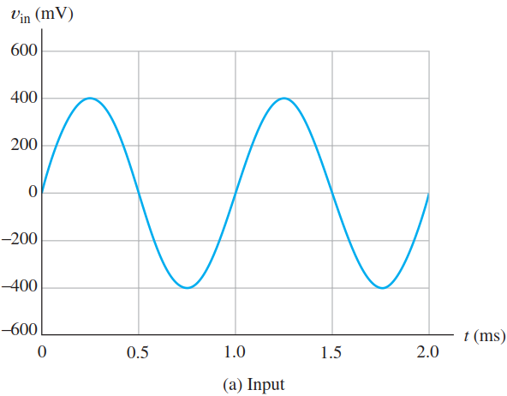
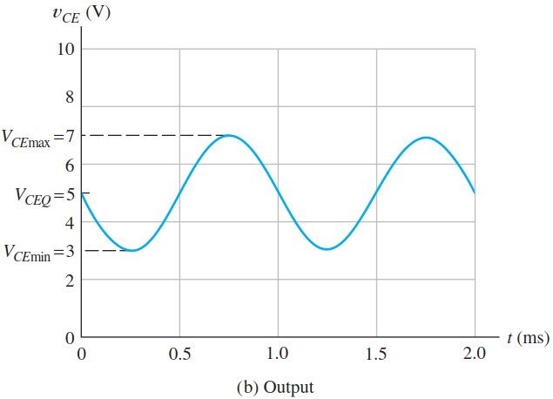
Nonlinear Distortion
Unlike the input, the output signal is not a precise sine wave
The ampliﬁer is slightly nonlinear because of the curvature of the characteristics of the transistor.
Therefore, as well as being ampliﬁed and inverted, the signal is distorted

Slide 35
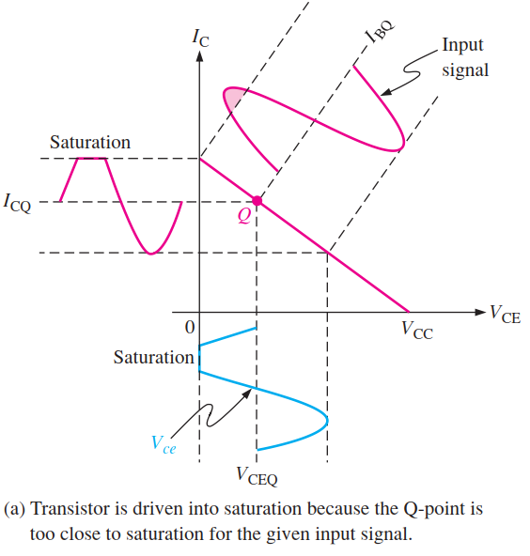
Waveform distortion
The Q-point is the point at which signal variations at the input terminal are amplified and accurately reproduced at the output terminal

Slide 36
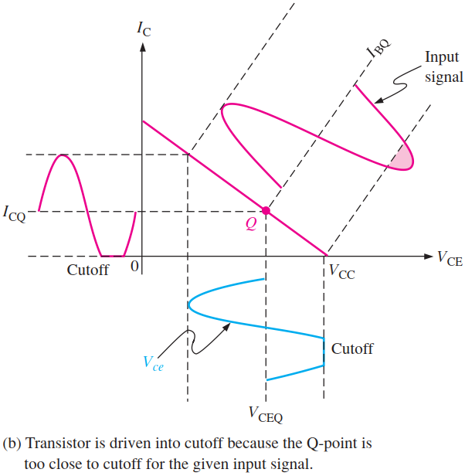
Waveform distortion

Slide 37
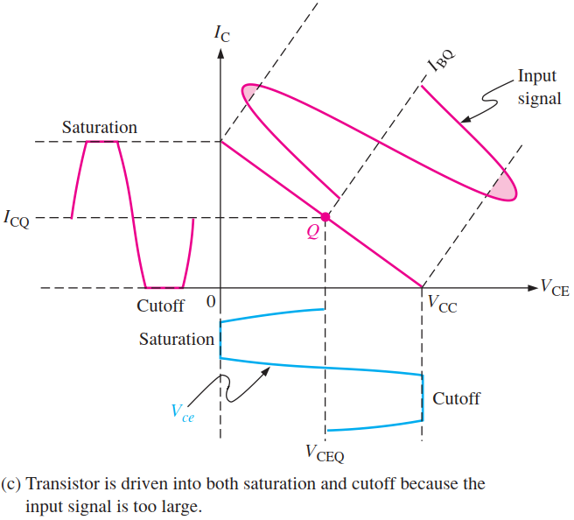
Waveform distortion

Slide 38
LARGE-SIGNAL DC CIRCUIT MODELS
In the analysis or design of BJT ampliﬁer circuits, we often consider the dc operating point (Q point) separately from the analysis of the signals
We consider the dc operating point ﬁrst, then, we turn our attention to the signal to be ampliﬁed
We present models for large-signal dc analysis of BJT circuits.
Then, in the next section, we show how to use these models to analyze bias circuits for BJT ampliﬁers
In the active region, the base–emitter junction is forward biased, and the base–collector junction is reverse biased

Slide 39
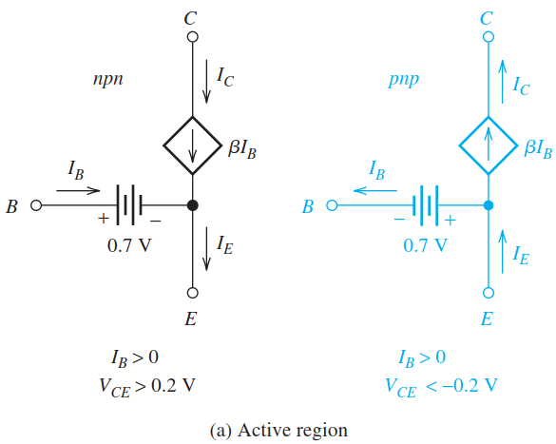
Active-Region Model
The constraints given in the ﬁgure for IB and VCE must be satisﬁed to ensure validity of the active-region model.

Slide 40
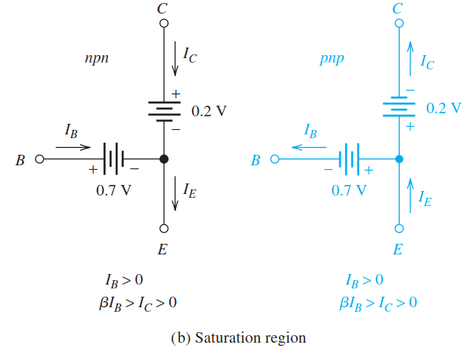
Saturation-Region Model
In the saturation region, both junctions are forward biased

Slide 41
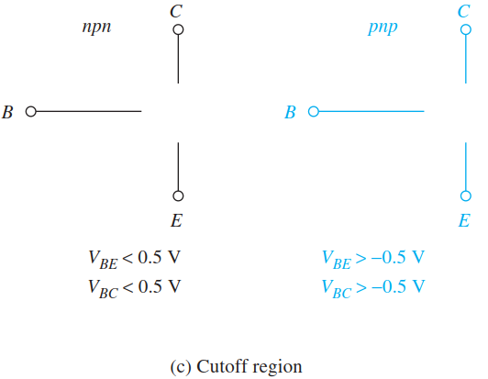
Cutoff-Region Model
In cutoff, both junctions are reverse biased and no currents ﬂow in the device.
Thus, the model consists of open circuits among all three terminals

Slide 42
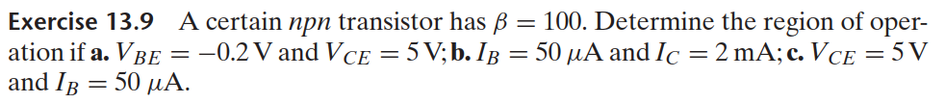

Slide 43
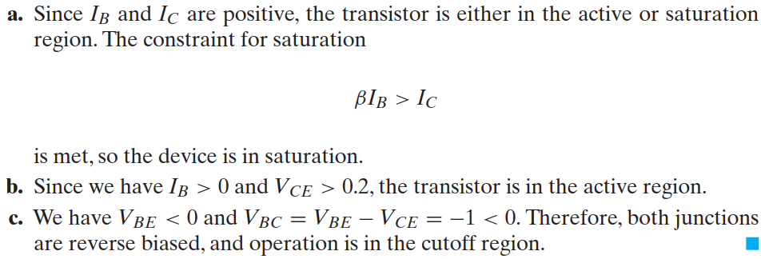


Slide 44
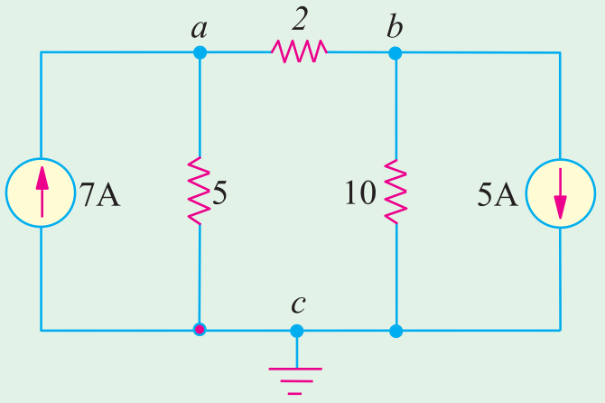
find various branch currents in the circuit

Slide 45
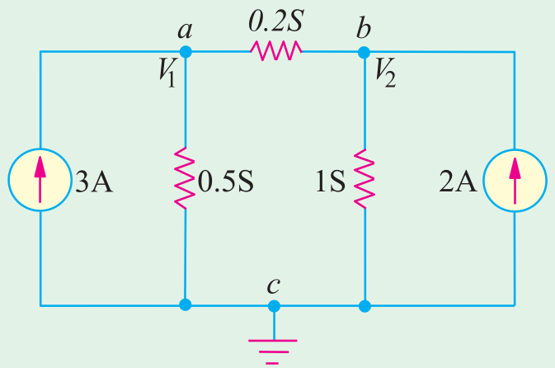
Iac = 2 A; Iab = 5 A, Ibc = 0

Slide 46
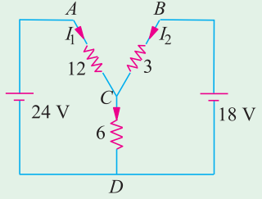
5 V, 2.5 V; Iac = 2.5 A; Iab = 0.5 A; Ibc = 2.5 A
I1 = 6/7 A; I2 = 10/7 A; I3 = 16/7 A

Slide 48
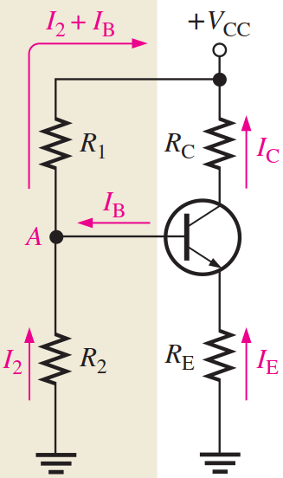
Voltage Divider Bias
It is a method of biasing a transistor for linear operation using a single-source resistive voltage divider
A dc bias voltage at the base of the transistor can be developed by a resistive voltage-divider that consists of R1 and R2
VCC is the dc collector supply voltage.
Two current paths are between point A and ground: one through R2 and the other through the base-emitter junction of the transistor and RE.

Slide 49





Voltage Divider Bias
To analyze the circuit, first calculate the voltage on the base using the unloaded voltage-divider rule

Slide 50
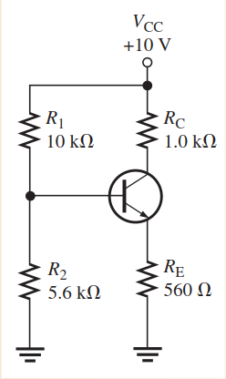
Determine VCE and IC in the stiff voltage-divider biased transistor circuit of if ßDC= 100 and VBE = 0.7v

Slide 51




Slide 52
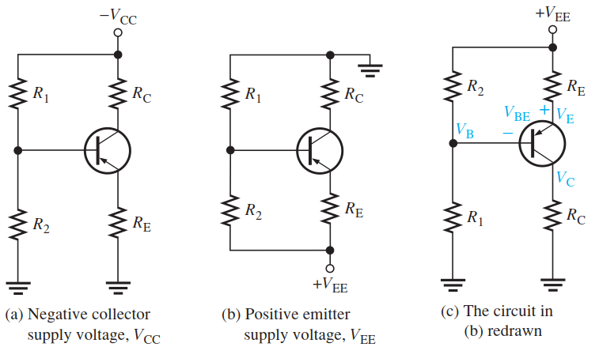
Voltage Divider Bias(pnp)
A pnp transistor requires bias polarities opposite to the npn.
This can be accomplished with a negative collector supply voltage

Slide 53
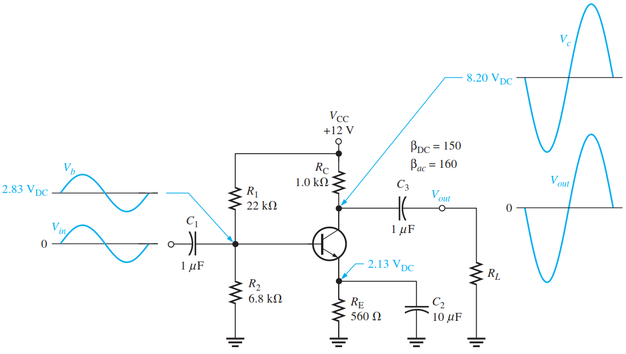
THE COMMON-EMITTER AMPLIFIER
Three amplifier configurations are the common-emitter, the common-base, and the common-collector.
The common-emitter (CE) configuration has the emitter as the common terminal, or ground, to an ac signal
CE amplifiers exhibit high voltage gain and high current gain

Slide 54
THE COMMON-EMITTER AMPLIFIER
A common-emitter amplifier with voltage-divider bias and coupling capacitors C1 and C3 on the input and output and a bypass capacitor, C2, from emitter to ground.
The input signal, Vin, is capacitively coupled to the base terminal, the output signal, Vout, is capacitively coupled from the collector to the load.
The amplified output is 180° out of phase with the input

Slide 55
THE COMMON-EMITTER AMPLIFIER
There is no signal at the emitter because the bypass capacitor effectively shorts the emitter to ground at the signal frequency.
All amplifiers have a combination of both ac and dc operation, which must be considered, but keep in mind that the common-emitter designation refers to the ac operation

