Slide 1
NETWORK PROTOCOLS
Introduction to Protocols
Medium Access Control Protocols
TCP/IP Protocol
OSI Layering Protocol Software

Slide 2
INTRODUCTION TO PROTOCOLS
Computers, just like humans, use rules, or protocols, to communicate. A protocol is a set of rules and formats that govern the communication between communicating peers. That is a mutually agreed-upon set of rules, conventions, and agreements for the efficient and orderly exchange of information.
OR
The protocol defines the format and meaning of the data that is exchanged. It also determines whether the network uses a peer-to-peer or client/server architecture.
The most common set of protocols used on local wired networks is Ethernet. The Ethernet protocol defines many aspects of communication over the local network, including message format, message size, timing, encoding, and message patterns.
Protocols are especially important on a local network. In a wired environment, a local network is defined as an area where all hosts must “speak the same language” or in computer terms “share a common protocol”.

Slide 3
INTRODUCTION TO PROTOCOLS
A network protocol can be viewed as a common network communication standard used to define a method of exchanging data over a computer network. A network protocol defines the rules and conventions for communication between different devices, participating in a computer network.
If computers or computer-like devices want to communicate with each other, they must follow a set of predefined communication rules. Devices participating in network communication should know about the common network protocol and communicate according to the way defined by the network protocol. In other words, standard network protocol software must be running on both devices participating in network communication.
Examples of standard network protocols are Transmission Control Protocol (TCP), User Datagram Protocol (UDP), Internet Protocol (IP), Address Resolution Protocol (ARP), Hypertext Transfer Protocol (HTTP), File Transfer Protocol (FTP), Trivial File Transfer Protocol (TFTP), Simple Mail Transfer Protocol (SMTP), Domain Name System Protocol (DNS), etc. Network protocols are layered such that each one relies on the protocols that underlie it. Sometimes referred to as a protocol stack.

Slide 4
TRANSMISSION CONTROL PROTOCOL (TCP)/INTERNET PROTOCOL (IP)
TCP/IP is a set of network protocols or standards that enable communication between computers. If two devices in a network want to communicate, they need to use a common set of network protocols.
TCP/IP is the industry standard. Almost all Operating Systems now supports TCP/IP. TCP/IP is known as "the language of the Internet". If you want your computer and computer-like devices (laptops, tablets, mobiles, etc.) to work on the Internet, you have to use TCP/IP protocol suite. It is a family of protocols that make the Internet work.
TCP/IP allows many different operating systems and computer platforms to interoperate with one another seamlessly over a computer network. TCP/IP will function regardless of the operating system or hardware manufacturer type. This allows different entities to interact and understand one another.

Slide 5
TRANSMISSION CONTROL PROTOCOL (TCP)/INTERNET PROTOCOL (IP)
TCP/IP is designed with one major goal in mind; to decentralize network communications. If a single node on the network fails, other devices continue to function independently and are uninfluenced by the failed system. TCP/IP is based on a defined set of rules for how data communication protocols operate; these rules are defined in the Open Systems Interconnection (OSI) model. This model examines each function of the protocol stack within TCP/IP and computer networking.
TCP software breaks messages into packets, hands them off to the IP software for delivery, and then orders and reassembles the packets at their destination. IP software deals with the routing of packets through interconnected networks to their final destination.

Slide 6
TRANSMISSION CONTROL PROTOCOL (TCP)/INTERNET PROTOCOL (IP)
Features of TCP/IP include:
Multi-Vendor Support
Interoperability
Logical Addressing
Routability
Name Resolution
Error Control and Flow Control
Multiplexing/De-multiplexing

Slide 7
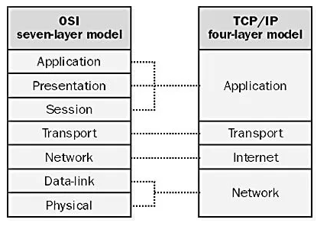
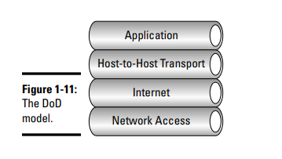
TCP/IP MODEL
The four major components of the model are the application layer, transport layer (host to host/end to end), Internet layer, and network access layer. Each layer has a specific responsibility.
TCP/IP implements almost the same networking layers as the OSI reference model. However, some TCP/IP protocols work at more than one level.
Figure 1: OSI Model and TCP/IP Model

Slide 8
TCP/IP MODEL
Layer 4-Application Layer:
The application layer model roughly combines the functionality of the three upper layers in the OSI model namely, the application, presentation, and session layers. The application layer is where network applications are placed. Examples of network applications are web browsers, chat clients, and email clients. Network applications reside on the application layer and use its bottom layer, which is the transport layer to connect to remote computers. This is where user information is handled and packaged for delivery to the transport layer.
Layer 3-Transport layer:
The Transmission Control Protocol (TCP) and User Datagram Protocol (UDP) reside at the transport, or host-to-host layer and provide valuable services in data delivery and error correction. TCP is used for reliable connections and UDP is used for fast streaming type of connections.
The transport layer provides an addressing system for different applications, known as port numbers. The transport layer delivers data to the exact application by assigning port numbers to applications. It supports communication between different devices across different networks.

Slide 9
TCP/IP MODEL
Layer 3-Transport layer:
UDP is an alternative to TCP. TCP is highly reliable, as compared to UDP. Data can be sent between two hosts without establishing a logical connection between sending and receiving hosts. This is called connectionless transport. Connectionless transport protocols do not guarantee the reliable delivery of data segments. However, they are a bit faster than connection-oriented transport protocols, because they do not need time to establish and maintain connections. User Datagram Protocol (UDP) is a connectionless transport protocol.
A transport protocol that establishes a logical connection between the sending and the receiving hosts is called a connection-oriented transport protocol. Connection-oriented transport protocols usually guarantee the reliable delivery of data segments. However, they are a bit slower than connectionless transport protocols. This is because they need to establish and maintain the connection. Transmission Control Protocol (TCP) is a connection-oriented transport protocol.

Slide 10
TCP/IP MODEL
Layer 3-Transport layer:
Connection-oriented transport involves creating a logical connection between the sending and the receiving hosts and exchanging acknowledgments between the hosts.
Data segments are sequenced, allowing them to be sent in any order and reassembled on the receiving host. Flow control is also part of connection-oriented reliable data transport. Flow control involves the sender and the receiver coordinating to sustain an optimal data transfer flow: As the receiver processes the data segments, it acknowledges reception to the sender. The sender then sends more segments.
TCP on the sending host establishes a logical connection to TCP on the receiving host. This step is called a three-way handshake call setup or virtual circuit setup. The sending host and the receiving host use this connection, or virtual circuit, to coordinate their data transfer.
Any host can initiate TCP connections. The host that initiates the TCP connection becomes the sending host. The other host is the receiving host. However, TCP connections allow both hosts to send and receive TCP segments.

Slide 11
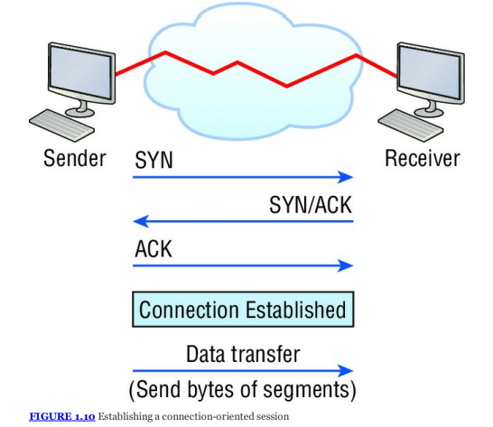
THREE-WAY HANDSHAKE
The first step to establishing a TCP connection involves a three-way handshake.
The host that initiates the network communication sends a TCP “Synchronize” (SYN) message to the receiving host to notify it that it wants to establish a TCP connection. This message contains, among other things, the sender starting sequence number for the TCP transmission.
The starting sequence number is the sequence number of the first TCP segment to transfer from sender to receiver. The sending and the receiving host then negotiate connection parameters.
The receiving host replies with a TCP “Synchronize” (SYN) message that contains the receiver starting sequence number. This message also sends an acknowledgment (ACK) to the sending host, indicating that the receiving host did receive the first TCP “Synchronize” message.
The sending host sends back an acknowledgment (ACK) to the receiving host to let it know that it did receive the receiver starting sequence number and that it is ready to send. At this point, the bidirectional TCP connection is established. TCP connections are bidirectional because both hosts send SYN and ACK messages to each other to synchronize and guarantee a reliable data transfer.
Figure 2: Three-way-handshake

Slide 12
TCP/IP MODEL
Table 1: TCP vs UDP
TCP | UDP
1. It is highly reliable but very slow | 1. It is less reliable but very fast
2. Supports segmentation | 2. Does not support segmentation
3. Has error checking and correction | 3. Lacks error checking and correction

Slide 13
TCP/IP MODEL
Layer 2-Internet:
The network layer is responsible for moving data from one network to another network. The main protocol in the network layer is IP. IP uses IP addresses to identify the source and destination of IP traffic. The routing function is associated with the network layer. The Internet Protocol is associated with this layer and is responsible for delivering packets across interconnected networks.
Layer 1-Network access layer:
The physical layer is responsible for sending computer bits from one device to another along with the network. The physical layer transmits the data either electrically, optically, or as radio waves. LAN standards (eg. Ethernet) are associated with the data link layer. The data link layer uses MAC addresses to identify the source and destination computers. Like the physical layer in the OSI model, the network access layer is responsible for delivering data across the physical network hardware.

Slide 14
THE OSI REFERENCE MODEL
The Open Systems Interconnection Model (OSI Model) is a conceptual framework used to describe the functions of a networking system. This characterizes computing functions into a universal set of rules and requirements in order to support interoperability between different products and software.
The OSI reference model was designed by the International Organization for Standardization (ISO) and defines how data is moved between a source and destination computer’s software applications over a network.
It is made up of seven layers. These layers divide network communications architecture in a top-to-bottom approach. Each layer is responsible for a specific, exclusive set of functions not handled at any other layer. The OSI model breaks down the problems involved in moving data from one computer to another computer.
A layer in the OSI model is a portion that is used to categorize the specific problem. All the problems which are related to the communications are answered by specific protocols operating at different layers.

Slide 15
THE OSI REFERENCE MODEL
The main purposes of this model are to allow compatibility among various computer manufacturers’ network hardware and to provide a structured method for designing network protocols. Equipment from different vendors on the same network would communicate seamlessly together using the OSI model as a reference.
Each manufacturer can design its equipment using this model as a blueprint, guaranteeing compatibility and functionality. Each layer has a defined set of responsibilities and is independent of the layers above and below it.
The network layer may prepare and hand data off to either the transport or data link layer, depending on the direction of network traffic. If data is being received, it flows up the stack. Data that is being sent travels down the stack.

Slide 16
THE OSI REFERENCE MODEL
Network protocols are tasked with moving the data through a network and following the rules put in place by the OSI model. Some protocols operate at different layers in the stack than other protocols, depending on function, and implement the layers’ functionality. The seven layers consist of upper and lower layers.
The OSI reference model is designed in seven functional layers. Each layer has a precise mission, and each layer works fairly independently of the upper and lower layers. Upper layers use the services provided by lower layers, but the internal workings of each layer are not visible to other layers.

Slide 17
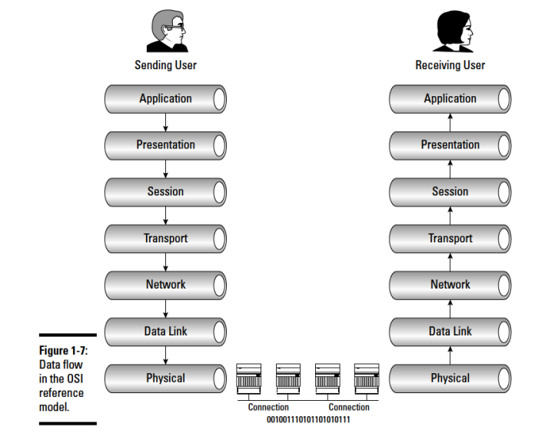
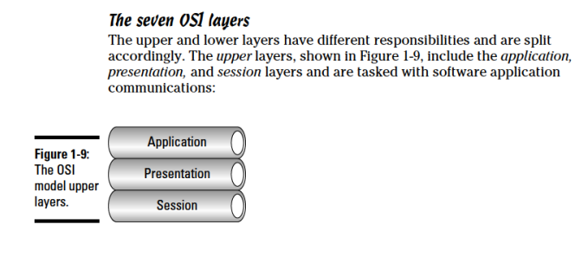
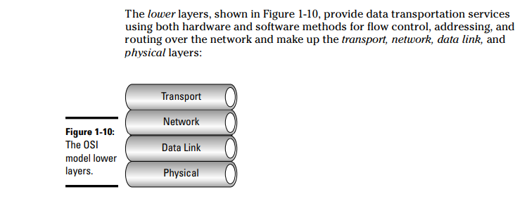
THE OSI REFERENCE MODEL
Upper Layers
Lower Layers
Figure 3: Data Flow in the OSI Reference Model

Slide 18
SUMMARY OF THE SEVEN OSI MODEL
Application layer
The application layer is responsible for application-specific end-user processes and is the closest layer to the actual end-user. Typical functions of the application layer include communication synchronization, resource availability determination, and identification of partners for communication. Some examples of application layer protocols include Hypertext Transfer Protocol (HTTP), File Transfer Protocol (FTP), Simple Mail Transfer Protocol (SMTP), and Telnet.
Presentation layer
The presentation layer also referred to as the syntax layer, formats and encrypts data over the network. It also provides data to the application layer in a format it can understand. The translation is performed between application and network formats, ensuring that no compatibility issues exist.
Session layer
The last of the upper layers is the session layer. It is responsible for controlling computer connections between local and remote applications. It initiates, controls, and terminates sessions using full-duplex, half-duplex, or simplex operations.
Transport layer
The transport layer provides seamless data transfer between computer systems using flow control and end-to-end error recovery, keeping track of datagram delivery and retransmitting lost packets. TCP and the connectionless UDP operate at this level.
Network layer
The network layer is responsible for transporting data between networks and is also called the routing layer. All routed networks connected to the Internet function at this level using the Internet Protocol, and data is transferred in a series of hops. Internetworking, switching, routing, addressing, error handling, congestion control, and packet sequencing are handled here.
Data link layer
The data link layer resides above the physical layer and manages errors from the physical layer and it is divided into sublayers:
The Media Access Control (MAC) layer, is useful for controlling network access.
The Logical Link Control (LLC) layer, is responsible for frame synchronization, flow control, and error checking.
The data link layer also encodes and decodes data packets into bits and manages errors from the physical layer, promoting reliable delivery on the physical medium.
Physical medium
The physical layer resides at the bottom of the stack and defines the physical hardware used on the network, such as network interface cards, host bus adapters, repeaters, hubs, and cabling.

Slide 19
OSI LAYER 7-APPLICATION LAYER
This is the layer that most users interact with because it provides a means to assess information on the internet. The application layer provides network services to the end-users (Google Chrome, Firefox, Microsoft Outlook, etc.). These services are protocols that work with the data the client is using.
All these interactive protocols provide a set of services that allow the application layer to supply data to and receive data from the presentation layer. Real traffic data will often be generated from the application Layer. It doesn’t provide services to any other layer, but supports network applications and implements the end-user services provided by a network.
It is important to distinguish between Layer 7 protocols and Layer 7 software applications. For example, you use Web-browsing software to view Web pages that are transferred to your computer using the Hypertext Transfer Protocol (HTTP). Web pages are coded in Hypertext Markup Language (HTML) text format. This layer represents the various network applications such as e-mail readers, Web browsers, Hypertext Transfer Protocol (HTTP), File Transfer Protocol (FTP), and Network File System (NFS).

Slide 20
OSI LAYER 7-APPLICATION LAYER
The application layer provides a user interface and processes network data. The application layer on the sending host produces the network data to be transmitted from the sender host. The application layer on the receiving host consumes the network data produced and transmitted by the sender host. The following TCP/IP protocols are found at Layer 7.
Simple Mail Transfer Protocol (SMTP) transfers, edits, and displays e-mail messages on the Internet.
Hypertext Transfer Protocol (HTTP) is used to transfer text in HTML format from one host to another.
File Transfer Protocol (FTP) is used to transfer files between hosts on the internet.
Network File System (NFS) is used to share file systems over the network.
Hypertext Markup Language (HTML) is a language that marks up text with hyperlinks to allow jumping from one text document to another. The Web is based on HTTP and HTML.
Simple Network Management Protocol (SNMP) is used to provide a distributed network management framework to monitor and manage host and network devices over the network.
Domain Name System (DNS) is a protocol that helps keep track of host names and logical (IP) addresses in a network.
Dynamic Host Configuration Protocol (DHCP) is used to assign dynamic logical addresses (IP addresses) to hosts in a network.
Post Office Protocol version 3 (POP₃) is used by email clients to retrieve messages from remote servers.
Terminal Emulation Protocol (TELNET) is used for remote terminal access.
Uniform Resource Locator (URL) is a symbolic string that identifies a Web page.

Slide 21
WEB BROWSER
A browser is used to view Web pages. Web browsers use HTTP to transfer Web pages to and from your computer. Web browsers also work at the presentation layer because they need to convert and render non-HTML format that may be embedded in an HTML Web page. For instance, when you browse a Web page that contains a video-streaming window, the Web page contains code embedded into the HTML text to instruct the Web browser on how to play that video stream. Remember that Layer 6 is doing the data conversion.

Slide 22
OSI LAYER 6-PRESENTATION LAYER
This layer is mostly concerned with the data format. It converts the data between different formats so that both the sender and the receiver can use heterogeneous data. For example, mail messages contain various data formats: text, application attachments, video, audio, and graphical signatures.
It presents data to the application layer and is responsible for data translation and code formatting. One very effective way of ensuring a successful data transfer is to convert the data into a standard format before transmission. When the presentation layer receives data from the application layer, it makes sure that the data is in the proper format before it is passed to the session layer.
It converts characters and numbers into machine-understandable binary format. On the other side of communication, when the presentation layer receives data from the session layer, it makes sure that the data is in the proper format and once again converts it into the proper format.

Slide 23
OSI LAYER 6-PRESENTATION LAYER
Formatting functions at the presentation layer may include compression, encoding, encryption, and ensuring that the character code set (ASCII, Unicode, etc.) can be interpreted on the other end. This process is called translation.
The presentation layer on the sending host receives the data payload from the application layer. The presentation layer on the sending host converts the data into a format that is easily transportable over the network.
Layer 6 protocols and Layer 6 software applications exist. For example, Multipurpose Internet Mail Extensions (MIME) is a Layer 6 protocol that is used by e-mail software programs and Web browsers to convert e-mail contents that are not text into a data format that can be viewed, rendered, or otherwise processed on the computer host.

Slide 24
OSI LAYER 6-PRESENTATION LAYER
Modern e-mail applications and Web browsers use Unicode at the presentation layer to convert characters between the character set of the sender and the character set of the receiver. Unicode provides a standard way to code characters in different character sets, including multi-byte characters for some languages.

Slide 25
OSI LAYER 5- SESSION LAYER
It allows the establishment of sessions between machines, e.g. to allow remote logins and provide file transfer service. It helps in setting up and managing connections by enabling the sending and receiving of data (establishes the session between the sender and the receiver).
Authentication and authorization are performed by the session layer. It is responsible for:
dialogue control (which entity sends when with half-duplex communications)
token management (control which entity can operate on shared data)
Synchronization (E.g. insertion of checkpoints in large data transfers)
The session layer is responsible for establishing, managing, and terminating connections between applications at each end of the communication. In the connection establishment phase, the service and the rules for communication between two devices are proposed.
Dialog control between devices also occurs at this layer. Communication between hosts’ various applications at the Session layer, from a client to a server, is coordinated and organized via three different modes: simplex, half-duplex, and full-duplex.

Slide 26
OSI LAYER 5- SESSION LAYER
The session layer does the following:
Opens and maintains logical communication channels between network applications running on the sending host and network applications running on the receiving host.
Handles authentication: Some network applications use authentication mechanisms before they open a logical communication channel (session) with a remote host.
The session layer maintains a logical communication channel between a network application running on the sending host and a network application running on the receiving host.
The following TCP/IP protocols are found at Layer 5:
Telnet: A protocol used to open login sessions on a computer host.
RPC: Remote-procedure call protocol is used to allow the execution of procedures (programs) on remote hosts.
iSCSI: The Internet small computer system interface protocol allows you to send SCSI commands over a TCP/IP network. iSCSI is used to interconnect specialized storage devices and computer hosts using a TCP/IP network.

Slide 27
OSI LAYER 5- SESSION LAYER
The participating devices must agree on the rules. Once the rules are established, the data transfer phase begins.
Connection termination occurs when the session is complete, and communication ends gracefully. In practice, Session Layer is often combined with the Transport Layer.
OSI LAYER 4-TRANSPORT LAYER
It is responsible for the transmission of data across network connections. This layer coordinates how much data is sent, how fast, where it goes etc. These services are controlled by TCP and UDP. This distinction gives application developers more options because they have a choice between the two protocols when they are designing products for this layer. The Transport layer can be either connectionless or connection-oriented.
It Provides reliable end-to-end communication. It creates the abstraction of an error-controlled, flow-controlled, and multiplexed end-to-end link.

Slide 28
OSI LAYER 4-TRANSPORT LAYER
The basic function is to take data from the session layer, split it up into smaller units, and ensure that the units arrive correctly. It is concerned with the efficient provision of service. If any packet is lost during transmission, the missing packets can be sent again. The transport layer also determines the type of service to provide to the session layer.
The transport layer does the following:
Breaks the data to be transmitted into small chunks called data segments that can be easily sent over the network medium.
Reassembles the data in order on the receiving host. Data segments are not guaranteed to arrive in order at the destination since they may use different routes to reach the destination host. The transport layer also provides some error-detection mechanisms. At the receiving system, the transport layer will be responsible for opening all of the packets and reconstructing the original message. It has three phases: Connection establishment, Data transfer, and Connection Termination.

Slide 29
OSI LAYER 4-TRANSPORT LAYER
Connection Establishment:
When the client sends a connection request to the server, the server sends an acknowledgment (ACK) to the client. The client further acknowledges the server to complete the process of connection establishment.
The connection establishment process is called a Three-Way TCP connection Handshake.
Data Transfer:
It is responsible for:
Error-free data transfer
Ordered data transfer
Retransmission of lost data
Discarding the duplicate packet
Congestion throttling

Slide 30
OSI LAYER 4-TRANSPORT LAYER
Connection Termination:
Error-free data transfer
Order data transfer: TCP adds sequence numbers to the segments and transmits them. At the receiving end, the TCP module uses the sequence numbers to construct the application message in the correct order.
Retransmission of lost segments: For a reliable data transfer, the receiver TCP sends an ACK to the sender TCP for each TCP segment it receives. If ACK is not received, the TCP segment is retransmitted.
Discarding duplicated packets: Copies of the same segment are discarded using unique sequence numbers in the TCP header.
Congestion throttling or flow control: Set time to control data flow.

Slide 31
OSI LAYER 3-NETWORK LAYER
The network layer is responsible for facilitating data transfer between two different networks. If the two devices communicating are on the same network, then the network layer is unnecessary. The network layer breaks up segments from the transport layer into smaller units, called packets, on the sender’s device, and reassembles these packets on the receiving device. The network layer also finds the best physical path for the data to reach its destination; this is known as routing.
The network layer adds logical addresses or IP addresses to the TCP segment or UDP datagram to form an IP packet and then uses routers to send IP packets to other networks. The Network layer of the OSI model is responsible for managing logical addressing information in the packets and the delivery of those packets to the correct destination (best path for data delivery).
Routers direct the data packet generated by the network layer using information stored in a table known as a routing table. The routing table is a list of available destinations that are stored in memory on the routers. Routing is the process of moving an IP packet from a source to a destination present in the frame network. Routing is not needed when the source and destination computers are present in the same network.

Slide 32
OSI LAYER 3-NETWORK LAYER
When a packet arrives at a Router, it examines the destination IP address of a received packet and makes routing decisions accordingly. Routers use routing tables to determine which interface the packet will be sent to. A routing table lists all networks for which routes are known. Each router’s routing table is unique and stored in the RAM of the device.
A routing table is a set of rules, often viewed in table format, that is used to determine where data packets traveling over an Internet Protocol (IP) network will be directed. All IP-enabled devices, including routers and switches, use routing tables. Choosing the best possible path for data delivery from the source to the destination will include the use of the following methods: OSPF, BGP, and IS-IS.
It manages the mapping between logical addresses and physical addresses. For IP addresses, this is accomplished through Address Resolution Protocol (ARP). The logical addresses are used to uniquely identify a computer on the network, but at the same time identify the network that the system resides on. The logical address is used by network layer protocols to deliver the packets to the correct network. The logical addressing system used is also known as the IP address or layer 3 address.

Slide 33
OSI LAYER 3-NETWORK LAYER
Logical Addressing:
On a host, the MAC address does not change. It remains the same regardless of where the host is placed on the network.
The IP address is similar to the address of a person. It is known as a logical address because it is assigned logically based on where the host is located.
The IP address, or network address, is assigned to each host by a network administrator based on the local network.
IP addresses contain two parts.
One part identifies the local network. The network portion of the IP address will be the same for all hosts connected to the same local network.
The second part of the IP address identifies the individual host. Within the same local network, the host portion of the IP address is unique to each host.

Slide 34
OSI LAYER 3-NETWORK LAYER
The network layer does the following:
Chooses the best route to send packets between hosts.
Assigns logical addresses to all devices in the network to be able to identify each source host and each destination host, as well as each network through which packets need to be routed.
Logical addresses are assigned at the network protocol level. Physical addresses are assigned on a physical device, such as a network card.
Receives each data segment from the transport layer on the sending host and wraps it in a data packet along with routing data. The packet is sent down to the data link layer to send it over the network’s physical medium.
On the receiving host, the network layer unwraps the packet received to extract the data segment and sends it up to the transport layer. Several protocols operate at the network layer, such as IP, IPX, AppleTalk, and SNA.

Slide 35
OSI LAYER 2- DATA LINK LAYER
The data link layer is very similar to the network layer, except the data link layer facilitates data transfer between two devices on the SAME network. The data link layer takes packets from the network layer and breaks them into smaller pieces called frames. It is also responsible for flow control and error control in intra-network communication.
The data link layer provides for the physical transmission of data and handles error notification, network topology, and flow control. This means that the data link layer will ensure that messages are delivered to the proper device on a LAN using hardware addresses and will translate messages from the network layer into bits for the physical layer to transmit. The data link layer transmits data on a physical medium.
The data link layer formats the messages, each called a data frame and adds a customized header containing the hardware destination and source address. This added information forms a sort of capsule that surrounds the original message
The data link layer uses physical addresses assigned to each physical network device in the local network to route data from one physical device to another. These addresses are called Media Access Control (MAC) addresses. MAC addresses uniquely identify a specific network device, such as a switch, a router, or a network interface card (NIC) in a computer host device.

Slide 36
OSI LAYER 2- DATA LINK LAYER
The data link layer receives each packet from the network layer on the sending host and wraps it up in a data frame along with local routing data. The data frame is sent down to the physical layer to code an electrical or optical signal to transmit it over a wire or over the air (wireless transmission). On the receiving host, the data link layer unwraps the data frame received to extract the packet and sends it up to the network layer.
The data unit in the data link layer is called an Ethernet frame. The data link layer is logically divided into two sublayers.
The Media Access Control (MAC) Sublayer and
The Logical Link Control (LLC) Sublayer.

Slide 37
OSI LAYER 2- DATA LINK LAYER
The MAC Sublayer determines the physical addressing of the hosts. The MAC sub-layer maintains the physical device addresses for communication with other devices on the network.
The MAC addresses are burned into the network cards and constitute the low-level address used to determine the source and destination of network traffic. It is also known as the physical address, layer 2 address, or hardware address.
The MAC sublayer
The MAC address is 48 48-bit (six bytes) binary address represented in hexadecimal. An example of a 48-bit MAC address in binary is shown below:
(10101010.11110000.11000001.11100010.01110111.01010001)
It can be represented as a shorter hexadecimal equivalent AA.F0.C1.E2.77.51 (12 hexadecimal numbers). Every network adapter has a MAC address assigned to it when it was manufactured.
It is responsible for data encapsulation and accessing the media. In data encapsulation, the MAC sublayer adds a header and a tracer to the IP packet received from the network layer.

Slide 38
OSI LAYER 2- DATA LINK LAYER
The header contains the MAC address of the sender and the receiver. The trailer contains 4 bytes of error-checking data used to detect errors in the received Ethernet frame.
The first three bytes of the MAC address identify the vendor who manufactured the product (For example a NIC Card). It is known as Organizationally Unique Identifier (OUI). OUI numbers are assigned by the IEEE to the manufacturer.
The next three bytes are Network Interface Controller Specific numbers. Network Interface Controller-specific numbers are assigned by the manufacturer to the NIC.
Logical Link Control sublayer
The Logical Link Control sublayer is responsible for synchronizing frames, error checking, and flow control. Flow control is a technique that restricts the amount of data that a sender can transmit. The receiving devices have processing speed and limited memory to store the incoming data. If the limit is exceeded, the incoming data will be lost. To avoid this, the receiver informs the sender to slow down the transmission rate before these limits are met.

Slide 39
OSI LAYER 2- DATA LINK LAYER
Logical Link Control sublayer
Error control performs two functions: Error detection and Retransmission. Error detection is done by using the error-checking byte added to the trailer of the frame.
The frame retransmission is done using the Automatic Repeat Request (ARQ). The receiver sends an acknowledgment to the sender when a frame is received. When an acknowledgment is not sent to the receiver, the sender sends the frame again.
LLC sub-layer can also re-size the IP packet received from the network layer to fit them in the data link layer frames. The layers set up links across the physical network, check transmission errors, and package bits into frames.

Slide 40
ETHERNET FRAMES
The format for Ethernet frames specifies the location of the destination and source MAC addresses, and additional information including:
Preamble for sequencing and timing
Start of frame delimiter
Length and type of frame
Frame check sequence to detect transmission errors
The size is limited to a maximum of 1518 bytes and a minimum of 64 bytes from the Destination MAC Address field through the Frame Check Sequence.
The preamble and start frame delimiter (SFD) fields are not included in the max/min size
Figure 4: Ethernet Frames

Slide 41
HIERARCHICAL DESIGN OF ETHERNET NETWORKS
Imagine how difficult communication would be if the only way to send a message to someone was to use the person’s name. On an Ethernet network, the host MAC address is similar to a person’s name. A MAC address indicates the individual identity of a specific host, but it does not indicate where on the network the host is located. If all hosts on the Internet (over 400 million of them) were each identified by only their unique MAC address, imagine how difficult it would be to locate a single one. Additionally, Ethernet technology generates a large amount of broadcast traffic for hosts to communicate.
For these two reasons, large Ethernet networks consisting of many hosts are not efficient. It is better to divide larger networks into smaller, more manageable pieces. One way to divide larger networks is to use a hierarchical design model. In networking, hierarchical design is used to group devices into multiple networks that are organized in a layered approach.
A hierarchical, layered design provides increased efficiency, optimization of function, and increased speed. It allows the network to scale as required because additional local networks can be added without impacting the performance of the existing ones. The hierarchical design has three basic layers: access layer, distribution layer, and core layer.

Slide 42
HIERARCHICAL DESIGN OF ETHERNET NETWORKS
Access Layer- to provide connections to hosts in a local Ethernet network.
Distribution Layer - to interconnect the smaller local networks.
Core Layer - a high-speed connection between distribution layer devices.
Figure 4: Hierarchical Design of Ethernet Networks
With this new hierarchical design, there is a need for a logical addressing scheme that can identify the location of a host. This is the Internet Protocol (IP) addressing scheme.

Slide 43
OSI LAYER 1-PHYSICAL LAYER
Finally arriving at the bottom, we find that the Physical layer does two things: it sends bits and receives bits. This layer includes the physical equipment involved in the data transfer, such as the cables, hubs, and switches. This is also the layer where the data gets converted into a bit stream, which is a string of 1s and 0s. The physical layer of both devices must also agree on a signal convention so that the 1s can be distinguished from the 0s on both devices.
The Physical layer communicates directly with the various types of actual communication media. Different kinds of media represent these bit values in different ways. The Physical layer specifies the electrical, mechanical, procedural, and functional requirements for activating, maintaining, and deactivating a physical link between end systems.
This layer is also where you identify the interface between the data terminal equipment (DTE) and the data communication equipment (DCE). The Physical layer’s connectors and different physical topologies are defined by the OSI as standards, allowing disparate systems to communicate. Physical circuits are created on the physical layer of the OSI model. Physical layers describe the electrical, radio waves, or optical signals used for communication.
The physical layer is concerned with the physical characteristics. This includes the voltage of the electrical current used to transport the signal, the media, impedance characteristics, the physical shape of the connector, Synchronization, etc.

Slide 44
OSI MODEL AND TCP/IP MODEL
Figure 6: OSI Model and TCP/IP Model

Slide 45
OSI REFERENCE LAYER TCP/IP MODEL
Table 2: OSI Reference Model and TCP/IP
Application Layer | HTTP etc. | Application Layer
Presentation Layer
Session Layer
Transport Layer | TCP, UDP | Transport Layer
Network Layer | IPv4, IPv6 | Internet Layer
Data link Layer | Ethernet | Network Access Layer
Physical Layer

Slide 46
BENEFITS OF THE OSI REFERENCE MODEL
Independent operating layers with clearly defined interlayer interfaces allow layers to evolve internally without impact on other layers.
The network communication problem is divided into smaller problems. By dividing the network communication process into several precise tasks and assigning a specific layer to each task, it’s easier to manage the whole process.
It also allows each layer to specialize to specific network communication contexts. For example, the physical layer constantly changes to support new transmission media. Thus, the network model as a whole can adapt to support new media with localized change at the physical layer only.
A network reference model provides a blueprint for all manufacturers, guaranteeing compatibility of varied devices from various manufacturers.

Slide 47
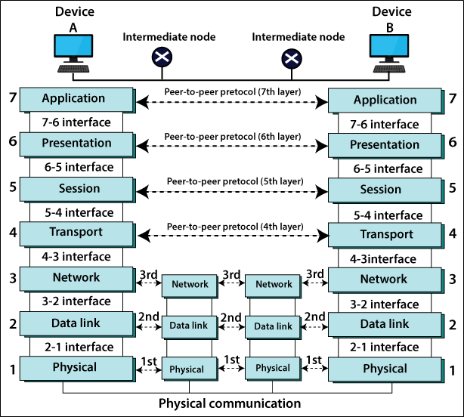
TCP IP AND OSI

Slide 48
COMMUNICATION BETWEEN TWO COMPUTERS
The image below shows the communication between two computers.
Figure 5: Communication Between Two Computers

