Slide 1

Mini Project-2A Presentation II T.E. (Computer Engg.) Sem - V
2023-24
(Even)

Slide 2

“ CAMPUS-CONNECT ”
Group members name & Roll No :
PRAVIN PRADEEP SINGH TEB245
RONEET GULABCHAND YADAV TEB253
SHUBHAM SUBHASHCHANDRA TiWARI TEB258
Name of Project Guide :
Prof. Shirin .H. Matwankar

Slide 3
Presentation Outline
Abstract
Introduction
Literature Survey
Objective & Scope
Problem Definition
Proposed System Architecture / Framework Design
Algorithm and Process Design Details
Tech Stacks
References
Conclusion

Slide 4

ABSTRACT
The Interlinked Campus Placement Website is a user-friendly platform that streamlines campus recruitment for neighboring colleges within the same university.
It centralizes job openings, empowering students to create detailed profiles for better job matching.
Recruiters access a dedicated dashboard for easy candidate tracking and communication. Comprehensive data analytics offer valuable insights, aiding decision-making for students and colleges.
The platform ensures data security and fosters a trustworthy ecosystem.
Overall, it revolutionizes the campus placement process, fostering success and growth within the academic community.

Slide 5
INTRODUCTION
The Interlinked Campus Placement Website is a user-friendly platform that streamlines campus recruitment for neighboring colleges within the same university.
It centralizes job openings, empowering students to create detailed profiles for better job matching.
Recruiters access a dedicated dashboard for easy candidate tracking and communication. Comprehensive data analytics offer valuable insights, aiding decision-making for students and colleges
The platform ensures data security and fosters a trustworthy ecosystem.
Overall, it revolutionizes the campus placement process, fostering success and growth within the academic community.

Slide 6
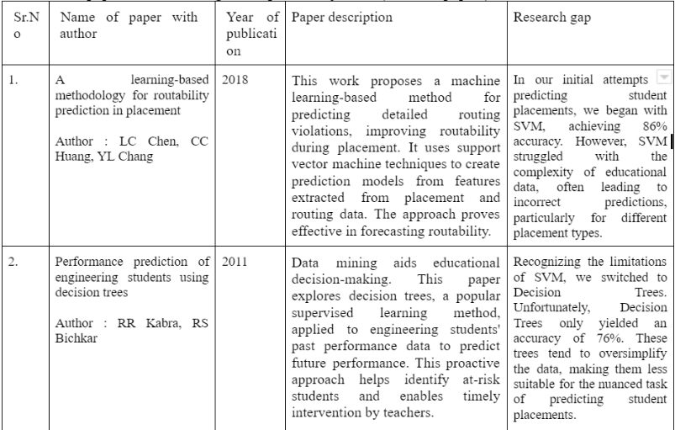
LITERATURE SURVEY

Slide 7
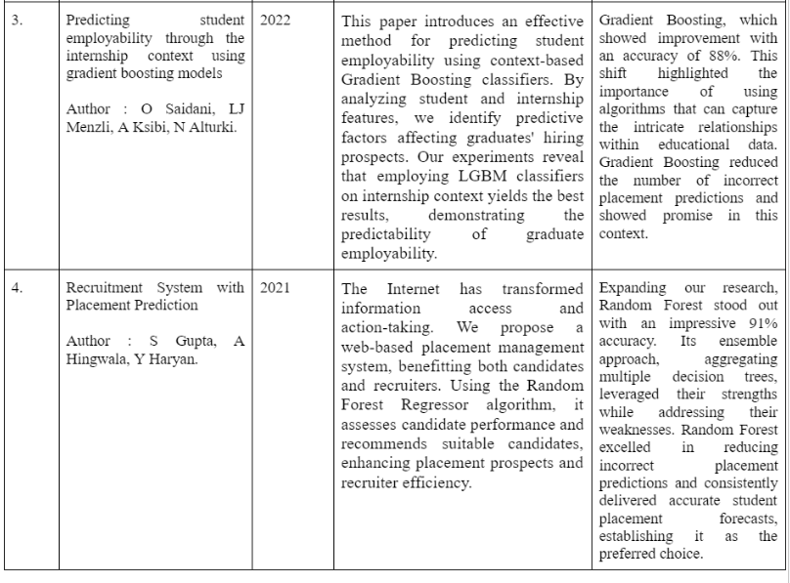
LITERATURE SURVEY

Slide 8
OBJECTIVE & SCOPE
OBJECTIVE :
Efficient Placements: Campus Connect streamlines placements using technology and analytics for precise student-role matching.
Industry Alignment: Campus Connect aligns students' skills with industry needs, enhancing their employability.
Diverse Career Paths: The platform encourages students to explore diverse roles, aiding informed career decisions.
User-Friendly Interface: Campus Connect simplifies administrative tasks for colleges and recruiters, ensuring smooth operations.

Slide 9
OBJECTIVE & SCOPE
SCOPE :
Predictive Analytics: Utilizing predictive analytics, the platform matches students with suitable roles.
Transparent Process: The platform ensures transparency in placements for students and recruiters
.Skills Enhancement: Campus Connect offers resources for students to enhance their job readiness.
Feedback Mechanism: Campus Connect includes a feedback system for continuous improvement.
Lasting Partnerships: The platform fosters enduring relationships between colleges and companies.

Slide 10
Problem DEFINITION
Limited Choices: Traditional placements restrict students' options, offering few opportunities across colleges.
Role Mismatch: Many students find themselves in jobs that don't align with their skills, leading to potential job dissatisfaction.
Complex Processes: Placements involve paperwork and coordination challenges, often causing delays.
Skills Gap: Graduates sometimes lack the skills industries require, making it difficult to secure suitable jobs.
Uncertain Decisions: Without data insights, decisions about placements can be uncertain and less informed

Slide 11
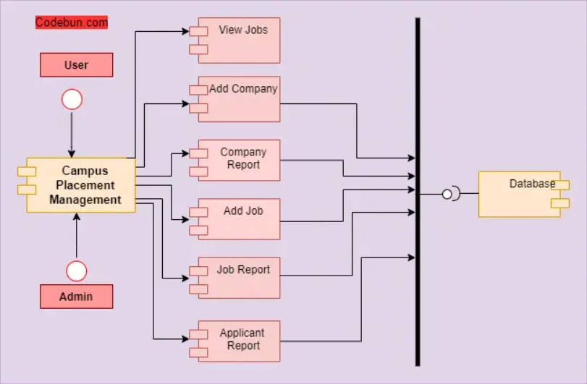
PROPOSED SYSTEM ARCHITECTURE

Slide 12
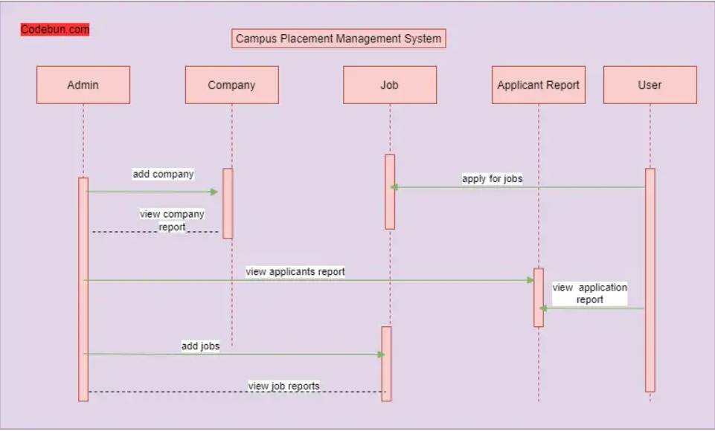
PROPOSED SYSTEM ARCHITECTURE

Slide 13
ALGORITHM AND PROCESS DESIGN
Random Forest Classifier: By aggregating predictions from multiple decision trees, Random Forest provides robust placement predictions by analyzing various student attributes like their CGPA , Internships ,Certifications , Stream and also History of backlogs and their historical placements.
Then, it performs Rows sampling and feature sampling and then it trains on them by making n numbers of decision trees and trains on them by repeating the same process.
Then, On testing dataset is fed to the Classifier it then predicts by Averaging all the outputs given from all the decision trees.
Why we used it ? Since the RandomForestClassifier can handle large datasets there’s no issue of overfitting and also it gives more accuracy since it uses majority voting on all the outputs given by the Decision trees.

Slide 14







TECH STACKS

Slide 15
References
A learning-based methodology for routability prediction in placement Author : LC Chen, CC Huang, YL Chang
Performance prediction of engineering students using decision treesAuthor : RR Kabra, RS Bichkar
Predicting student employability through the internship context using gradient boosting models Author : O Saidani, LJ Menzli, A Ksibi, N Alturki.
Recruitment System with Placement Prediction Author : S Gupta, A Hingwala, Y Haryan.
https://react.dev/
https://firebase.google.com/
https://jupyter.org/

Slide 16
Conclusion
The implementation of the campus pool placement system has shown promising results in streamlining the placement process.
The platform's user-friendly interface and efficient algorithm have significantly reduced administrative overhead and improved the overall experience for both students and recruiters.
The incorporation of data analytics has provided valuable insights, enabling better decision-making for placement strategies. It is evident that this system holds great potential in revolutionizing the placement process, making it more transparent, efficient, and effective.
With further refinement and feedback integration, this tool can serve as a benchmark for optimizing placement procedures in educational institutions.
The successful deployment of the campus pool placement system stands as a testament to the benefits of leveraging technology for enhancing academic and professional opportunities for students.

Slide 17

Our Hosted Website :

Slide 18
Thank You!

