Slide 1
C686 Software capstone task c
Dialogo project
Jump to: Class / UML Document
Jump to: SQL Entity Relationship Document
Jump to: Design Document – Low Fidelity
Jump to: Design Document – High Fidelity
Jump to: Testing Documentation
Jump to: Sources Documentation
Author: Leanna Chisholm

Slide 2
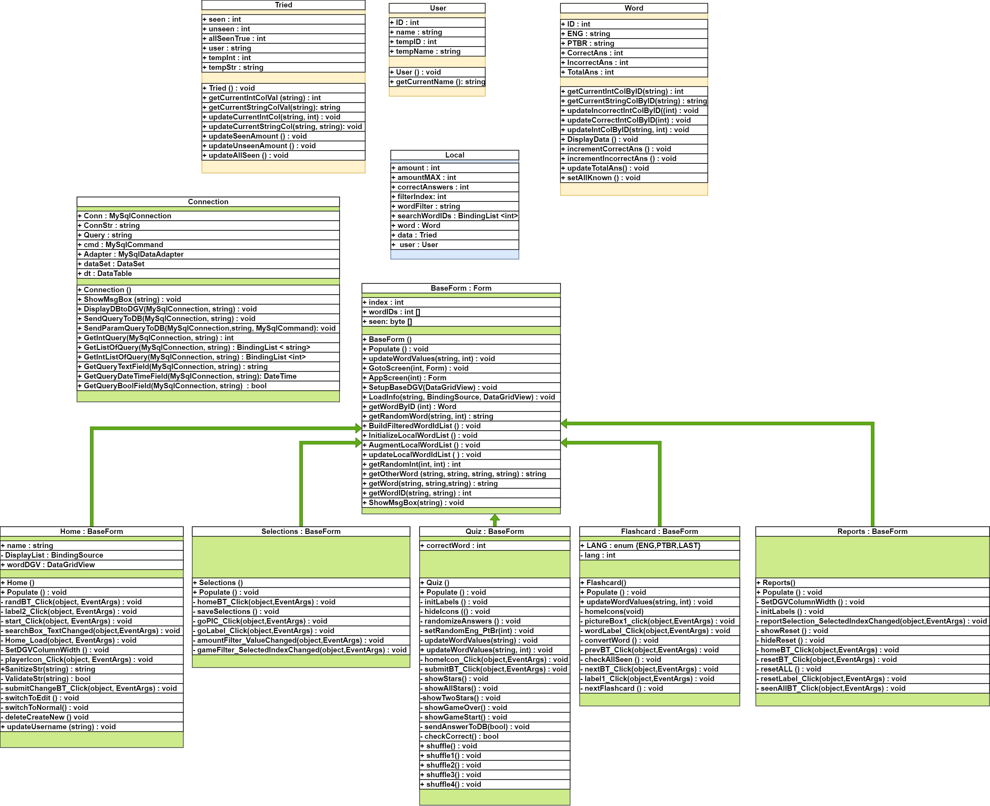
UML Class Diagram – C# infrastructure

Slide 3
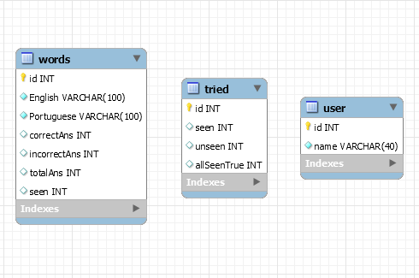
Entity Relationship Diagram – SQL infrastructure
These database tables are fully independent of each other and are used to store data for the application.
No Foreign keys are used.

Slide 4
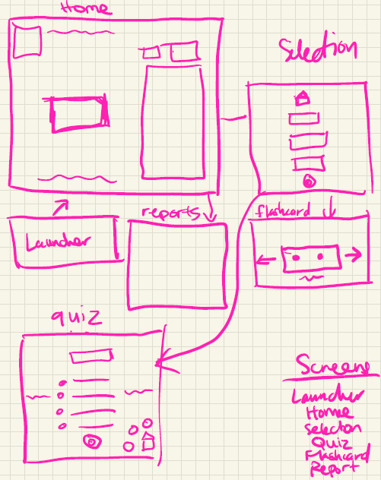
App Design Storyboard - Low Fidelity
This is the initial app
Storyboard design.
This is what I used to start creating the application screens shown in the next slide.
It also helps determine how the screens should flow and transition.

Slide 5
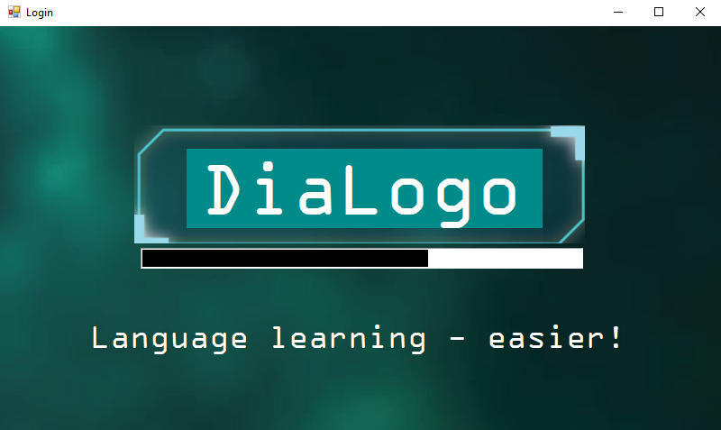
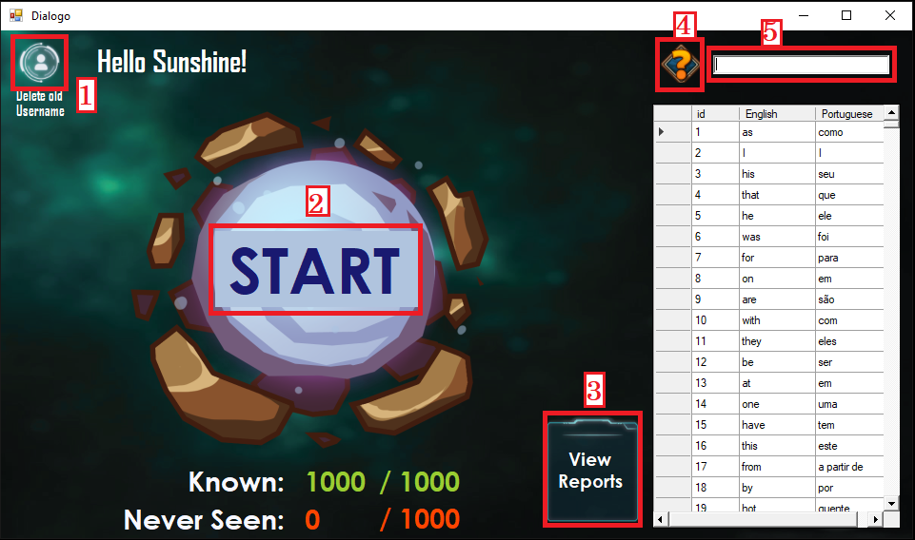
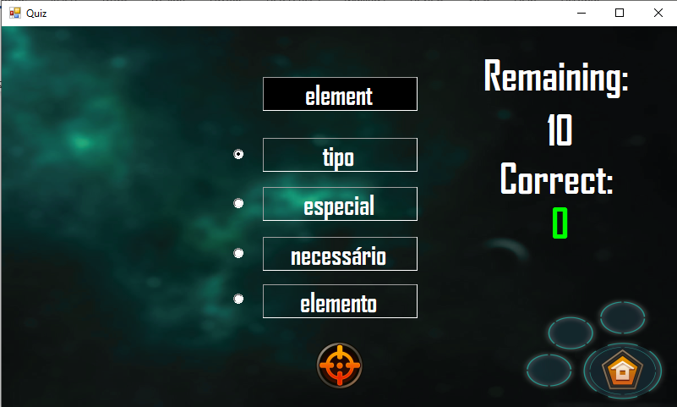
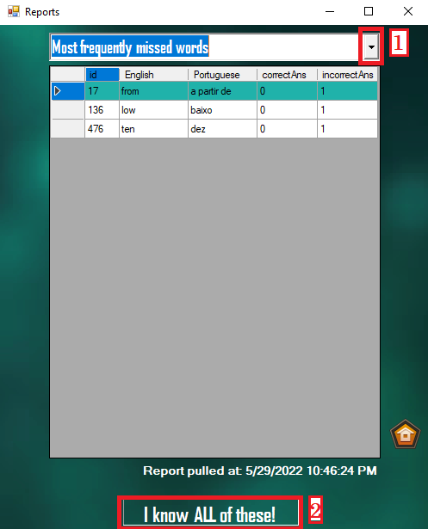
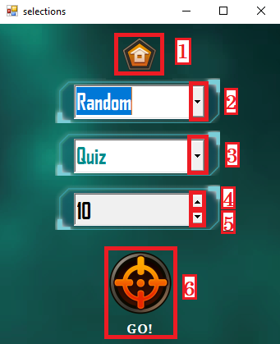
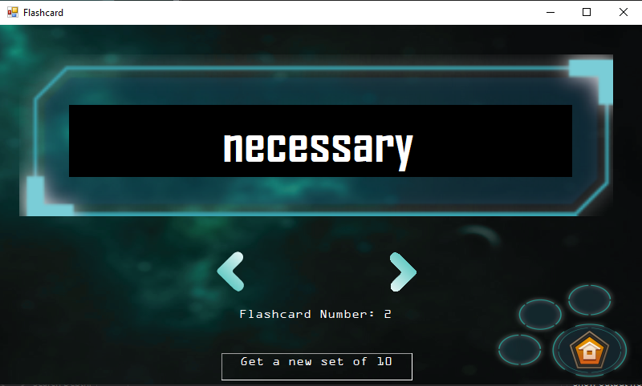
App Design Storyboard - High Fidelity
Launcher
Home
Quiz
Reports
Selections
Flashcards

Slide 6
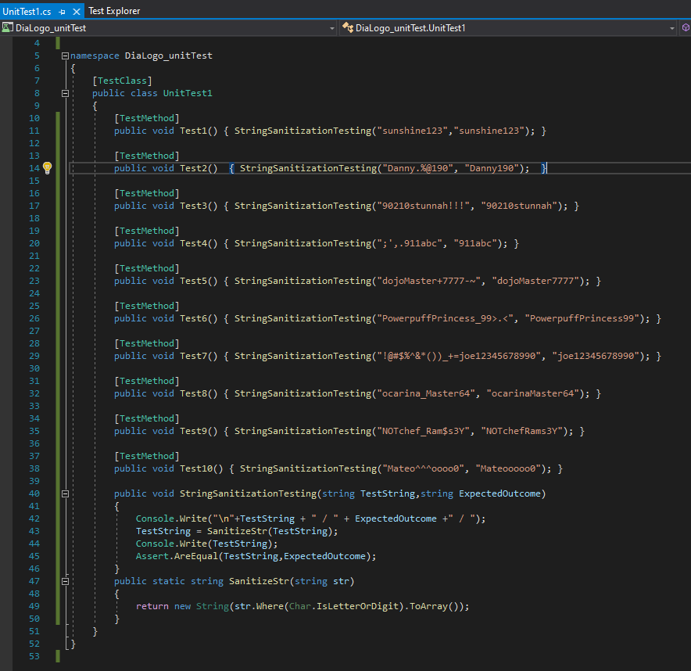
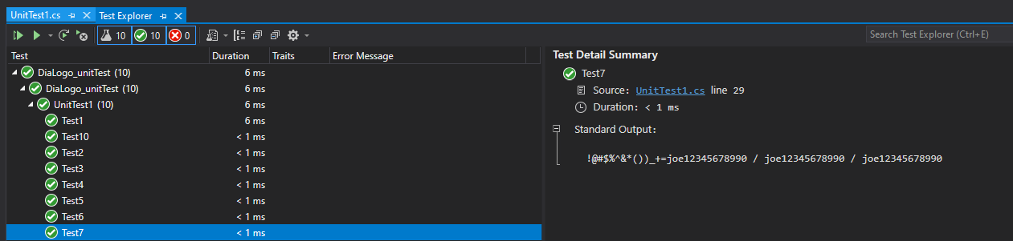
Testing Summary
Stress testing was done to confirm the SanitizeStr(string) functionality met the expected outcome. Ten test cases were undertaken.
The test cases assert whether what we input into the TestString variable matches the ExpectedOutcome after running through the SanitizeStr(TestString) subroutine.
Each Test case includes whether it passed, and the output in this order:
Original string input / Expected output / Actual output

Slide 7
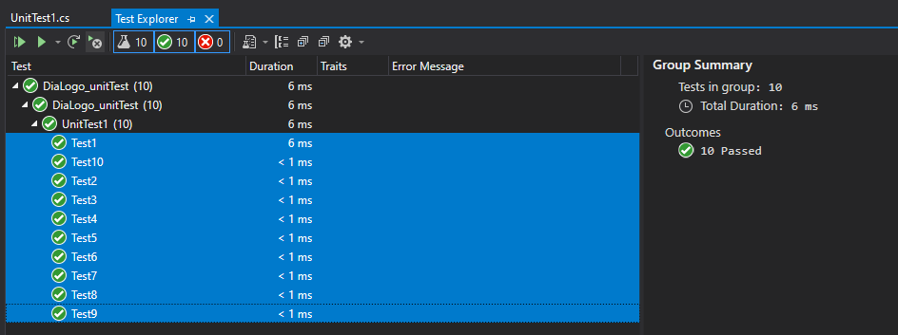
Testing Summary ( Continued )
Each Test required three things:
Input test string with invalid characters
Expected valid string output
Access to the SanitizeStr(string) function
This SanitizeStr(string) function is used in production on the Home screen to validate a username input by the user.
When the tests are run, it produced the test case outcomes shown in the next two slides.
10 test case tasks are broken down which provide the pass/fail based on the sanitized string being equal or identical to the expectedOutcome string.
Access to the System.Linq library is needed to run the str.Where(bool) function as well as access to the .Net 4.7.2 framework.
Testing source code and solution can be found in the provided ‘deliverables’ folder.

Slide 8
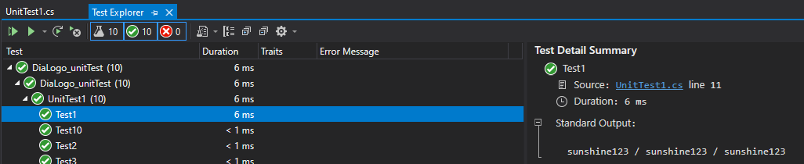
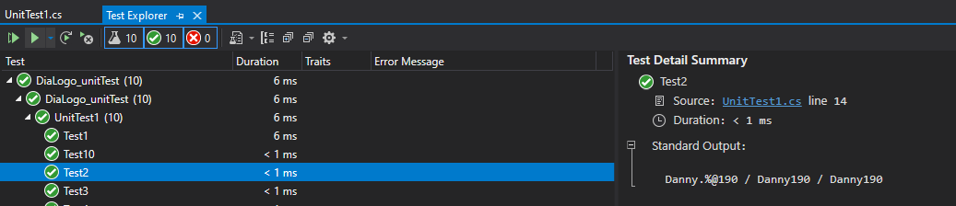
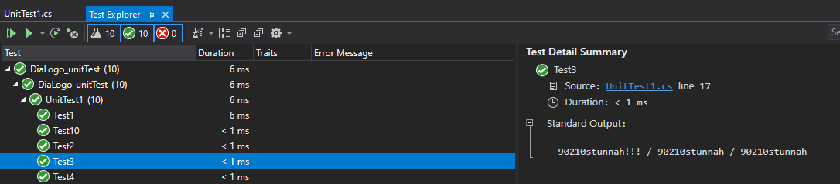
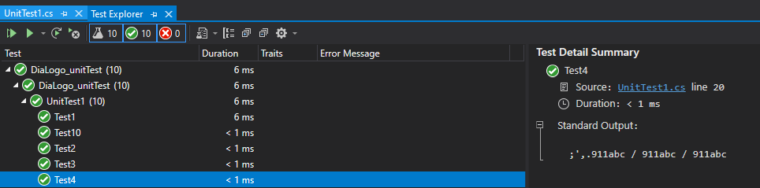
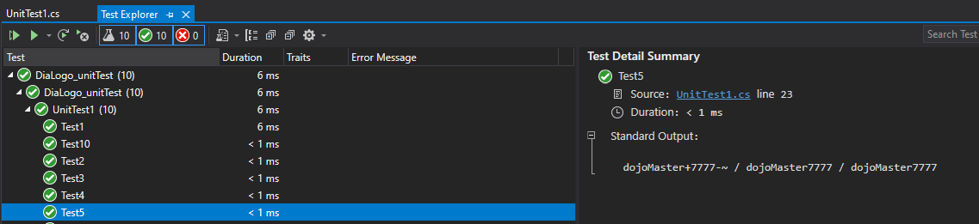
Testing Screenshots – Test cases 1 to 5
Test #1 - Passed
Test #2 - Passed
Test #3 - Passed
Test #4 - Passed
Test #5 - Passed

Slide 9
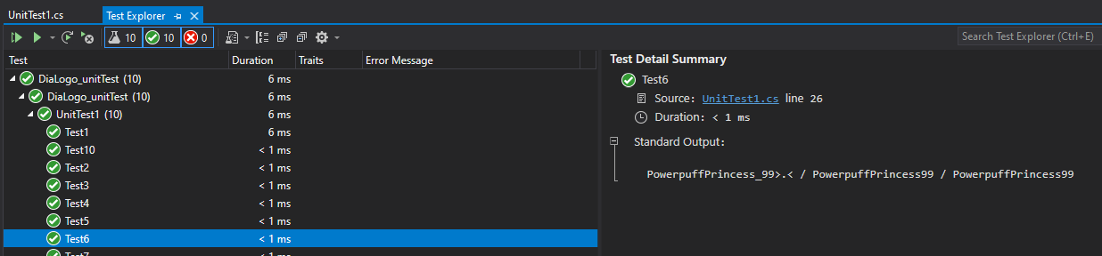
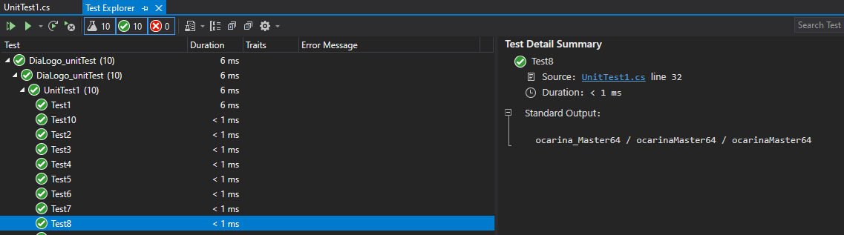
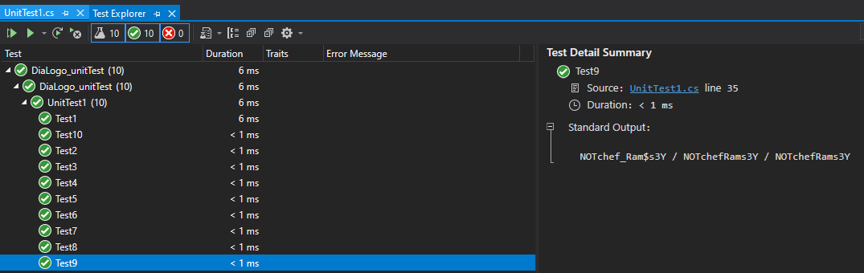
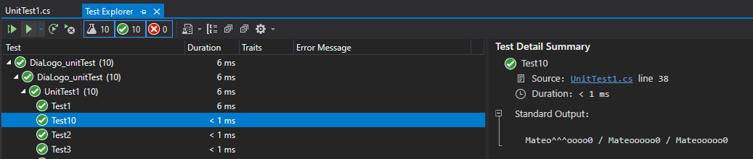
Testing Screenshots – Test cases 6 to 10
Test #6 - Passed
Test #7 - Passed
Test #8 - Passed
Test #9 - Passed
Test #10 - Passed

Slide 10
Sources
SCI-FI UI Components full pack | GameDev Market $6.00
https://www.gamedevmarket.net/asset/sci-fi-ui-components-full-pack/
GameDev Market. (2020, April 20). Sci-fi Ui Components Full Pack. GameDev Market. Retrieved August 29, 2022, from https://www.gamedevmarket.net/asset/sci-fi-ui-components-full-pack/
GUI Icons | GameDev Market $10.00
https://www.gamedevmarket.net/asset/gui-icons-8656/
GameDev Market. (2017, May 6). Gui Icons. GameDev Market. Retrieved August 29, 2022, from https://www.gamedevmarket.net/asset/gui-icons-8656/

