Slide 1
Codefest 2022
DirectoryScanner software
presented by:
Leanna Chisholm

Slide 2


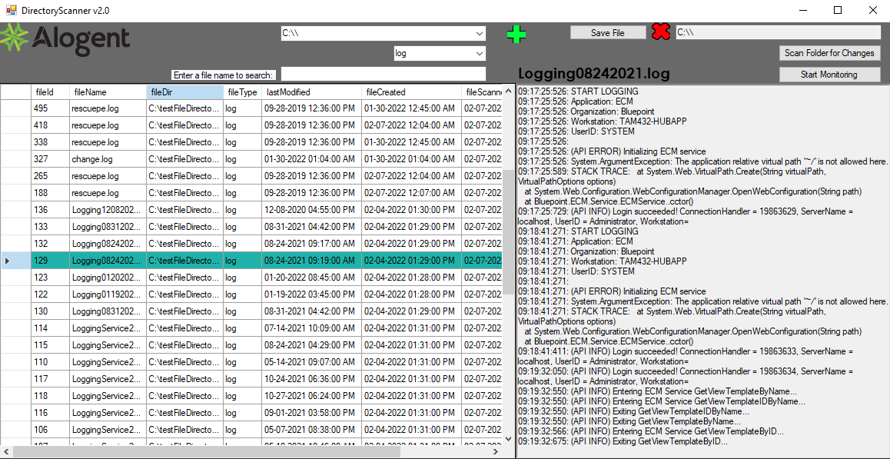
The DirectoryScanner software can be loaded onto any server or client machine to monitor, scan, archive, and restore files both to and from a given database accessible by user-friendly GUI.
Deploying this may assist Alogent in many respects and allow us to move away from goanywhere to an in-house solution.
As this is deployable on any pc / server, the app usage changes by the end-users needs, combining any of the solutions below for Datacenter, On-Prem, and for Alogent IT / Support roles.
-Track changes to file content over time
-Track file movements from one directory to another
-Files can be backed up and restored to an archived version
-Files can be regenerated if lost or deleted
-Logs would accessible in one central location
-Directories and folder infrastructure can be archived for disaster recovery
-Files and folders become searchable for cybersecurity and vulnerability testing, i.e.(“Log4j”)
-Save space, some files won’t need to be stored locally.

Slide 3
File.py
dbFetch.py
files
filecontent
directoryScraper.py
directoryscanner
database
DirectoryScanner GUI
filename

Slide 4
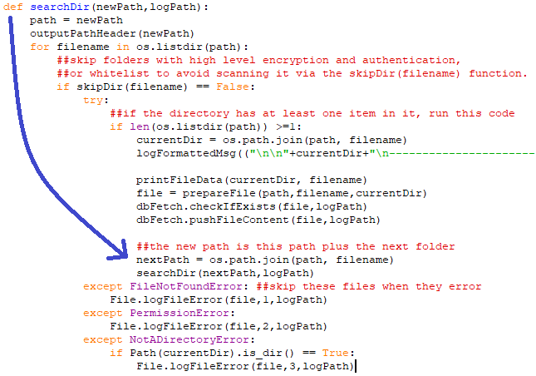
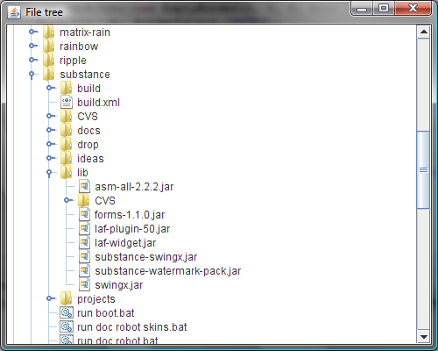
The recursive directory search can work on any pc as it dynamically scans each item in, checking for duplications as it goes down the selected directory tree.
If no duplication is found, it commits items to the database & logs the occurrence.

Slide 5
DirectoryScanner GUI

Slide 6
Features that can be added:
-File text could be searchable to make filtering more precise.
This would help to narrow down ERRORS across all scanned logs.
-Can be modified to scan specified directories, do the unzip jobs, track migrations, replacing our reliance on Goanywhere
-Save directories to a 3rd database so they don’t need to be re-added every time
-delete old file references in bulk or individually to clean up the database
-remote scanning via network directory UNC \\
-parse & commit inetpub logs correctly
Optional:
-Store pdf and tif/jpg/png images
(takes a large amount of storage space, and we already sort of do this through archive/FD5)

Slide 7
Issues addressed:
On-Prem & Datacenter Servers: | Alogent Support Teams & IT
Accidentally deleted or moved files can be regenerated in any directory specified | Scan and search known vulnerabilities across entire directories
File movements may be tracked over time if archived manually / auto | Disaster recovery tool, infrastructure recovery
All Logs could be accessible in one location | Potential in-house solution to tracking file content and migrations
Pre/post upgrade configs could be archived and restored if ran before and after upgrades | *Potentially* able to scan network paths and remotely scan /add files to/from another pc
See what directories, files, or clients are using the most space
*potentially* can do our own unzips, move Alogent from using goanywhere to an in-house solution

Slide 8
Issues addressed:
On-Prem & Datacenter Servers:
Accidentally deleted or moved files can be regenerated in any directory specified
File movements may be tracked over time if archived manually / auto
All Logs could be accessible in one location
Pre/post upgrade configs could be archived and restored if ran before and after upgrades
See what directories, files, or clients are using the most space
*potentially* can do our own unzips, move Alogent from using goanywhere to an in-house solution
Alogent Support / IT :
Scan and search known vulnerabilities across entire directories
Disaster recovery tool, infrastructure recovery
Potential in-house solution to tracking file content and migrations
*Potentially* able to scan network paths and remotely scan /add files to/from another pc

