Slide 1
APL LOGISTICS
Supply Chain
Profitability Intelligence
Customer · Product · Profitability Performance Analysis
$34.3M
15.54%
175,021
19,761
Revenue
Profit Margin
Clean Records
Customers
Prepared by: APL Analytics Division | May 2026 | Confidential

Slide 2
Agenda
APL Logistics | KWE Group
What we'll cover today
01
Executive Financial Overview
Revenue, Profit, Margin — the numbers that matter
02
Customer Intelligence
Pareto analysis, segmentation, Bleeder detection
03
Product & Category Diagnostics
SKU-level margins, loss leaders, category performance
04
Discount Impact Analysis
Leak quantification, threshold modeling, policy simulation
05
Market & Regional Analysis
Geographic profit mapping, market divergence
06
Pipeline & Technology
Architecture, tech stack, methodology overview
07
Strategic Recommendations
5 prioritized actions for immediate margin recovery
APL Logistics | Supply Chain Profitability Analysis | May 2026 | CONFIDENTIAL

Slide 3
Executive Financial Overview
APL Logistics | KWE Group
Top-line performance across 175,021 validated transactions
$34.3M
$5.3M
15.54%
3.33%
Gross Revenue
Net Profit
Profit Margin
Discount Leak Ratio
All valid orders
After all costs
Portfolio-wide
~$1.14M eroded
19,761
115
49
5
23
11,506
Unique Customers
Product SKUs
Categories
Global Markets
Regional Nodes
Geo Coordinates
KEY INSIGHT
APL Logistics earns 84¢ in costs for every $1 of revenue. The 3.33% discount leak alone represents ~$1.14M of fully recoverable margin — equivalent to a 21% uplift on current net profit.
APL Logistics | Supply Chain Profitability Analysis | May 2026 | CONFIDENTIAL

Slide 4
02
Customer Intelligence
Who is actually making us money — and who isn't

Slide 5
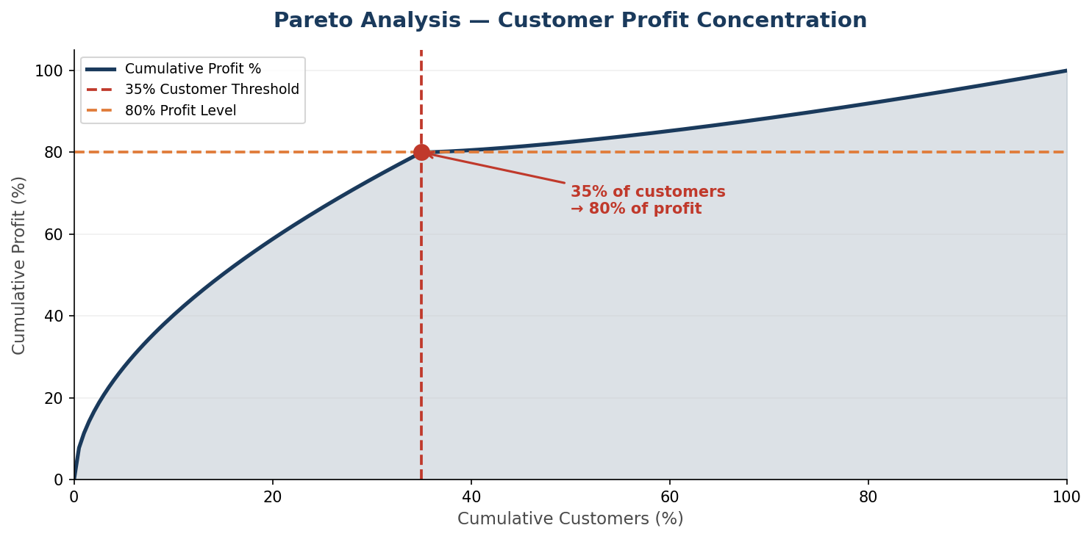
Pareto Analysis — Customer Profit Concentration
APL Logistics | KWE Group
The 80/20 Rule confirmed: 34.89% of customers drive 80% of profits
PARETO FINDING
34.89%
of customers → 80% of profit
BLEEDER RISK
243
high-volume, negative-margin customers
Strategic Implication: Focus commercial excellence resources on the top-35% VIP tier to protect 80% of the profit pool with minimal overhead.
APL Logistics | Supply Chain Profitability Analysis | May 2026 | CONFIDENTIAL

Slide 6
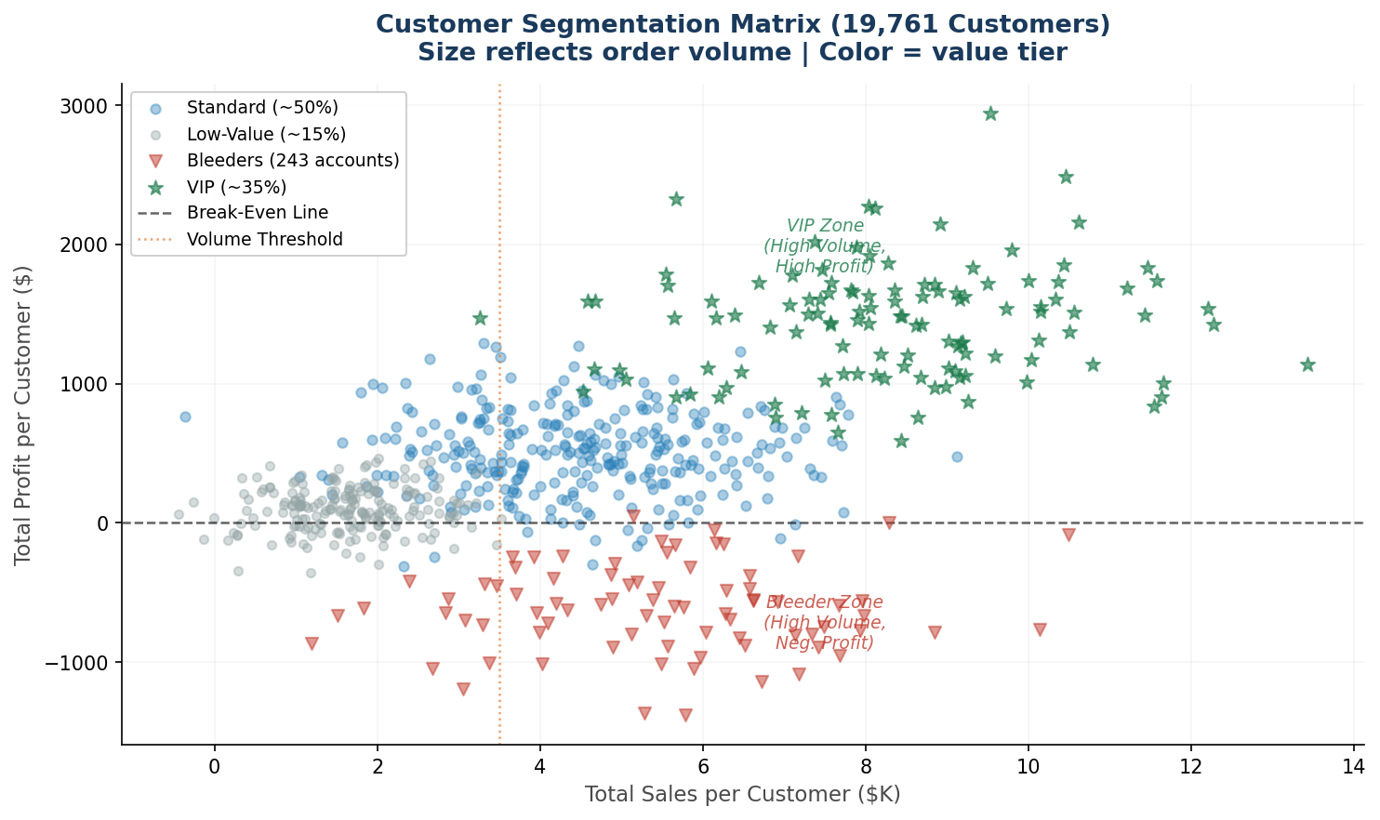
Customer Segmentation Matrix
APL Logistics | KWE Group
19,761 customers classified into 4 value tiers by Sales vs. Profit
VIP (~35%)
PROTECT
High Sales + High Profit
Standard (~50%)
OPTIMIZE
Moderate Sales + Profit
Low-Value (~15%)
REVIEW
Low contribution
Bleeders (243)
REPRICE / EXIT
High Sales + Neg. Profit
APL Logistics | Supply Chain Profitability Analysis | May 2026 | CONFIDENTIAL

Slide 7
03
Discount Impact Analysis
Where margin goes to die — and how to stop it

Slide 8
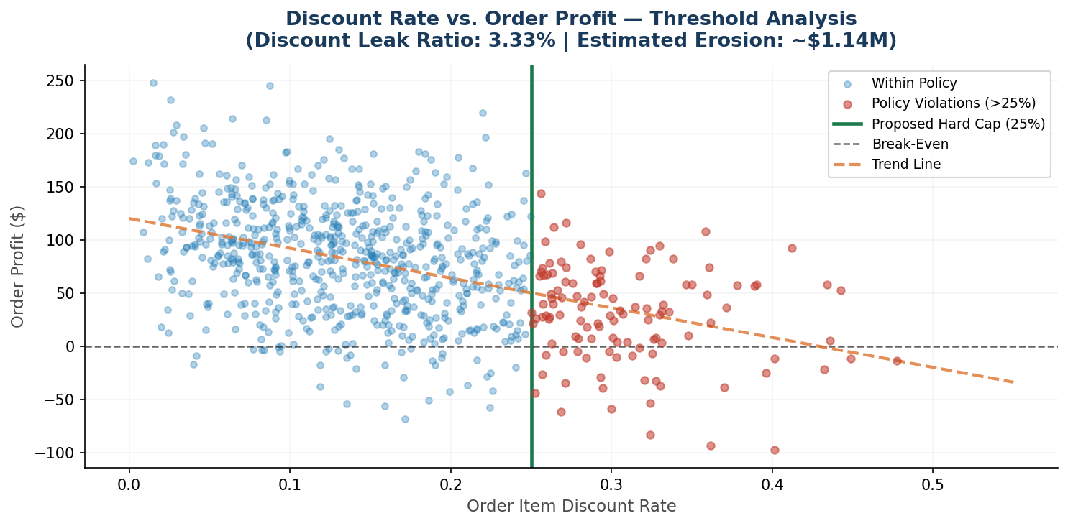
Discount Rate vs. Order Profit — Threshold Analysis
APL Logistics | KWE Group
Orders above 25% discount cap are flagged as Policy Violations
3.33%
Discount Leak Ratio
~$1.14M
Annual Margin Eroded
25%
Proposed Hard Cap
−0.066
Discount-Profit Correlation
APL Logistics | Supply Chain Profitability Analysis | May 2026 | CONFIDENTIAL

Slide 9
What-If Discount Simulator
APL Logistics | KWE Group
Interactive pricing scenario modelling in the Streamlit dashboard
Current State
Proposed Policy
Aggressive Cap
No Cap
25% Hard Cap
15% Hard Cap
Net Profit
Net Profit
Net Profit
$5.3M
$6.44M
~$7.0M+
Discount leakage continues unchecked
+$1.14M from cap on violating orders
Higher recovery, customer impact risk
The Streamlit What-If Simulator allows executives to drag a discount cap slider and see real-time margin recovery estimates across the full dataset.
APL Logistics | Supply Chain Profitability Analysis | May 2026 | CONFIDENTIAL

Slide 10
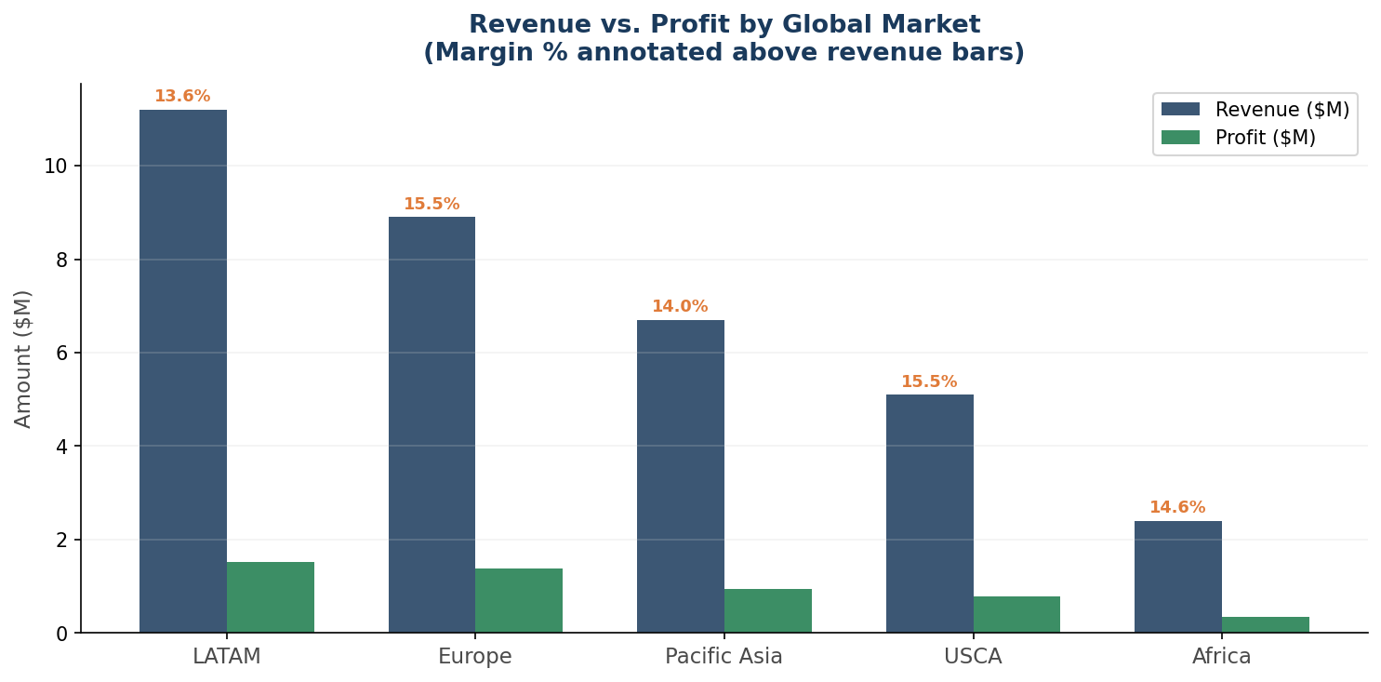
Market & Regional Profit Analysis
APL Logistics | KWE Group
Revenue rank ≠ Profit rank — margin divergence across 5 global markets
KEY OBSERVATION
Revenue rank and profit rank diverge across all 5 markets. A market that leads in gross revenue may lag in margin — making revenue-only reporting a strategic liability. Margin rates range from 13.6% to 15.5% across markets — seemingly narrow, but at $34.3M revenue scale, a 1% margin difference = $343K.
SPATIAL COVERAGE
11,506
Geo Coordinate Nodes
23
Regional Sub-Nodes
5
Global Markets
APL Logistics | Supply Chain Profitability Analysis | May 2026 | CONFIDENTIAL

Slide 11
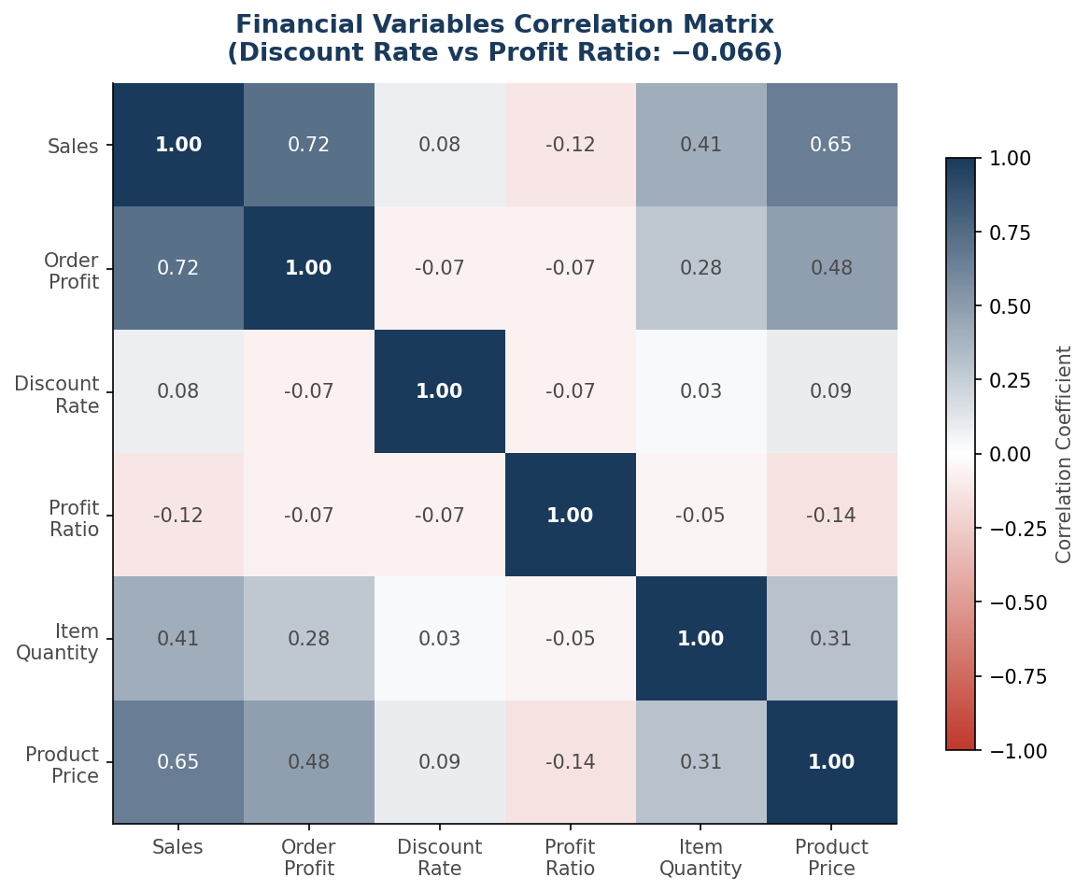
Financial Variables Correlation Matrix
APL Logistics | KWE Group
Understanding statistical relationships between key business metrics
DISCOUNT FINDING
Discount Rate ↔ Profit Ratio: −0.066
Mild but consistently negative across all markets
STRONG CORRELATION
Sales ↔ Order Profit: +0.72
Product Price ↔ Sales: +0.65
IMPLICATION
Higher-priced products naturally drive more revenue and profit. Discount erosion is mild in aggregate but structurally harmful in high-volume segments.
APL Logistics | Supply Chain Profitability Analysis | May 2026 | CONFIDENTIAL

Slide 12
Analytical Pipeline Architecture
APL Logistics | KWE Group
End-to-end data flow: from raw CSV to executive dashboard
📂
🧹
📐
⚙️
📊
🗺️
📱
📋
Raw CSV
Cleaning
KPI Engineering
Aggregation
Analytics
Spatial
Dashboard
Reports
180,519 records
5,497 outliers removed
6 KPIs + CVI
5 Parquet files
Pareto, Segments, Corr.
11,506 geo-nodes
Streamlit 4-tab UI
Paper + PPT + BLUF
TECH STACK:
Python | Pandas | NumPy | Plotly | Folium | Streamlit | Apache Parquet | Matplotlib | Jupyter Notebooks
All pipelines run in <2 seconds | 82.4% memory reduction via Parquet compression | Complete reproducibility via Jupyter notebook
APL Logistics | Supply Chain Profitability Analysis | May 2026 | CONFIDENTIAL

Slide 13
04
Strategic Recommendations
5 prioritized actions for immediate and sustained margin recovery

Slide 14
5 Strategic Recommendations — Priority Action Plan
APL Logistics | KWE Group
Ranked by financial impact and implementation feasibility
R1
Hard 25% Discount Cap
IMMEDIATE
~$1.14M recovered
Implement enterprise-wide discount ceiling. Mandate pricing committee approval for exceptions.
R2
Bleeder Customer Review
URGENT
Eliminate neg. margin
Commercial review of 243 Bleeder accounts — reprice contracts or initiate managed offboarding.
R3
VIP Retention Program
HIGH
Protect 80% of profit
Dedicated account management + SLA guarantees for top-35% CVI customers.
R4
Loss-Leader SKU Retirement
HIGH
Portfolio optimization
Retire or reprice bottom-10 loss-making products using Category Margin Score diagnostics.
R5
Margin KPIs in Regional Reporting
MEDIUM
Systemic reform
Replace revenue-only targets with balanced scorecards including profit margin per market.
APL Logistics | Supply Chain Profitability Analysis | May 2026 | CONFIDENTIAL

Slide 15
CONCLUSION
APL Logistics is
Revenue-Rich,
Margin-Exposed.
The gap between 15.54% current margin and recoverable potential is fully quantified.
The infrastructure, the data, and the analytical framework are in place.
What is required now is the executive will to act.
$34.3M
$1.14M
243
35%
Revenue
Recoverable Margin
Bleeders to Fix
Customers to Protect
APL Logistics Analytics Division | KWE Group | May 2026

