Slide 1

Department of Information Science & Engineering
Phase1 Presentation of Major project
AY:2025-26
“Design and Implementation of a Dataset-Agnostic, Cost-Aware and Self-Healing Data Observability Platform”
Under the Guidance of
Dr. Chaitra Naveen
HOD,
Dept. of ISE
By,
Chandrakala J.
Rashmi B.
Vimal S. D.
Yuktha S.

Slide 2
CONTENTS
1. Introduction
2. Problem Statement
3. Motivation
4. Literature Survey
5. Research Gap
6. Objectives
7. Proposed System
8. Methodology
9. Expected Outcomes
10. References

Slide 3
INTRODUCTION
Data has become a critical asset in modern businesses, driving decision-making, strategy, and innovation across industries.
Although organizations generate data at massive scale, much of it remains underutilized due to poor processing, unreliable pipelines, and data quality challenges.
In the era of AI and Machine Learning, reliable and high-quality data is essential, creating the need for intelligent, observable, and self-healing data systems.

Slide 4
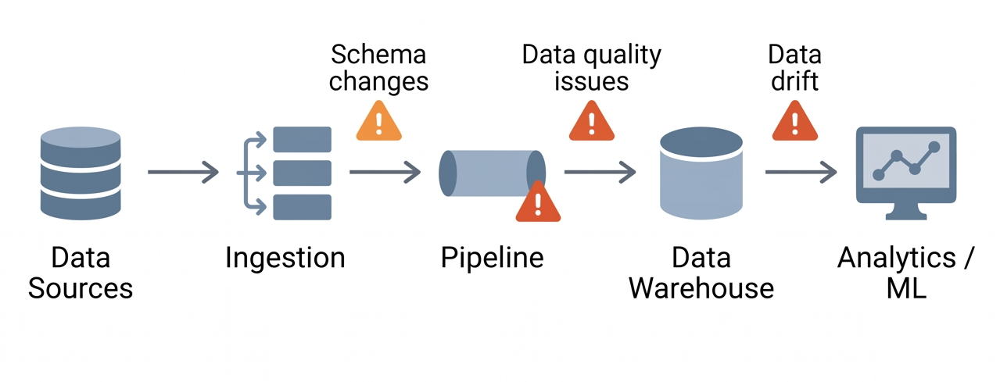
Problem Statement
Modern data pipelines process data from multiple sources and formats, but often suffer from silent failures and data quality issues that go unnoticed.
Errors during ingestion, transformation, or storage propagate to dashboards and AI/ML models, leading to incorrect insights and poor performance.
This creates a need for a dataset-agnostic, cost-aware, and self-healing data observability platform to ensure reliable data for business and AI applications.

Slide 5
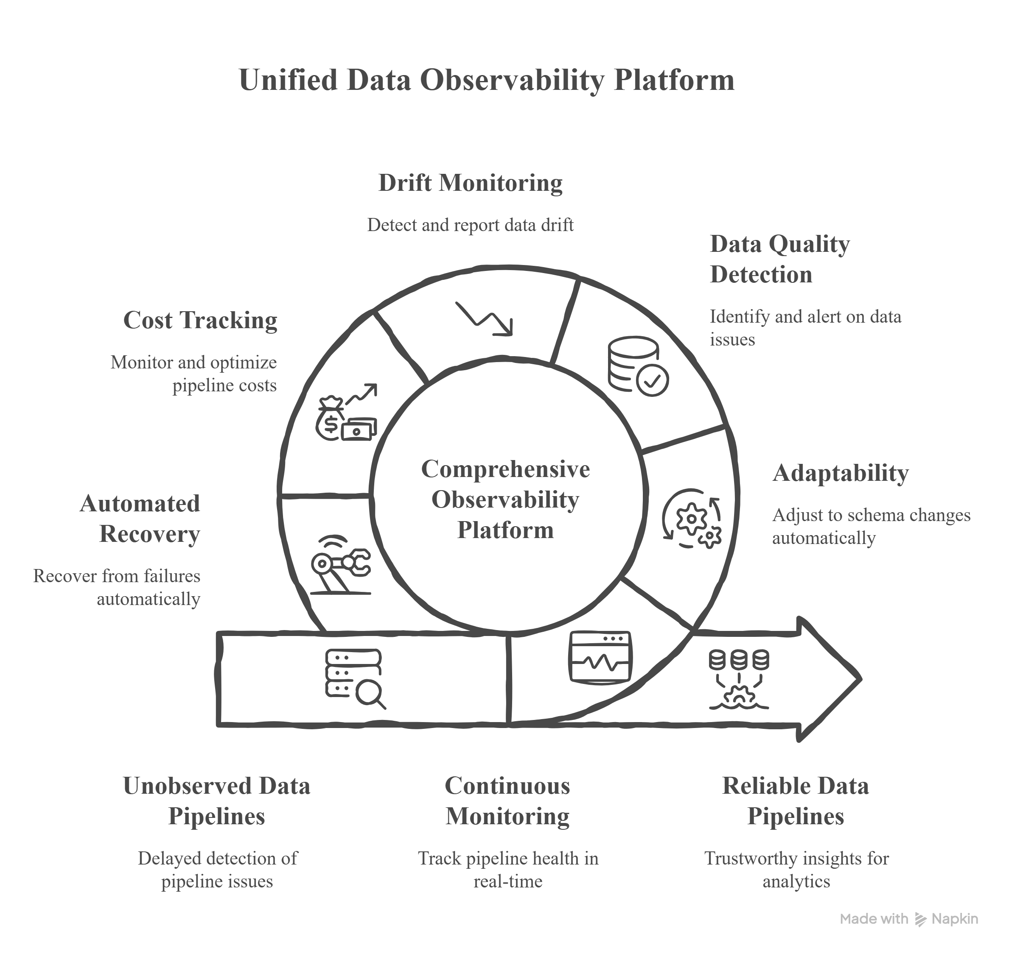
Motivation
Existing data pipelines lack visibility into data quality, failures, and cost.
Manual monitoring cannot scale in complex, AI-driven data environments.
This diagram shows how a data observability platform transforms unreliable pipelines into reliable, cost-efficient, and AI-ready systems.

Slide 6
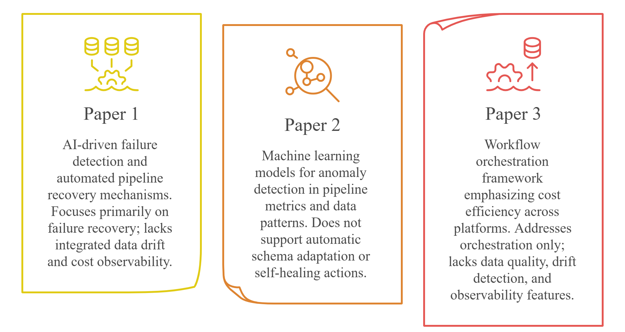
Literature Survey
Proactive Data Pipeline Maintenance via Machine Learning-Driven Anomaly Detection (2025)
Cost-Effective Big Data Orchestration Using Dagster: (2024)
Self-Healing Data Pipelines: (2026)

Slide 7
Research Gap
A detailed review of existing literature reveals the following research gaps in current data pipeline and observability solutions.
Existing research
Identified gaps
Pipeline failures are detected using rule-based or AI-driven recovery mechanisms.
Machine learning models are used for anomaly detection based on historical pipeline behaviour.
Workflow orchestration frameworks manage task execution and scheduling.
Data drift detection techniques are applied after model deployment.
Cloud government focuses on access control and policy enforcement.
Lack of the task-agnostic pipelines that adapt automatically to schema changes.
Limited integration of data quality monitoring within pipeline execution.
Absence of unified observability combining quality, drift, and cost matrix
Drift detection not embedded at the data pipeline level.
Cost awareness not treated as a core pipeline observability component.

Slide 8
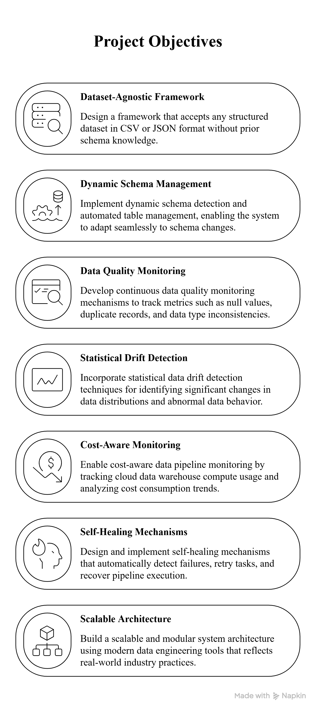
Objectives

Slide 9
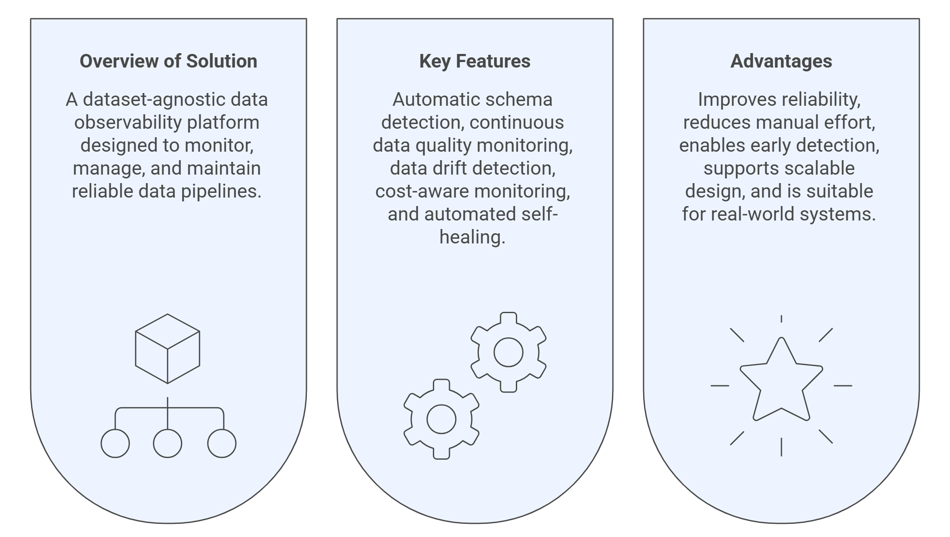
Proposed System

Slide 10
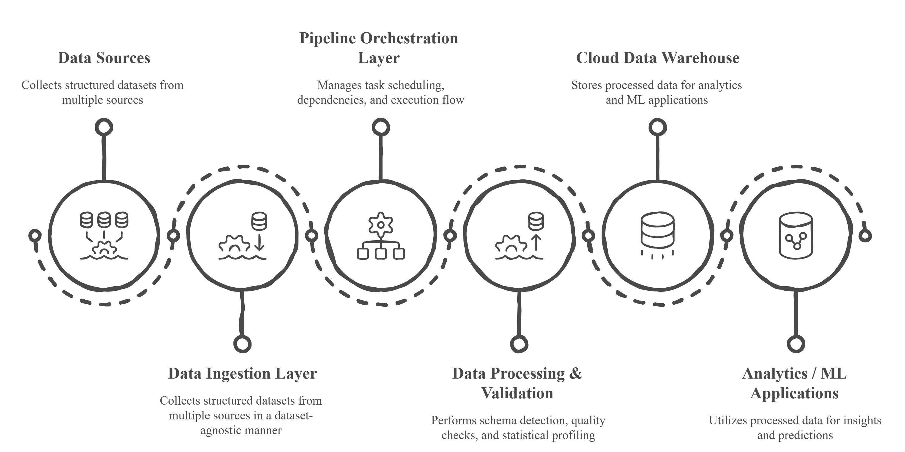
Methodology
End-to-end workflow of the proposed data observability platform, covering ingestion, schema detection, data validation, monitoring, and automated recovery.

Slide 11
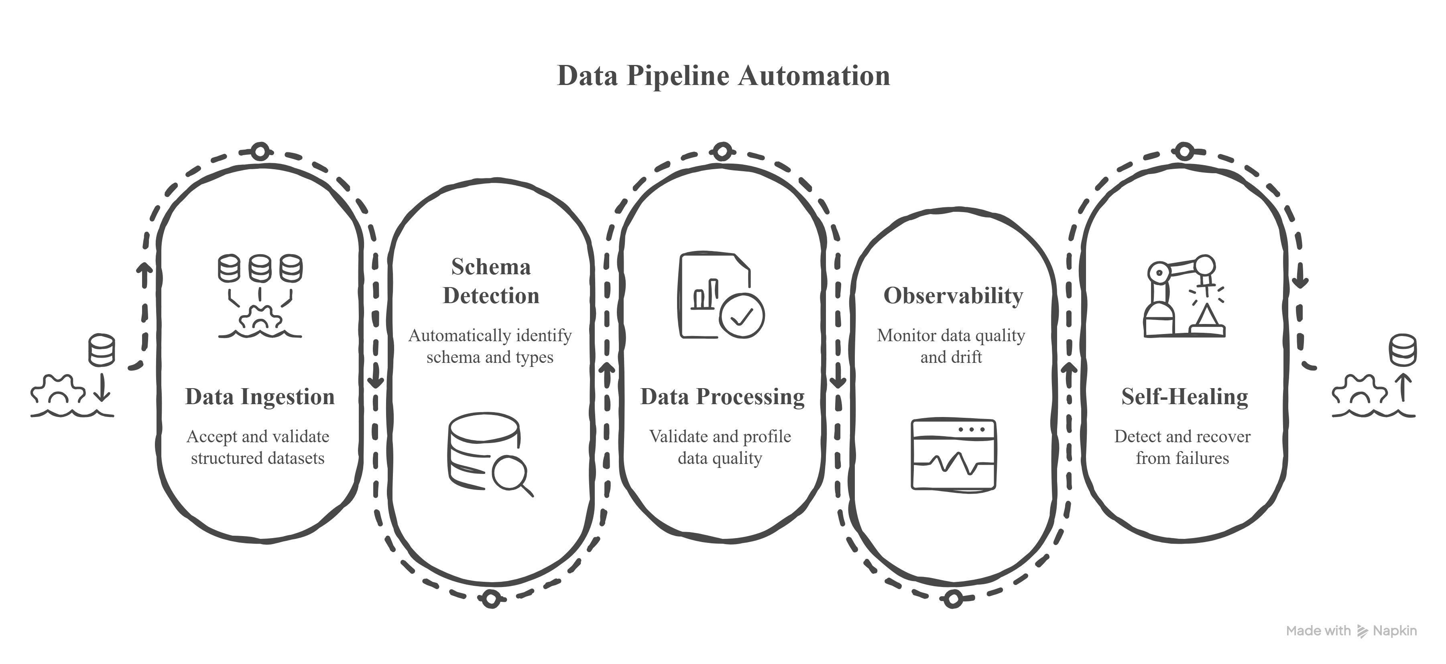
Expected Outcomes
Reliable and AI-ready data pipelines are achieved through continuous observability, data quality assurance, and self-healing mechanisms.

Slide 12
References
[1] R. Patel and S. Dey, “Self-Healing Data Pipelines: Leveraging AI to Detect and Correct Failures in Real-Time,” International Journal of Artificial Intelligence, Data Science and Machine Learning, 2026. [Online]. Available: https://ijaidsml.org/index.php/ijaidsml/article/download/407/371
[2] A. Sharma, P. Verma, and K. Rao, “Proactive Data Pipeline Maintenance via Machine Learning-Driven Anomaly Detection,” International Journal of Scientific Research in Science and Technology, vol. 11, no. 2, 2025. [Online]. Available: https://ijsrst.com/index.php/home/article/download/IJSRST251222663/IJSRST251222663/1481
[3] M. H. Khan, L. Petersen, and J. Ortega, “Cost-Effective Big Data Orchestration Using Dagster: A Multi-Platform Approach,” arXiv preprint arXiv:2408.11635, 2024. [Online]. Available: https://arxiv.org/pdf/2408.11635.pdf
[4] S. Liu, A. Banerjee, and T. Nguyen, “Governing Cloud Data Pipelines with Agentic AI,” arXiv preprint arXiv:2512.23737, 2025. [Online]. Available: https://arxiv.org/pdf/2512.23737.pdf
[5] J. Martinez, R. Kaur, and D. Chen, “Model Monitoring, Data Drift Detection, and Efficient Model Retraining: A Review,” arXiv preprint arXiv:2401.12345, 2024. [Online]. Available: https://arxiv.org/pdf/2401.12345.pdf
[6] N. Ahmed and S. Kulkarni, “A Survey on Data Drift Detection Methods in Machine Learning,” arXiv preprint arXiv:2305.09876, 2023. [Online]. Available: https://arxiv.org/pdf/2305.09876.pdf

Slide 13
Thank You
Questions?

