Slide 1
OptiForm AI: Intelligent Formwork Optimization
Team C.O.R.E.
Problem Statement 4: Automation of Formwork Kitting & BoQ Optimization
L&T CreaTech 2026

Slide 2
The Problem
Current Challenges in Formwork Management:
• Manual, slow, and error-prone calculation of Bill of Quantities (BoQ).
• Sub-optimal reuse of formwork due to missed repetition patterns across floors.
• Lack of data-driven 'Rent vs. Buy' decision making, inflating project costs.
• Un-tracked carbon footprints from poor asset utilization.

Slide 3
Our Solution: OptiForm AI
A data-driven platform designed to transform manual BoQ calculations into an intelligent, automated pipeline:
• Repetition Analytics: Automatically clusters vertical repetition patterns across floors.
• Precision Kitting: Uses operations research to generate optimized BoQ assembly kits.
• Financial Strategy: Analyzes rental bids against procurement to decide Rent vs. Buy.
• Sustainability Metrics: Calculates carbon reductions from optimized material reuse.

Slide 4
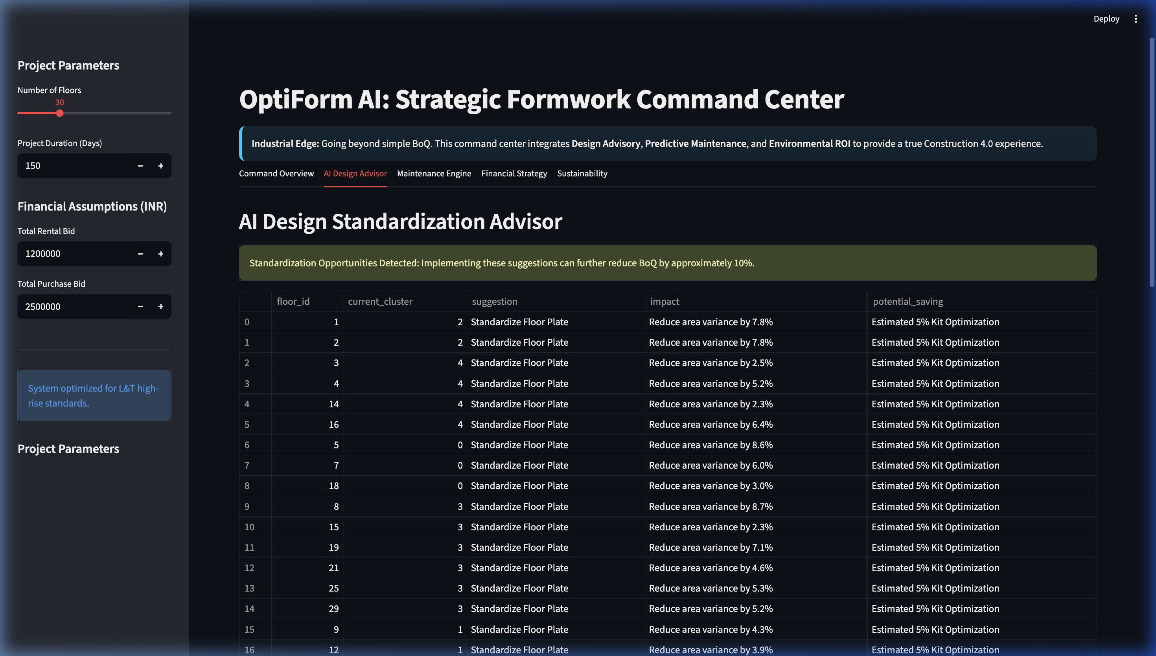
Out-of-the-Box Innovation
Beyond standard optimization, OptiForm AI includes:
• AI Design Advisor: Analyzes designs and suggests standardizations to further reduce BoQ.
• Predictive Maintenance Engine: Tracks asset health based on reuse history to predict failures.
• Digital Twin Readiness: Ready to export kit configurations to BIM or AR platforms.

Slide 5
The Analytics Pipeline
Seamless workflow from design to procurement:
1. Data Ingress (Floor plans & designs)
2. Repetition Clustering (Machine Learning)
3. Optimization Engine (PuLP / OR-Tools)
4. BoQ Generation (Kitting)
5. Financial & Decision Engine (ROI Engine)

Slide 6
Financial & Sustainability Impact
Demonstrable value for L&T projects:
• Reduced Inventory Costs: Eliminating excess through precise repetition clustering.
• Optimized ROI: Ensuring the right mix of renting and buying based on actual usage durations.
• Lower Carbon Footprint: Quantifying the environmental benefit of maximizing plywood and steel reuse cycles.

Slide 7
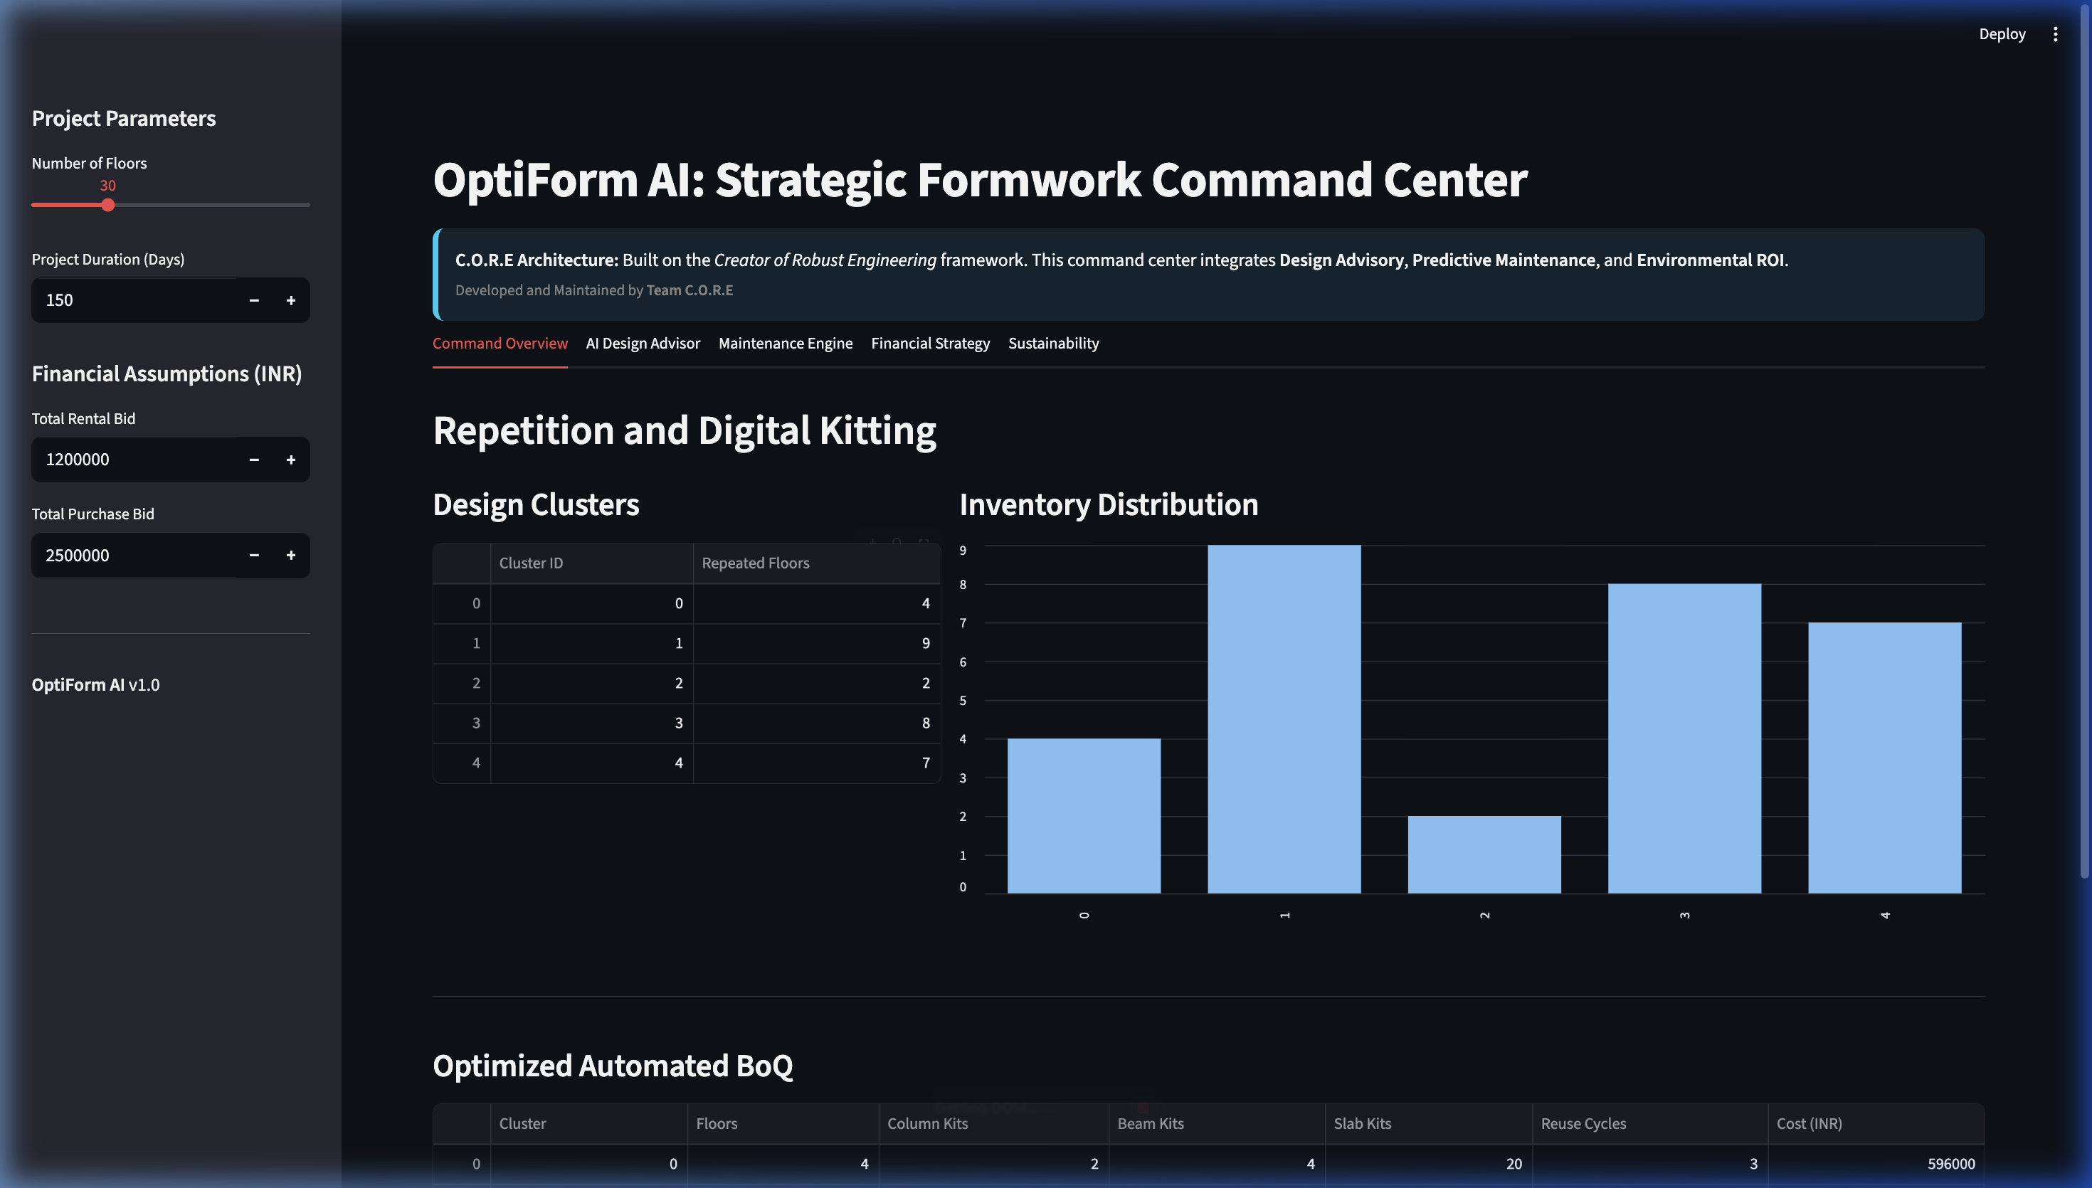
The Prototype: Command Center

Slide 8
Conclusion & Future Scope
Why OptiForm AI?
• Readily solves L&T's Problem Statement 4.
• Enhances speed, accuracy, and profitability of formwork management.
Future integration roadmap:
• Direct SAP ERP and BIM synchronization.
• IoT integration for real-time asset tracking on site.

