Slide 1
OptiForm AI
Intelligent Formwork Optimization
Problem Statement 4
Team C.O.R.E.

Slide 2
The Problem: Manual Inefficiency
Current Challenges in Formwork Management:
• Manual calculation of Bill of Quantities (BoQ) is slow & error-prone.
• Overlooking vertical floor repetitions leads to excess inventory.
• Lack of data-driven 'Rent vs. Buy' analytics inflates project costs.
• Un-tracked carbon footprints from poor asset utilization.
Team C.O.R.E. | L&T CreaTech 2026

Slide 3
Our Solution: OptiForm AI
Transforming manual workflows into an intelligent, automated pipeline:
• Repetition Analytics: ML clustering groups repeating floor designs.
• Precision Kitting: Instant, optimized BoQ assembly kits generated via OR.
• Financial Engine: Dynamic ROI modeling for Rent vs. Buy decisions.
• Sustainability Metrics: Automated carbon tracking for formwork reuse.
Team C.O.R.E. | L&T CreaTech 2026

Slide 4
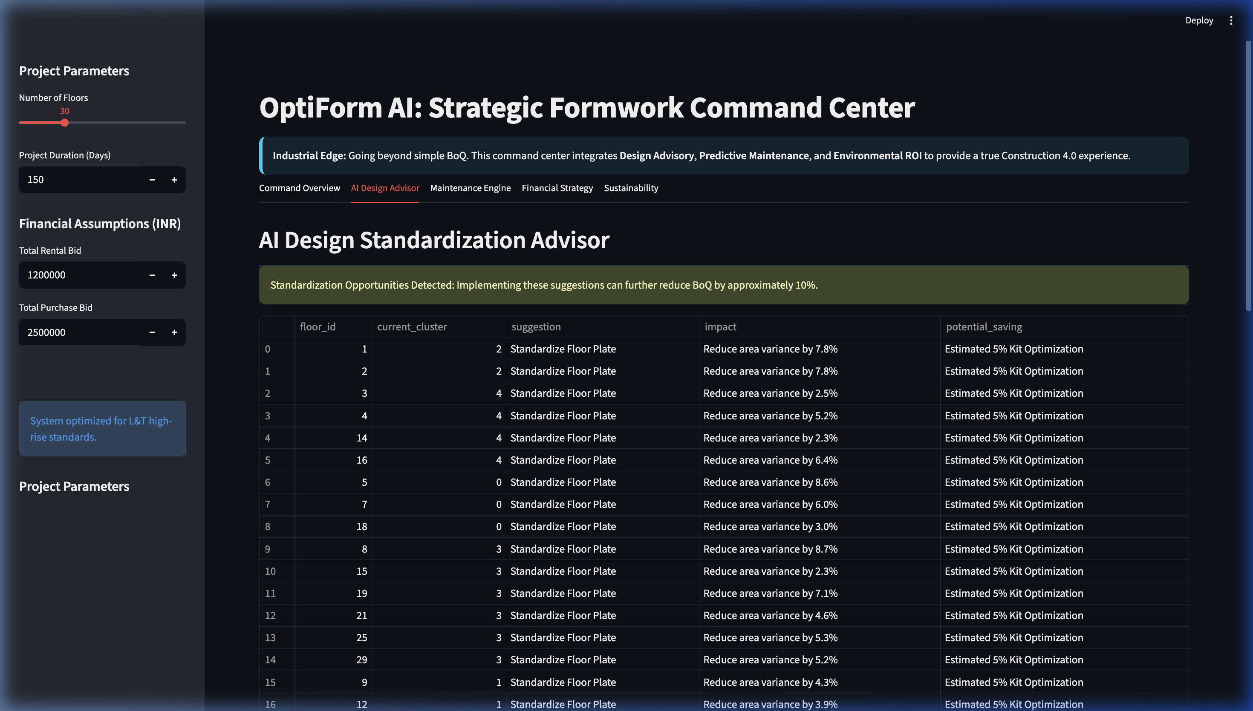
Out-of-the-Box Innovation
Beyond standard optimization:
1. AI Design Advisor:
Suggests architectural standardizations to reduce total BoQ.
2. Predictive Maintenance:
Tracks asset health to predict failures before they happen.
Team C.O.R.E. | L&T CreaTech 2026

Slide 5
The Analytics Pipeline
A seamless workflow from design data to final procurement:
1️⃣ Data Ingress (Floor Plans & BIM Data)
2️⃣ Repetition Clustering (Machine Learning)
3️⃣ Optimization Engine (BoQ Kitting)
4️⃣ Financial & Decision Engine (ROI & Strategy)
Team C.O.R.E. | L&T CreaTech 2026

Slide 6
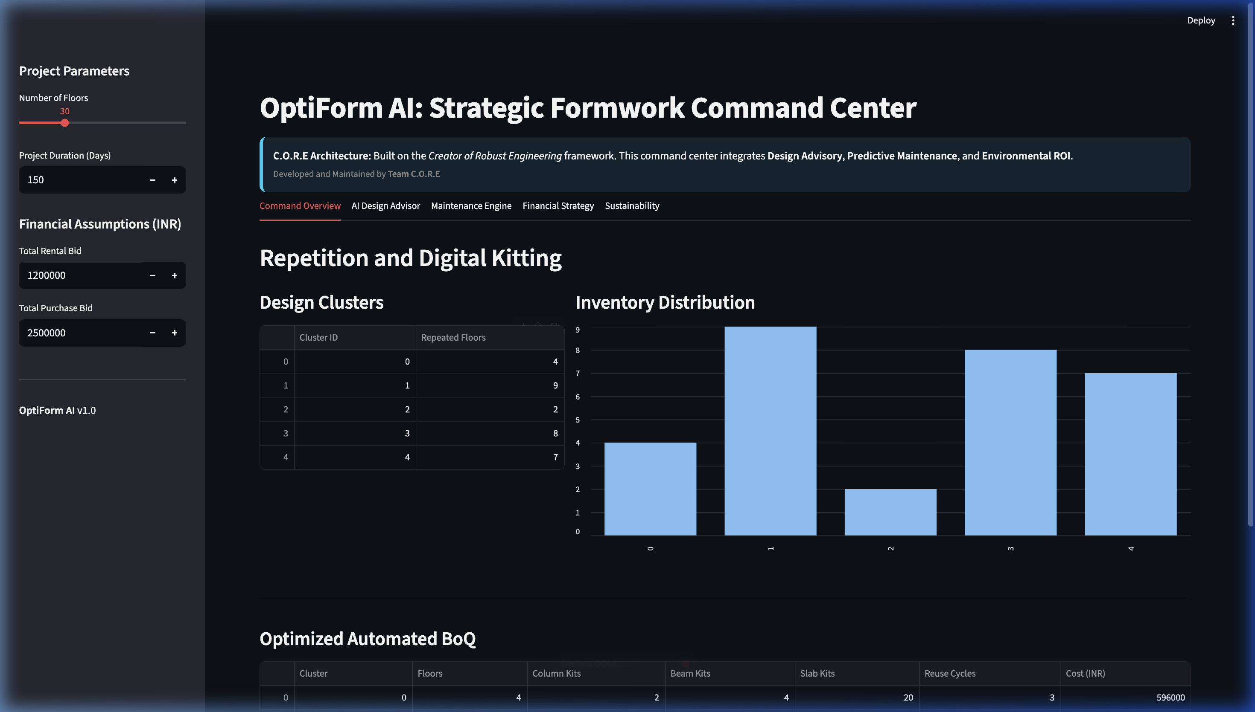
Working Prototype: Command Center
Team C.O.R.E. | L&T CreaTech 2026

Slide 7
Value Proposition & Future Scope
Why OptiForm AI for L&T?
• Drastically reduces planning time and excess inventory holding costs.
• Hard data for Rent vs. Buy decisions protects project margins.
Future Roadmap:
• Direct SAP ERP and BIM synchronization (Digital Twin ready).
• Real-time IoT tagging for on-site asset tracking.
Team C.O.R.E. | L&T CreaTech 2026

