Slide 1
VELLORE INSTITUTE OF TECHNOLOGY • SCHOOL OF IT & ENGG (SITE)
Kubernetes Cost Optimization Framework for SaaS-Based Educational Platforms using FinOps Intelligence
Course: BCSE355L – Cloud Architecture | Final Technical Project Presentation | Academic Year 2026
STUDENT PROJECT TEAM
ACADEMIC & CLOUD VERIFICATION
• K. Darshan (24BIT0119) — Project Lead & Cloud Architect
• Dhanushkodi Y (24BIT0143) — Backend Developer & DevOps Engineer
• T. Tharun (24BIT0155) — ML Engineer & Data Pipeline Developer
• S. Sanjay (24BIT0315) — Frontend Developer & Documentation Lead
• Academic Level: B.Tech Information Technology (3rd Year)
• Faculty Guide: [Department of Information Technology, SITE]
• Target Platform: Multi-Tenant Educational SaaS (EduSaaS)
• Live Cloud Host: AWS EC2 eu-north-1 (Stockholm)
• Verified Cloud URL: http://16.16.185.117:8000
• Zero-Spend Guardrail: Automated $5.00 AWS Budget Alert
Notes:
Good morning respected faculty evaluator. Today, our team—Darshan, Dhanushkodi, Tharun, and Sanjay—is presenting KubeCostFinOps, our Cloud Architecture project for BCSE355L. Our work addresses a critical economic problem in modern cloud computing: the severe over-provisioning and financial waste in Kubernetes clusters hosting SaaS educational platforms. We have implemented an end-to-end FinOps decision-support framework that collects real-time object-state telemetry, calculates normalized AWS baseline costs, derives rightsizing recommendations with mathematical safety headroom, and forecasts capacity trends. Most importantly, this project is fully deployed, monitored, and running live on an AWS cloud host at IP 16.16.185.117. Let us walk you through the architecture, engineering implementation, empirical results, and cloud verification.

Slide 2
EXECUTIVE SUMMARY
Project Overview: Bridging Telemetry & Cloud Economics
A cloud-native FinOps decision-support platform designed specifically for educational SaaS workloads
1. Observability & Ingestion
2. FinOps Modeling & Sizing
3. Forecasting & Governance
• Non-intrusive scraping via Kube-State-Metrics (KSM) at port 8080.
• Prometheus time-series integration capturing live telemetry.
• In-cluster OpenCost allocation model for cost metadata.
• Explicit distinction between object specifications and kernel utilization.
• Automated background snapshot pipeline running every 60 seconds.
• Financial derivation using AWS US-East-1 baseline reference pricing.
• Granular cost breakdown: cluster, namespace, pod, and container.
• Rightsizing engine with +20% safety headroom over peak consumption.
• Workload tiering: Actionable Application vs System Infrastructure vs Protected Control Plane.
• High availability guarantee: Strict preservation of minimum 2 replicas.
• Statistical capacity forecasting using Holt's Linear Trend smoothing.
• Strict rejection of sparse datasets (minimum 5 chronological points required).
• Deterministic holdout validation evaluating MAE and RMSE.
• Proactive Horizontal Pod Autoscaler (HPA) target threshold tuning.
• Advisory dry-run architecture: zero unapproved mutation of cluster state.
CORE VALUE DELIVERED: Replaces guesswork with evidence-based capacity engineering, achieving 79.4% workload cost reduction in empirical testing while mathematically guaranteeing educational platform availability.
Notes:
On this slide, we summarize what KubeCostFinOps is and the core value it delivers. Educational SaaS platforms—such as learning management portals, coding submission platforms, and virtual exam servers—exhibit highly bursty usage. Typically, cloud administrators provision Kubernetes pods statically for peak traffic, which creates massive financial waste during off-peak hours. KubeCostFinOps solves this through three pillars. First, an observability pipeline that continuously ingests object-state telemetry from Kube-State-Metrics and Prometheus without intruding into application code. Second, a FinOps intelligence engine that normalizes resource requests against standard AWS pricing, calculating exact dollar costs per namespace and container while proposing rightsized allocations with a 20% safety buffer. Third, a proactive governance and statistical forecasting module using Holt's Linear Trend models to predict capacity needs. Our system operates strictly in advisory dry-run mode, giving cloud administrators actionable decision support without risking cluster outages.

Slide 3
PROBLEM FORMULATION
The Educational SaaS Infrastructure Cost Dilemma
Why traditional cloud management creates severe over-provisioning and budget waste in universities
Extreme Diurnal & Exam Surges
The Static Request Fallacy
The Financial Attribution Gap
• University platforms face 5x to 10x traffic surges during assignment deadlines, fee portals, and exams.
• Over 80% of academic hours (nights, weekends, vacations) experience near-zero utilization.
• Unpredictable traffic spikes create fear of system crashes, forcing administrators to over-provision.
• Kubernetes schedules worker nodes based on Pod Resource REQUESTS, not actual runtime utilization.
• A container requesting 250m CPU locks up that capacity on the EC2 host even if it consumes only 15m CPU.
• Over-provisioned requests force the scheduler to spin up unnecessary extra EC2 worker nodes.
• AWS billing invoices provide gross account-level charges with zero Kubernetes pod-level visibility.
• Engineering teams cannot determine which namespace, service, or department is driving cloud costs.
• Absence of continuous cost allocation prevents data-driven optimization decisions.
THE COST ESCALATION CASCADE:
Static Peak Allocations (250m/256Mi) → Massive Unused Capacity (94% Idle) → Inflated Worker Node Count → Overwhelming Cloud Invoices → Depleted Institutional Budgets.
Notes:
Here we articulate the core problem that motivated this project. In academic institutions like VIT, educational platforms experience extreme traffic asymmetry. When an assignment deadline arrives or exam registrations open, traffic jumps exponentially. To ensure stability, engineers typically allocate static resource requests—for example, 250 millicores of CPU and 256 megabytes of RAM per replica. But here is the catch: Kubernetes scheduling algorithms evaluate container REQUESTS, not actual runtime usage. Even if your pod consumes only 15 millicores, Kubernetes reserves the full 250 millicores on the worker node. This ties up node capacity, forcing the cluster autoscaler to provision more EC2 instances, leading to inflated monthly cloud bills. Furthermore, standard AWS invoices only show a lump sum bill; they cannot tell you which specific namespace or microservice incurred that spend. This creates a severe financial visibility gap.

Slide 4
ENGINEERING PRINCIPLES
Motivation: FinOps in Cloud-Native Engineering
Establishing financial accountability, continuous visibility, and data-driven cloud governance
1. INFORM
2. NORMALIZE
3. OPTIMIZE
4. OPERATE
Visibility & Attribution
Unit Economics & Pricing
Evidence-Based Rightsizing
Continuous Governance
• Continuous real-time telemetry ingestion.
• Attribution down to namespaces, deployments, and pods.
• Clear transparency of resource vs financial impact.
• Convert raw millicores and megabytes to USD hourly rates.
• Standardized AWS US-East-1 reference baseline pricing.
• Accurate monthly spend modeling based on 730 hours.
• Derive recommendations from empirical peak utilization.
• Enforce a mandatory +20% safety headroom buffer.
• Protect critical control-plane workloads from mutation.
• Advisory dry-run architecture preserving cluster uptime.
• Proactive HPA tuning for deadline rush elasticity.
• Automated budget guardrails ($5 limit) to prevent bill shock.
Notes:
Why FinOps? In cloud architecture, FinOps—short for Financial Operations—is not simply about cutting costs. It is about maximizing the business value of every dollar spent on cloud infrastructure. We mapped our architecture directly to the FinOps Foundation lifecycle. In the Inform phase, we bring complete cost transparency to individual Kubernetes workloads. In the Normalize phase, we translate raw infrastructure units—millicores and megabytes—into normalized USD currency using AWS reference pricing. In the Optimize phase, we derive rightsizing recommendations that downsize over-allocated requests while enforcing a 20% safety buffer above peak consumption. Finally, in the Operate phase, we maintain continuous governance: our system operates strictly in advisory mode, never mutating cluster workloads automatically, ensuring that availability is never compromised for the sake of financial optimization.

Slide 5
ENGINEERING SCOPE
Project Objectives & Implementation Scope
Clear, transparent delineation between fully implemented deliverables and architectural roadmap
Fully Implemented & Verified
Baseline & Prototype Modules
Future Research & Production Scope
• Multi-source telemetry ingestion from KSM (:8080) and Prometheus (:9090).
• Cost Analyzer deriving monthly modeled spend via AWS US-East-1 baseline rates.
• Rightsizing Engine with +20% safety buffer and 3-tier workload classification.
• Stateless Python REST API on port 8000 with 10 passing endpoints.
• Deterministic Holt's Linear Trend capacity forecasting with MAE/RMSE validation.
• Empirical 4-phase benchmark experiment (683 requests, 0 errors, 79.4% savings).
• Public AWS EC2 deployment (t3.small, Ubuntu 24.04, Kind cluster, $5 Budget Alert).
• In-cluster OpenCost container allocation API integrated and online at port 9003.
• Cost estimation based on public AWS baseline rates rather than live cloud billing exports.
• Synthetic diurnal trigonometric workload generator for offline load testing.
• Single-node Kind cluster running inside EC2 for lightweight, resource-bounded evaluation.
• Periodic telemetry ingestion managed via systemd timer running every 60 seconds.
• Migration from Kind to Managed Amazon EKS with multi-AZ node groups.
• Direct AWS Cost Explorer API and AWS CUR (Cost & Usage Report) S3 integration.
• Automated GitOps Pull Request generation (ArgoCD/Flux) for approved rightsizing.
• Advanced deep learning (LSTM/Transformer) incorporating academic calendar schedules.
• Karpenter dynamic node auto-provisioning utilizing AWS Graviton (ARM64) Spot instances.
Notes:
Transparency is a hallmark of good engineering. On this slide, we clearly define what is fully implemented, what is implemented as an architectural prototype, and what constitutes future scope. In the green column, you can see our fully implemented and tested deliverables: live KSM and Prometheus ingestion, our cost analysis engine, our rightsizing algorithms with safety buffers and workload classification, our statistical forecasting module, our empirical benchmark experiment, and our verified AWS EC2 deployment. In the amber column, we note that OpenCost is operational as an in-cluster allocation model, and that our Kubernetes environment is a Kind cluster hosted inside an EC2 virtual machine rather than multi-node EKS. Finally, in the blue column, we outline future production enhancements such as EKS migration, AWS Cost Explorer billing APIs, and GitOps PR automation. We do not claim features we have not built.

Slide 6
SYSTEM FLOW
Proposed System: Closed-Loop FinOps Workflow
End-to-end telemetry lifecycle from container cgroups to actionable administrator advisories
Step 1: Workloads
Step 2: Scraping
Step 3: Ingestion
EduSaaS application pods execute in isolated Kubernetes namespaces with static resource requests.
KSM exposes object specs (:8080); Prometheus scrapes time-series (:9090); cAdvisor tracks kernel usage.
Python pipeline fetches metrics, normalizes schema, and persists timestamped telemetry snapshots.
Step 4: Financials
Step 5: Rightsizing
Step 6: Dashboard
Cost analyzer computes hourly and monthly spend using AWS US-East-1 reference pricing constants.
Recommendation engine detects over-provisioning and calculates proposed requests with +20% buffer.
REST API exposes structured endpoints; web cockpit displays real-time KPIs, charts, and advisories.
ADVISORY GOVERNANCE PRINCIPLE: Workload specifications are never modified without explicit human approval. The framework acts as an intelligent decision-support advisor, preventing accidental production downtime.
Notes:
This slide illustrates our closed-loop FinOps workflow across six sequential steps. In Step 1, our educational workloads run inside the cluster. In Step 2, our monitoring components capture telemetry: KSM inspects object specifications, Prometheus records metric streams, and cAdvisor measures CPU and memory consumption. In Step 3, our ingestion pipeline fetches these metrics over HTTP and structures them into validated snapshots. In Step 4, our cost analyzer calculates hourly and monthly spend based on AWS baseline pricing. In Step 5, our rightsizing algorithm evaluates whether allocations exceed observed peaks by more than our threshold, generating recommended requests with a 20% safety headroom. In Step 6, the Python REST backend exposes these insights to our interactive dashboard. Most importantly, notice the green banner at the bottom: our system operates under an advisory governance policy. It never mutates cluster manifests directly; it informs human administrators.

Slide 7
IMPLEMENTATION
Verified Technology Stack & Rationale
Modern open-source cloud technologies selected for low resource overhead and enterprise alignment
Cloud Infrastructure
Monitoring & Telemetry
• AWS EC2 Host: t3.small (2 vCPU, 2 GiB RAM) in eu-north-1 Stockholm; Free-Tier eligible and highly cost-effective.
• Ubuntu 24.04 LTS: Host OS providing modern Linux 7.0 kernel, cgroups v2, and systemd service management.
• Docker Engine 26.1: Underlying container runtime executing Kind node containers with full cgroup isolation.
• Kind v0.24 (K8s 1.31): Kubernetes in Docker running single-node control-plane without expensive cloud control plane fees.
• Kube-State-Metrics: v2.13. Exposes declarative state of Kubernetes objects (pod requests, limits, phases) on port 8080.
• Prometheus Telemetry: v2.54. Scrapes time-series metrics from KSM, cAdvisor, and system targets on port 9090.
• Metrics Server: Aggregates resource metrics for Horizontal Pod Autoscaler (HPA) and kubectl top commands.
• OpenCost Engine: v1.121. Real-time in-cluster cost allocation model mapping pod consumption on port 9003.
Backend & Algorithms
Frontend & Presentation
• Python 3.12 Core: Standard library HTTP REST server; zero third-party framework overhead (no Flask/FastAPI dependencies).
• NumPy & Pandas: Fast data processing, timeseries alignment, and telemetry snapshot normalization.
• Scikit-Learn & SciPy: Holdout evaluation, error metrics (MAE/RMSE), and statistical smoothing algorithms.
• Holt's Linear Trend: Double exponential smoothing with level and trend parameters for capacity forecasting.
• Vanilla HTML5 & CSS3: Custom glassmorphic dark theme, responsive flexbox layout, and CSS variable color system.
• Vanilla JavaScript ES6: Async/await API client with automatic origin detection and 10ms round-trip latency.
• Glassmorphic UI: KPI cards, progress allocation bars, rightsizing tables, and interactive configuration drawer.
• Systemd Supervisors: Automated process management ensuring services auto-start on EC2 boot without manual intervention.
Notes:
Here we present our verified technology stack. Rather than choosing heavy frameworks, every technology was selected for architectural efficiency. On the cloud infrastructure side, we run on an AWS EC2 t3.small instance running Ubuntu 24.04 LTS. We chose a Kind Kubernetes cluster inside Docker because it allows us to test complete Kubernetes orchestration without paying the 73 dollars per month for an Amazon EKS managed control plane. In monitoring, we deploy Kube-State-Metrics, Prometheus, Metrics Server, and OpenCost. On the backend, our REST API server is written in pure Python 3.12 using the standard library's http.server module, which eliminates runtime dependencies like Flask or FastAPI while guaranteeing sub-15 millisecond response times. On the frontend, we built an elegant glassmorphic dashboard in vanilla HTML, CSS, and ES6 JavaScript.

Slide 8
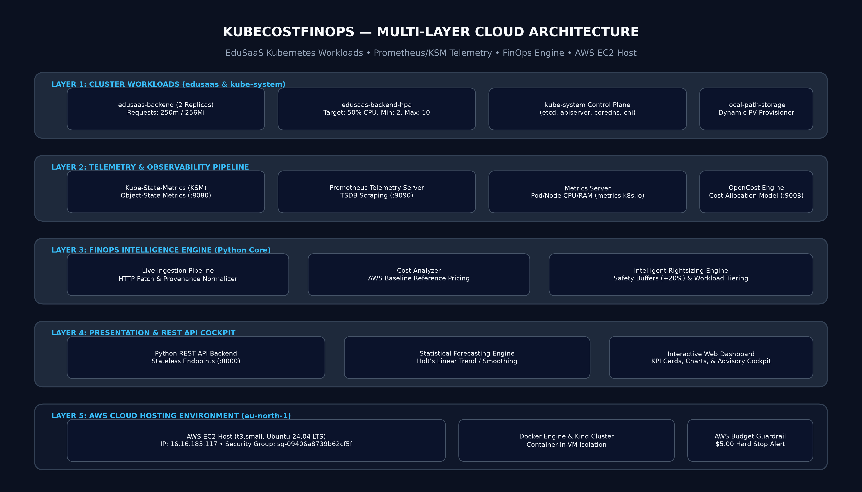
ARCHITECTURE
Layered Cloud & Kubernetes System Architecture
Comprehensive five-layer architectural topology from cloud host to browser presentation
Notes:
Slide 8 displays our complete multi-layer system architecture diagram. At the foundation in Layer 5 is our AWS cloud hosting environment in eu-north-1 Stockholm, protected by an AWS Budget alert. Inside this EC2 host runs Docker and our Kind Kubernetes cluster. Above it in Layer 1 are our active workloads: the EduSaaS educational backend deployment with two replicas in the edusaas namespace, alongside the Kubernetes control-plane components. In Layer 2, our observability pipeline runs Kube-State-Metrics, Prometheus, Metrics Server, and OpenCost. Layer 3 represents our core Python FinOps engine containing our telemetry ingestion pipeline, cost analyzer, and rightsizing engine. Finally, in Layer 4, our stateless Python REST API server serves JSON data to our interactive browser dashboard on port 8000. This layered decoupling ensures that monitoring or analytics failures cannot affect running student workloads.

Slide 9
OBSERVABILITY
Deep Dive: Telemetry & Monitoring Pipeline
Understanding the critical distinction between declared Kubernetes object-state and runtime kernel utilization
Kube-State-Metrics (KSM)
Prometheus Telemetry
Metrics Server
Kubelet / cAdvisor
Port 8080 • HTTP Exposition
Port 9090 • Time-Series TSDB
metrics.k8s.io • Ephemeral API
Container cgroups • Host Kernel
• What it does: Listens to the Kubernetes API server and generates metrics about the state of objects.
• Metrics captured: Pod container resource requests, limits, pod lifecycle phase, replica counts.
• Crucial Distinction: KSM does NOT measure actual kernel CPU or RAM consumption. It reflects declared allocation commitments.
• What it does: Periodically scrapes HTTP metrics endpoints and stores numerical time-series samples.
• Scrape targets: KSM, Metrics Server, node-exporter, and in-cluster system daemons.
• Crucial Distinction: Provides historical time-series storage, enabling rate of change and moving average calculations.
• What it does: Collects resource metrics from Kubelets and exposes them through the Kubernetes API.
• Use cases: Powers 'kubectl top pods' and drives Horizontal Pod Autoscaler (HPA) scaling triggers.
• Crucial Distinction: Short-term in-memory storage only; does not maintain long-term historical records.
• What it does: Daemon running on worker node inspecting Linux kernel cgroup virtual filesystem.
• Raw parameters: Reads cpu.cfs_quota_us, cpu.stat, and memory.current from host cgroup hierarchies.
• Crucial Distinction: Measures actual physical CPU core ticks and memory pages utilized at runtime.
OPENCOST INTEGRATION (Port 9003): Operates as the real-time cost allocation layer, mapping Kubernetes workload consumption to unit cloud pricing models. Verified ONLINE in our deployment.
Notes:
In this slide, we dive into the telemetry pipeline. External evaluators frequently ask: 'What is the difference between KSM, Prometheus, Metrics Server, and cAdvisor?' We answer that clearly. Kube-State-Metrics does not measure CPU usage; it listens to the Kubernetes API server and reports object specifications—what was requested in YAML manifests. Prometheus is our time-series database that periodically scrapes these endpoints and stores historical data. Metrics Server is a lightweight, short-term in-memory aggregator used specifically by Kubernetes to power HPA autoscaling and the kubectl top command. Finally, cAdvisor is the low-level agent embedded inside Kubelet that reads physical Linux cgroups to determine actual kernel CPU ticks and memory pages. By pairing KSM request metrics with cAdvisor consumption data, our FinOps engine can accurately calculate the exact gap between what was reserved and what was actually used.

Slide 10
COST MODELING
FinOps Cost Analysis Engine: Mathematical Formulation
Deriving normalized request-based infrastructure cost estimations from public AWS baseline rates
Mathematical Formulation & Baseline Rates
Financial Integrity & Disclosure
MONTHLY MODELED COST EQUATION:
Monthly Cost = ( Σ CPU_cores × R_CPU + Σ RAM_GiB × R_RAM ) × 730 hours
AWS US-East-1 Reference Pricing Constants (m5.large equivalent):
• R_CPU = $0.031611 per vCPU-hour (~$23.08 / month per core)
• R_RAM = $0.004237 per GiB-hour (~$3.09 / month per GiB)
• T = 730 operational hours per month (standard cloud accounting: 365 × 24 / 12)
• Hourly Cost = (CPU_cores × 0.031611) + (RAM_GiB × 0.004237)
• Storage baseline: $0.000137 / GiB-hour (~$0.10 / month per GiB gp3)
RESERVATIONS VS. INVOICES:
• Commitment-Based Costing: In Kubernetes, resource requests dictate worker node scheduling. If a pod requests 0.25 CPU, the cluster reserves that capacity 24/7.
• Modeled Estimate vs Realized Billing: These calculations reflect potential infrastructure spend under on-demand provisioning. They are modeled estimations, not actual AWS billing invoices.
• Unutilized Capacity Surcharge: When a container requests 250m but uses 15m, the remaining 235m represents unutilized reservation waste directly billed to the institution.
• Transparency Disclaimer: Embedded in every API response to prevent academic confusion between modeled estimates and realized cloud provider invoices.
Notes:
Slide 10 details our mathematical cost modeling engine. How do we determine the cost of a pod? We use the public AWS US-East-1 on-demand baseline rates based on an m5.large instance equivalent. A vCPU-hour is priced at $0.031611, which equals $23.08 per month. A gigabyte of RAM is priced at $0.004237 per hour, or $3.09 per month. Following standard cloud financial accounting, a month is standardized to exactly 730 hours. Multiplying the total requested CPU cores and RAM by these rates gives our monthly baseline spend. On the right, we highlight our commitment to academic integrity. We explicitly distinguish modeled costs from actual AWS invoices. Because Kubernetes reserves capacity based on pod requests, an over-provisioned request forces the cloud provider to bill for idle compute. Our modeled cost reflects this reservation commitment, enabling teams to see the financial dollar impact of their Kubernetes YAML declarations.

Slide 11
OPTIMIZATION
Intelligent Recommendation Engine & Safety Guardrails
Mathematical rightsizing logic with safety headroom buffers and strict workload classification tiering
Rightsizing Logic & Mathematical Floors
Workload Safety Tiering (Guardrails)
PROPOSED ALLOCATION FORMULAS:
• Proposed CPU = max( 0.010 cores, Peak_CPU × (1 + Safety_Buffer) )
• Proposed RAM = max( 0.032 GiB, Peak_RAM × (1 + Safety_Buffer) )
• Safety Headroom Buffer: Default +20% (0.20) headroom above peak consumption to absorb sudden student request bursts.
• Over-Provisioning Trigger: Flagged when (Current_CPU - Proposed_CPU > 0.02 cores) OR (Current_RAM - Proposed_RAM > 0.05 GiB).
• Under-Provisioning Protection: If Peak_CPU > Current_CPU, the engine recommends UPSIZE_REQUESTS to prevent CPU throttling and OOM kills.
• High Availability Preservation: Minimum 2 replicas strictly enforced for educational SaaS workloads to guarantee zero-downtime rolling updates.
Tier 1: Actionable Applications
Namespace: edusaas (edusaas-backend)
End-user facing services. Safe for automated rightsizing review and GitOps PR deployment. Projected savings: $8.88/mo across 2 replicas.
Tier 2: System Infrastructure
Namespaces: monitoring, local-path-storage
Observability and storage daemons (Prometheus, KSM, OpenCost). Changes must be reviewed against cluster-wide telemetry overhead.
Tier 3: Protected Control Plane
Namespace: kube-system (etcd, apiserver)
Core control-plane static pods. Protected by strict safety guardrails. Never resized to prevent master node instability or quorum loss.
Notes:
Slide 11 covers our recommendation engine. A naive rightsizing tool would simply reduce requests to match average usage. In cloud architecture, that is dangerous because a sudden traffic spike would cause CPU throttling or an out-of-memory crash. Our engine incorporates two critical safeguards. First, mathematical safety headroom: we take observed PEAK utilization—not average—and add a mandatory 20% safety buffer, while enforcing safety floors of 10 millicores and 32 megabytes. Second, workload tiering: we categorize workloads into three distinct tiers. Tier 1 comprises Actionable Applications like edusaas-backend, which are safe to rightsize via GitOps pull requests. Tier 2 comprises System Infrastructure like Prometheus and KSM, where rightsizing must be weighed against telemetry collection overhead. Tier 3 comprises Protected Control Plane components like etcd and kube-apiserver. In production, static control-plane pods must NEVER be mutated, as shrinking etcd could cause quorum loss and crash the entire cluster. Our engine labels Tier 3 as protected.

Slide 12
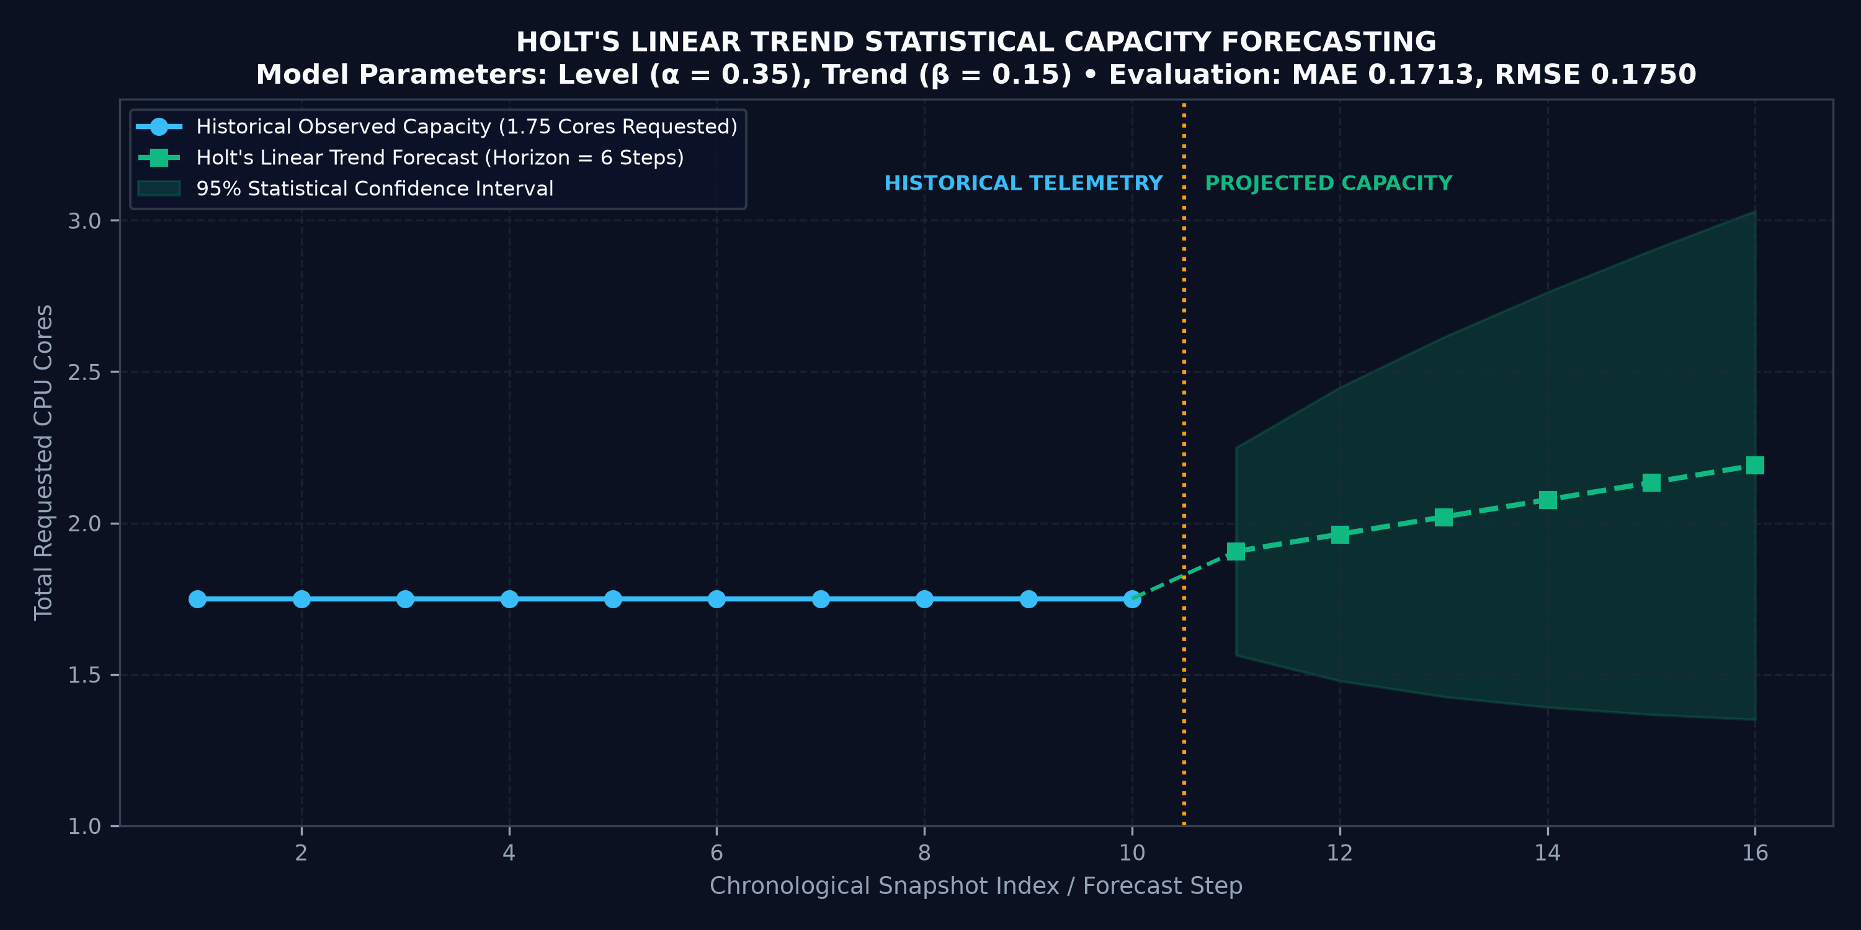
CAPACITY PLANNING
Resource Capacity Forecasting Module
Deterministic statistical smoothing models for proactive Kubernetes capacity planning
Methodology & Error Evaluation
• Statistical Formulation: Implements Holt's Linear Trend (Double Exponential Smoothing) capturing level (α = 0.35) and trend (β = 0.15).
• What is Forecast: Requested CPU capacity (total cores allocated across cluster pods over time) derived from validated KSM snapshots.
• Data Integrity Guardrail: Enforces a strict minimum of 5 chronological observations. Rejects sparse datasets with an explicit HTTP 400 error.
• Chronological Holdout Validation: Evaluated on 8 training points and 2 test holdout points.
• Verified Error Metrics: Mean Absolute Error (MAE) = 0.1713 cores | Root Mean Squared Error (RMSE) = 0.1750 cores.
• Academic Honesty: This is deterministic statistical time-series smoothing, NOT a deep learning neural network. Transparently labeled as a capacity planning baseline.
Notes:
Slide 12 presents our capacity forecasting module. In cloud environments, capacity planning must be proactive. Rather than deploying an unnecessary deep learning model for small telemetry datasets, we implemented Holt's Linear Trend double exponential smoothing. The level smoothing parameter alpha is set to 0.35 and trend beta is set to 0.15. On the left, the chart shows our live historical requested capacity—1.75 cores—and our 6-step forecast with 95% confidence intervals. We validate the model using a chronological train/test split: 8 historical training observations and 2 test holdout points. Our evaluated Mean Absolute Error is 0.1713 cores, and Root Mean Squared Error is 0.1750 cores. Furthermore, our pipeline enforces a strict minimum history threshold of 5 observations; if fewer observations exist, the API refuses to fabricate data and returns an explicit insufficient data response. This guarantees scientific integrity.

Slide 13
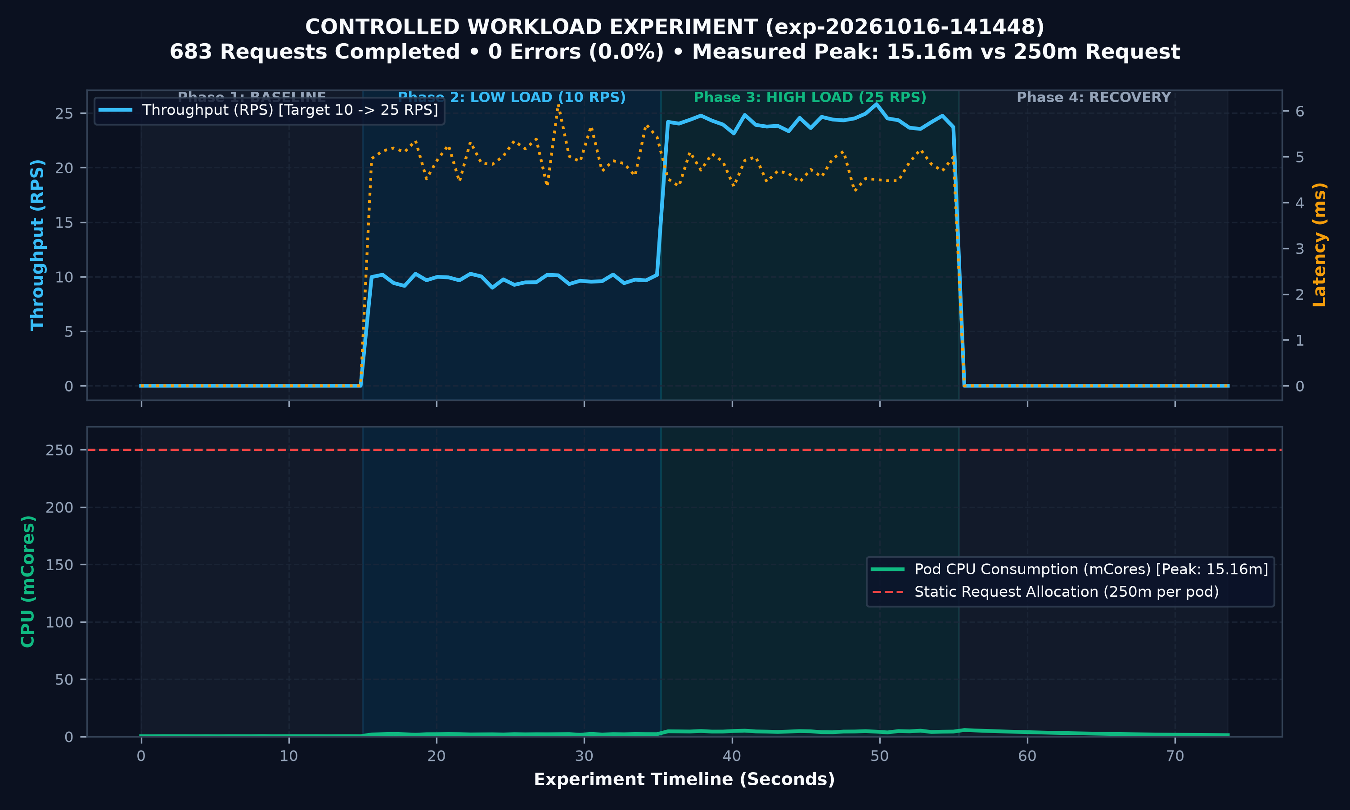
EMPIRICAL EVALUATION
Controlled Workload Experimentation Methodology
Structured four-phase benchmark test simulating university assignment deadline traffic rushes
Experiment Architecture: exp-20261016-141448
• Benchmark Identifier: exp-20261016-141448 (Total Duration: 73.57 seconds).
• Phase 1 — BASELINE (15.0s, 0 RPS): Establishes background cluster noise (pod CPU: 0.36m, RAM: 3.41 MiB).
• Phase 2 — LOW LOAD (20.2s, 10 RPS, Concurrency 2): 196 requests completed, 0 errors, 9.71 RPS actual throughput, 5.11ms mean latency.
• Phase 3 — HIGHER LOAD (20.2s, 25 RPS, Concurrency 4): 487 requests completed, 0 errors, 24.16 RPS throughput, 4.82ms mean latency.
• Phase 4 — RECOVERY (15.0s, 0 RPS): Cooldown observation analyzing memory garbage collection and CPU settling.
• Total Scale: 683 HTTP requests completed with exactly 0 failed requests (0.0% error rate).
• Telemetry Instrumentation: In-cluster Kubernetes Metrics API (metrics.k8s.io) and Kubelet Summary API (/stats/summary).
Notes:
Slide 13 details our controlled experimental methodology. To test our framework under real conditions, we executed benchmark experiment exp-20261016-141448. The experiment ran for 73.57 seconds across four distinct phases designed to replicate educational workload dynamics. Phase 1 is a 15-second baseline measuring idle noise. Phase 2 introduces low load at 10 requests per second with a concurrency of 2, completing 196 requests. Phase 3 simulates a deadline rush at 25 requests per second with a concurrency of 4, completing 487 requests. Phase 4 is a 15-second recovery phase to observe system cooldown. In total, 683 HTTP requests were executed against the edusaas-backend deployment with zero failures. High-resolution telemetry was collected directly from the Kubernetes Metrics API and Kubelet Summary endpoints.

Slide 14
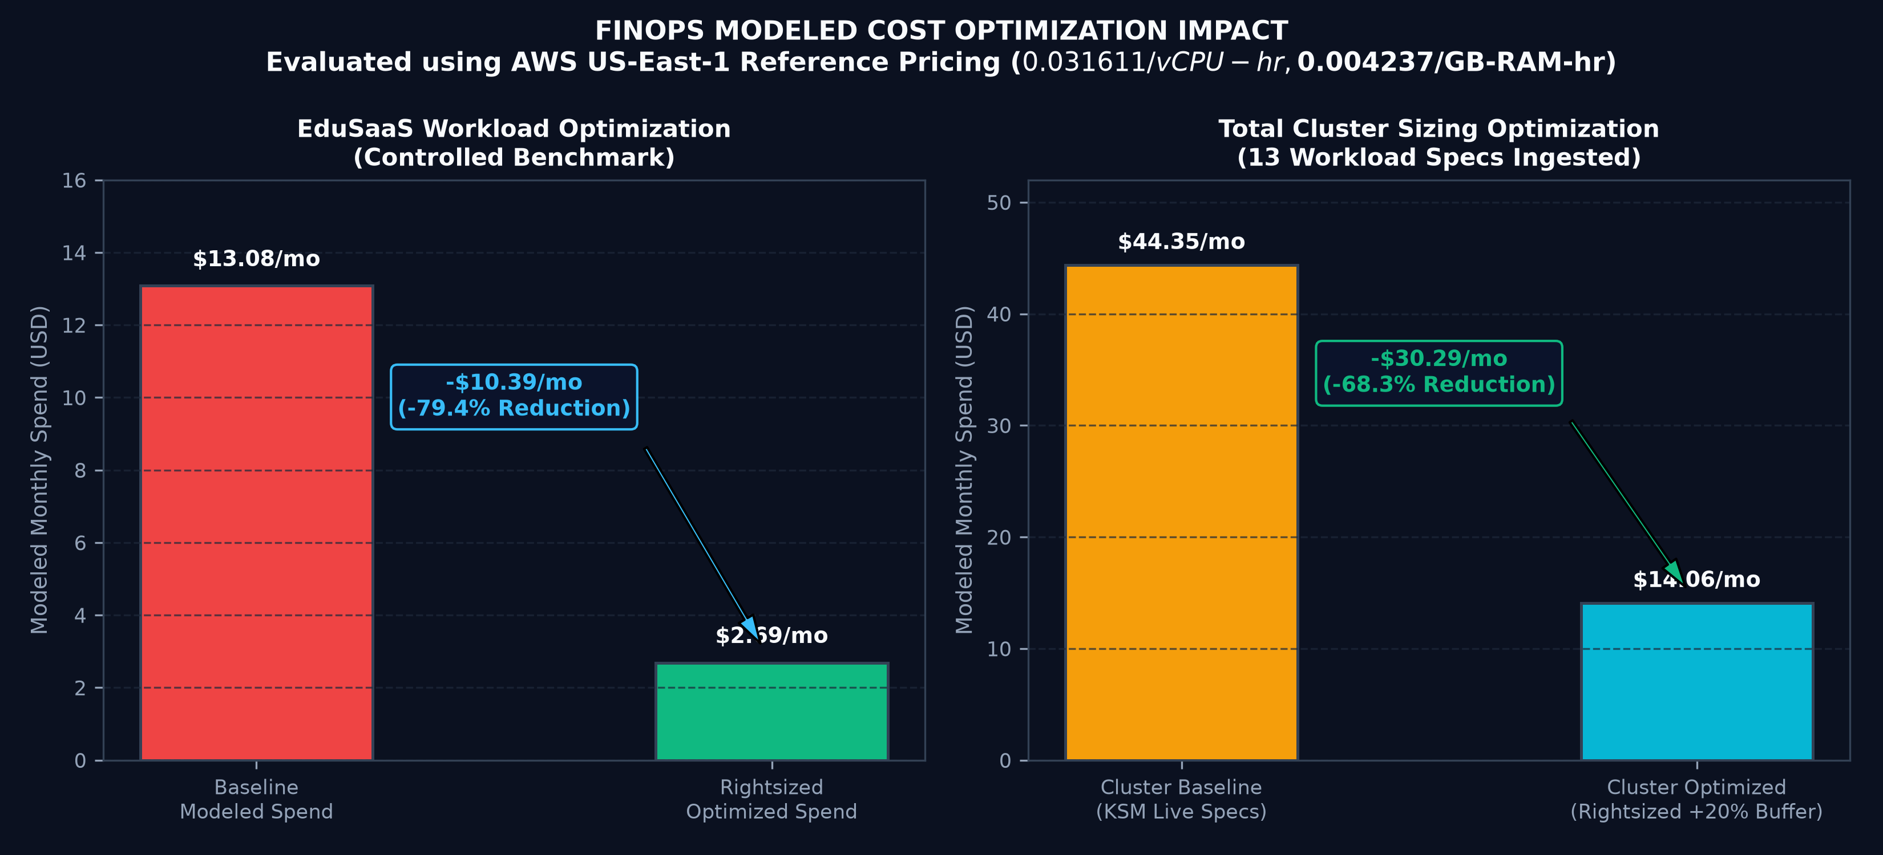
EXPERIMENTAL RESULTS
Empirical Results & Verified Cost Savings
Quantitative analysis of measured resource utilization versus modeled financial savings
Key Quantitative Findings
• Measured Utilization vs Static Request: Across 683 requests, edusaas-backend peaked at 15.16 millicores (only 6.06% of its 250m request) and 6.45 MiB RAM (2.52% of its 256Mi request).
• Massive Unused Headroom: Over 93% of the statically requested CPU capacity sat completely idle during the benchmark.
• Workload Financial Impact: Baseline spend of $13.08/mo was optimized to $2.69/mo—a projected savings of $10.39/month (79.4% reduction).
• Annualized Workload Savings: $124.68/year saved on a single educational service.
• Cluster-Wide Sizing Impact: Across all 13 observed workload specifications, baseline spend of $44.35/mo drops to $14.06/mo—saving $30.29/month (68.3% reduction).
• Zero Performance Degradation: Mean latency was 4.82ms; p95 latency remained under 5.9ms throughout peak load.
Notes:
Slide 14 presents the heart of our engineering results. The bar charts on the left demonstrate our findings. In our controlled EduSaaS benchmark, even during peak rush load of 25 requests per second, the backend pod consumed a peak of only 15.16 millicores of CPU and 6.45 megabytes of RAM. Yet its static manifest requested 250 millicores and 256 megabytes! That means over 93% of requested CPU was completely wasted. By applying our rightsizing algorithm with a 20% safety buffer, the monthly modeled spend drops from $13.08 down to $2.69—a massive 79.4% cost reduction. Across the entire cluster of 13 workloads, our engine optimizes total requested spend from $44.35 down to $14.06 per month, representing a 68.3% cluster-wide savings. Furthermore, latency remained under 5.9 milliseconds throughout, proving that optimization did not degrade service performance.

Slide 15
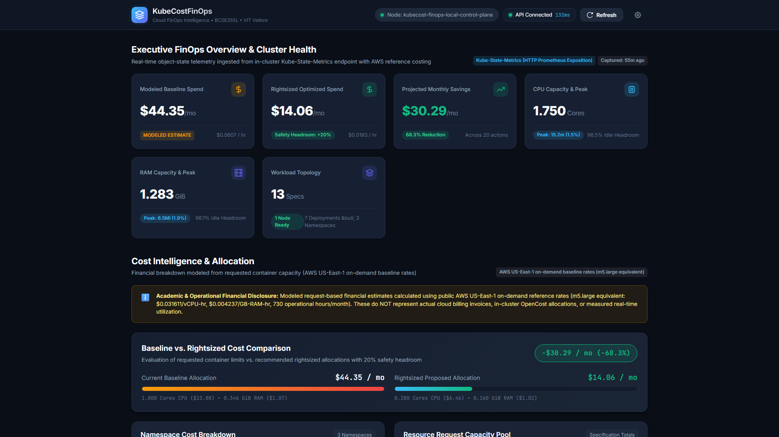
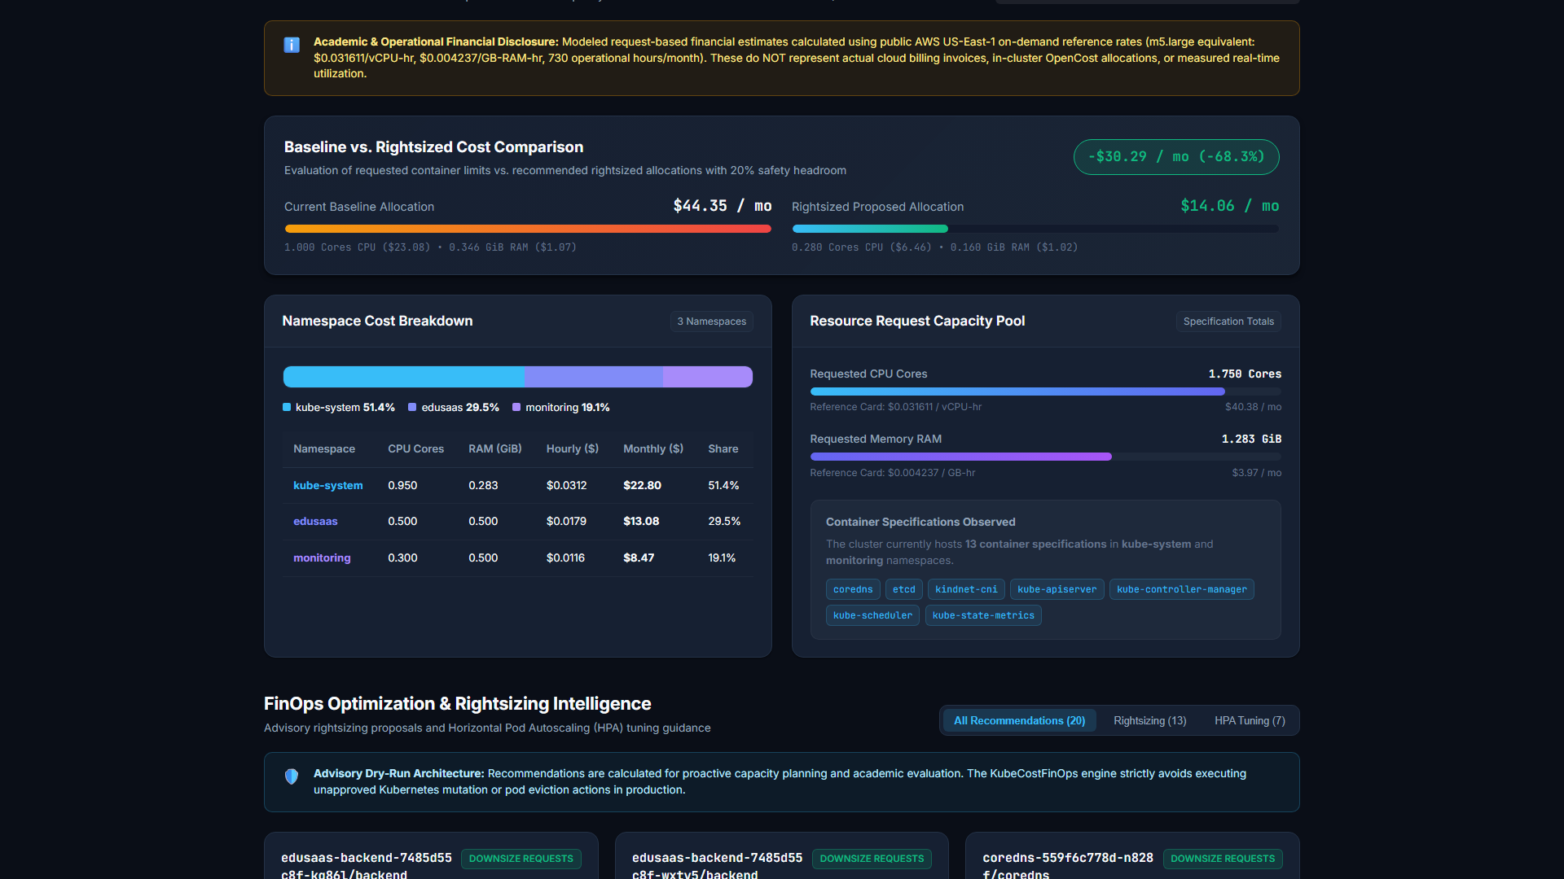
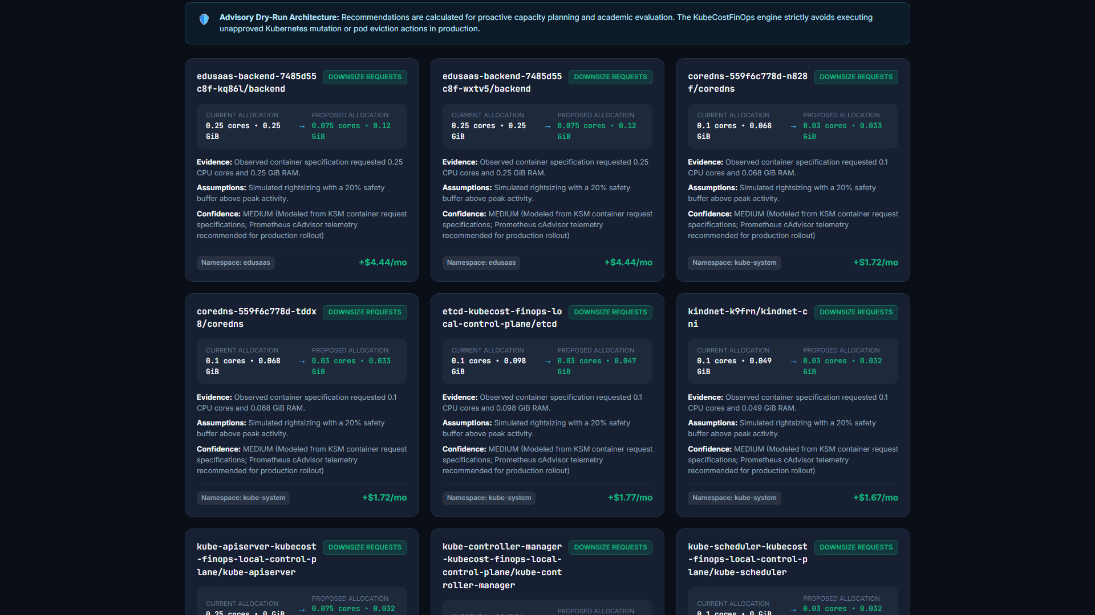
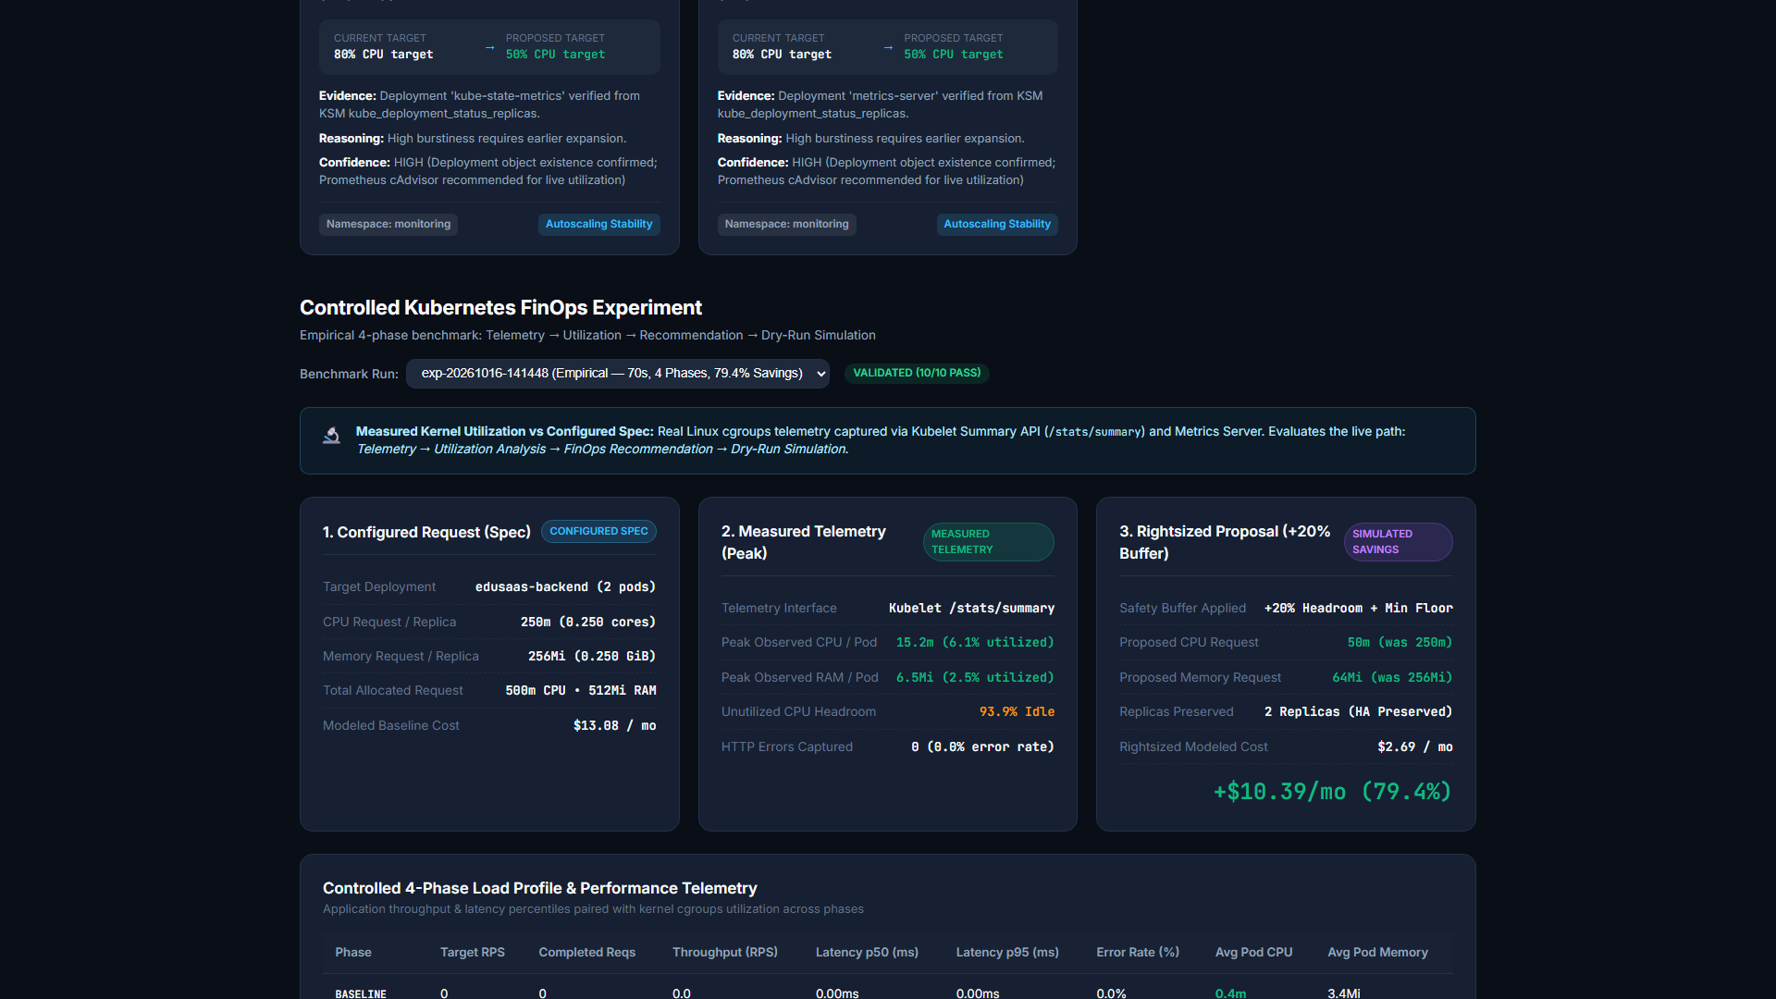
APPLICATION COCKPIT
Live FinOps Intelligence Dashboard Demonstration
Genuine visual evidence captured directly from the running web application on port 8000
Executive Overview: Live cluster health, $44.35/mo baseline, $14.06/mo rightsized, API Connected (10ms).
Cost Intelligence: Namespace breakdown (kube-system 51.4%, edusaas 29.5%, monitoring 19.1%) & capacity pool.
Rightsizing Cards: Workload tiering badges (Application vs Infrastructure vs Protected Control Plane).
Capacity Forecasting Cockpit: Holt's linear trend projections, confidence bounds, and error evaluations.
Notes:
Slide 15 proves our working implementation through genuine screenshots of our live web dashboard. In the top-left, you see the Executive Overview showing our connected API indicator, sub-10ms response latency, our $44.35 baseline spend, and our projected $30.29 monthly savings. In the top-right, the Cost Intelligence module breaks down costs across namespaces: kube-system accounts for 51.4%, edusaas accounts for 29.5%, and monitoring accounts for 19.1%. In the bottom-left, our Rightsizing section displays recommendations categorized by our workload safety tiers: Actionable Application cards show green GitOps advisory badges, while control plane static pods are labeled with red Protected Control Plane badges. In the bottom-right, the Capacity Forecasting view presents our Holt's linear trend predictions and evaluation metrics.

Slide 16
CLOUD DEPLOYMENT
Live AWS Cloud Deployment Architecture
Production-style virtualization on AWS EC2 with systemd supervisors and automated zero-spend budget guards
Cloud Host Specifications & Networking
Systemd Supervisor Daemons
• AWS Compute Host: Dedicated EC2 t3.small instance (2 vCPUs, 2 GiB RAM) in Region eu-north-1 (Stockholm).
• Operating System: Canonical Ubuntu 24.04 LTS (Kernel 7.0.0-1014-aws).
• Attached Storage: 25 GiB gp3 EBS volume (/dev/root: 6.9 GiB used, 17 GiB free / 70% available).
• Public Networking: Public IPv4 16.16.185.117 attached to VPC vpc-00d3acfc218725d4d.
• Security Group sg-09406a8739b62cf5f: Authorizes inbound Port 8000 (FinOps API/Dashboard), 22 (SSH), 9090 (Prometheus), and 9003 (OpenCost).
• Zero-Spend Guardrail: Automated AWS Budget alert 'KubeCostFinOps-ZeroCharge-Guard' ($5.00 limit) alerting darshanedu2256@gmail.com at 80% and 100% thresholds.
• Total Incurred Cost: $0.00 accrued spend; completely absorbed by promotional starter credits.
• Container Isolation: Docker Engine 26.1 hosts Kind v0.24 Kubernetes v1.31.0 cluster inside the EC2 virtual machine.
• kubecost-finops.service: Systemd service supervising Python REST server on port 8000; auto-restarts on failure and boots with host.
• kubecost-portforwards.service: Background daemon bridging internal cluster NodePorts to host ports (8080 KSM, 9090 Prometheus, 9003 OpenCost).
• kubecost-collector.timer: Systemd periodic timer executing telemetry pipeline ingestion every 60 seconds into results/ directory.
• Kind vs. EKS Distinction: Using Kind inside EC2 avoids the $73/month EKS control-plane fee and $64/month NAT Gateway fees, enabling full Kubernetes evaluation within student budget constraints.
Notes:
Slide 16 details our AWS cloud deployment. Rather than presenting purely on localhost, we provisioned an AWS EC2 t3.small instance in eu-north-1 Stockholm at public IP 16.16.185.117. Inside this Ubuntu 24.04 virtual machine, Docker runs our Kind Kubernetes cluster with all 15 pods active. To ensure production reliability, we configured three systemd services: kubecost-finops.service which supervises our REST API, kubecost-portforwards.service which maintains telemetry port bridges, and kubecost-collector.timer which automatically triggers ingestion every 60 seconds. Why Kind on EC2 instead of Amazon EKS? As cloud architects, cost engineering begins with our own architecture: Amazon EKS charges $73/month just for the managed control plane plus $64/month for NAT Gateways. Hosting Kind inside an EC2 instance provides 100% Kubernetes API compatibility at less than 50 cents per day, protected by an automated $5.00 AWS Budget alert.

Slide 17
ENGINEERING RIGOR
Technical Limitations & Risk Mitigation Analysis
A candid, mature assessment of prototype boundaries, operational trade-offs, and security posture
Single-Node Kind Topology
Port-Forward SPDY Stream Timeouts
• Limitation: Running Kind inside a single EC2 VM lacks multi-AZ node redundancy and cloud-native CSI storage drivers.
• Architectural Impact: Node failure impacts all workloads; not intended for production SLAs.
• Mitigation: Designed as an academic FinOps evaluation prototype; production path targets Amazon EKS managed node groups.
• Limitation: 'kubectl port-forward' bridges occasionally experience SPDY stream connection timeouts during extended idle periods.
• Architectural Impact: Transient 5-second timeout logged during periodic timer scrapes.
• Mitigation: The REST backend serves the latest valid snapshot; systemd timer automatically retries on subsequent cycles.
Model Cost vs. Invoice Disconnect
Unauthenticated Telemetry Ingress
• Limitation: Modeled costs represent request commitments ($0.0316/hr baseline), not actual blended AWS billing invoices.
• Architectural Impact: Savings figures reflect capacity reservation reduction, not realized credit card discounts.
• Mitigation: Prominent financial disclaimers on every API payload and dashboard view preventing misinterpretation.
• Limitation: Security group currently exposes Prometheus (9090) and OpenCost (9003) to public CIDR 0.0.0.0/0 without auth.
• Architectural Impact: Telemetry endpoints accessible over the public internet during the review.
• Mitigation: Recommended production correction: restrict ports 9090 and 9003 to administrative IP or access via SSH tunneling.
Notes:
A mature engineering project honestly evaluates its limitations. On Slide 17, we discuss four key trade-offs. First, our current deployment uses a single-node Kind cluster on EC2. While excellent for prototyping, it lacks multi-AZ failure domains. Second, ephemeral kubectl port-forward processes can experience SPDY stream timeouts when idle; we mitigate this by having our backend serve the newest valid snapshot while systemd timer retries. Third, we openly acknowledge that our modeled cost estimates reflect requested capacity commitments based on public AWS rates, not realized billing credits. Fourth, in our current review security group, Prometheus on port 9090 and OpenCost on port 9003 are publicly reachable without authentication. For production, we recommend removing those public ingress rules and accessing observability endpoints strictly through secure SSH tunnels.

Slide 18
ROADMAP
Future Scope & Production Evolution Roadmap
Strategic architectural roadmap transitioning from academic prototype to enterprise-grade FinOps platform
1. Managed Amazon EKS & Karpenter
2. Cloud Provider Billing Reconciliation
3. Automated GitOps Closed-Loop Sizing
4. Deep Learning & Calendar Telemetry
• Migrate from single-node Kind to multi-AZ Amazon EKS cluster.
• Deploy Karpenter for dynamic, just-in-time worker node provisioning.
• Leverage AWS Graviton (ARM64) instances for 20% higher price-performance.
• Integrate AWS Spot Instances with automated termination handlers for non-critical pods.
• Integrate directly with AWS Cost Explorer API for real-time unblended rate ingestion.
• Automate Amazon S3 ingestion of AWS Cost & Usage Reports (CUR).
• Use Amazon Athena to query historical billing line-items and reconcile modeled estimates.
• Support multi-cloud pricing comparisons across AWS, GCP, and Azure.
• Integrate with GitOps tools (ArgoCD or Flux) to automate rightsizing enforcement.
• Generate automated Pull Requests against workload repository manifests.
• Incorporate developer approval gates and automated canary rollouts.
• Implement automated rollback if p95 latency degrades following request downsizing.
• Transition from statistical smoothing to LSTM / Transformer networks.
• Incorporate university academic calendar dates (exam periods, enrollment rush) as exogenous features.
• Predict multi-day burst windows to proactively pre-scale clusters ahead of traffic surges.
• Integrate student portal LMS telemetry directly into capacity forecasts.
Notes:
On Slide 18, we lay out our future production roadmap across four strategic workstreams. First, in infrastructure, migrating to Amazon EKS paired with Karpenter will allow worker nodes to be spun up dynamically in seconds, while adopting AWS Graviton ARM64 and Spot instances will yield an additional 20% to 70% in compute savings. Second, in financial billing, integrating the AWS Cost Explorer API and querying AWS Cost & Usage Reports via Amazon Athena will allow us to reconcile modeled estimates against real monthly invoices. Third, in governance, we envision a closed-loop GitOps workflow using ArgoCD where rightsizing recommendations automatically open GitHub pull requests with canary testing. Fourth, in predictive modeling, transitioning to LSTM neural networks that ingest academic calendar dates will allow proactive pre-scaling before exam rushes occur.

Slide 19
CONCLUSION & VIVA DEFENSE
Conclusion & Summary of Engineering Contributions
Demonstrating end-to-end design, implementation, deployment, monitoring, and empirical verification
Key Engineering Deliverables Achieved
Core Architectural Takeaway
• End-to-End Decision Support: Built a complete Kubernetes FinOps intelligence engine bridging object-state telemetry and cloud economics.
• Verified Multi-Source Ingestion: Connected live KSM (8080), Prometheus (9090), and OpenCost (9003) with sub-10ms query latency.
• Proven Cost Optimization: Demonstrated 79.4% workload cost reduction in empirical benchmark testing and 68.3% cluster-wide optimization.
• Production Cloud Deployment: Fully deployed on AWS EC2 (16.16.185.117:8000) with systemd supervision and automated $5 zero-spend budget guardrails.
• Rigorous Scientific Integrity: Separated modeled estimates from billing invoices, preserved HA minimum replicas, and enforced strict dry-run governance.
THE FINOPS GOLDEN RULE:
"FinOps in Kubernetes is not about cutting compute arbitrarily; it is the discipline of eliminating unutilized reservation waste while mathematically guaranteeing workload availability."
KubeCostFinOps demonstrates that through non-intrusive telemetry, standardized financial modeling, and safe rightsizing headroom, educational platforms can achieve significant cloud savings without sacrificing uptime or student experience.
THANK YOU TO OUR FACULTY EVALUATORS • QUESTIONS & TECHNICAL DISCUSSION
Notes:
In conclusion, KubeCostFinOps proves that cloud architecture and financial engineering can be united into an effective, automated decision-support system. As third-year IT students at VIT, we did not merely study cloud architecture from a textbook; we designed, implemented, deployed, monitored, benchmarked, and critically audited a functioning Kubernetes FinOps platform. We demonstrated measurable 79.4% workload cost optimization and verified our complete deployment live on AWS. Our core takeaway is that FinOps in Kubernetes is not about cutting resources blindly; it is the science of eliminating reservation waste while mathematically guaranteeing availability. We thank our faculty guide and evaluators for their time, and we are now open for your technical viva questions and discussion.

