Slide 1




CNN Pothole Prediction
Team5: Dev0B0101
Zijie Lei, Zhenyi Xie, Kai Zheng, Huixian Gong

Slide 2
Danger of Pothole
Of approximately 33,000 traffic fatalities each year, one-third involve poor road conditions.
27 percent of major urban roads (interstates, freeways and other arterial routes) are deemed substandard and provide unacceptably rough rides for motorists.
Only 31 percent of roads are deemed to be in good condition
City Percent of roads ranked as “poor” in Los Angeles-Long Beach-Santa Ana is 64%

Slide 3

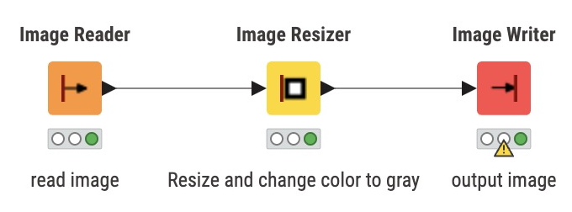
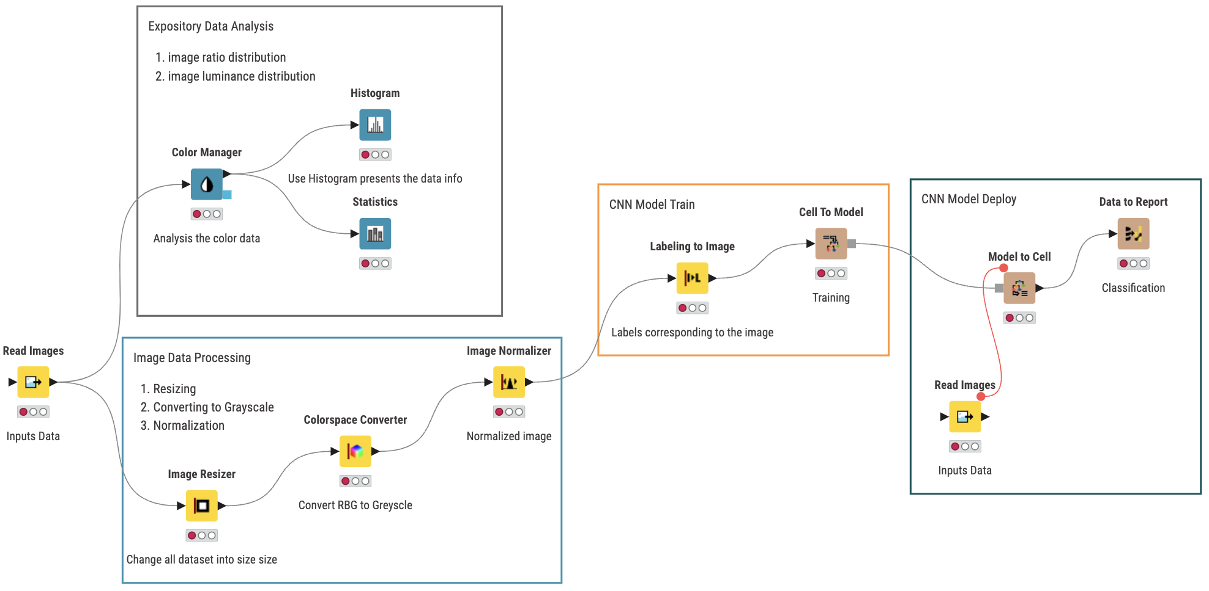
Simple View:
Complete View:

Slide 4
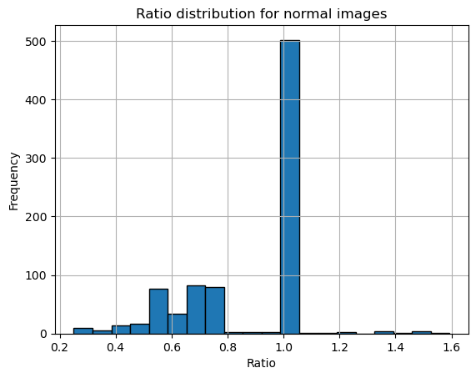
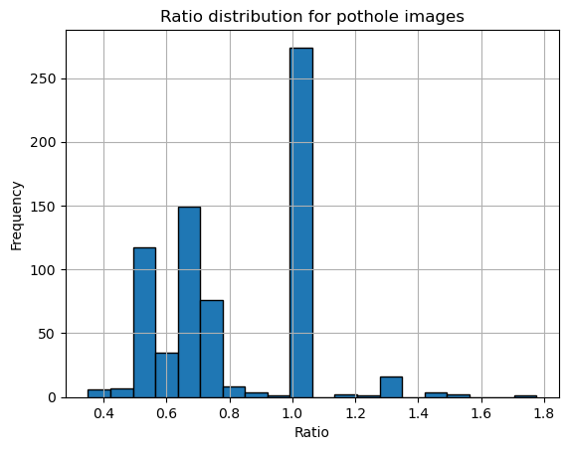
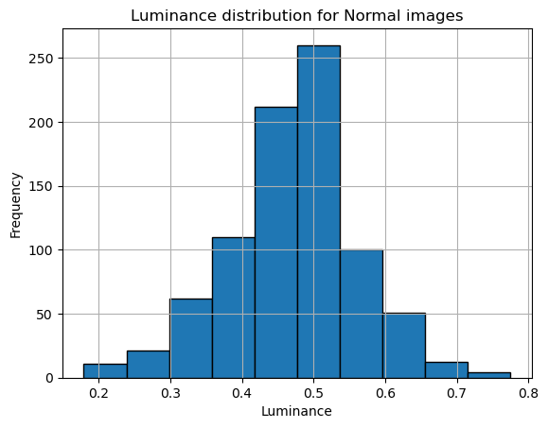
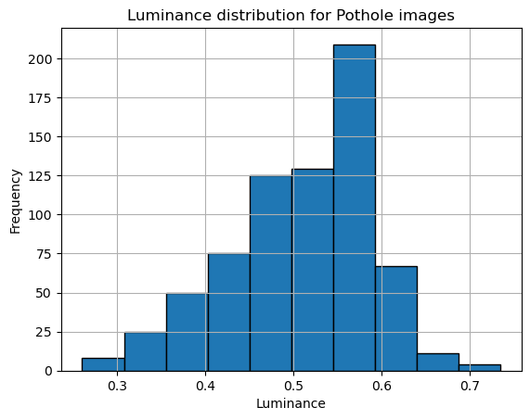
Dataset Statistics

Slide 5
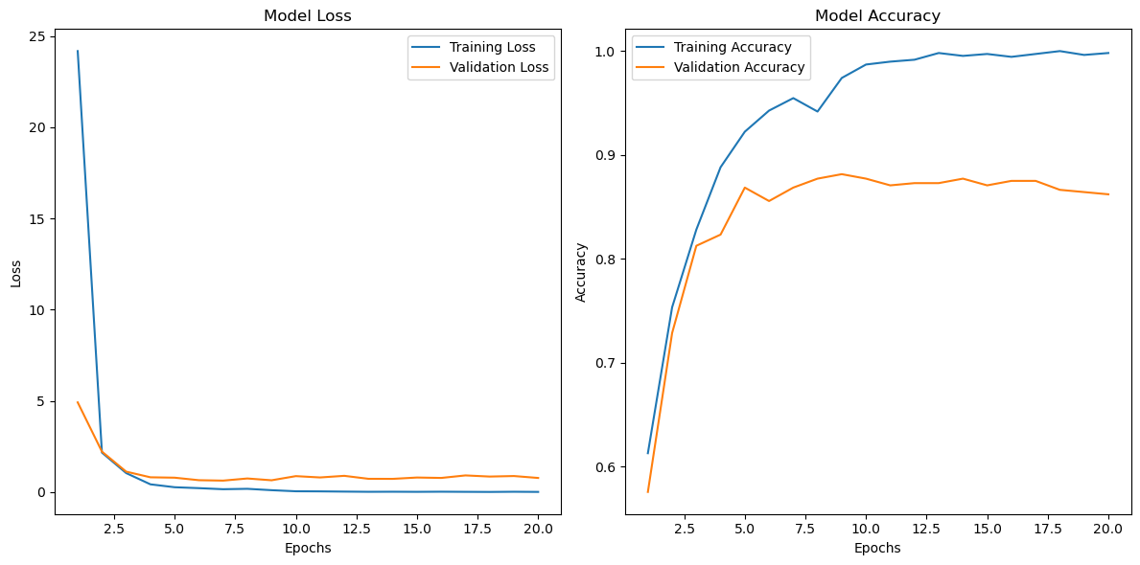
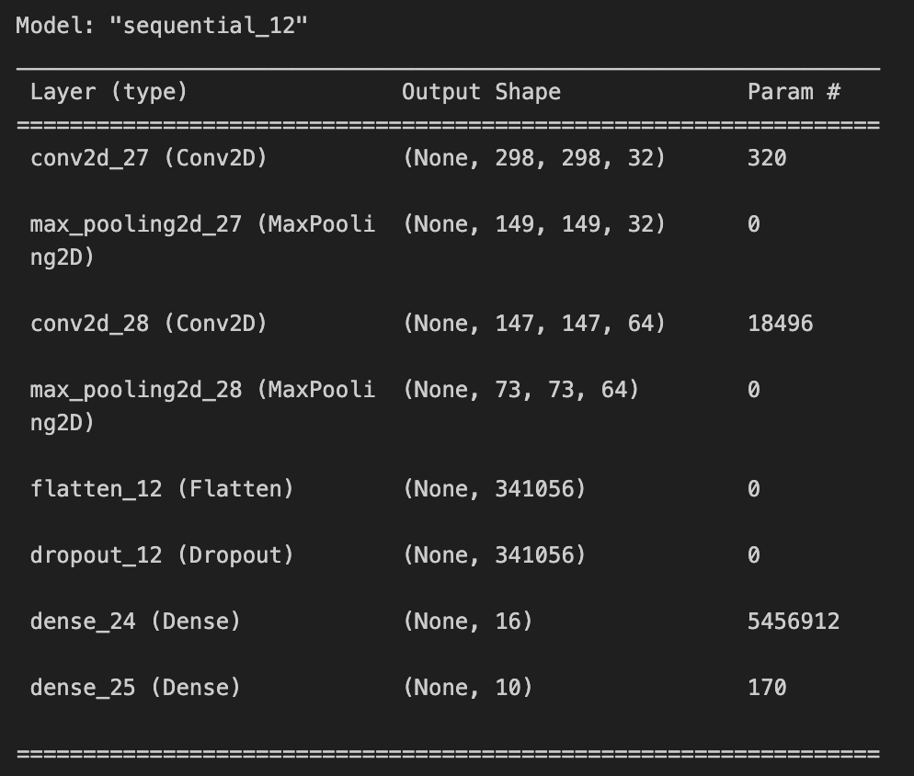
Our model

