Slide 1
SALARY MANAGEMENT SYSTEM
ESFP-II

Slide 2
OUR AIM FOR THE PROJECT→
OUR AIM TO BUILD THIS PROJECT IS TO MANAGE THE SALARIES OF THE EMPLOYEES IN A STRUCTURED FORMAT , USING FILES AND ALSO AT THE SAME TIME ENSURING SECURITY WITH LOGIN FUNCTION ACCESS.

Slide 3
THE FUNCTIONS IN THE WHOLE PROject ARE→ 1) insert 2) deletes 3) edit 4) search 5) displayPayslip 6) saverecords 7) list

Slide 4
HEADER FILES USED IN THE PROJECT→
#include<iostream>
#include<stdio.h>
#include<stdlib.h>
#include<string.h>
#include<conio.h>
#include<windows.h>
#include<time.h>
#include<iomanip>
#include<ctype.h>

Slide 5
CONCEPTSof c++ language used
1. Class and Objectives.
2. Arrays.
3. Functions.
4. Structures.
5. File handling

Slide 6
BELOW IS THE EXECUTION OF THE PROGRAM AND FLOW OF THE PROGRAM →
1) AT THE START THE PROGRAM WILL TELL US TO PRESS ANY KEY WE WISH TO PRESS FOR THE NEXT FUNCTIONS TO PERFORM.
2)IT WILL ASK US ABOUT THE LOGIN ID AND LOGIN PASSWORD OF THE CONTROLLER OF THE PROGRAM TO ENSURE SAFETY OF THE DATA.
3)THEN IT WILL SHOW US A BUFFERING TIME OF UPTO 3 SECONDS TILL THE MAIN PAGE SHOWS UPS.
4)FINALLY THE MAIN PAGE WILL SHOW UP WITH ALL THE OPERATION THAT COULD BE PERFORMED BY THE BUILT SOFTWARE.

Slide 7
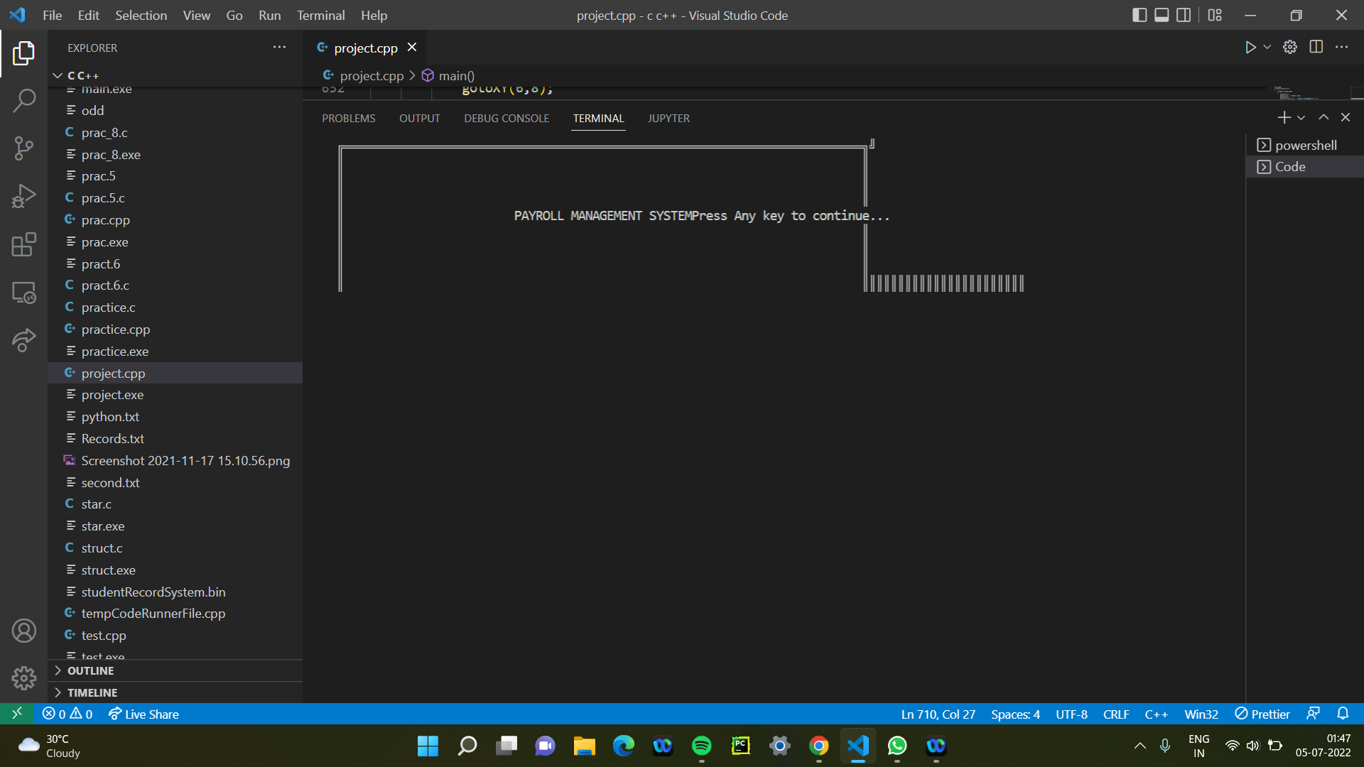

Slide 8
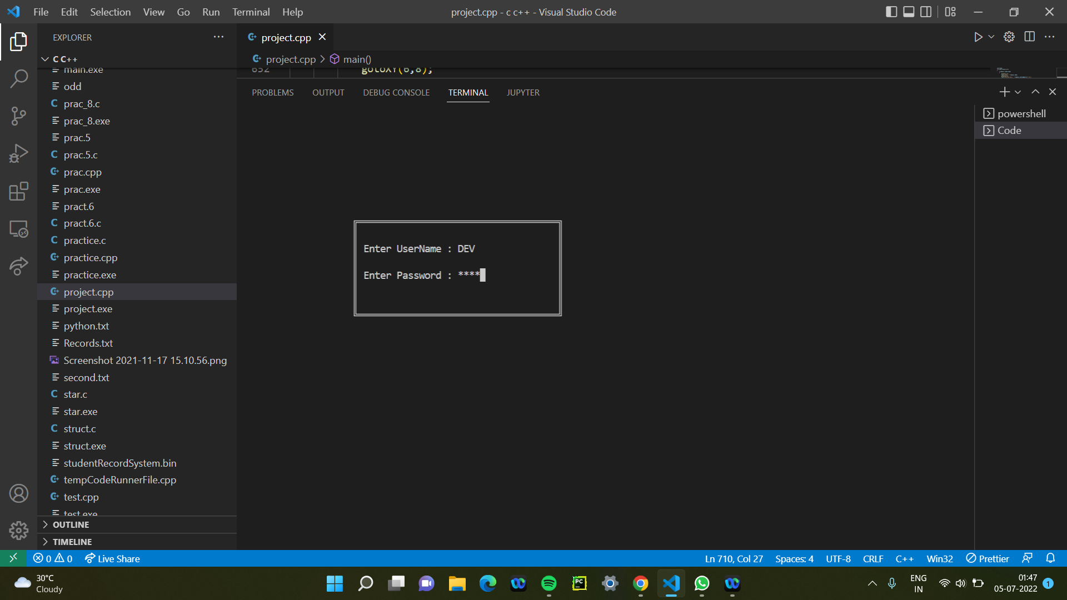

Slide 9
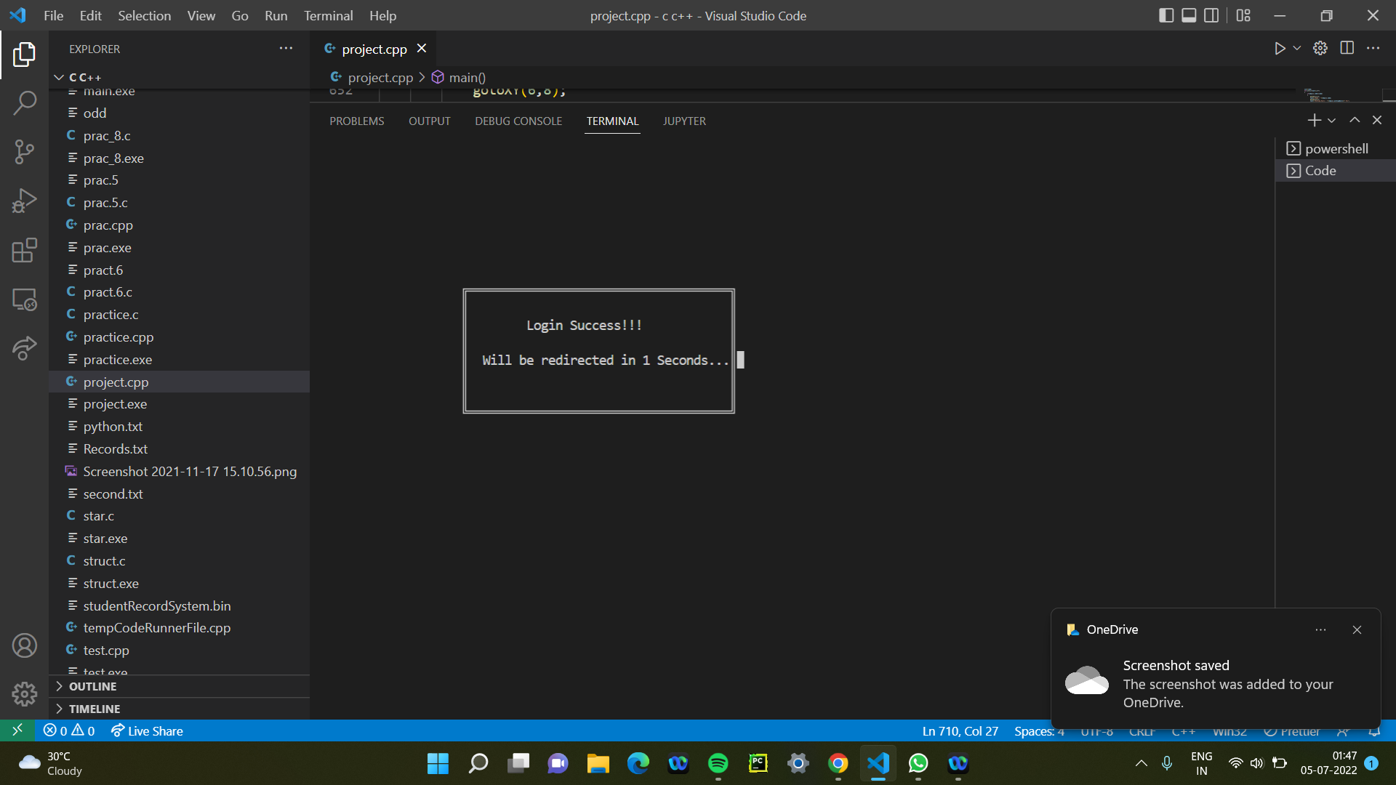

Slide 10
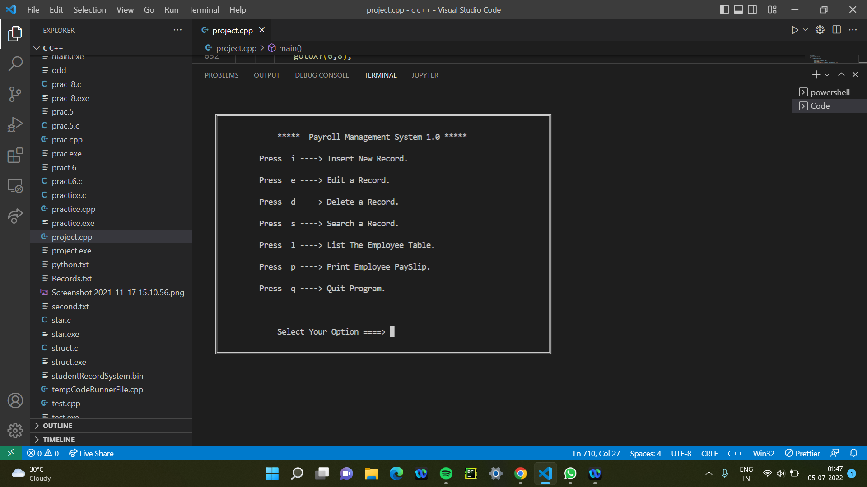

Slide 11
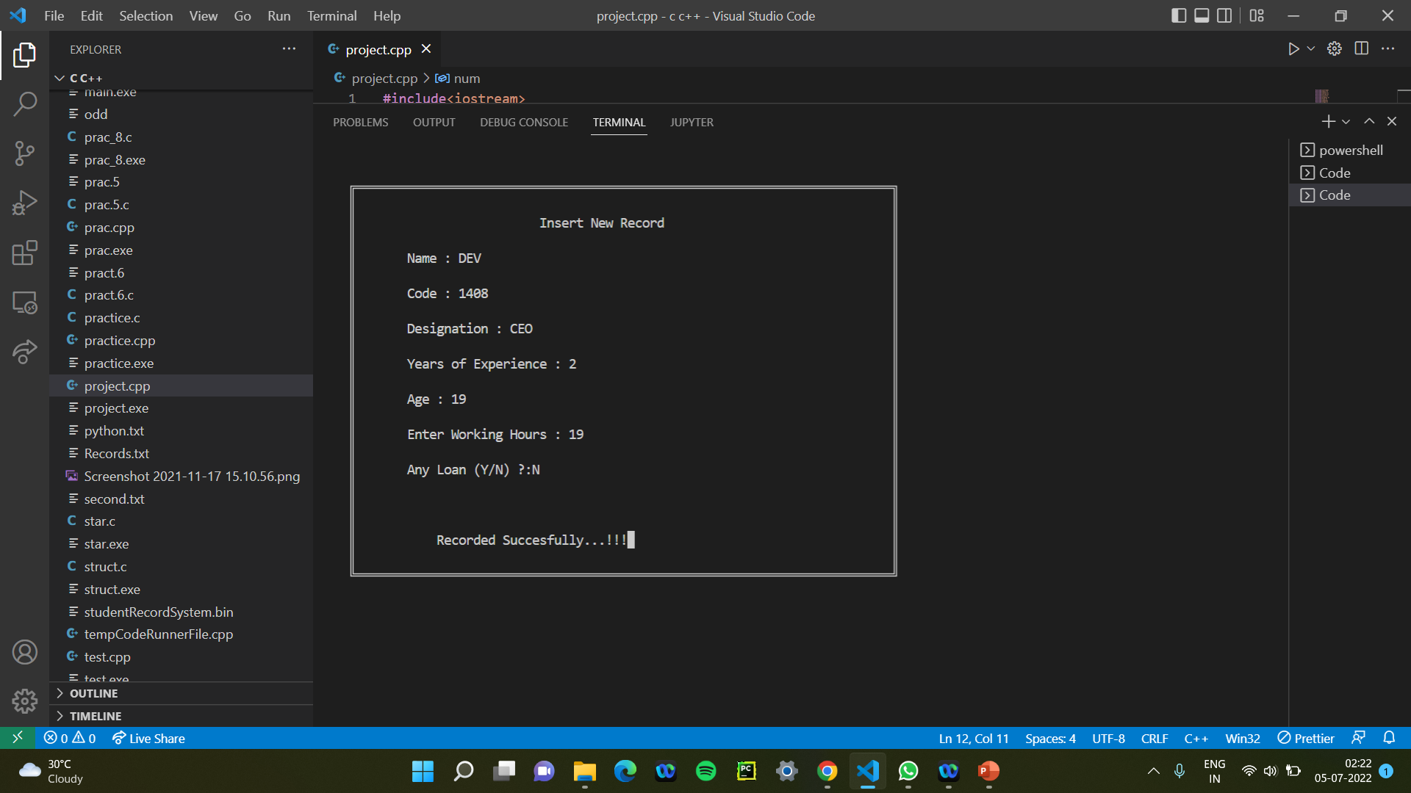

Slide 12
THANK YOU
-DEV PATEL
ENROLLMENT NO. → 21162101003

