Slide 1
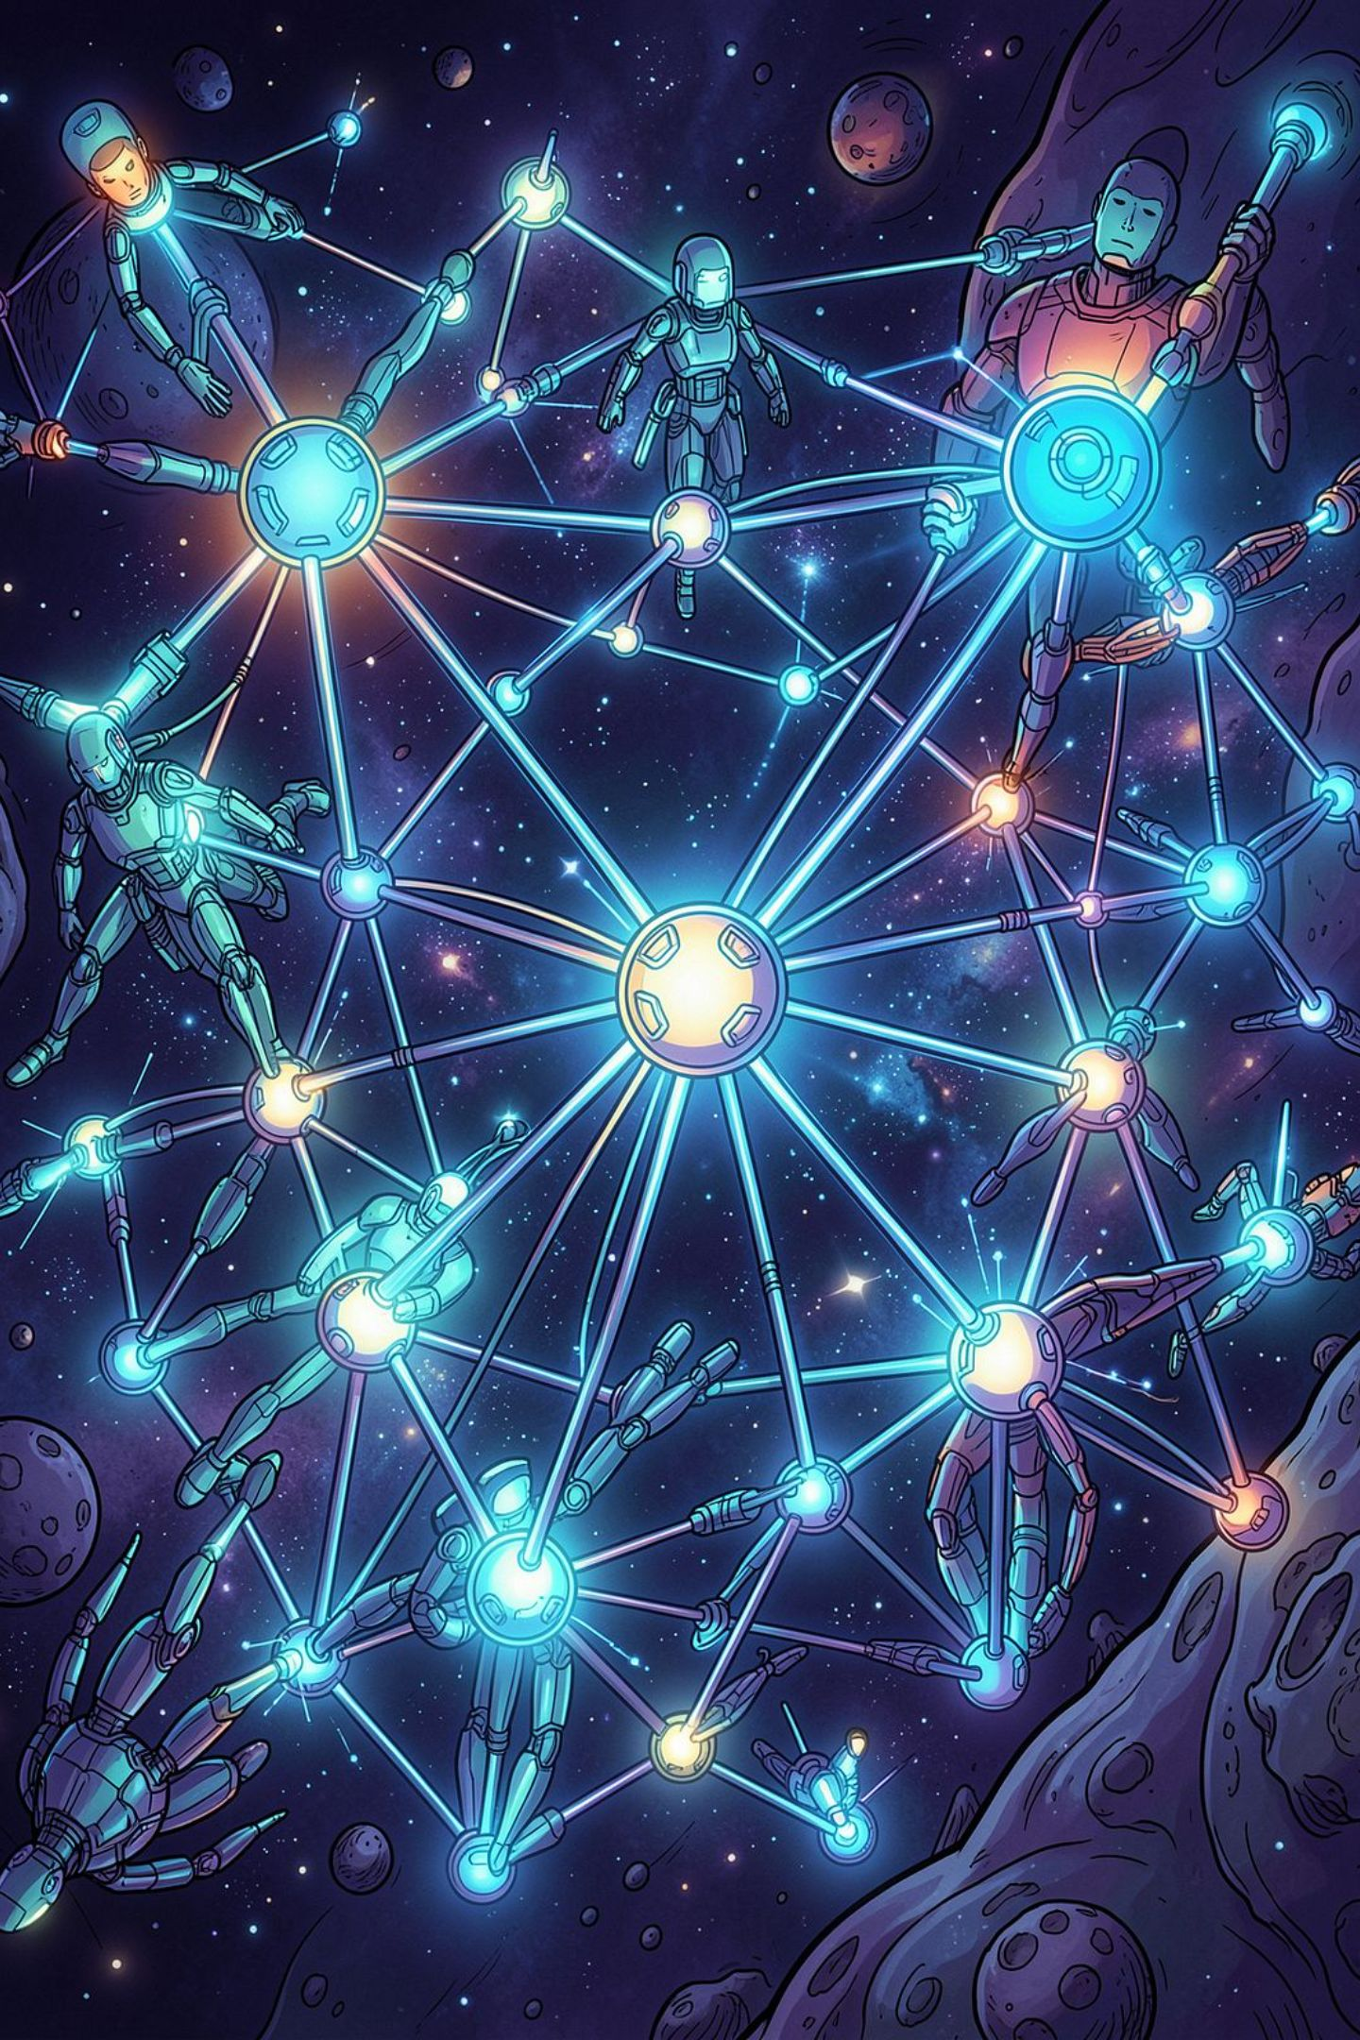
Multi-Agent Systems (MAS)
An introduction to intelligent, collaborative computing systems
Presented by:
Dev Pandya
Aman Ajmeri
Divyesh Rathod
Guided by:
PROF. MAHIMN SIR PANDYA

Slide 2
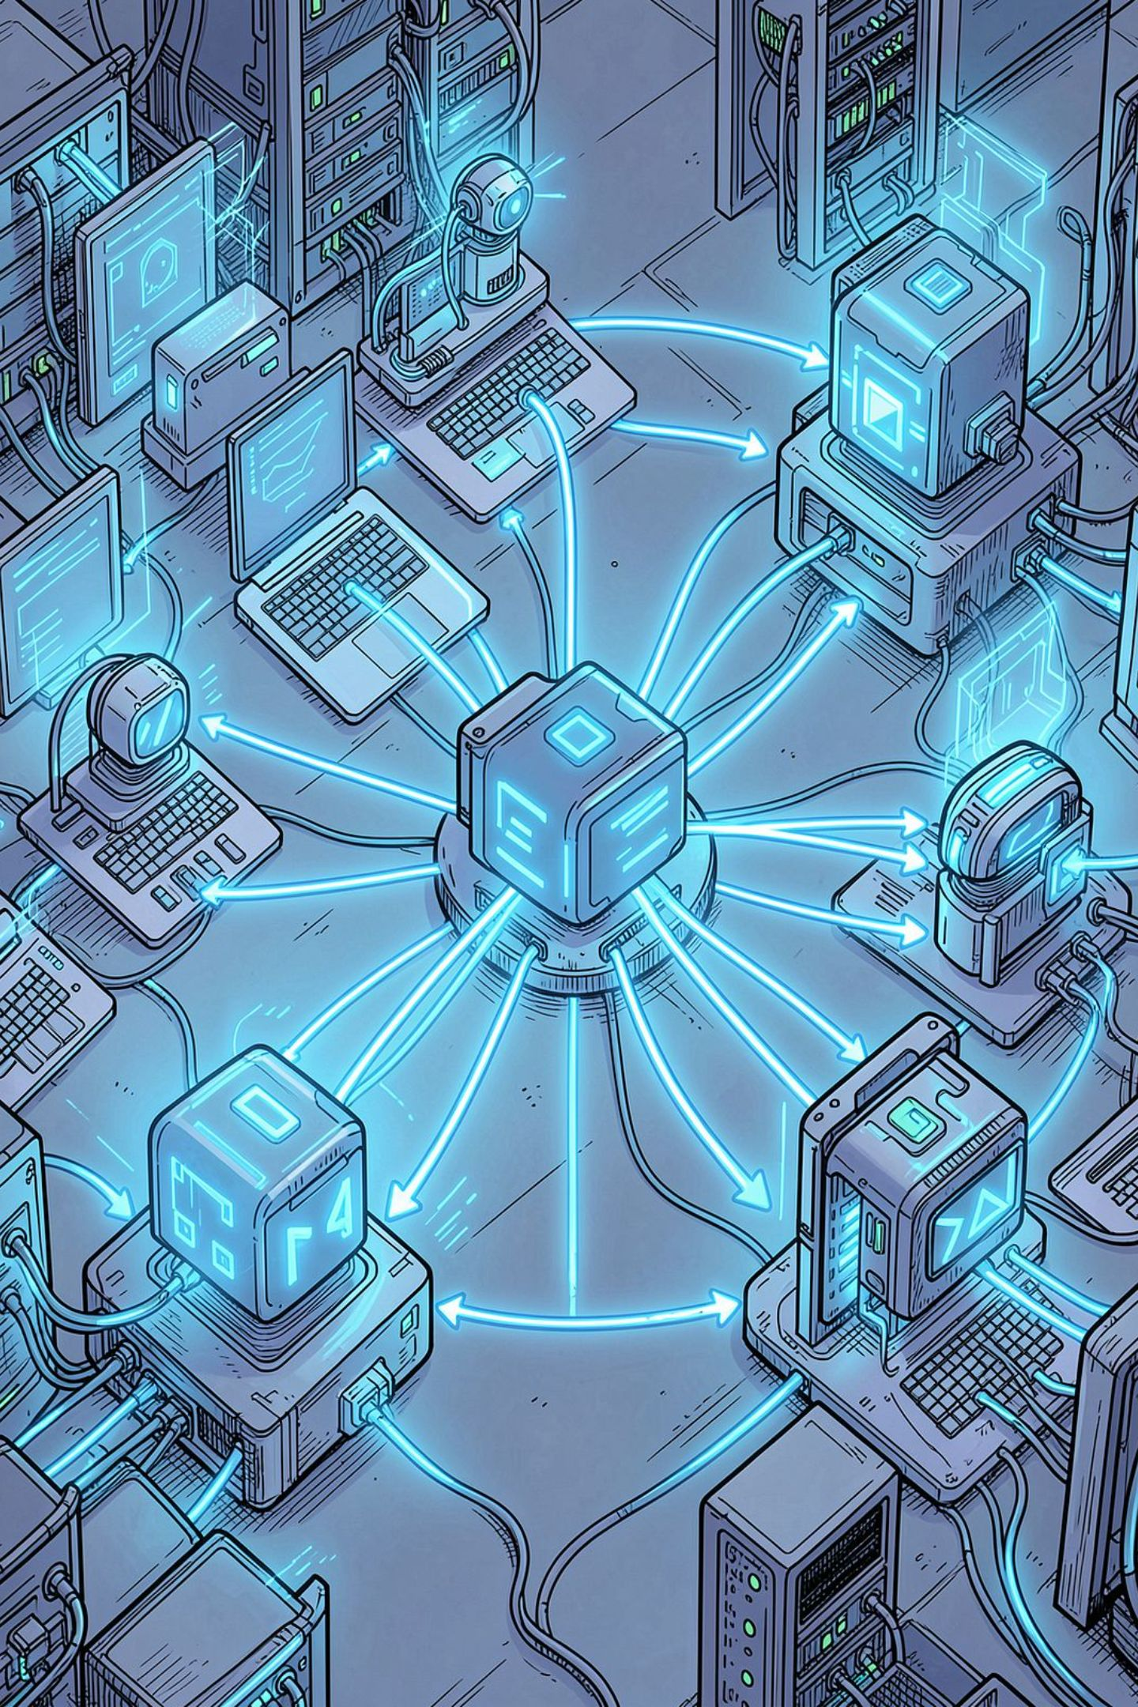
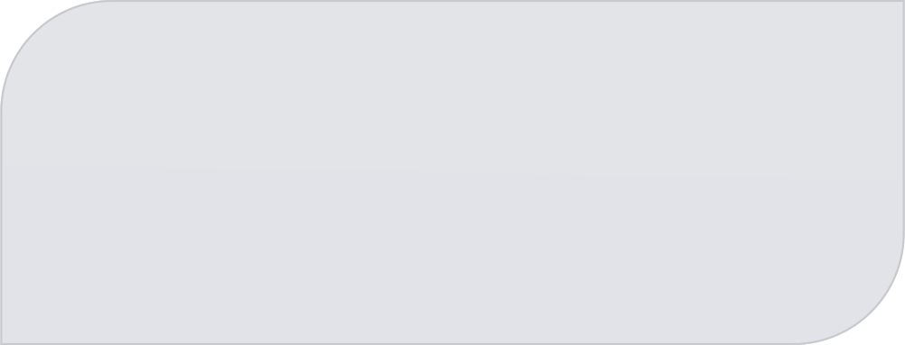
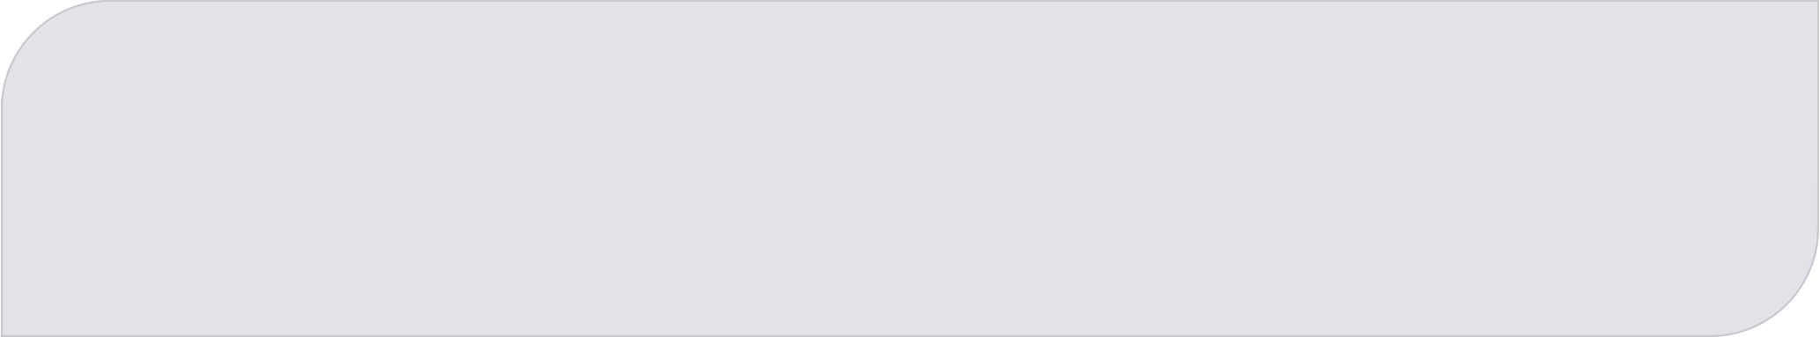
Introduction to Multi-Agent Systems
Traditional software runs as a single, centralised program. But real-world problems — from traffic management to financial trading — demand distributed, intelligent, and collaborative solutions. Multi-Agent Systems answer that call by modelling complex interactions between autonomous entities.
🌐 Distributed
🤝 Collaborative
No single point of control
Agents work together
⚡ Intelligent
Each agent reasons and decides

Slide 3
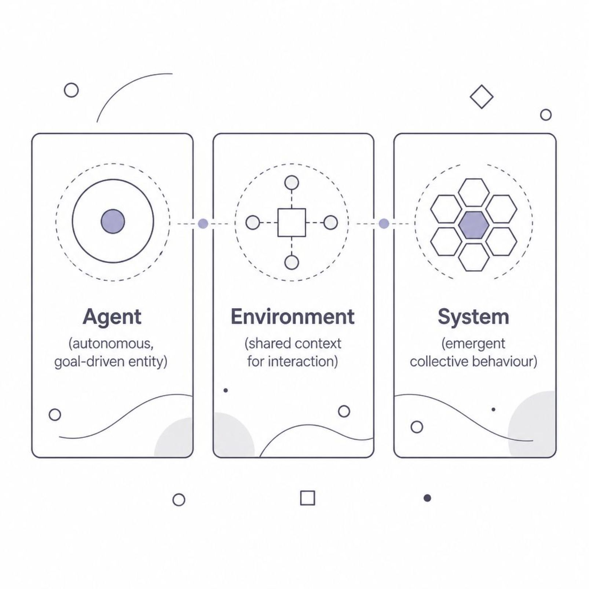
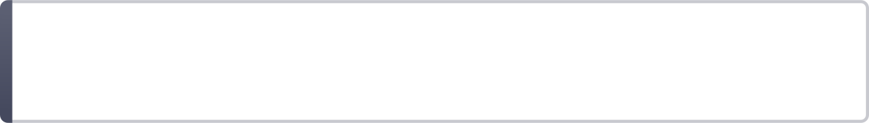
What is a Multi-Agent System?
A Multi-Agent System (MAS) is a system composed of multiple interacting intelligent agents — software entities that perceive their environment, make autonomous decisions, and act to achieve goals.
Agent
Environment
Interaction
An autonomous entity with sensors, reasoning, and actuators
The shared space in which agents operate and interact
Communication, cooperation, or competition between agents

Slide 4
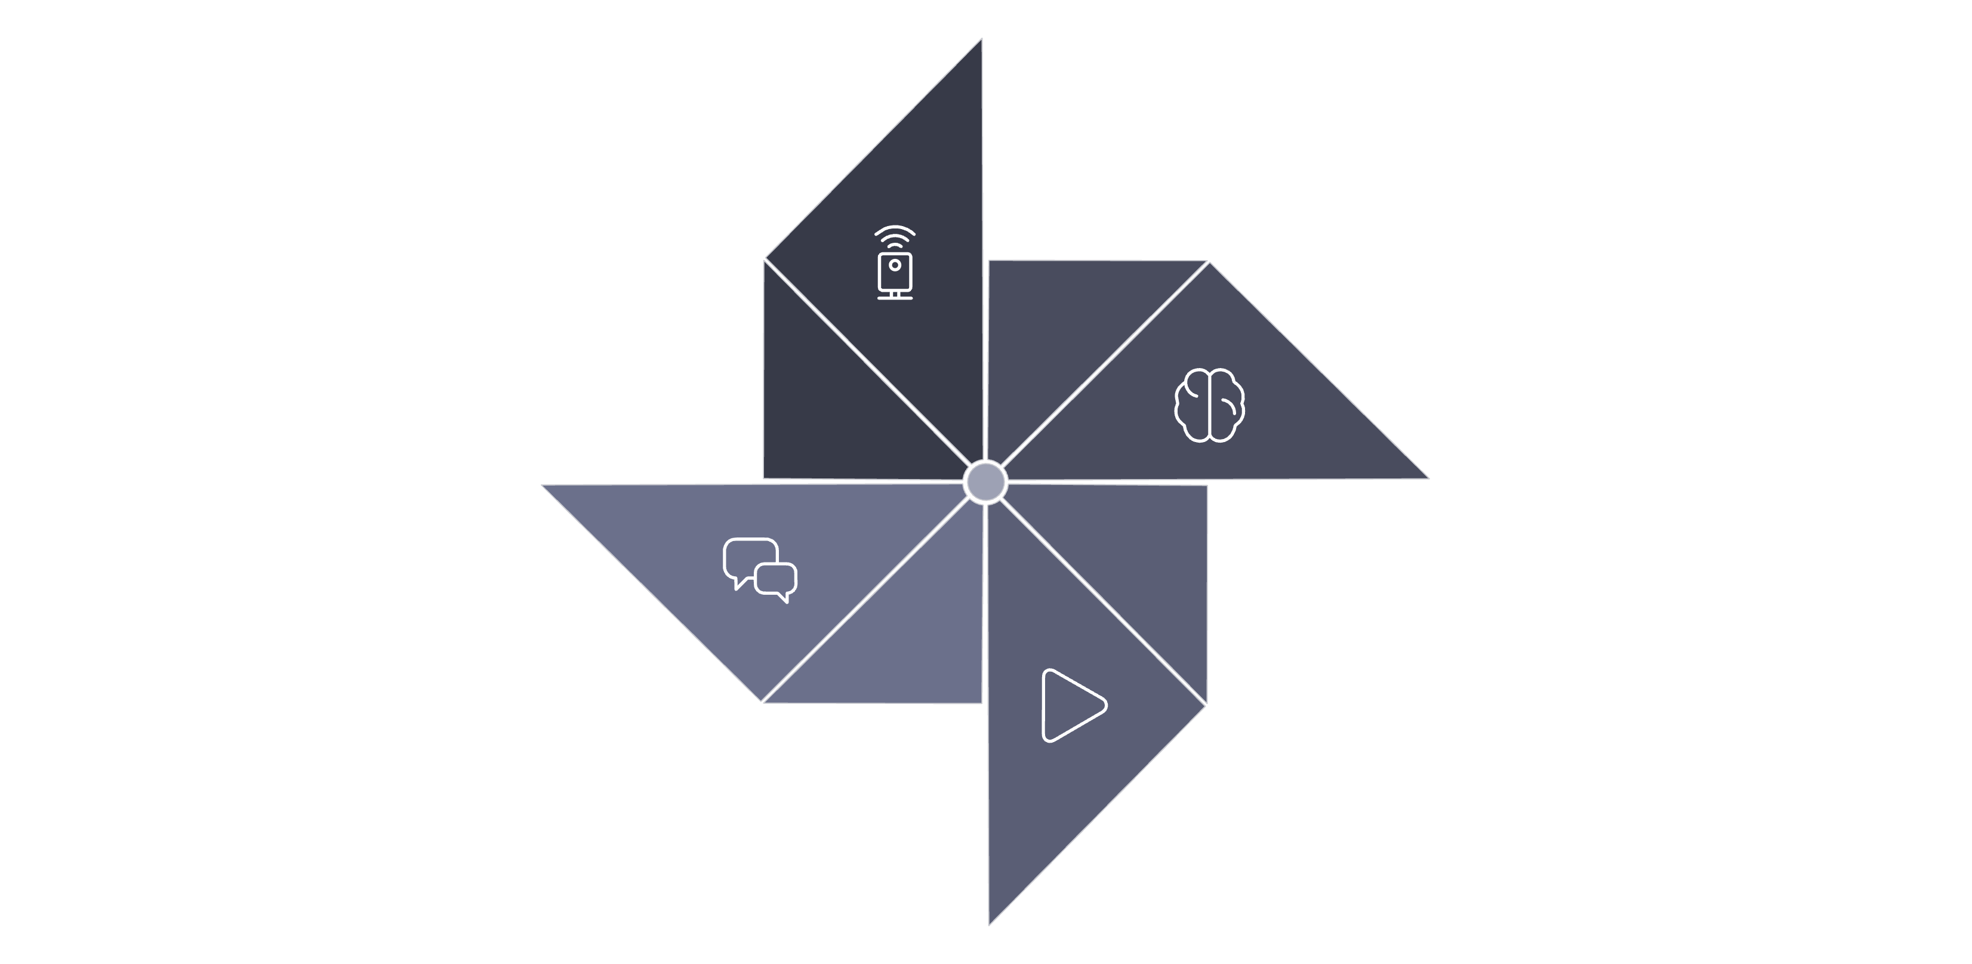
How Multi-Agent Systems Work
MAS operates through a continuous cycle of perception, reasoning, and action — all happening in parallel across agents.
Reason
Perceive
Act
Communicate
Agents may cooperate (share goals), compete (pursue conflicting goals), or negotiate to reach agreements — all without centralised control.

Slide 5

Core Features & Characteristics of MAS
Autonomy
Reactivity
Agents control their own actions without external commands
Agents perceive and respond to environment changes in real time
Proactiveness
Social Ability
Agents take initiative to pursue goals, not just react
Agents communicate and collaborate using shared protocols
Intelligence
Emergence
Agents use reasoning, learning, or planning to make decisions
Complex system-level behaviour arises from simple agent rules

Slide 6
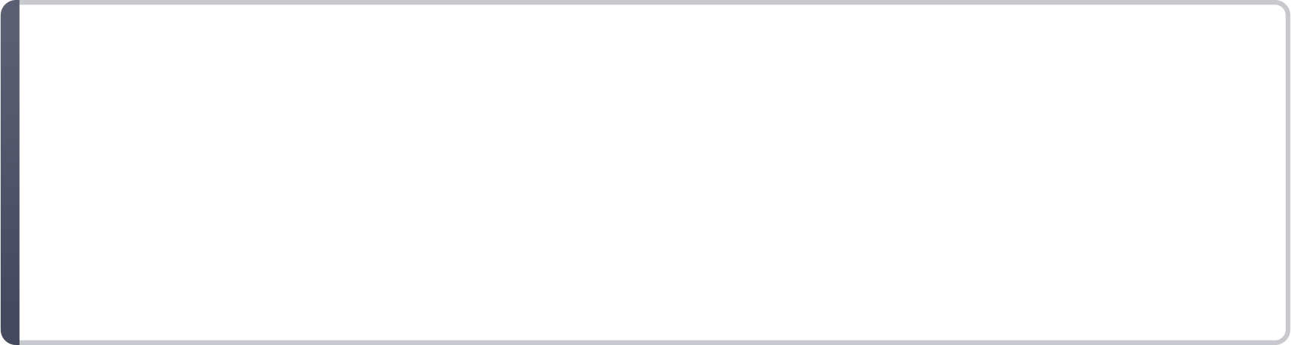
Important Considerations in MAS Design
1
Coordination & Conflict
⚠️ Trust & Security
How do agents avoid stepping on each other's goals? Mechanisms like negotiation, auctions, and voting are essential.
Malicious agents can disrupt the system; trust models and authentication are critical.
2
Communication Protocols
⚖️ Fairness
Standard languages like FIPA-ACL and KQML enable structured, meaningful agent-to-agent dialogue.
Resource allocation and task distribution must be equitable among competing agents.
3
Scalability
🔄 Adaptability
The system must perform reliably as the number of agents grows — from tens to thousands.
Agents must handle dynamic, unpredictable environments gracefully.

Slide 7
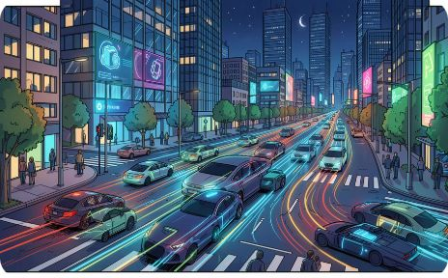
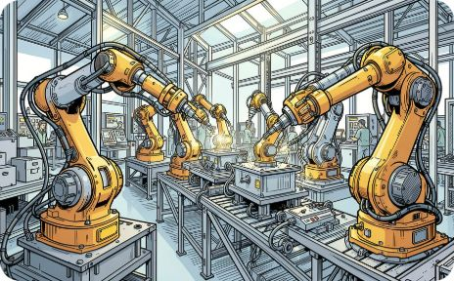

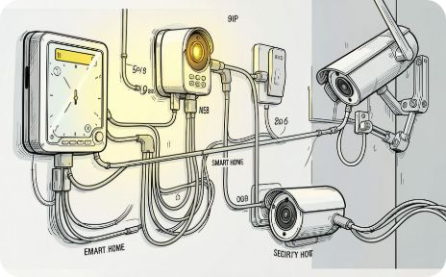
Common Usages & Applications of MAS
🚗 Smart Transportation
🏭 Industrial Automation
📈 Financial Trading
🏠 Smart Environments
Traffic light coordination, autonomous vehicles, and route optimisation in real time
Coordinated robots in manufacturing, warehouse logistics, and supply chain management
Algorithmic trading bots that negotiate, compete, and adapt in live markets
IoT ecosystems where devices autonomously manage energy, security, and comfort

Slide 8
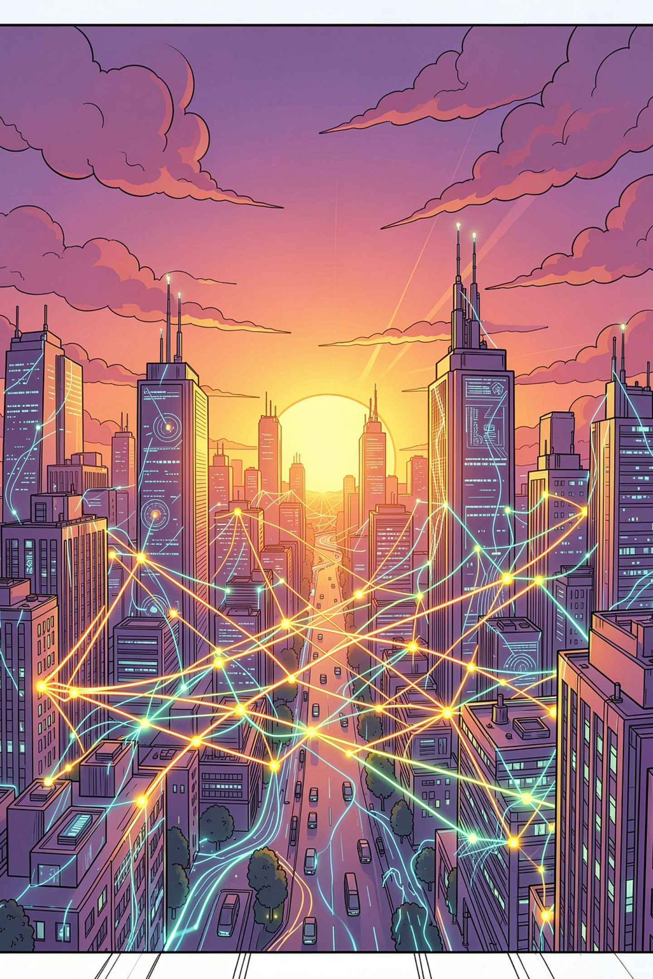

Conclusion: Key Takeaways on MAS
🔑 Distributed Intelligence
🔄 Emergent Behaviour
MAS replaces single-point control with collaborative, autonomous agents
Complex outcomes arise from simple, local agent interactions
🌍 Real-World Impact
From traffic to trading, MAS powers some of today's most critical systems
Final Thought: As AI and IoT continue to evolve, Multi-Agent Systems will become the backbone of intelligent, adaptive, and scalable solutions across every industry.
Thank you for giving your time

