Slide 1
INTERNSHIP PROJECT

Slide 2

Hello!
Name : Devansh Saxena
Branch : IT
St no : 2013205

Slide 3
PYTHON PROJECT
1
BANKING MANAGEMENT SYSTEM

Slide 4
DATABASE MANAGEMENT
A large section of My project focuses on database management. You’ll have to create a database for the banking solution to facilitate its functioning. You should be familiar with the basics of database management.

Slide 5
Bank Management System
The Bank Management System (BMS) is a web-based application used for paying financial institutions for the services they provide to the Bureau of the Fiscal Service. BMS also provides analytical tools to review, and approve compensation, budgets, and outflows.

Slide 6
Who uses BMS?
Three groups use BMS:
The Bureau of the Fiscal Service owns BMS.
The Federal Reserve Bank of St. Louis runs BMS.
Financial institutions that provide services to Fiscal Service use BMS to report and get paid.

Slide 7
The Problem
Customer experience is an integral part of a bank’s operations. That’s why banks focus a lot on improving customer experience by removing hassles and enhancing the facilities they provide. Opening a new account in a bank usually requires a person to visit the bank, fill out a form, and submit the necessary papers. All of these tasks take up a lot of time and dampen the overall customer experience. Moreover, many people have to take time out of their schedules to go to a bank.

Slide 8
The Solution :
You can solve this problem by creating a software solution where people can sign up and open a new account in a bank digitally. This way, the person wouldn’t have to visit the bank physically and thus, would save a lot of time and effort. The banking management system can also allow the user to make transactions, deposit and withdraw funds, and check the account balance. Your solution would need an admin section which would look after the users’ accounts and the overall wellbeing of the database. You’ll have to connect the software to a database which will store all user information in distinct storage.

Slide 9

How to Make the Project More Challenging
While this project is quite challenging, you can enhance its difficulty and take it a level further. To do so, you can add a layer of security, so the user’s data remains safe. Your software can have a login window where every user has to enter the password and username to access their accounts. You can also add a feature of opening multiple types of accounts. For example, banks offer Current accounts, Savings accounts, and others. Different accounts can have various facilities.

Slide 10

A Code is worth a thousand words
A complex idea can be conveyed with just a single code base, namely making it possible to absorb large amounts of data quickly.

Slide 11
Source Code for Python Banking Project
It allows users to open new accounts
Users can make transactions by entering the respective amounts
Users can check the balance of their accounts
Admin can view a list of users to see how many users there are along with their details
As you can see, it is quite basic, and you can add more functionalities according to your requirements.

Slide 12
8,526,124
Whoa! That’s a big number, aren’t you proud? These are the Demographics of Python all over the world

Slide 13
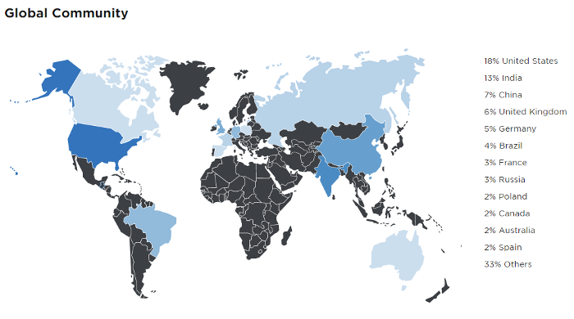

Slide 14
What is the significance of working on mini projects?
Working on live projects is very beneficial for a growing programming geek. There are multiple reasons why we strongly recommend you to keep working on projects: When you apply your theoretical learning in building something practical, your confidence goes on to the next level and gives you a feeling that you actually know something of value. Experimenting clears all your doubts that theory cannot. When you try to apply something and fail, it’s not a setback. It solves your confusion about the particular implementation and provides you with multiple other ways to implement it. The biggest benefit that working on projects provides is that it polishes your programming skills. Just watching video solutions does not help you get anywhere. You need practical implementation of your learning in order to master it.

Slide 15
What is the logic behind the bank management system project?
This bank management system is beginner-friendly and is based on all the beginner’s concepts. This project performs all the significant features of banking software. You can create a new login user-id, view your credit and withdrawal records and statements, send and receive money, and edit your account information.This project is specialized for beginners so you can create this project even if you are not that comfortable with Python. You can add the login system as well as where you can provide two options- “login with email id or continue with google”.
You can use the Google API for adding this functionality to your banking system.

Slide 16
Project ideas similar to the bank management system.
There are several project ideas that can be built using Python. Following are some of the most popular ones: A pharmacy management system should implement the functionalities such as an ordering system, inventory management, invoicing system, and additional functionality for prescribing medicines.
Hotel Management System is a project that should include features such as a reservation system, room management, housekeeping management, and invoice automation. A student management system should include functionalities such as profile management, account management, student record system, and hostel management.

Slide 17
Credits
Geekforgeeks
Upgrad
Wikipedia
Sildecarnival

Slide 18
Thanks!

