Slide 1

Presentation on:
HouseHive-A Buying & Selling Platform
“HouseHive”

Slide 2
Team Members:
Himanshu Tenguriya
Divyansh Sharma
Amit Lavania
Garima Yadav

Slide 3
Abstract
Introduction
Project Design
Project Analysis
Contents:
Project Progress Evaluation
Future Scope
Conclusion

Slide 4

Abstract
The HouseHive is a web-based application that allow users to buy , sell and rent
. their properties.
This system is established for all the users who are interested in buying and selling
or renting their properties.

Slide 5

Introduction
HouseHive is a modern and user-friendly platform that connects buyers, sellers, and renters of real estate properties. The website features a direct contact feature that enables users to contact property owners and landlords directly to ask questions, schedule viewings, or discuss potential deals.
One of the primary goals of the project was to create a user-friendly and interactive platform that caters to the needs of users across different devices and platforms

Slide 6
Project Analysis
Objective:
To help people in buying ,selling or renting .
Problem:
People sometime finds it difficult to engage with the property owner or the buyer .As nowadays the brokers are there to waste your money.
Solution:
Work on an Online platform that focuses on direct communication between the buyer and the seller of the property.

Slide 7
PROPOSED SOLUTION
The solution to this problem is to create an online platform for buying and selling of property.
A online platform that allows a direct contact feature that enables users to contact property owners and landlords directly to ask questions, schedule viewings, or discuss potential deals.

Slide 8
OBJECTIVES
The main objectives of the online system include:
1. Inspire and Inform:
The primary objective of online website could be to inspire and inform readers about people with different property .
2. Provide Tips and Guidance:
2.1 An online website that aims to provide helpful engage tips and resources about the property.
2.2 It can also include informative tips about the property ,and also about the owner of the property .
3.Create a Memorable User Experience:
Finally, an online website can aim to create a memorable user experience for its readers.

Slide 9
Project Design
SignUp
Login/Logout
Listing Houses
User
Email
Check others experiences.

Slide 10
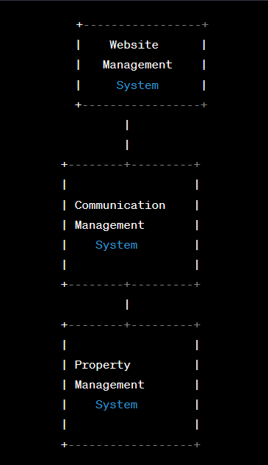
Data Flow Diagram:

Slide 11
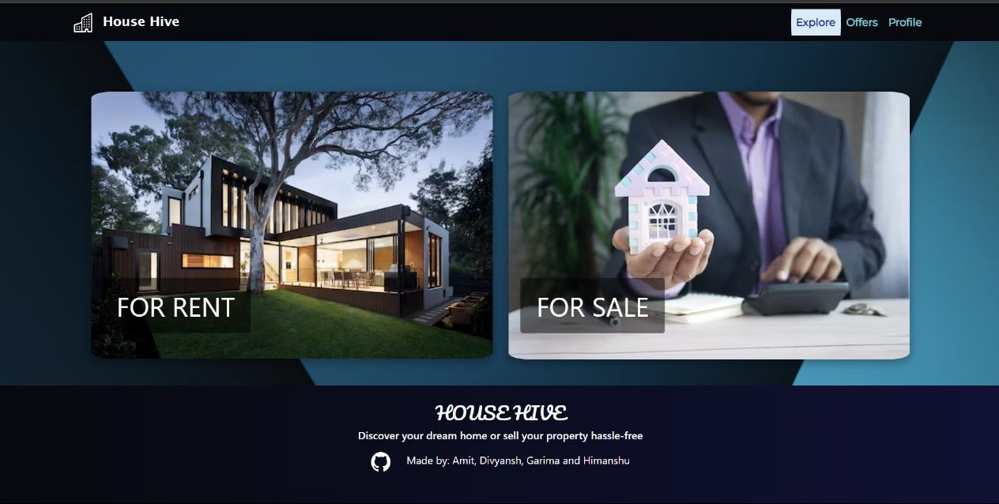
Home Page:

Slide 12
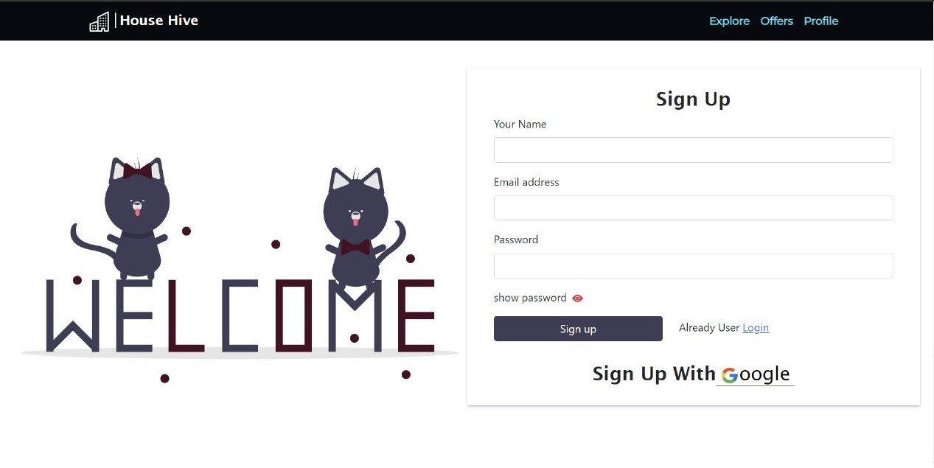
SignUp Page
Any users can create an account by registering. The system will validate the user email and will reject them if they are missing or if the user email is already taken.
Customer fill all the details and clicks register.
System validates email and password fields.
System authorizes the user and create their account.

Slide 13
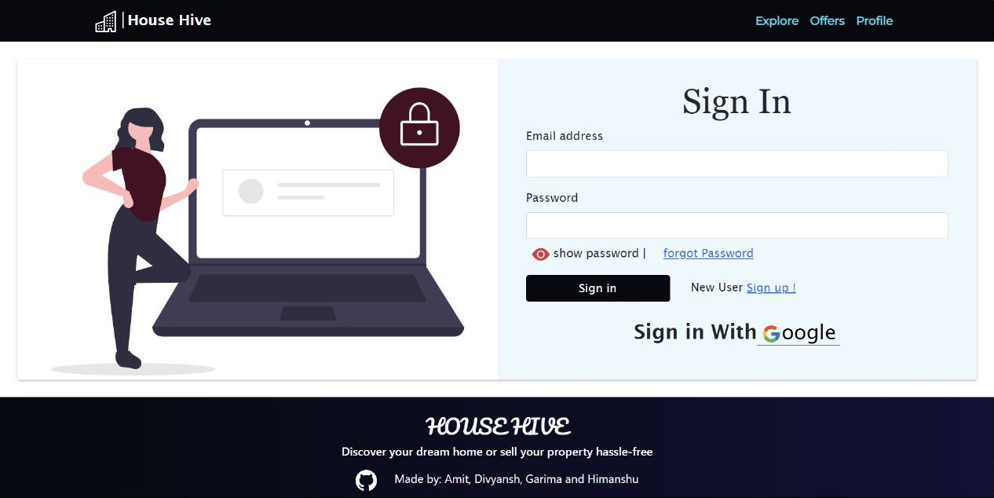
Sign In page
Login Page consist of username and password.
Customer have to give username and password to login.
System validates the details.

Slide 14
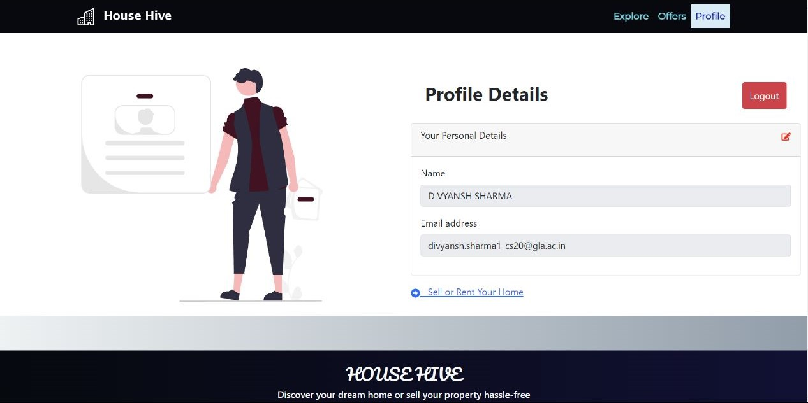
User Profile Page:

Slide 15
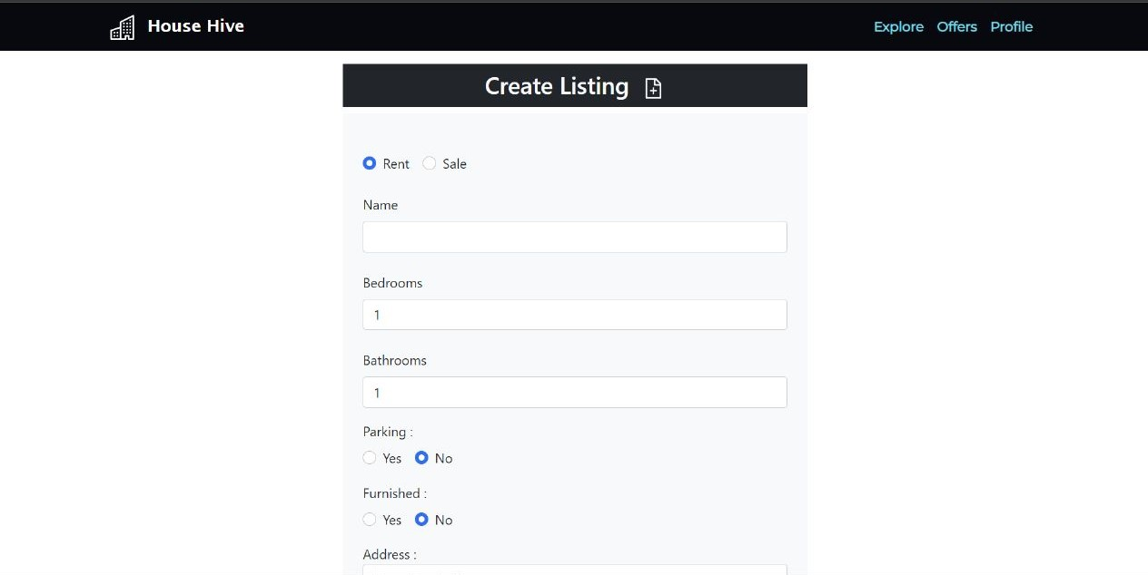
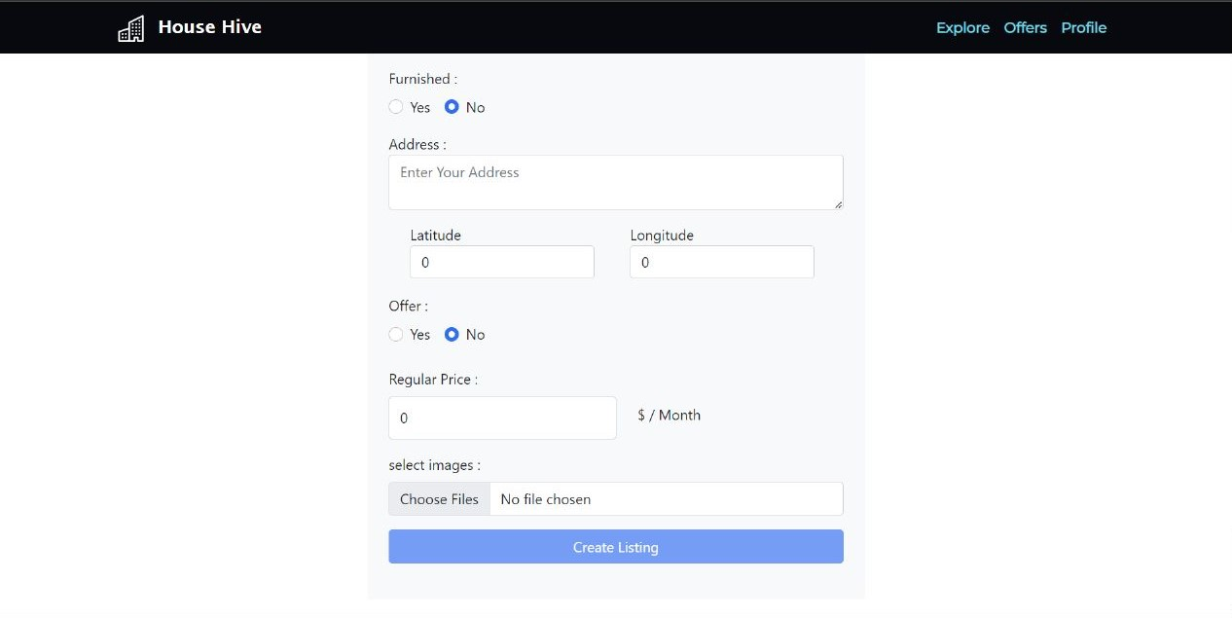
Create Listing:

Slide 16
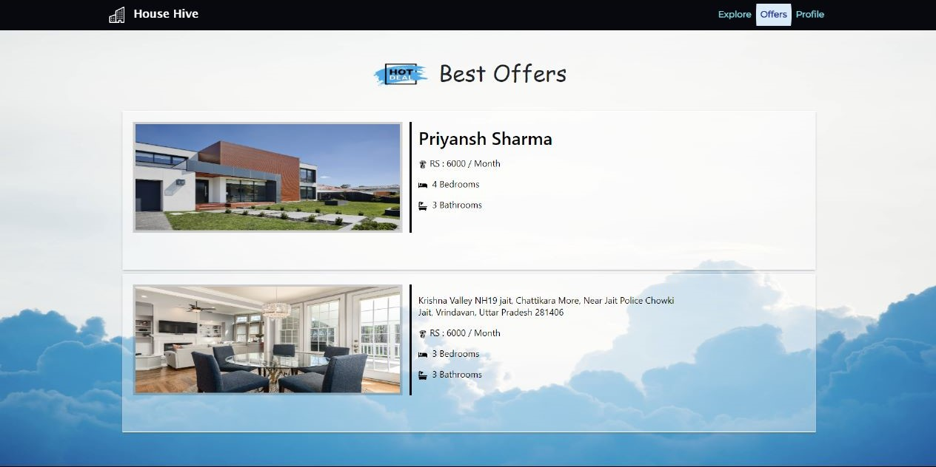
Listing of Property

Slide 17
Technologies Used:
Frontend Technologies:
HTML
CSS
ReactJs
Backend Technologies:
FireBase
Cloud Firestore
FireBase Authentication & Storage

Slide 18
Future Plans
We would like to say that our system did not capture everything that would be required and would therefore recommend for future improvement on the following:
An expansion to other places around the country.
Features to make online payment .
A Mobile Application that provides all the features to the user that are present in the website.
Feature to inspect the property through video call.

Slide 19
Conclusion
The HouseHive is an online web application that offers users to a platform for buyers, sellers, and renters of real estate properties to connect with each other.
The website can aim to provide a secure and efficient way for users to manage their property listings and communicate with potential buyers or renters.With its user-friendly interface and direct communication feature, the web application makes it easy for users to interact with each other and discuss about the property.

Slide 20
With its focus on user support and future developments, the web application is committed to providing an exceptional user experience for its users.
The main objective is to create a successful and functional website that satisfies the needs of its users and contributes to the development of the real estate industry..
Thank you for your time and attention, and we look forward to hearing your feedback and suggestions as we continue to improve and evolve the web application.

Slide 21
Thank You

