Slide 1


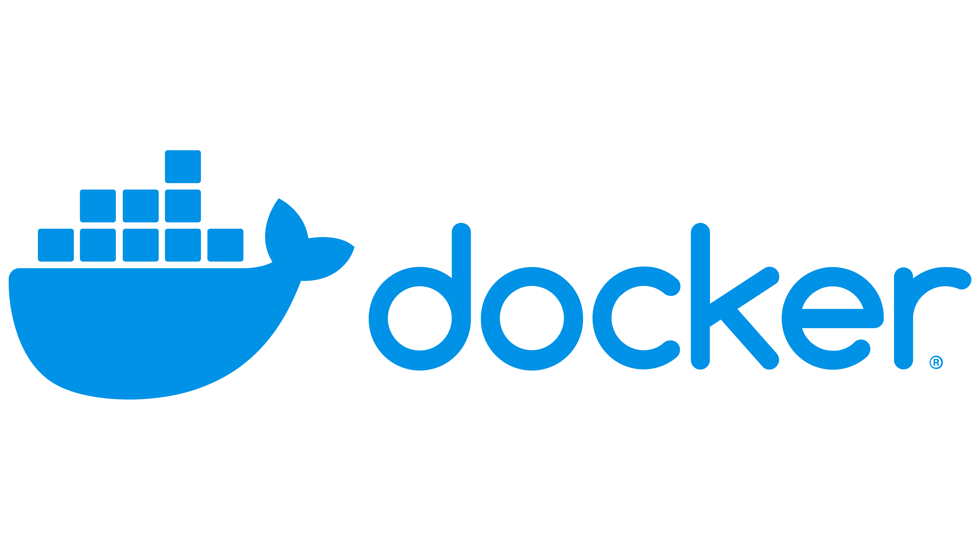

Slide 2

Course contents
what is docker
Install docker engine
What is container, image. Pull & push commands
dockerfile & docker compose
Create Jenkins on docker
use volume and network

Slide 3
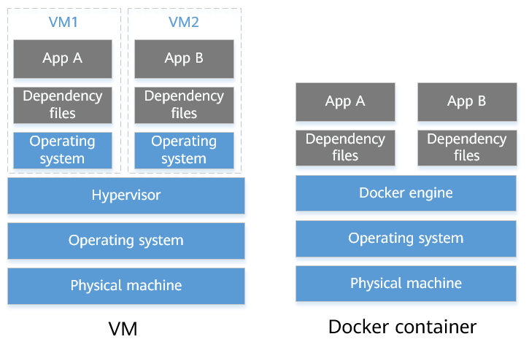

Slide 4
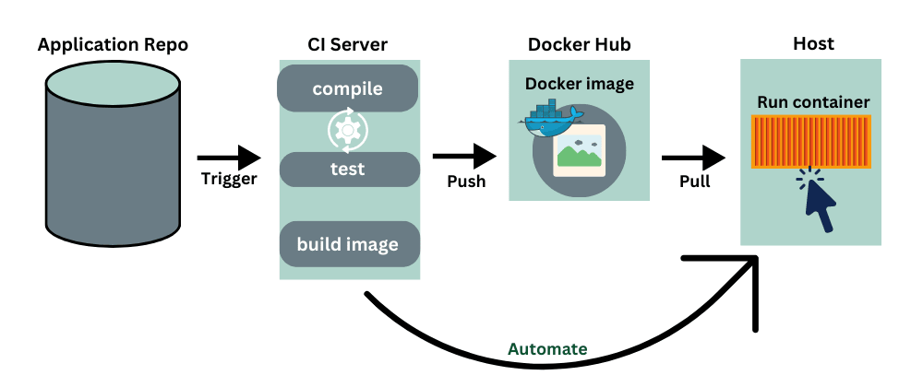

Slide 5
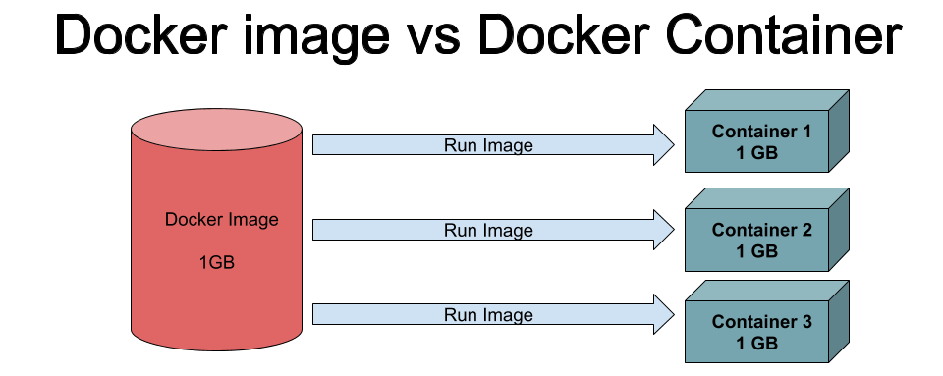

Slide 6
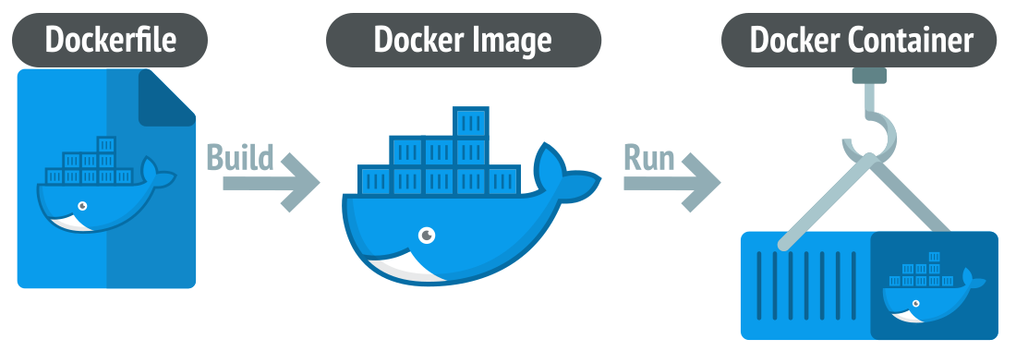

Slide 7
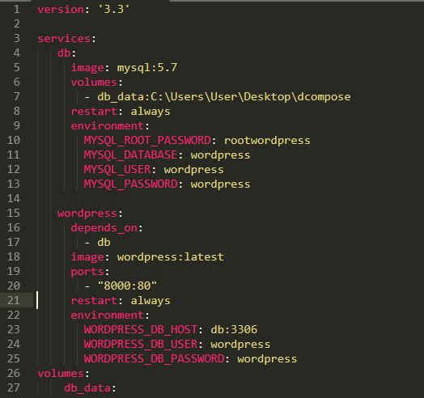

Slide 8
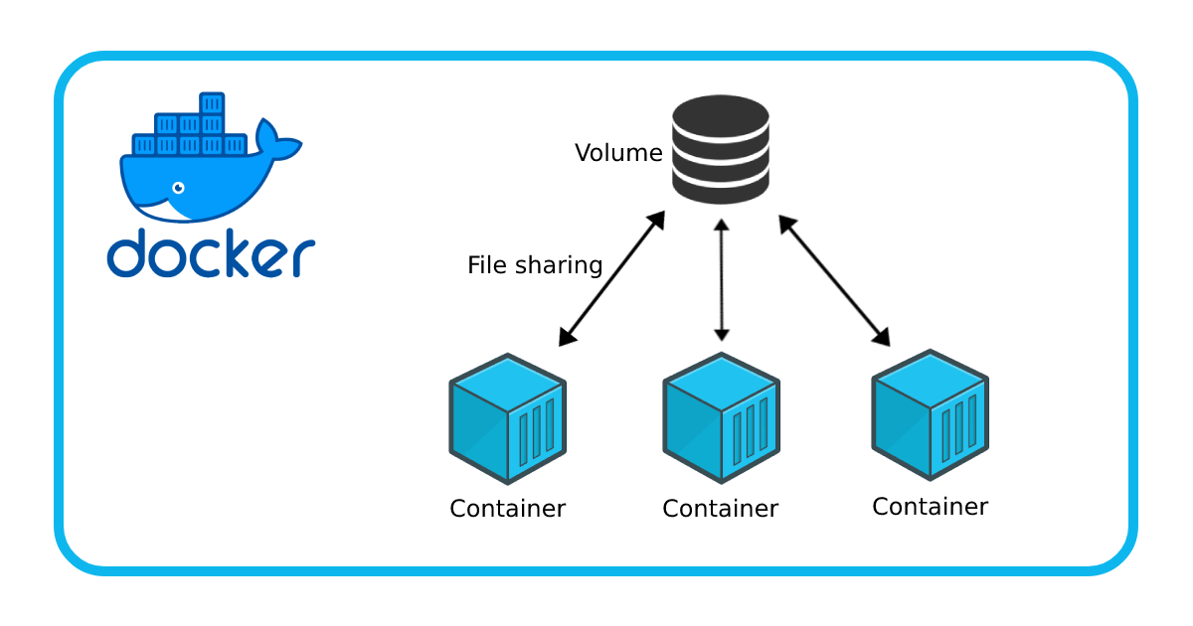

Slide 9
Docker network
Paste here picture

Slide 10

Task

Slide 11
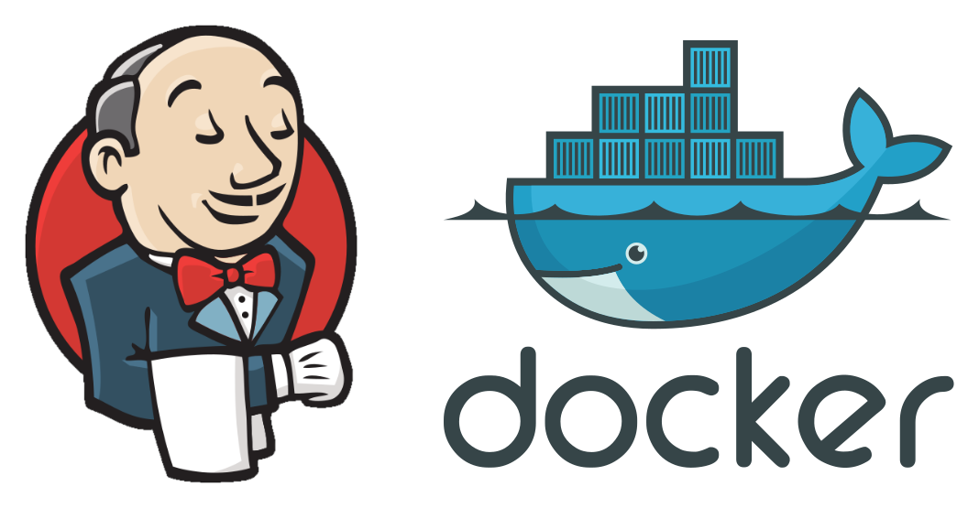
task
Create Jenkins to Build Docker Container with Volume

