Slide 1
Dev8D 2012
Introduction to jQuery
Graham Klyne

Slide 2
Prerequisites and assumptions
A running computer
Basic working knowledge of HTML, CSS and Javascript
Firefox browser with Firebug
  Any browser should work, but this combination is recommended
Your favoured text editor
A copy of sample files from GitHub:
  https://github.com/Dev8D/Dev8D/tree/master/2012/jQuery

Slide 3
This session
Starting from a very simple “Hello world” webpage, add successive jQuery-based capabilities to create a simple dynamic web page
Estimated time 30 minutes
Sample files are provided for each step, but you should feel free to experiment with the code as you build it, to get a good feel for what the code is actually doing, and how to bend it to your will

Slide 4
1. Hello World
<html>
<head>
<script type="text/javascript"
src="js/jquery-1.7.1.js"></script>
<script type="text/javascript">
$(document).ready(function() {
$('#name').text("World");
});
</script>
</head>
<body> <h2>Hello <span id="name">?</span></h2>
</body>
</html>

Slide 5
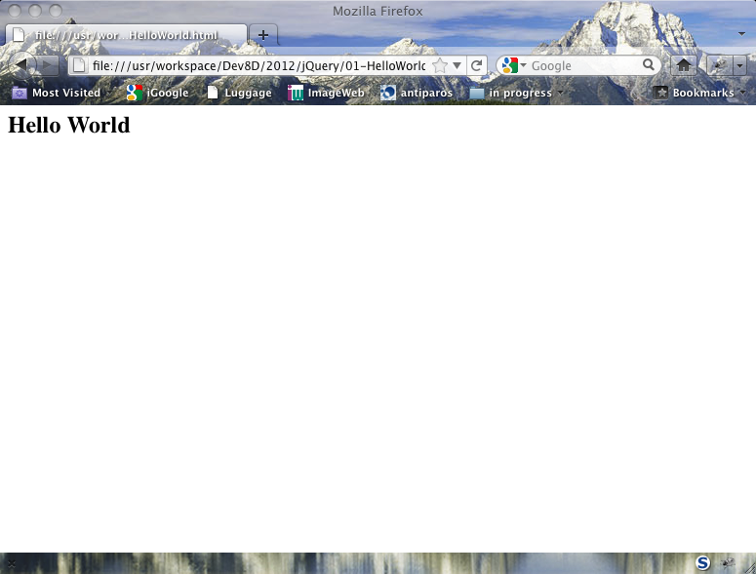
Hello World

Slide 6
2. User Input
:
<script type="text/javascript">
$(document).ready(function() {
$('#name').text("World");
$('body button').click(function() {
$('#name').text($('#yourname').val());
});
});
</script>
</head>
<body> <h2>Hello <span id="name">?</span></h2>
Enter your name here: <input id="yourname"></input>
<button>Update</button>
</body>

Slide 7
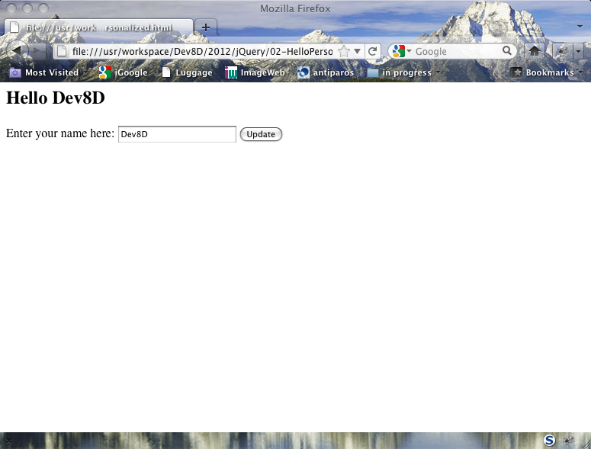

Slide 8
3. Adding style
<script type="text/javascript">
$(document).ready(function() {
$('#name').text("World");
$('body button').click(function() {
$('#name').text($('#yourname').val());
$('#name').css('color', 'red');
$('#name').css(
{ 'font-family': 'cursive',
'font-size': 'larger'});
});
});
</script>

Slide 9
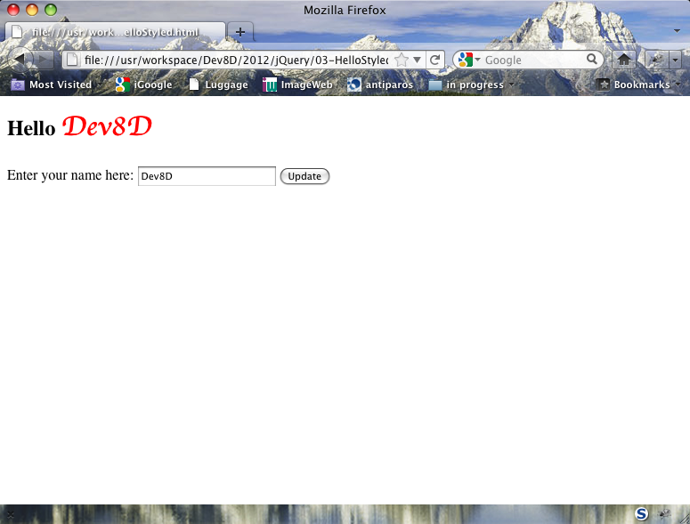

Slide 10
4. Using functions and CSS
$('#flashfirst').click(flashFirstById);
$('#flashsecond').click(flashSecondById);
function flashFirstById() { flashYellow($('#first')); };
function flashSecondById() { flashPink($('#second')); };
function flashYellow(jqueryobject){
jqueryobject.each( function(index, elem) {
$(elem).toggleClass('highlightyellow');
});
};
function flashPink(jqueryobject){
jqueryobject.each( function(index, elem) {
$(elem).toggleClass('highlightpink');
});
};
<style>
.highlightyellow { background-color:yellow; }
.highlightpink { background-color:rgb(255,128,128); }
</style>

Slide 11
4. Using functions and CSS
<div>
<button id='flashfirst'>flash first</button>
<button id='flashsecond'>flash second</button>
</div>
<div>
<ol>
<li id="first">First
<ul>
<li>1 sub 1</li>
<li>1 sub 2</li>
</ul>
</li>
<li id="second">Second
<ul>
<li>2 sub 1</li>
<li>2 sub 2</li>
</ul>
</li>
</ol>
</div>

Slide 12
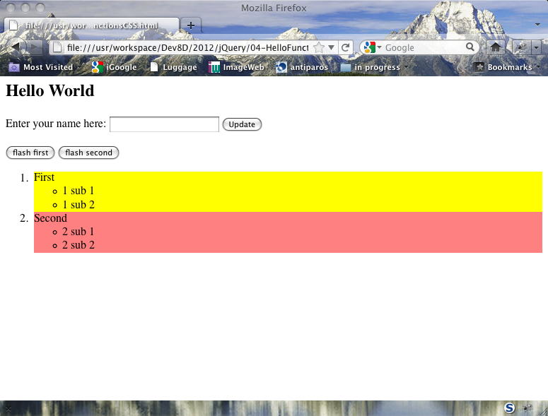

Slide 13
5. Selectors
function flashFirstById() { flash($('#first'), 'highlightyellow'); };
function flashSecondById() { flash($('#second'), 'highlightpink'); };
function flashByName() { flash($('button'), 'highlightgreen'); };
function flashByClass() { flash($('.aaa'), 'highlightblue'); };
function flashByNesting() {
flash($('ol li'), 'textred');
flash($('ul li'), 'textgreen');
};
function flashByAttribute() {
flash($('[test="select"]'), 'textgreen');
};
function flashByPos() {
flash($('li').eq(3), 'textred');
flash($('li').eq(4), 'textblue');
};
function flash(jqueryobject, cssclass) {
jqueryobject.each( function(index, elem) {
$(elem).toggleClass(cssclass);
});
};

Slide 14
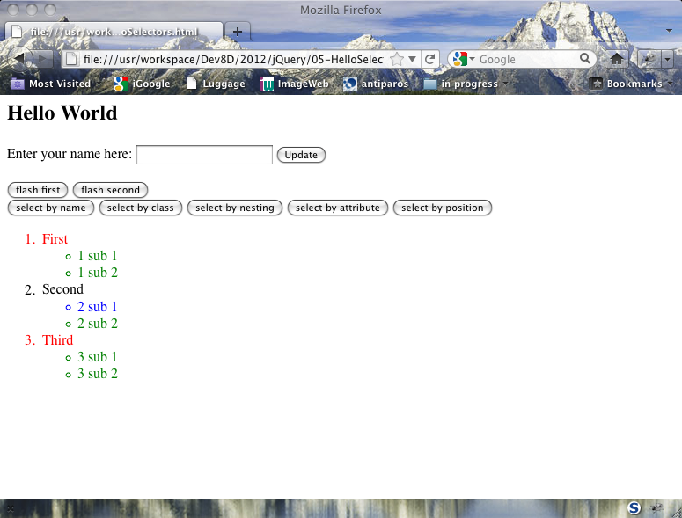

Slide 15
6. Modularization
<head>
<link rel="stylesheet" type="text/css"
href="css/06-HelloModular.css" />
<script type="text/javascript"
src="js/jquery-1.7.1.js"></script>
<script type="text/javascript">
jQuery.noConflict(); // Don't define jQuery "$" variable
</script>
<script type="text/javascript"
src="js/06-HelloModular.js/"></script>
<script type="text/javascript">
jQuery(document).ready(function() {
Hello.registerHandlers()
});
</script>
</head>

Slide 16
6. Modularization
if ( typeof(Hello) == "undefined" ) Hello = {};
(function ($) {
Hello.registerHandlers = function () {
$('#name').text("World");
};
Hello.flashFirstById = function () {
Hello.flash($('#first'), 'highlightyellow');
};
Hello.flash = function (jqueryobject, cssclass) {
jqueryobject.each( function(index, elem) {
$(elem).toggleClass(cssclass);
});
};
}) (jQuery);
Namespace

Slide 17
6. Simple dynamic content
<h2>
Hello <span id="name">?</span>&nbsp;
<button id="showNameEntryBox">
<span class="showhide">Show</span>
entry form
</button>
</h2>
$("#NameEntryBox").hide();
$("#showNameEntryBox").click( function (event) {
Hello.showHide(event, "#NameEntryBox")
});
Hello.showHide = function(event, selector) {
if ($(event.currentTarget).find(".showhide").text()
== "Hide") {
$(selector).hide();
$(event.currentTarget).find(".showhide").text("Show");
} else {
$(selector).show();
$(event.currentTarget).find(".showhide").text("Hide");
};
};

Slide 18
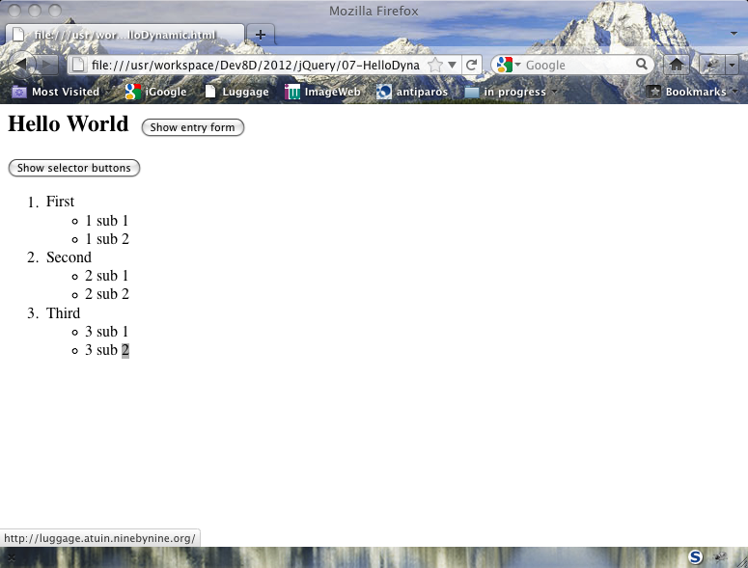

Slide 19
(End of session 1)

