Slide 1
Customer Shopping Behavior Analysis
Uncovering spending patterns, customer segments, product preferences, and subscription behavior from 3,900 transactions to guide strategic business decisions.

Slide 2
Dataset at a Glance
3,900
Transactions
18
Features
37
Missing Ratings
Key Feature Groups
Demographics: Age, Gender, Location, Subscription Status
Purchase Details: Item, Category, Amount, Season, Size, Color
Behavior: Discounts, Promo Codes, Frequency, Review Rating, Shipping Type

Slide 3

Data Preparation in Python
01
Load & Explore
Imported dataset with pandas; used
df.info()
and
.describe()
for initial inspection.
02
Clean & Standardize
Imputed missing Review Ratings with category median; renamed columns to snake_case.
03
Feature Engineering
Created
age_group
bins and purchase_frequency_days; dropped redundant
promo_code_used
.
04
Database Load
Connected Python to PostgreSQL and loaded the cleaned DataFrame for SQL analysis.

Slide 4
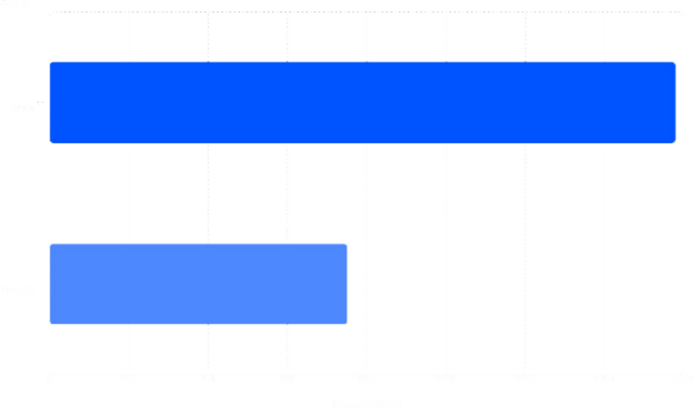
Revenue & Spending Insights
158k
75.2k
Key Findings
Male customers generated $157,890 vs. Female at
$75,191 in total revenue.
Express shipping users averaged $60.48 vs. $58.46 for Standard — a small but notable premium.
839 customers used discounts yet still spent above the average purchase amount.
•

Slide 5
Top-Rated Products & Discount Dependency
Top 5 Products by Avg. Rating
Most Discount-Dependent Products
Product | Avg. Rating |  | Product | Discount Rate
Gloves | 3.86 |  | Hat | 50.00%
Sandals | 3.84 |  | Sneakers | 49.66%
Boots | 3.82 |  | Coat | 49.07%
Hat | 3.80 |  | Sweater | 48.17%
Skirt | 3.78 |  | Pants | 47.37%

Slide 6

Customer Segmentation
2.13%
Segment Breakdown
17.97%
Loyal·7₇· _{9.9%} Returning·1_{·1}·7₇.9_{.9}7₇%% New·_{·2}·._{.13%}
79.9%
Customers were classified based on purchase history into three segments:
Loyal (3,116): High repeat purchase count — the dominant group.
Returning (701): Moderate engagement with growth potential.
New (83): Recently acquired customers to nurture.
•
•
Repeat buyers with >5 purchases: 958 subscribers
vs. 2,518 non-subscribers.

Slide 7
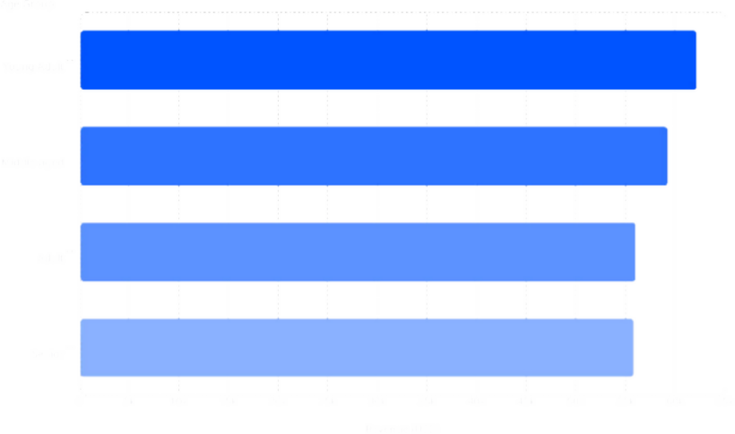
Subscription & Revenue by Age Group
Subscription Status
62.1k
Status | Customer s | Avg. Spend | Total Revenue
Subscriber s | 1,053 | $59.49 | $62,645
Non- Subscriber s | 2,847 | $59.87 | $170,436
59.2k
56k
55.8k
Young Adults lead in revenue. Avg. spend is nearly identical across subscription status — volume drives the gap.

Slide 8
Top Products by Category
👗 Clothing
Blouse — 171
Pants — 171
Shirt — 169
💍 Accessories
Jewelry — 171
Sunglasses — 161
Belt — 161
👟 Footwear
Sandals — 160
Shoes — 150
Sneakers — 145
🧥 Outerwear
Jacket — 163
Coat — 161

Slide 9
Power BI Dashboard
3.9K Customers | $59.76 Avg. Purchase
3.75 Avg. Rating | 27% / 73% Subscribers vs. Non

Slide 10




Business Recommendations
Boost Subscriptions
Promote exclusive benefits to convert the 73% non- subscriber base.
Review Discount Policy
Balance sales boosts with margin control — especially for Hat, Sneakers, and Coat.
Loyalty Programs
Reward repeat buyers to accelerate movement into the Loyal segment.
Targeted Marketing
Focus on high-revenue Young Adults and express- shipping users; highlight top-rated products.

