Slide 1
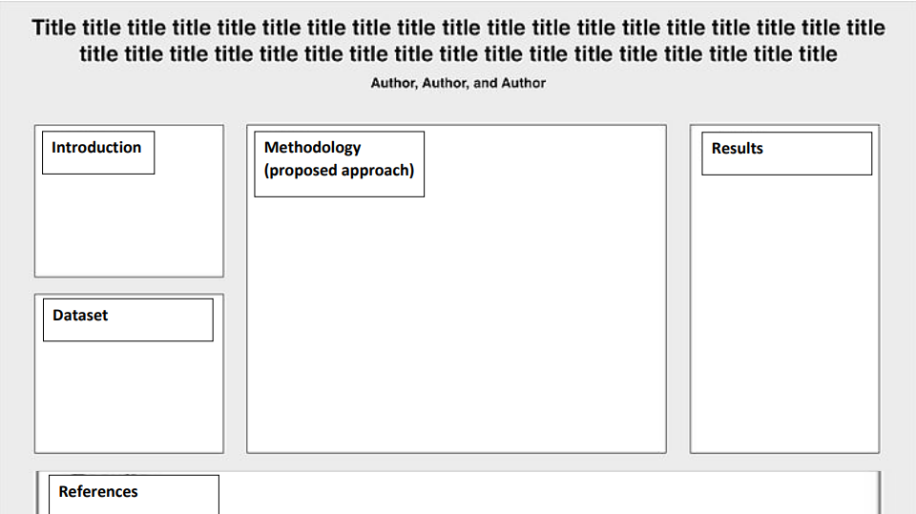
Deep Learning-Based Histopathological Classification of Lung Cancer Types Using Augmented CNN Models
Lung cancer is one of the leading causes of cancer-related deaths globally, accounting for 1.8 million deaths in 2020 alone [1]. Early and accurate diagnosis is crucial for improving patient outcomes and survival rates [2]. Histopathological examination of lung tissue remains the gold standard for diagnosing and classifying lung cancer types [3]. However, this manual process is time-consuming and subject to inter-observer variability, relying heavily on the expertise of pathologists [4].
The dataset used in this project is the Lung and Colon Cancer Histopathological Image Dataset (LC25000), published by Borkowski et al. [5]. Each image is 768x768 pixels. But for the models we are using the images were preprocessed to be 150x150 pixels.
[1] W. H. Organization, "WHO," 2020. [Online]. Available: https://www.who.int/news room/fact-sheets/detail/cancer. [Accessed 18 12 2024]. [2] A. C. Society, "cancer," 2021. [Online]. Available: https://www.cancer.org/cancer/types/lung-cancer/detection-diagnosis-staging.html. [Accessed 18 12 2024]. [3] J. C. a. T. Allen, "vol. 136 no.12," in Lung Cancer Biomarkers: Present Status and Future Developments, 2012, pp. 1478-1486. [4] D. C. D. M. R. a. J. S. S. G. A. Müller, "vol. 9, no. 8," in Inter-observer Variability in Lung Cancer Diagnosis, 2014, p. e47–e48.
[5] M. M. B. L. B. T. C. P. W. L. A. D. a. S. M. M. A. A. Borkowski, Lung and Colon Cancer Histopathological Image Dataset (LC25000), 2019.

