Slide 1
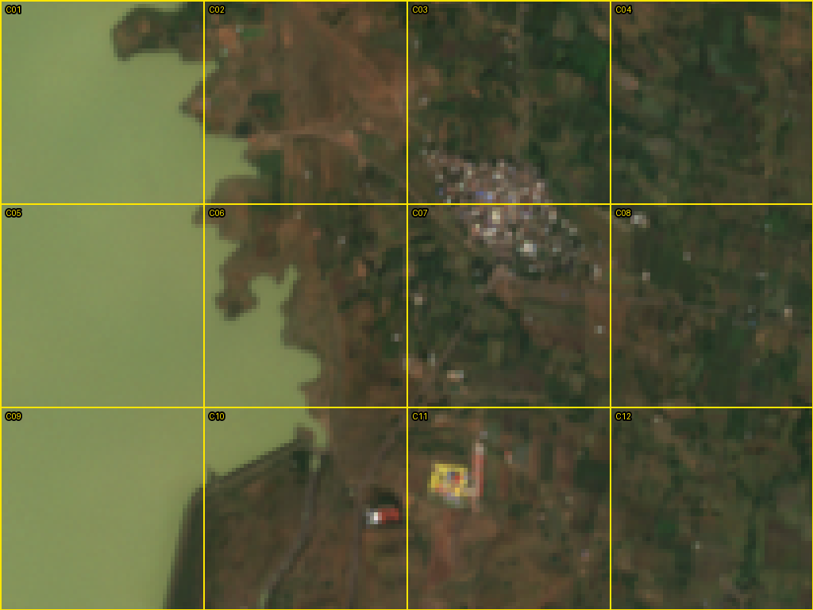
Land cover at the Kashyapi Dam reservoir edge
Q1 · LAND-COVER CLASSIFICATION
Nashik, Maharashtra · Sentinel-2, 2019. A reproducible 12-cell classification compared with Dynamic World and CGLS-LC100.
Aniket Sawargaonkar · October 2026
Notes:
This is a land-cover exercise on a 3 square kilometre box at the edge of the Kashyapi Dam reservoir near Nashik. I built my own random-forest classification for 12 grid cells, then compared it with two published products, Dynamic World and the Copernicus 2019 land-cover map. The point is not just the map but being able to trace every number back to an image and a line of code.

Slide 2
Five steps, each with a saved output
THE EXERCISE
1
2
3
4
5
Fix the grid
Label six by eye
Classify all 12
Compare
Diagnose and test
3 × 4 cells of 500 m, 3.0 km², saved as GeoJSON with cell IDs
Seeded random draw; labelled from RGB chips before any model output
Random forest on two Sentinel-2 seasons, trained outside the grid
Dynamic World and CGLS-LC100 2019 on the same footprints
Two disagreeing cells explained; one choice changed and rerun
OUTPUTS IN THE REPOSITORY
Grid and boundary GeoJSON · 12 RGB chips per season · cell-level CSV with visual, method and comparator labels, valid-pixel counts and uncertainty · run logs with every image ID · two Colab notebooks
Kashyapi Dam land cover · 2019
2
Notes:
The brief had five parts and I kept an output for each. The grid was fixed first. Six cells were drawn with a seed and labelled by eye before I saw any model output. A random forest classified all 12 cells. I then compared it with Dynamic World and the Copernicus map, diagnosed two cells where they disagree, and reran the analysis with one choice changed.

Slide 3
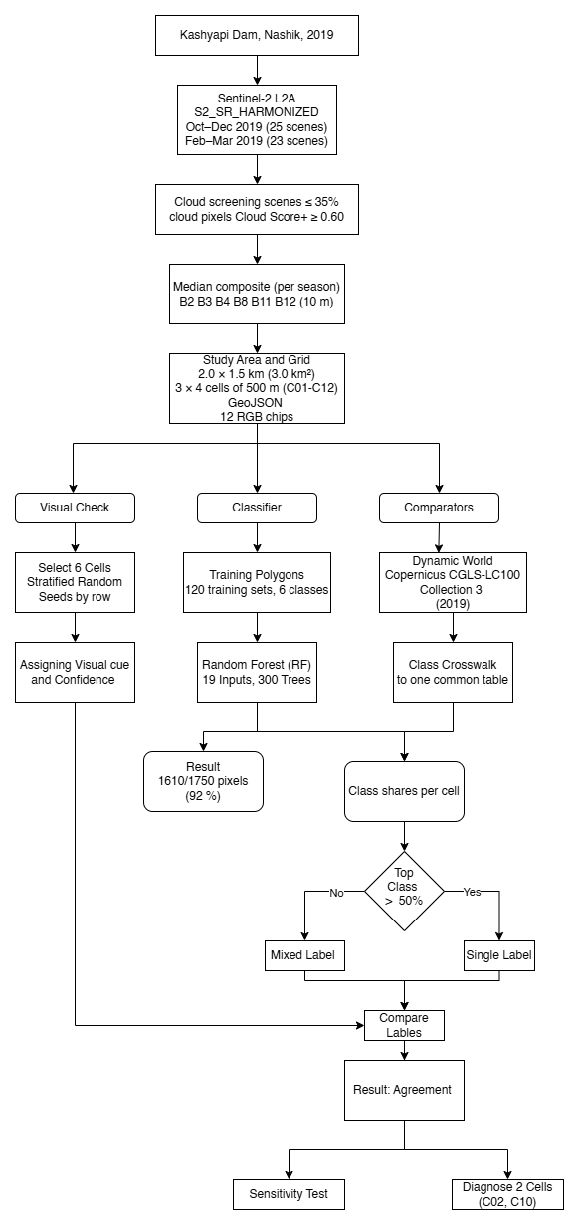
Methodology Flowchart
3

Slide 4
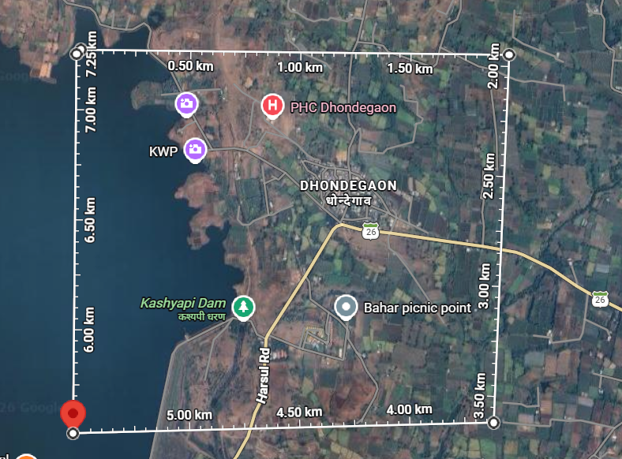
A 3 km² box on the reservoir edge
STUDY AREA
Where
Western edge of the Kashyapi Dam reservoir, Nashik district, Maharashtra
Size
2.0 × 1.5 km = 3.0 km² (limit 4 km²); 12 cells of 500 × 500 m, C01–C12, left to right from the north-west
Corners
SW 20.069111 N, 73.603390 E
NE 20.082812 N, 73.622394 E
Projection
UTM 43N (EPSG:32643); corner snapped to the 10 m Sentinel-2 pixel grid
Why here
Open water, a seasonal margin, a village, farmland and hill scrub in one box
4
Notes:
The box is 2 by 1.5 kilometres, under the 4 square kilometre limit, and split into twelve 500 metre cells. I chose the reservoir edge on purpose: within one box there is open water, a margin that floods and dries with the seasons, a village, farmland and hill scrub. The corner is snapped to the Sentinel-2 10 metre grid, so every cell holds exactly 2,500 pixels.

Slide 5
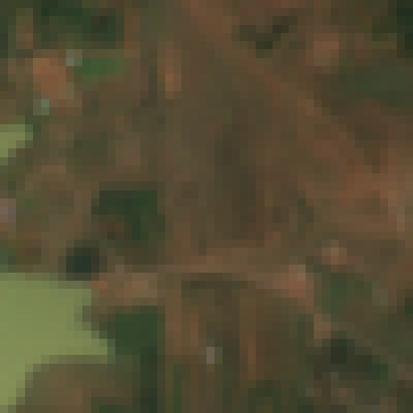
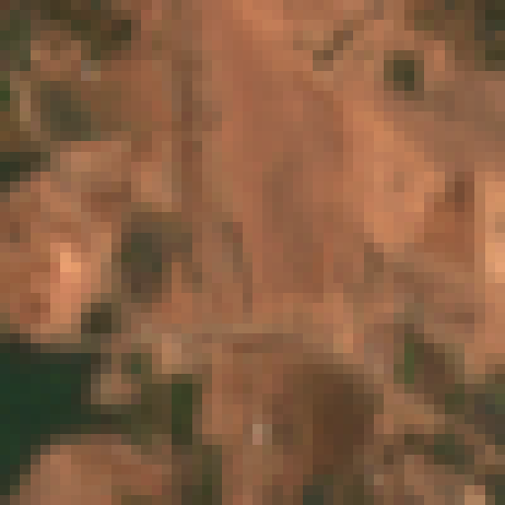
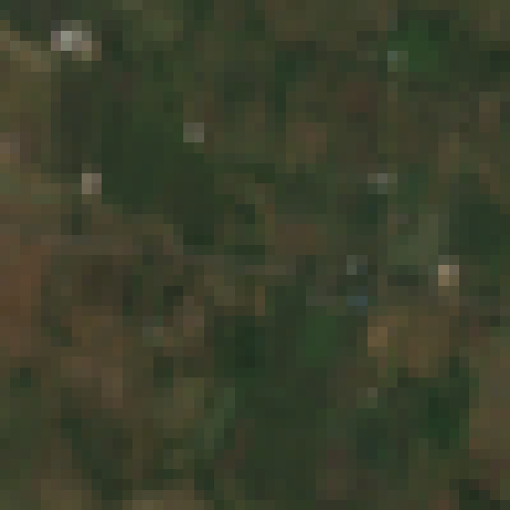
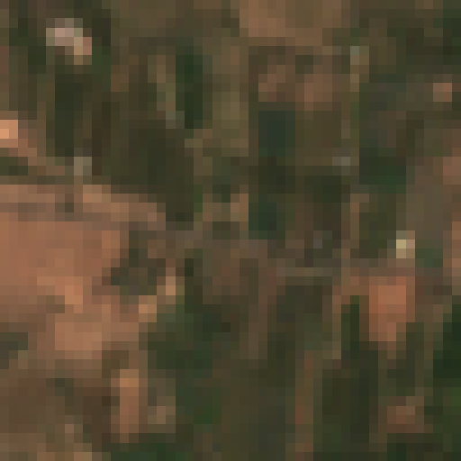
Two 2019 seasons, cloud-screened
IMAGERY
 | Main window | Second window
Dates | 1 Oct – 31 Dec 2019 | 1 Feb – 31 Mar 2019
Scenes | 25 (tile 43QCC) | 23 (tile 43QCC)
Role | Chips, visual labels, model input | Model input only
Oct–Dec
Feb–Mar
COPERNICUS/S2_SR_HARMONIZED (Level-2A)
Scenes with cloud ≤ 35%; pixels kept where Cloud Score+ cs_cdf ≥ 0.60
Per-pixel median of B2, B3, B4, B8, B11, B12 at 10 m
Valid data: 2,500 of 2,500 pixels in every cell, both windows (about 22–25 clear looks per pixel)
Chips: B4/B3/B2, one fixed 0–0.30 reflectance stretch
C02 (slope, top) and C08 (farmland, bottom): they separate in the dry season
Kashyapi Dam land cover · 2019
5
Notes:
The main window is October to December 2019, just after the monsoon. I added February to March 2019 as a second input because right after the monsoon fields, scrub and grass are all green. In the dry season the slope dries out and looks pale, while fields are either bare or carry a green rabi crop. Every cell had valid data in all 2,500 pixels in both windows, so coverage is not a source of disagreement here.

Slide 6
Six CGLS classes, one cell rule for every source
CLASS SCHEME
Class (CGLS code) | Definition used
Shrubs (20) | Woody perennials with persistent woody stems, under 5 m, no single main stem
Herbaceous vegetation (30) | No persistent stem above ground; tree and shrub cover below 10%
Cropland (40) | Temporary crops then harvest and bare soil, including fallow plots and field margins
Built-up (50) | Buildings, roads and other man-made surfaces
Bare or sparse vegetation (60) | Soil, sand or rock with vegetation below 10% all year
Permanent water (80) | Lakes, reservoirs and rivers
Herbaceous wetland (90) | Comparator only: permanent mix of water and herbaceous or woody vegetation
Forest (111–126) | Comparator only: tree canopy above 15%, the twelve CGLS forest types merged
Cell rule: a cell takes one class only if it covers more than 50% of the cell's 10 m pixels; otherwise "Mixed (top and second)".
Kashyapi Dam land cover · 2019
6
Notes:
I used the Copernicus class names and codes so the crosswalk to the comparators is direct. Forest and herbaceous wetland appear only in the comparator maps, because there were no reliable training patches for them near the site, so my model cannot predict them. The same 50 percent rule turns pixel shares into a cell label for every source, which keeps the comparison fair.

Slide 7


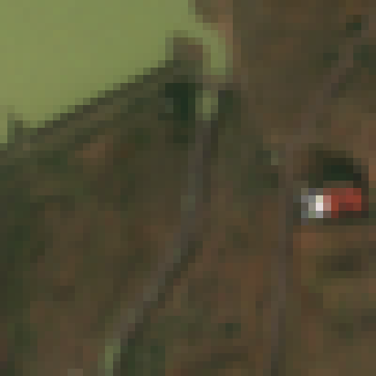
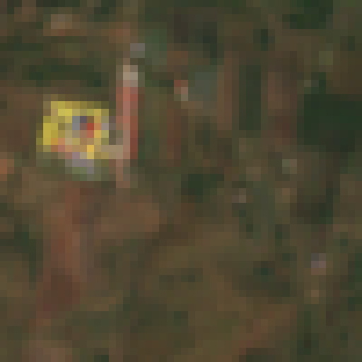
Six cells, labelled by eye before any map
VISUAL LABELS
Drawn with random.Random(2019).sample, two cells per grid row, seed fixed before viewing. Labelled from the Oct–Dec chips, without AI.
C01 · High
C02 · High
C05 · High
Permanent water
Shrubs
Permanent water
C08 · Medium
C10 · Medium
C11 · Medium
Cropland
Mixed (Built-up and Shrubs)
Mixed (Cropland and Shrubs)
High one class clearly over ~70%, unambiguous · Medium clear main class with a sizeable second, or somewhat ambiguous · Low unsure or genuinely mixed
Kashyapi Dam land cover · 2019
7
Notes:
The six cells came from a stratified random draw, two per grid row, with seed 2019 fixed in the code before I looked at any image. I labelled them from the October to December chips only, without AI and before any model or comparator output. I kept mixed labels where the cell genuinely is mixed. These are an imperfect, very small check, not ground truth.

Slide 8

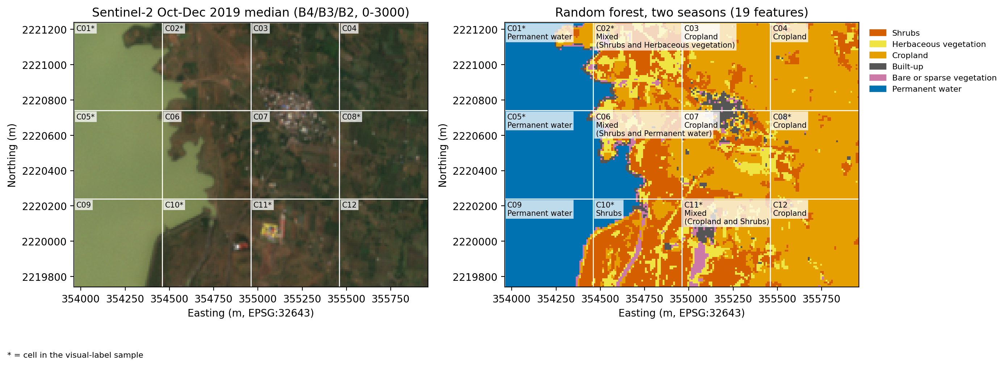
A random forest on two seasons
METHOD
Two composites
19 features
Random forest
Cell label
Oct–Dec and Feb–Mar medians, 6 bands each
Bands + NDVI, NDBI, MNDWI per season, + NDVI change
300 trees, balanced weights, seed 2019
Pixel class → cell shares → over-50% rule
8
Notes:
I chose a conventional classifier over a vision-language model because it is fully reproducible and every pixel decision can be traced. Each pixel gets 19 features: the six bands and three indices for each season, plus the change in NDVI between them. The forest gives class probabilities; each pixel takes the most likely class, and the cell label comes from pixel shares with the 50 percent rule. I also keep the share of low-confidence pixels, those whose top probability is under 0.5, as an uncertainty column.

Slide 9
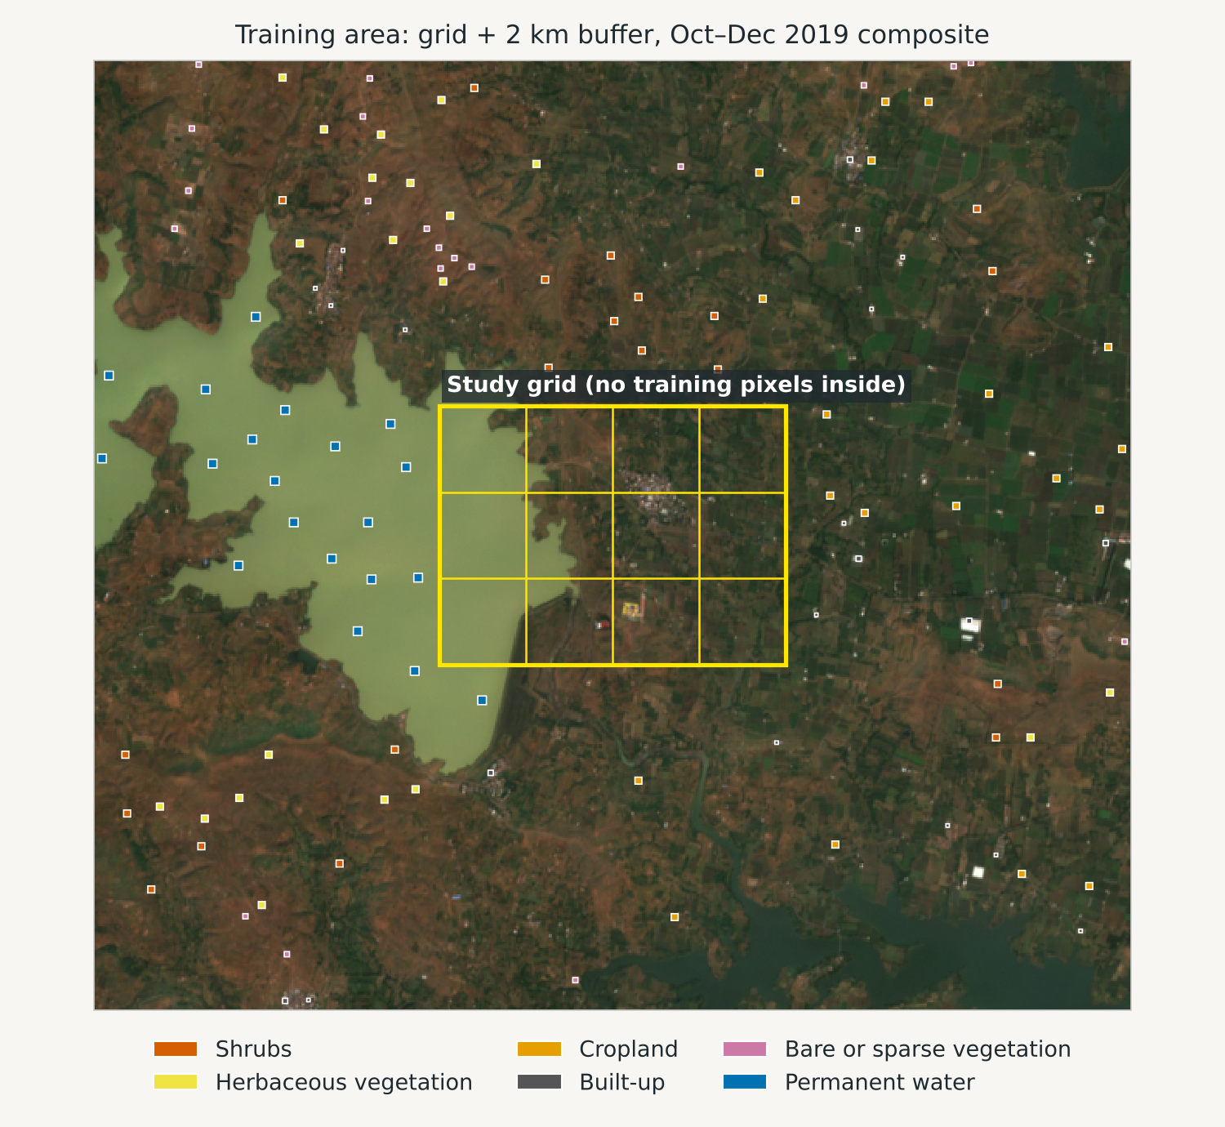
Trained outside the grid, never on comparators
TRAINING DATA
120
1,750
0
polygons, 20 per class
training pixels
pixels inside the grid
Within a 2 km buffer and at least 100 m outside the grid; 4–25 pixels per square
Pixels per class: Shrubs, Herbaceous, Cropland 320 each · Built-up 110 · Bare 180 · Water 500
Comparators opened only after RF labels were saved; no pretrained model, so no training overlap to disclose
9
Notes:
Training and evaluation locations are kept separate: every polygon sits at least 100 metres outside the grid, and the code drops any pixel that falls inside a study cell. I want to be clear that the polygons were made semi-automatically by a script written with AI help, inside zones I marked by eye, and then checked square by square in both seasons. Dynamic World and the Copernicus map were never used to train or tune the model.

Slide 10
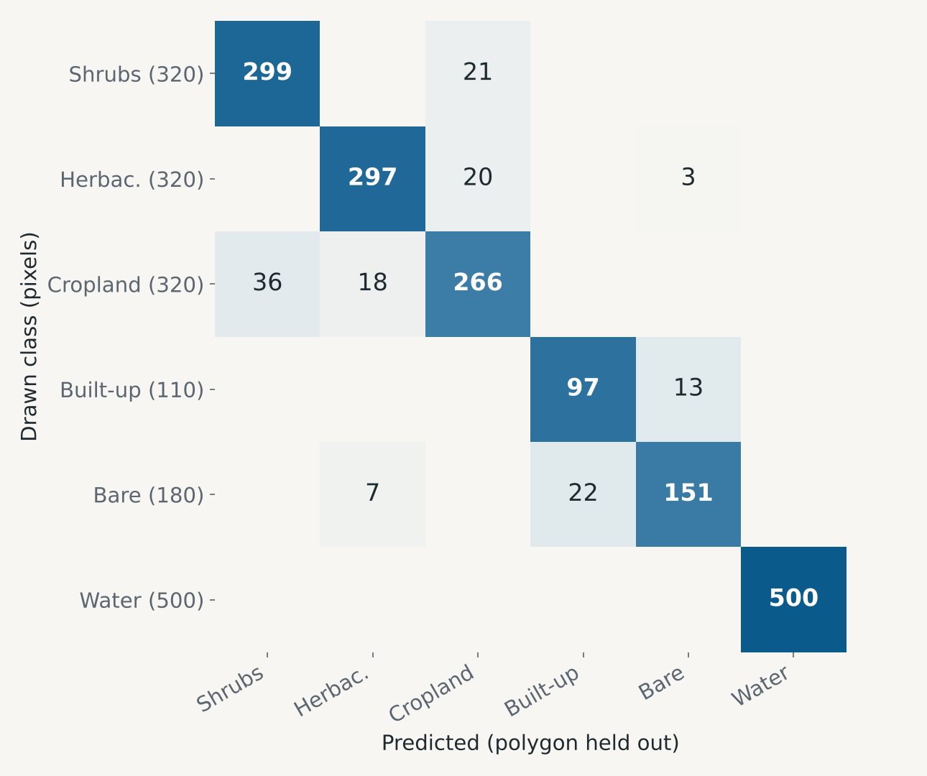
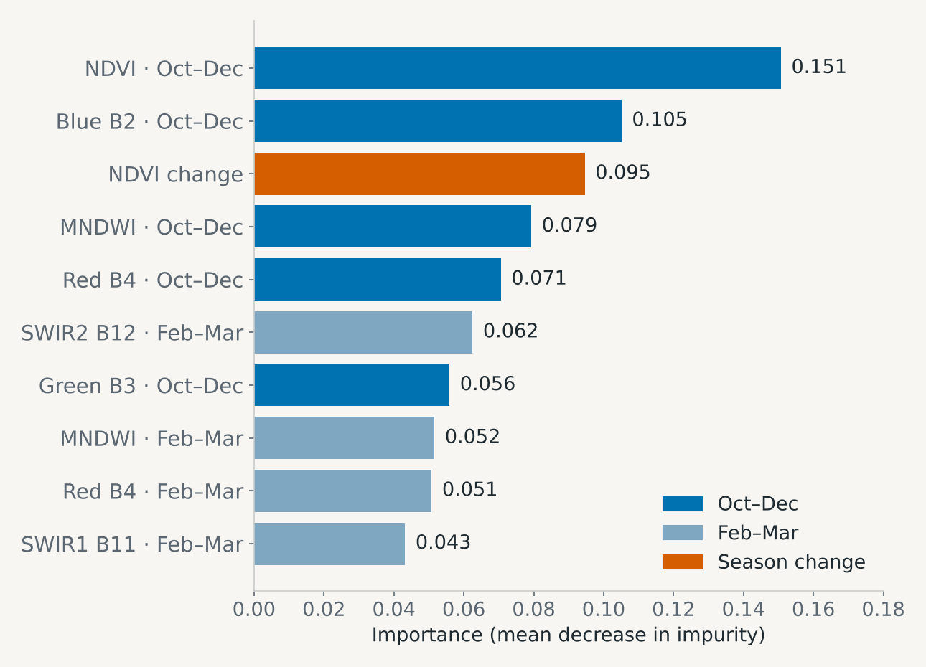
92% on held-out polygons, an optimistic number
INTERNAL CHECK
1,610 / 1,750
98.2%
grouped 5-fold CV, whole polygons held out (92.0%)
out-of-bag score (pixels held out, more optimistic)
Agreement with my polygons, not map accuracy. Squares are uniform and made by the same rules, unlike mixed 500 m cells. Weakest class: Cropland, 266 / 320.
10
Notes:
Held-out whole polygons give 1,610 correct out of 1,750 pixels, 92 percent. I do not call this accuracy: the squares are uniform patches made by the same rules in the same zones, so held-out ones resemble the training ones. The out-of-bag score, 98 percent, is even more optimistic because it holds out pixels. Cropland is the weakest class, confused with shrubs and grass, which is exactly where the comparators disagree later. NDVI change between the seasons is the third most important feature, which supports using two seasons.

Slide 11
Same footprints, different resolution and time
COMPARATORS
One 10 m grid (EPSG:32643), same 12 cells; every source valid in all 2,500 pixels of every cell.
 | Random forest (mine) | Dynamic World V1 | CGLS-LC100 Collection 3
Product ID | – | GOOGLE/DYNAMICWORLD/V1 | COPERNICUS/Landcover/100m/ Proba-V-C3/Global/2019
Time | Oct–Dec + Feb–Mar 2019 | The same 48 scenes (25 + 23) | Annual 2019
Resolution | 10 m | 10 m | 100 m (25–36 native pixels per cell)
Aggregation | Highest-probability class per pixel | Mean probability per class over all 48 images, then highest mean; 39–40 looks per pixel | Nearest neighbour onto the 10 m grid, no area weighting
Crosswalk (DW → class): water → Permanent water · grass → Herbaceous · crops → Cropland · shrub_and_scrub → Shrubs · built → Built-up · bare → Bare · trees → Forest* · flooded_vegetation → Herbaceous wetland* *comparator only
11
Notes:
Dynamic World was matched scene by scene to the 48 Sentinel-2 images in my composites, so it describes the same time window. I averaged its class probabilities over all 48 images and took the highest mean per pixel, rather than a modal label. CGLS is one 100 metre map for the whole of 2019, so each cell holds only 25 to 36 of its pixels, and it can legitimately differ where cover changes within the year. I resampled it by nearest neighbour and did not area-weight.

Slide 12
My random forest and Dynamic World give the same label in 7 of 12 cells, and overlap in 11 of 12.
MAIN FINDING
All three maps agree on open water and farmland. They part ways where cover is mixed or seasonal: the reservoir margin and the hill slope.
This is agreement between maps, not accuracy.
Notes:
Here is the headline before the evidence. My model and Dynamic World match exactly in 7 of 12 cells, and in 11 of 12 if a mixed label can match either of its classes. All three sources agree on the clear cases. The disagreements are concentrated in the places where land cover itself is ambiguous or changes through the year. None of this is accuracy: there is no independent reference here except my six visual labels.

Slide 13
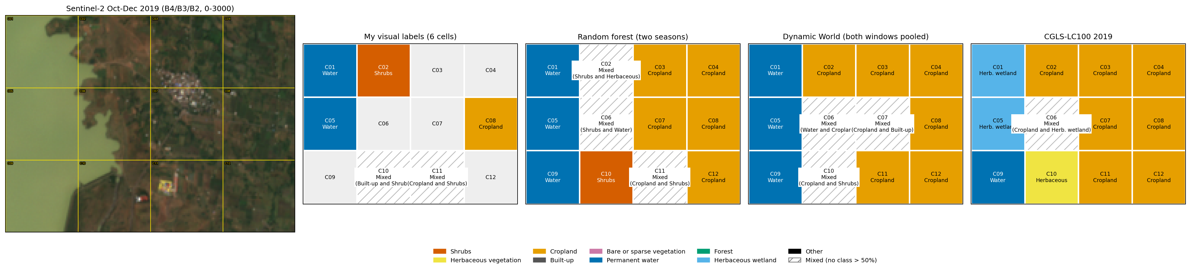
Twelve cells, four sources
RESULTS
All agree: 5 cells
CGLS: water as wetland
Three answers: C06, C10
C03, C04, C08, C12 farmland and C09 open water
C01, C05 open water become Herbaceous wetland: 100 m pixels, annual map with low-water months
Reservoir margin; C02 slope also splits (RF scrub vs cropland in both products)
13
Notes:
The figure shows each source's cell label on the same grid. Five cells, the farmland on the right and C09 water, get the same label from all three sources. Part of the Copernicus mismatch is a definition effect: it labels the open-water cells C01 and C05 as herbaceous wetland because its pixels are 100 metres and it summarises the whole year, including low-water months. The real disagreements are at the reservoir margin, C06 and C10, and on the C02 slope.

Slide 14
Every count with its denominator
AGREEMENT
Pair | Cells | Exact label | 95% CI (exact) | Same or overlapping | Area in common
RF vs Dynamic World | 12 | 7 | 32–81% | 11 | 74%
RF vs CGLS | 12 | 6 | 25–75% | 7 | 58%
Dynamic World vs CGLS | 12 | 7 | 32–81% | 9 | 66%
My labels vs RF | 6 (3 High) | 4 (2) | 30–90% | 6 (3) | –
My labels vs DW | 6 (3 High) | 3 (2) | 19–81% | 5 (2) | –
My labels vs CGLS | 6 (3 High) | 1 (0) | 3–56% | 2 (0) | –
Exact: same class, or the same Mixed pair. Overlapping: a Mixed label also matches either of its classes. Area in common: sum of the smaller share per class, mean of 12 cells. Brackets: my 3 High-confidence cells only.
Map vs map is agreement, not accuracy. My six labels are an imperfect check by one person; 4 of 6 fits a true rate anywhere from 30% to 90%.
14
Notes:
Every number here has its denominator: 12 cells between products and 6 for my visual labels, 3 of them high confidence. The Wilson intervals show how little 12 or 6 cells can tell us. 7 of 12 is consistent with a true match rate anywhere from about a third to four fifths. I keep product-versus-product agreement separate from any claim about accuracy. Against my own labels the random forest matched 4, Dynamic World 3 and Copernicus 1, but with 6 cells that ranking is fragile.

Slide 15
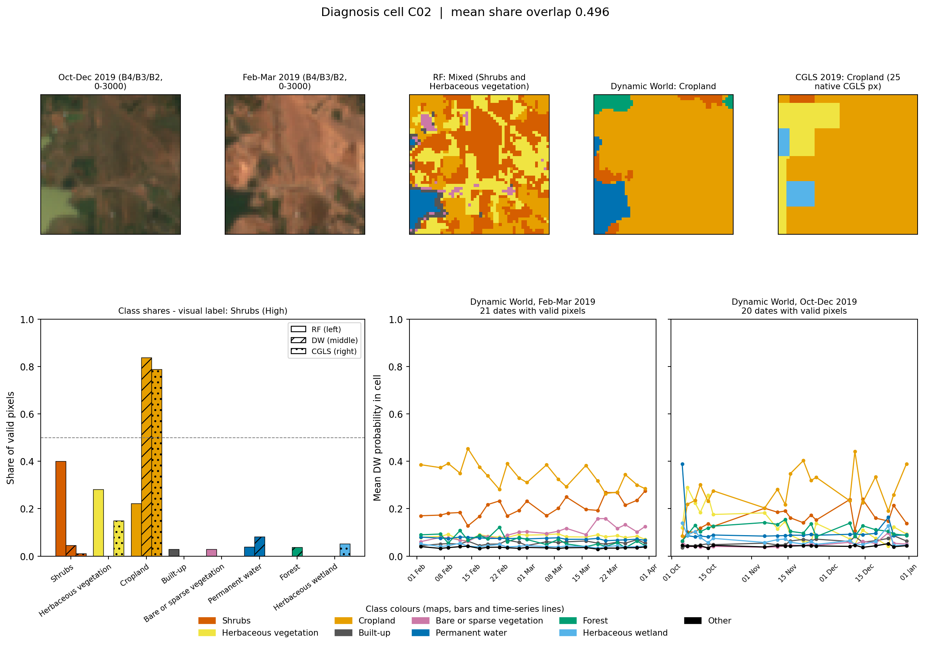
Scrub to me, cropland to both products
DIAGNOSIS 1 · C02
Source | Label
Visual | Shrubs (High)
RF | Mixed: Shrubs 40%, Herb. 28%
DW | Cropland 84%
CGLS | Cropland 79% (25 px)
OBSERVED
Pale and dry in Feb–Mar. DW's per-date cropland probability stays about 0.3–0.45: a weak preference.
HYPOTHESIS
Rain-fed fields left unplanted outside the monsoon, so they look like dry scrub.
WOULD SETTLE IT
Jun–Sep 2019 images: active fields turn green and regular. Then a field visit.
15
Notes:
I labelled C02 as shrubs with high confidence. My model splits it between shrubs and grass, while both products call it cropland. What I can observe: in February to March the slope is pale and dry, and Dynamic World's cropland probability on individual dates is only around 0.3 to 0.45, never a confident call. My hypothesis, not yet tested, is that parts of the slope are rain-fed kharif fields that lie fallow outside the monsoon. Monsoon-season imagery would test it, since active fields should look green and regular in shape.

Slide 16
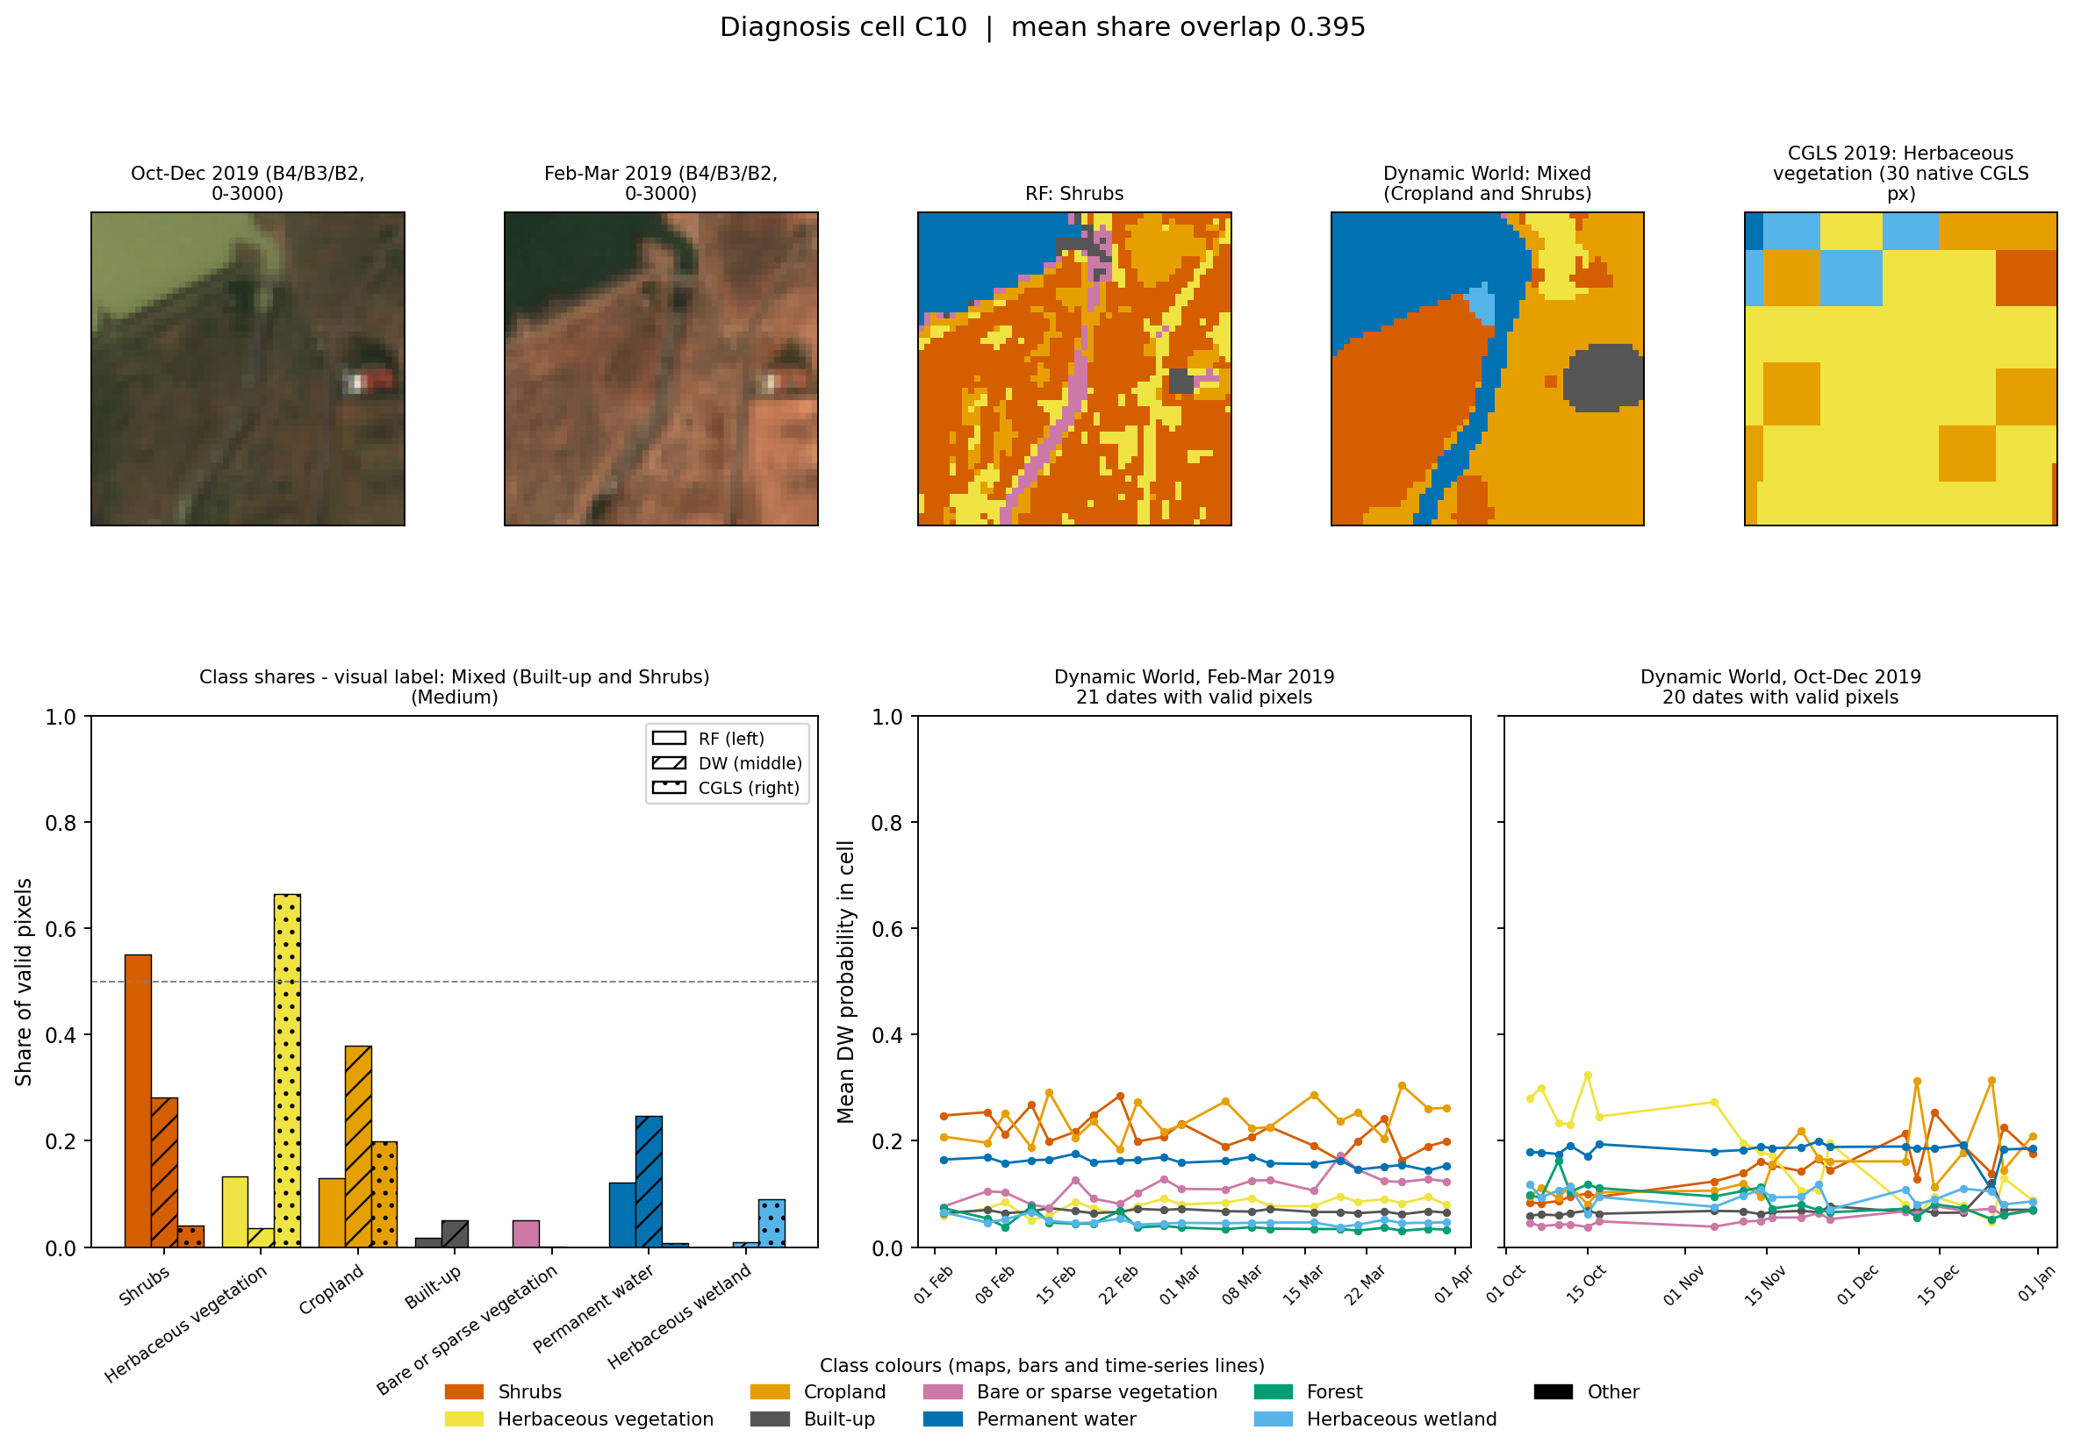
Four sources, four different answers
DIAGNOSIS 2 · C10
Source | Label
Visual | Built-up + Shrubs (Med.)
RF | Shrubs 55%
DW | Mixed: Crop 38%, Shrubs 28%
CGLS | Herbaceous 66% (30 px)
OBSERVED
Water edge, a stream channel, one small compound. Built-up is 5% or less on every map, so my label over-weighted the compound.
HYPOTHESIS
A seasonal drawdown margin, grazed or farmed as water falls, drawn differently by each map.
WOULD SETTLE IT
Monthly water extent through 2019, reservoir levels, a dated field visit.
16
Notes:
C10 sits where the reservoir meets the land. Every source gives a different answer. What I can observe is the water's edge, a stream channel the model picks out as bare ground, and one small compound. Built-up is at most 5 percent on every map, so my own label gave the compound too much weight. That is a correction to my label. The hypothesis is that this is a drawdown zone, exposed as the water falls and then grazed or farmed, which each product handles differently. A monthly series of water extent and a field visit would test it.

Slide 17
Dropping Feb–Mar changed no random-forest label
SENSITIVITY TEST · DATE WINDOW
0 / 12
RF cropland share fell, slightly
Diagnosis cells
Cell | Two seasons | Oct–Dec only
C03 | 76% | 65%
C04 | 85% | 82%
C08 | 85% | 83%
C12 | 91% | 89%
C02: no change in any product. C10: DW moves to Mixed (Herbaceous + Water), consistent with a seasonal margin, not proof of it.
RF labels changed (retrained on 9 Oct–Dec features)
2 / 12
DW labels changed (C03, C10)
Direction right, effect small. The main finding holds without the dry-season images.
7 → 6
RF–DW exact agreement, of 12
Water cells unchanged (C05 99% → 99%)
17
Notes:
I changed one choice, the date window, from two seasons to October to December only. The random forest was retrained on the nine October to December features with the same polygons, pixels and seed; Dynamic World was averaged over the 25 October to December images; Copernicus, an annual map, stayed the same. The original outputs are kept. The direction of my prediction was right: cropland share fell in every farm cell. But the effect was small and no random-forest label changed. What would have changed my conclusion is labels flipping between runs, especially in farmland cells, and that did not happen.

Slide 18
What a land-cover map cannot tell us yet
BEYOND LAND COVER
Commons use and access
A second period
Imagery shows what covers the land, not who uses it or by what right. A shrub or grass cell could be private, government or village common land.
Separate real change from seasonality and from uncertain project dates.
Same pipeline, same months, in later years
Several years first, to learn normal year-to-year variation (e.g. rainfall)
Count only changes larger than that variation and lasting across years
Unclear project start: compare periods well before and well after, not the years around it
Land records of village grazing land (gairan), 7/12 extracts
Gram panchayat decisions
Interviews with the people who use the land
Dated field visits
18
Notes:
A cell classified as shrubs or grass says nothing about tenure or use. To establish commons use I would combine the map with land records of village grazing land, gram panchayat decisions, interviews and dated field visits. For a second period, I would rerun the identical method for the same months in later years. Several years first give the normal year-to-year variation, so only changes larger than that and lasting across years count as real. If a project's start date is unclear, I would compare periods well before and well after it rather than the years right around it.

