Slide 1
One login, every app.
MOSIP DECODE 2026 · PROBLEM STATEMENT 03
OpenID Connect Native SSO for Mobile Apps, implemented in eSignet (Go) and the ThunderID engine, with Android reference apps.
Anurag Thakur · eSignet | Enable Native SSO in eSignet Go for Mobile Apps

Slide 2
Native apps do not share a login
A citizen with a wallet, a health app and a tax app from the same vendor authenticates three times: UIN, OTP, consent, every app, on the same phone. Browser cookies never reach a native app's sandbox.
What the spec asks for
A deliberately designed, cryptographically secured hand-off of authentication state between apps on one device
No shared cookie, no repeated login, no silent widening of consent
Standards: OIDC Native SSO 1.0, RFC 8693 token exchange, RFC 9449 DPoP, FAPI 2.0
3×
0
1
OTP + consent for three apps
shared session between native apps
trusted login is all that is needed

Slide 3
The solution in three moves
1
2
3
Super app logs in once
Secret stays bound
Child app signs in silently
PAR + PKCE + DPoP with a hardware key (Key A) and the new device_sso scope. eSignet returns access_token, id_token and a device_secret.
The device secret is a signed-then-encrypted JWT carrying cnf.jkt = Key A, sid, scope and the consented claims; the id_token carries ds_hash and the same sid.
Over a signature-protected IPC it gets id_token + device_secret + a DPoP proof signed by Key A, and exchanges them (RFC 8693) for its own token.

Slide 4
Architecture: who does what
PHONE (one vendor certificate)
eSIGNET (GO) + THUNDERID ENGINE
Vendor Wallet
super app · Key A in Keystore
ThunderID engine
authorization-code grant · token exchange
ds_hash · sid · cnf.jkt · scope ⊆ grant
DeviceSecretProvider (eSignet)
generate / validate · vendor family
derived consent
IPC: id_token, device_secret,
DPoP proofs (signature permission)
Keymanager
sign (OIDC key) + encrypt
(DEVICE_SECRET_ENC)
Consent store
consent_detail + history
(derived consent audit)
Vendor Health
child app · no key of its own

Slide 5
Flow 1: super app login with device_sso
1
POST /oauth2/par — scope=openid profile email device_sso, dpop_jkt = thumbprint(Key A), PKCE, PS256 private_key_jwt
id_token gains
2
Custom Tab: eSignet OTP login and consent (the user chooses which claims to release)
ds_hash
BASE64URL(SHA-256(device_secret))
sid
shared with the device secret
3
POST /oauth2/token (authorization_code) with a DPoP proof by Key A
4
Engine checks the client is registered for device_sso and calls GenerateDeviceSecret(sub, auth_id, sid, client_id, scope, acr, claims, cnf.jkt)
device_secret carries
5
eSignet signs the claims and encrypts the JWS to its component encryption key: an opaque device_secret
iss · sub · auth_id · sid · client_id · scope · acr · claims · cnf.jkt · iat · exp · jti
6
Response: access_token (cnf.jkt), id_token (ds_hash, sid), device_secret — stored encrypted in the app

Slide 6
Flow 2: child app silent sign-in
1
Child asks the super app (ContentProvider, signature-level permission): id_token, device_secret, DPoP proof for POST /oauth2/token
Seen on the phone
2
“Signed in silently in 185 ms”
No browser. No OTP. No consent screen.
act.sub = mosip-super-app
cnf.jkt = Key A
Super app re-checks the caller's signing certificate and signs the proof with Key A — the key never leaves it
3
POST /oauth2/token grant_type=token-exchange, subject_token=id_token, actor_token=device_secret, scope=openid profile email
4
Engine: client enabled · secret decrypted and verified · ds_hash · sid · sub · cnf.jkt = DPoP key · vendor family · scope ⊆ grant · consent
5
Response: DPoP-bound access_token with act.sub = super app; userinfo returns the consented claims

Slide 7
Six bindings make the hand-off safe
ds_hash
sid
cnf.jkt = DPoP key
The id_token names exactly one device secret. Swap either and the exchange fails.
Both tokens descend from the same authentication (session id, or the authorization id).
Only a proof from Key A redeems the secret; a stolen pair is useless without the hardware key.
Vendor family
Scope ⊆ grant
Derived consent
Same relying party or an allow-listed sibling, registered for device_sso. Others get invalid_grant.
The child never exceeds what the super app was granted; device_sso itself is never exchangeable.
Only claims the user accepted for the super app are released; anything else is interaction_required.

Slide 8
Bonus: re-consent instead of silent over-sharing
The super app's consent is reused, never widened. eSignet compares the child's required claims with what the user accepted and either derives a consent record for the child (with an audit row) or refuses the silent path.
Child requests
openid email
email was declined
on the super app's consent
interaction_required
“claims not consented: email”
Child requests
openid profile
name was accepted at the
super app's consent
Silent sign-in; consent recorded
for the child app + history row
On interaction_required (or invalid_scope) the child app explains why and opens the eSignet consent flow for its own client.

Slide 9
Every mandatory task, plus the bonus
# | Task | Where | Status
1 | device_sso scope on the authorize request | eSignet config · ThunderID protocol scope | done
2 | Token endpoint validates the scope for the client | ThunderID auth-code grant · eSignet provider | done
3–4 | DeviceSecretProvider interface; generate / validate | ThunderID providers · eSignet keymanager (JWS+JWE) | done
5–6 | Token endpoint issues and returns the device secret | ThunderID auth-code grant · token response | done
7–8 | Child app fetches credentials over IPC and calls token exchange with Key A DPoP | Android SDK + apps | done
9 | Token exchange: device-secret actor, ds_hash, sid, client enablement, cnf.jkt | ThunderID token exchange | done
10a / 10b | Child scope ⊆ super scope; device_sso refused on exchange | ThunderID | done
Bonus | Re-consent in the child app | ThunderID + eSignet consent + apps | done

Slide 10
What we built and how we proved it
2
upstream pull requests
thunder-id/thunderid · mosip/esignet develop-go
35/35
end-to-end checks against a live eSignet
incl. every negative case and re-consent
50+
new unit tests across the engine
and the eSignet provider
3
Android modules: SDK, Vendor Wallet,
Vendor Health, one vendor certificate
Also: Postman collection (20 requests), design + API documentation, OpenAPI update, configuration reference, demo script.

Slide 11
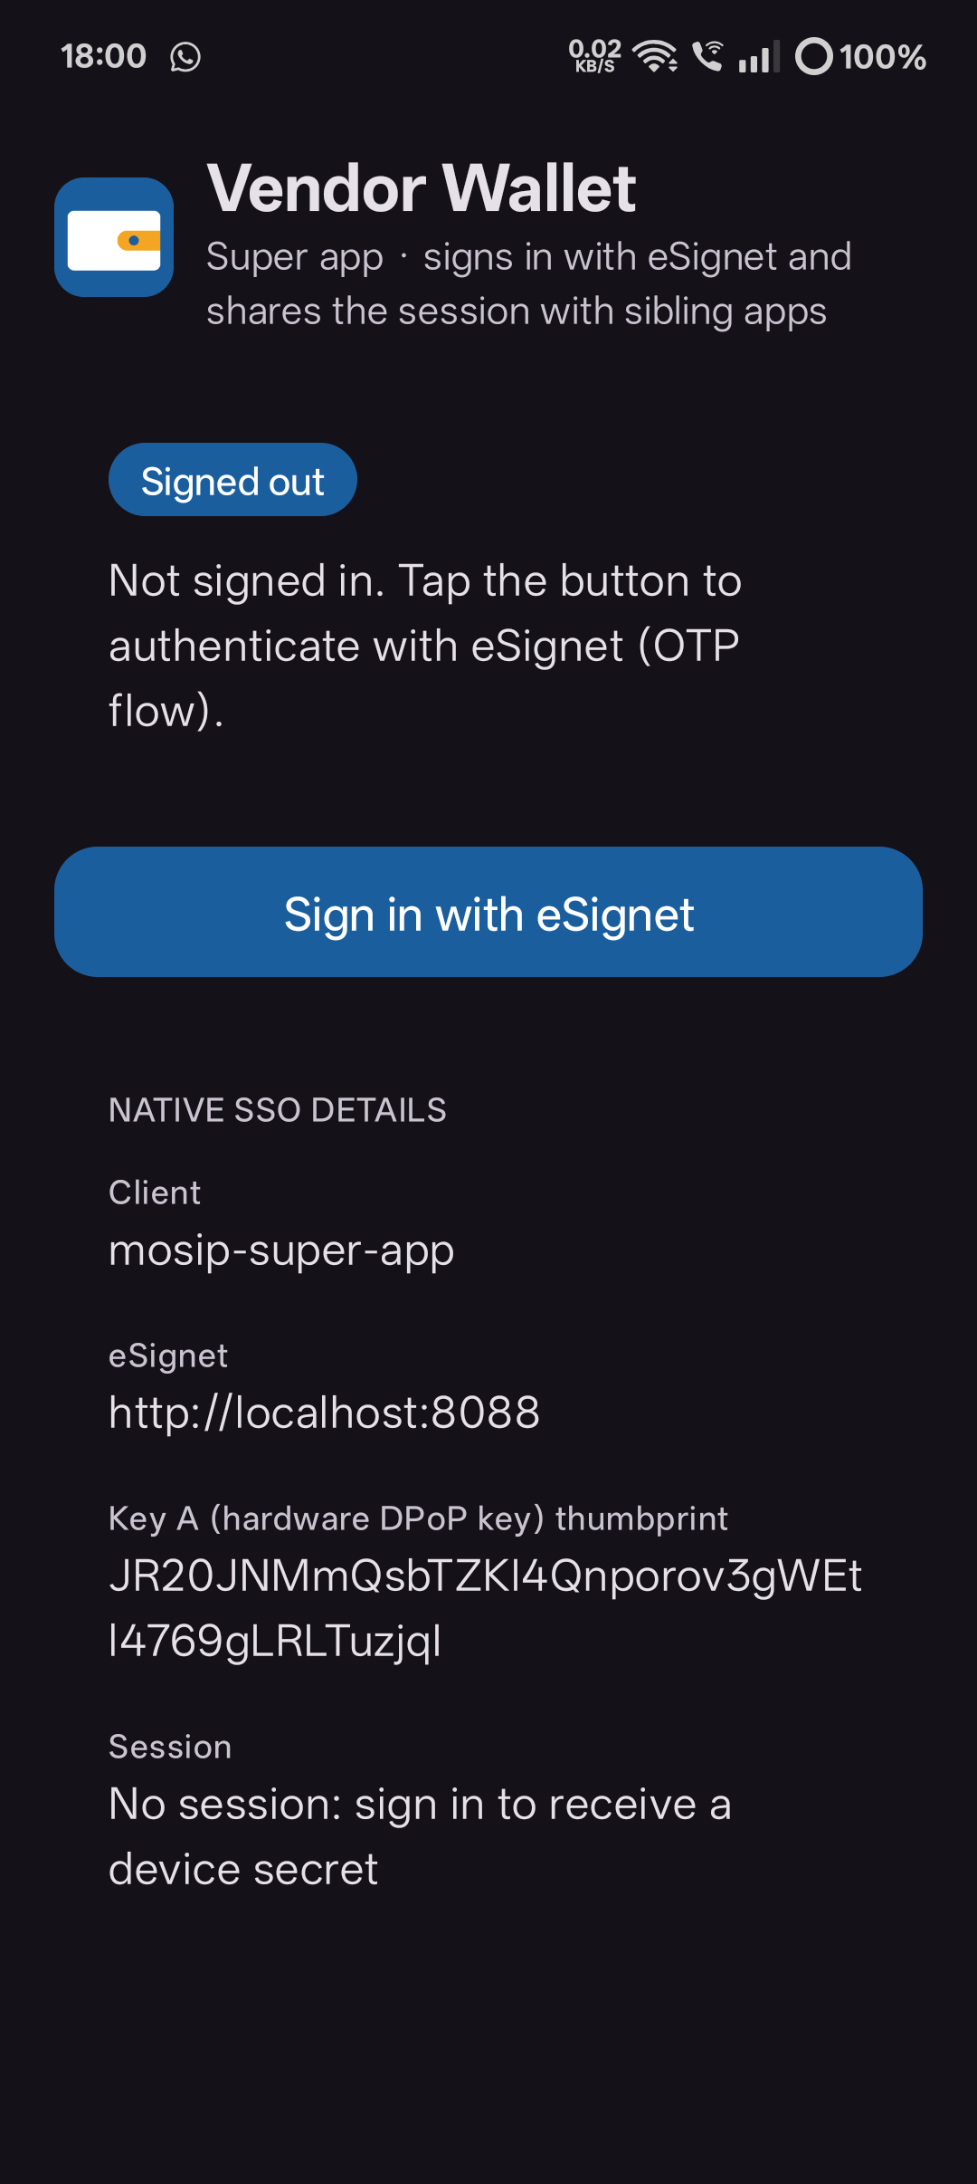
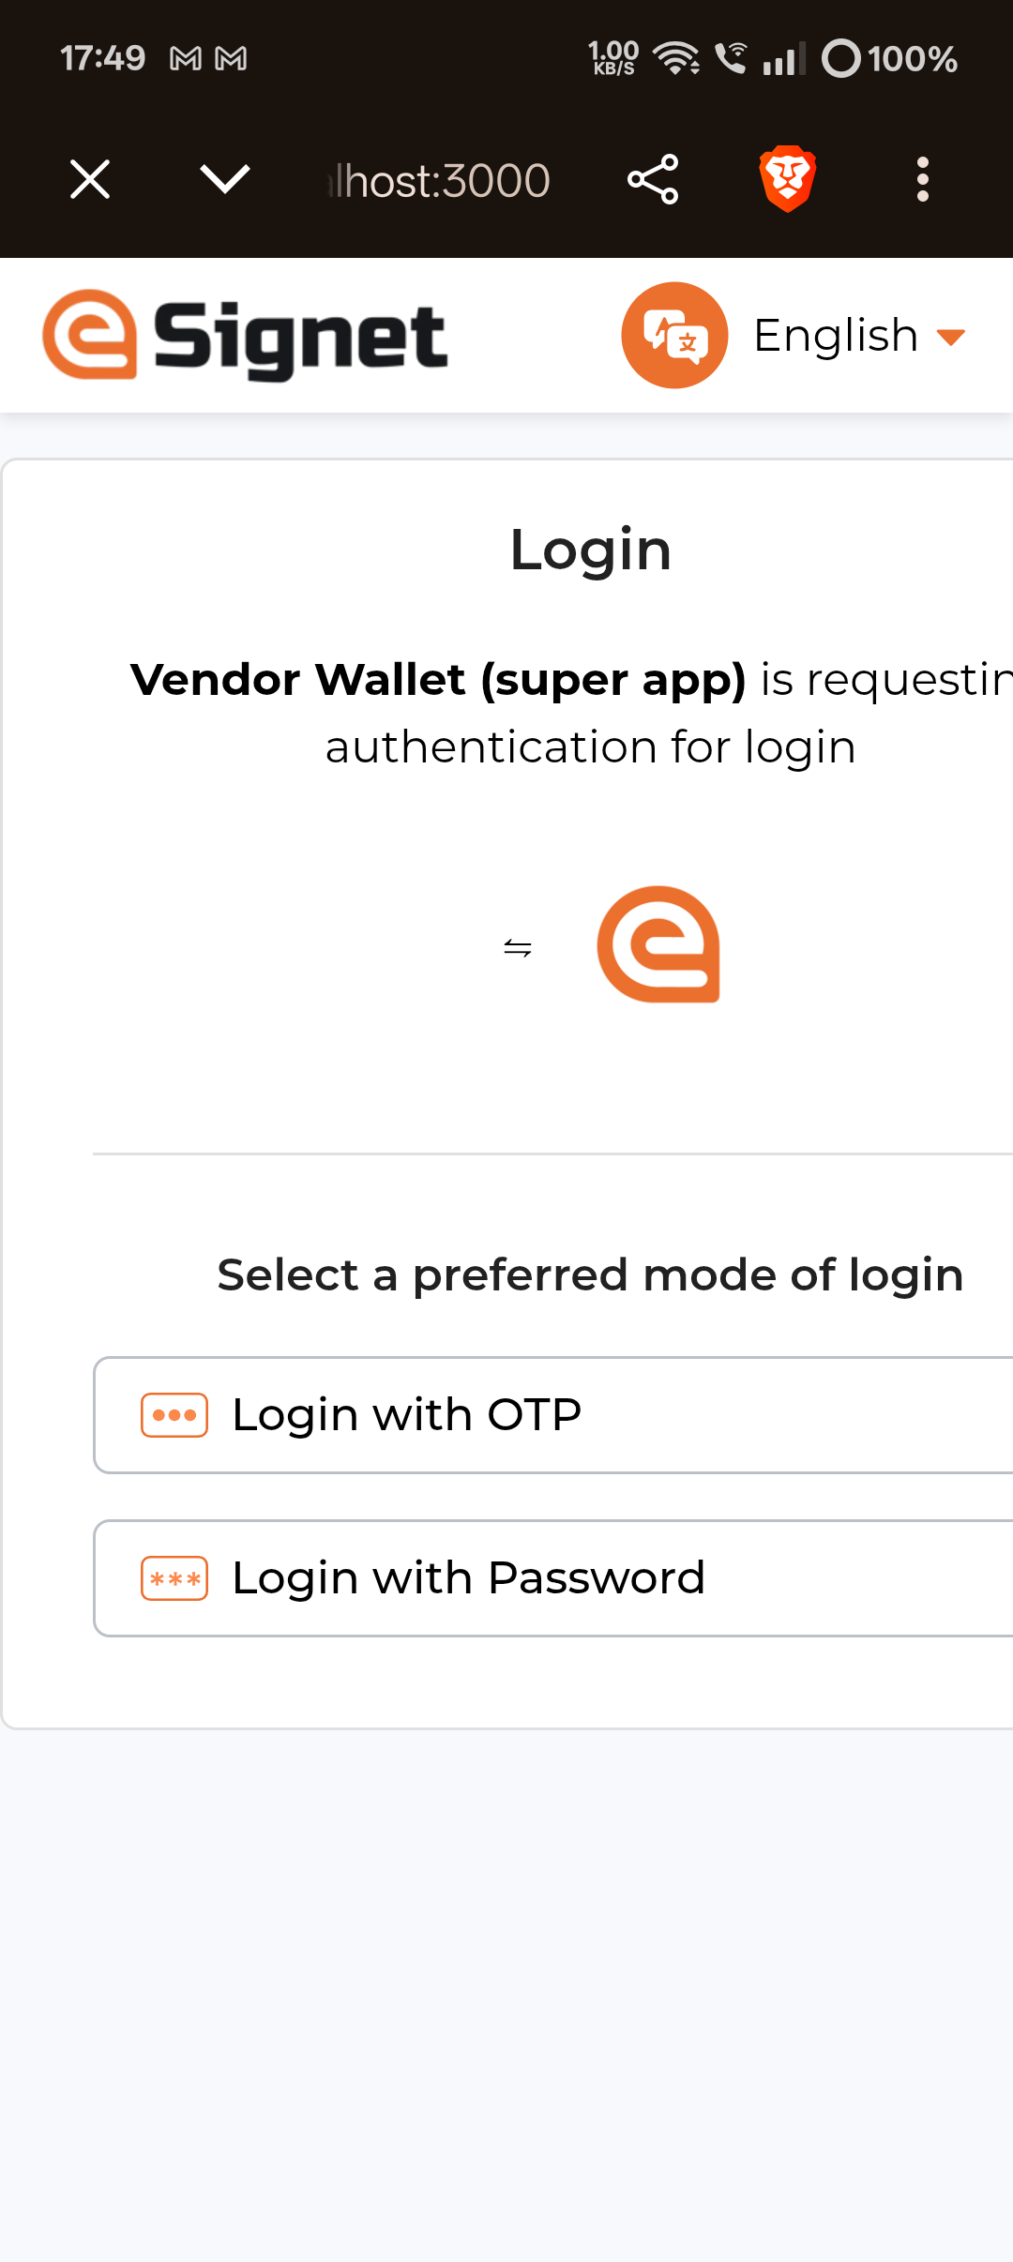
The reference apps show relying parties what to build
nativesso-sdk: PAR/PKCE/DPoP client, Key A in the Android Keystore, PS256 private_key_jwt, encrypted session store, IPC contract
Vendor Wallet exports a ContentProvider behind a signature-level permission and re-checks the caller's certificate on every call
Vendor Health never holds a key: every DPoP proof is signed by the Wallet, so its token is bound to the same hardware key
On-screen details for the demo: sid, ds_hash, SHA-256 of the stored secret, act.sub, cnf.jkt
Fallback to interactive consent when eSignet answers interaction_required or invalid_scope

Slide 12
Upstream path and what comes next
Upstream contributions
Natural follow-ups
thunder-id/thunderid: provider contracts, device-secret issuance, token exchange with device-secret actor tokens, consent hook (DCO signed-off)
mosip/esignet develop-go: DeviceSecretProvider, derived consent, token_exchange clients, config, docs (DCO signed-off)
Plus an eSignet community fix: #2555 (unrecognised consent purposeName)
Revoke a device secret family on super-app sign-out (jti is signed and available)
Single-use jti tracking where a deployment wants it
A consent-screen line item explaining device_sso to the citizen
iOS reference app (App Groups + Keychain access groups)
MOSIP IDA: encrypted KYC stays opaque; sibling apps share the relying-party decryption key

Slide 13
One trusted login, reused securely across every app in the family.
THANK YOU
Code, tests, Postman collection, documentation and the demo are in the submission repository. Try it: docker compose up, ./make.sh run, python3 tests/native_sso_e2e.py.

