Slide 1
Skin Disease Classifier
Applied Image Processing
Prepared by: Group 19
Anurag Thakur 2023IMG-008
Baviskar Pratik Subhash 2023IMG-014
Kshitij Dhamanikar 2023IMG-029
Kushagra Agarwal 2023IMG-030
Vibhor Kumar 2023IMG-054

Slide 2
Problem Statement and Objectives
Classify 8 skin disease categories from images
Develop CPU-friendly ViT-based training and inference pipeline
Increase accuracy using model ensembling and robust evaluation
Integrate best model in web application runtime
Maintain reproducible experiments with saved metrics and confusion outputs
Provide student-ready report and presentation deliverables

Slide 3
Dataset and Experimental Setup
Evaluation split: hf_hybrid_150 test set
8 classes, 23 images per class, 184 total test samples
CPU-only training environment
Leakage-safe subset verification used for reliability
Final scoring tracked with accuracy, macro precision, and macro recall
Class-level diagnostics captured using confusion matrix analysis

Slide 4
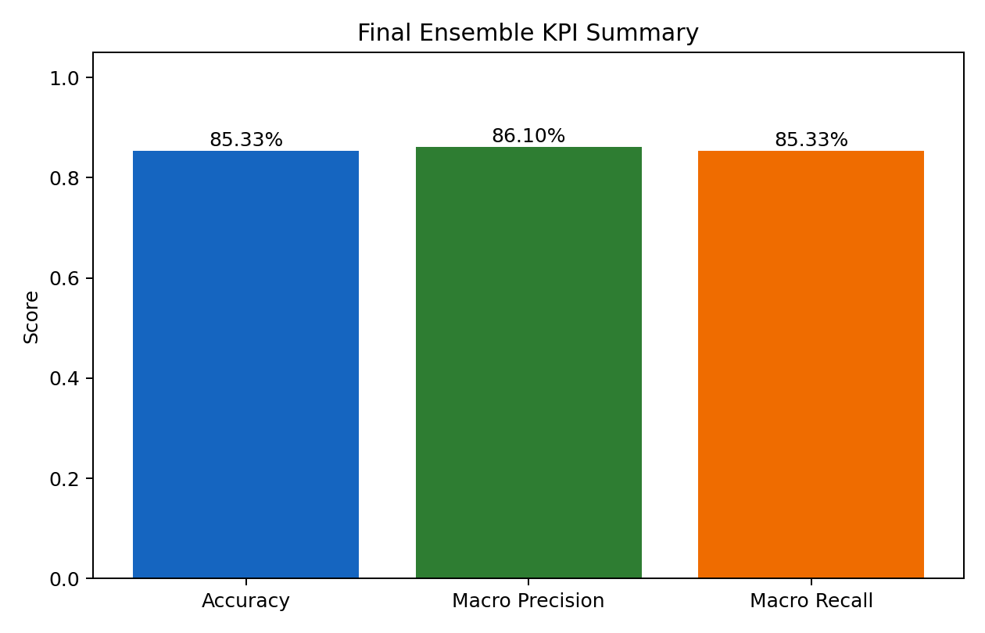
KPI Summary
Key Insights
Accuracy reached 85.33% on the test split.
Macro precision and recall both remained above 85%.
Final performance of deployed ensemble

Slide 5
Final Metrics Table
Class | Precision | Recall | Support
acne | 0.7931 | 1.0000 | 23
bcc | 0.8800 | 0.9565 | 23
bkl | 0.9091 | 0.8696 | 23
eczema | 0.8750 | 0.6087 | 23
ak | 0.9130 | 0.9130 | 23
melanoma | 0.9091 | 0.8696 | 23
psoriasis | 0.7143 | 0.8696 | 23
tinea | 0.8947 | 0.7391 | 23
Overall: Accuracy=0.8533, Macro Precision=0.8610, Macro Recall=0.8533

Slide 6
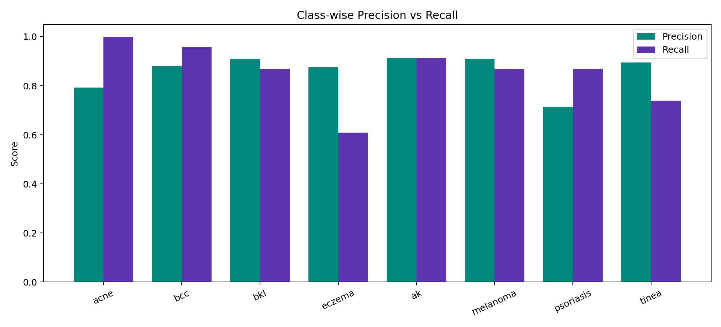
Class-wise Precision and Recall
Key Insights
Acne and BCC show strong recall.
Eczema recall is the major challenge class.
Per-class balance improved over single-model baseline.

Slide 7
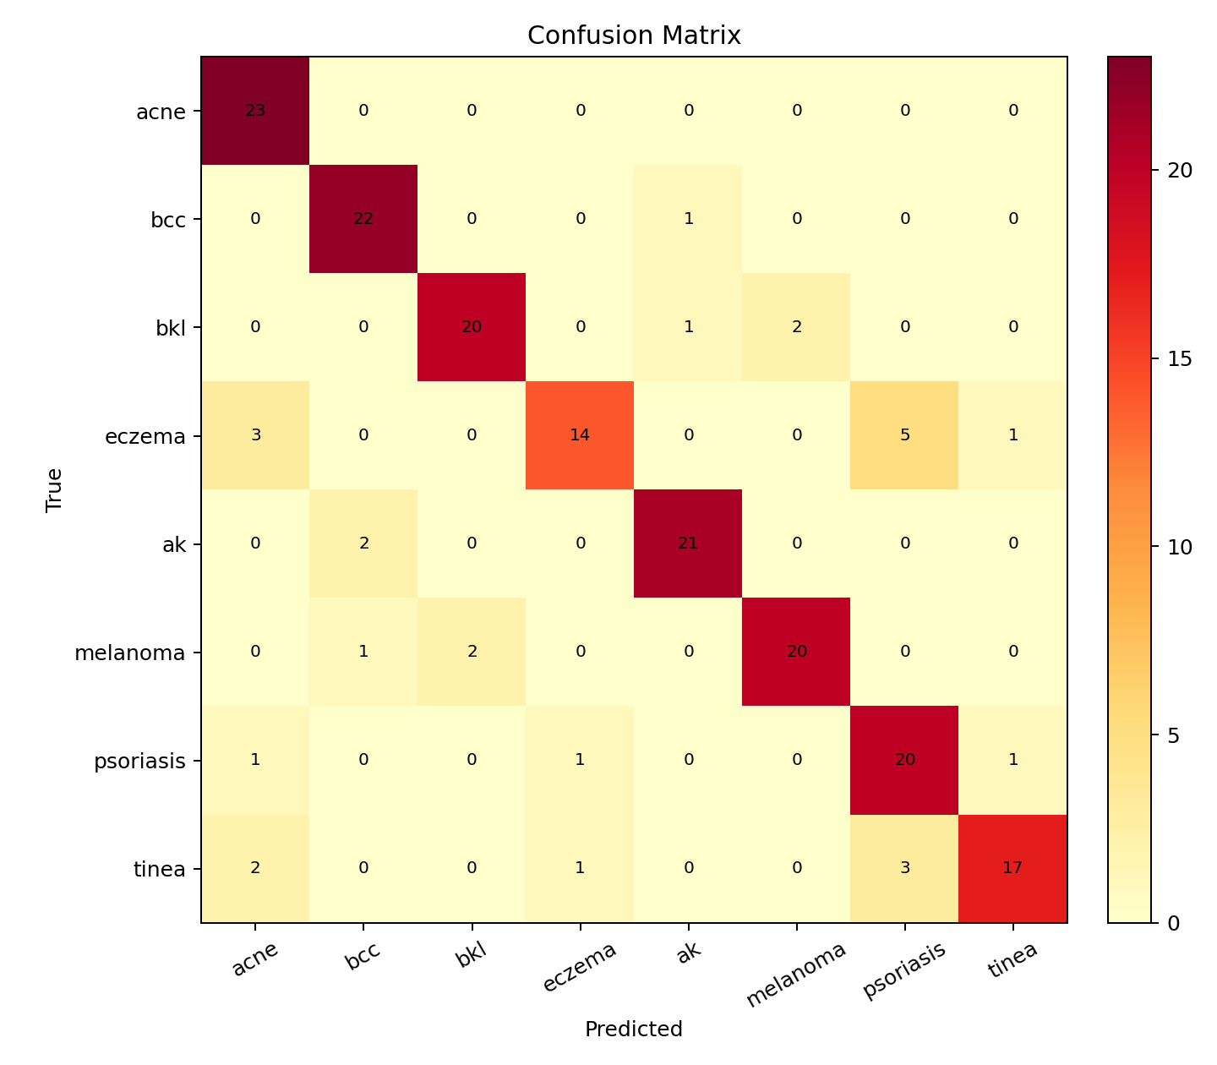
Confusion Matrix
Key Insights
Most errors occur in clinically similar categories.
AK occasionally overlaps with BCC.
Eczema and Psoriasis still need more separation.

Slide 8
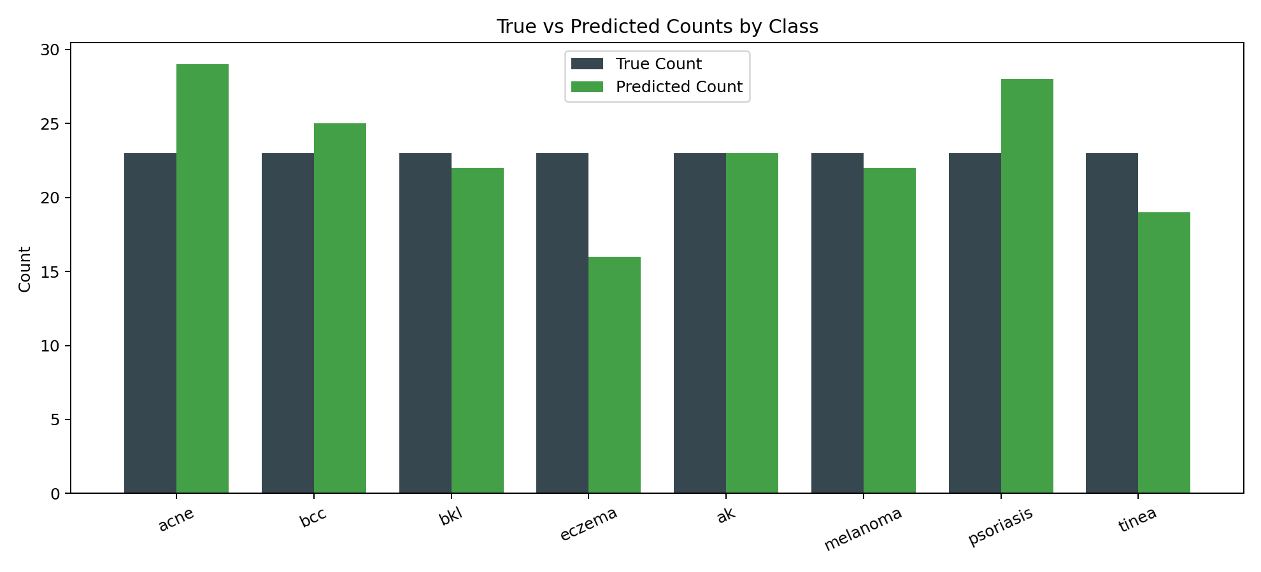
Prediction Distribution
Key Insights
Predicted volumes are close to true counts.
Some over-prediction appears in Acne and Psoriasis.
Under-prediction in Eczema aligns with recall gap.

Slide 9
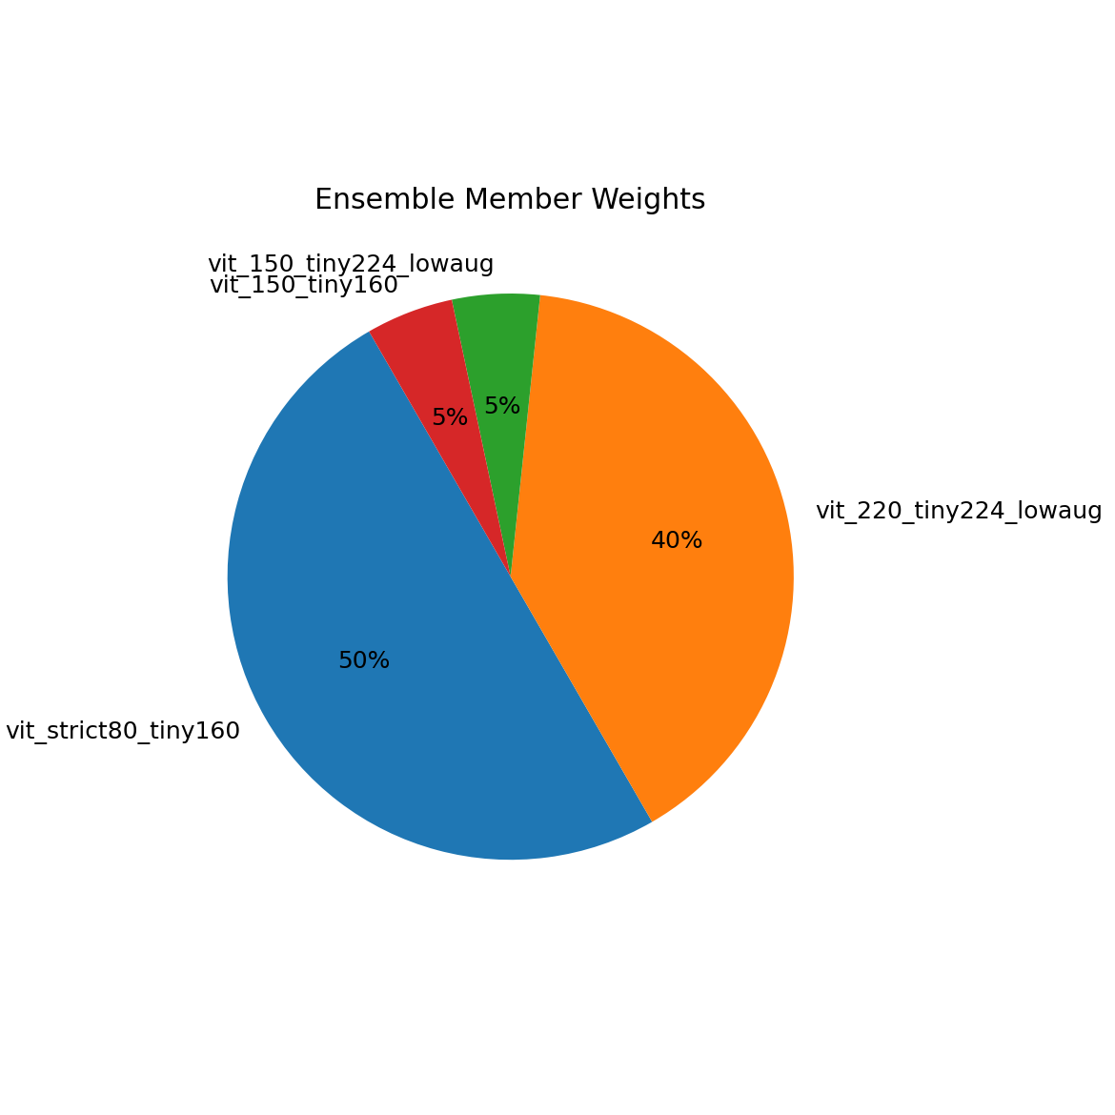
Ensemble Composition
Key Insights
Two strongest members carry 90% total weight.
Small-weight members improve calibration stability.
Weighted voting gave better robustness than single model.

Slide 10
Future Scope and Roadmap
Build strict non-overlap benchmark split for final academic evaluation
Train higher-capacity ViT with longer schedule and distillation
Add confidence thresholding and abstention for uncertain cases
Run external validation on a separate dataset
Improve Eczema and Tinea recall via targeted data curation
Deploy versioned monitoring dashboard for drift and class-wise degradation

