Slide 1
UCS503P · SOFTWARE ENGINEERING PROJECT
Poolit
Pooled Quick-Commerce for Hostels
Dev Ariwala
Paryag Kakkar
1024170433
1024170447
Odd Semester 2026–27
Notes:
Introduce Poolit and the team. Course UCS503P, Software Engineering Project.

Slide 2
PROBLEM STATEMENT
Higher cost per student
Hostel students ordering food individually each pay a full delivery fee, discouraging frequent ordering and creating inefficiency for vendors doing many small deliveries.
Every individual order carries the full delivery fee, which discourages frequent ordering.
More trips per vendor
Vendors make many small deliveries instead of consolidated runs to the same hostel.
Poolit incentivizes students to order within the same time window so deliveries can be consolidated, cutting cost per student and delivery trips per vendor.
Notes:
Explain the inefficiency of individual hostel food delivery.

Slide 3
PROPOSED SOLUTION
Poolit is a pooled quick-commerce app for college hostels — students in the same hostel order individually within a shared time-boxed window (a “slot”), and the per-student delivery fee drops in real time as more students join. The live-dropping fee counter is the core product hook.
1–2 orders
3–5 orders
6–9 orders
10+ orders
₹20
→
₹10
→
₹5
→
Free
Notes:
The live-dropping fee counter is the core hook of the product.

Slide 4
TARGET USERS
Two actors, two experiences
Students
Vendors
Mobile-first app
Desktop Vendor console
Order individually into their hostel’s open pool, watch the fee counter drop live, and track delivery — no account needed, name-only identity.
Run every hostel’s pools from one dashboard — close pools, dispatch, manage inventory, and read analytics. Authenticated via email/password.
Authenticated
All hostels, one view
No login
Live fee counter
Order tracking
Inventory & analytics
Notes:
Two personas: students on mobile, vendors on desktop.

Slide 5
FEATURE OVERVIEW
Student App
Vendor Console
Select hostel & browse that hostel’s vendor menu
View all hostels’ pools on one dashboard
Add to cart & place order into the open pool
Close a pool early, or let the timer auto-close it
Watch the delivery fee counter drop live
See a consolidated pick list per pool
Track order: Pooling → Preparing → On the way → Delivered
Dispatch closed pools & mark orders delivered
View order history & reorder
Manage inventory — restock via presets or custom amount, low-stock alerts
Manage profile, wallet & addresses
Analytics — revenue trend, orders by hour, peak-hours heatmap, hostel breakdown
Notes:
Walk through student app features, then vendor console features.

Slide 6
TECH STACK
A TypeScript monorepo, backed by Supabase
Frontend
Backend
Database
React + TypeScript, Vite, monorepo with a shared domain package (types, business rules, API client)
Express.js REST API
Supabase (PostgreSQL), incl. Postgres RPC functions for atomic operations
Auth
Deployment
Background Job
Supabase Auth (email + password) for vendors; students stay frictionless / unauthenticated
Vercel
Polling-based scheduler auto-closes pools on timer expiry, serverless-compatible via an internal sweep endpoint
Notes:
Overview of the monorepo and infrastructure choices.

Slide 7
SYSTEM ARCHITECTURE
Student App (SPA)
Vendor Console (SPA)
port 5173
port 5174
↓
Shared domain package
types · business rules · API client
↓
Express REST API
↔
Pool Scheduler
port 5057
auto-close sweep
↓
Supabase / Postgres
Supabase Auth
data + RPC functions
vendor login
Notes:
Two SPAs share a domain package, hitting an Express API backed by Supabase, plus a pool scheduler.

Slide 8
SDLC METHODOLOGY
Iterative / Incremental (Agile-influenced)
Each phase delivered a working increment — prototype, backend v1, migrated backend, authenticated console, polished UI, deployed, hardened — cycling through the standard stages repeatedly rather than a single linear pass.
Requirements
→
Design
→
Implementation
→
Testing
→
Deployment
→
Maintenance
↻ iterate through phases 1–10
Requirements
Design
Implementation
Testing
Deployment
Maintenance
Phase 1
Phases 2, 6
Phases 2–5, 7
Phase 9
Phase 7
Phases 8, 10
Notes:
Iterative/incremental, agile-influenced. Map ten phases onto the six classic SDLC stages.

Slide 9
PROJECT TIMELINE
Development Phases — Odd Semester 2026–27
Aug
Sep
Oct
Nov
1· Requirements
2· Frontend prototype
3· Backend v1 (Mongo)
4· Migrate to Supabase
5· Vendor auth
6· Console UI revamp
7· Deployment
8· Hardening pass
9· Testing & QA
10· Report & demo
Completed
In progress (current)
Planned
Notes:
Ten sprints across a 15-week semester, mapped to a Gantt chart. As of today five sprints are complete.

Slide 10
CORE BUSINESS LOGIC
Fee Ladder
Slot Lifecycle
Orders in slot
→
→
Fee
Open
Closed
Dispatched
1–2
Closes via timer expiry or manual vendor action.
₹20
3–5
₹10
Order Lifecycle
6–9
₹5
Placed
→
Pooled
→
Dispatched
→
Delivered
10+
Free
Strict, no skipped states — invalid transitions rejected (HTTP 409).
Fee is a function of distinct orders in a slot, recomputed live while open and locked once closed.
Notes:
Fee ladder plus slot and order lifecycle state machines.

Slide 11
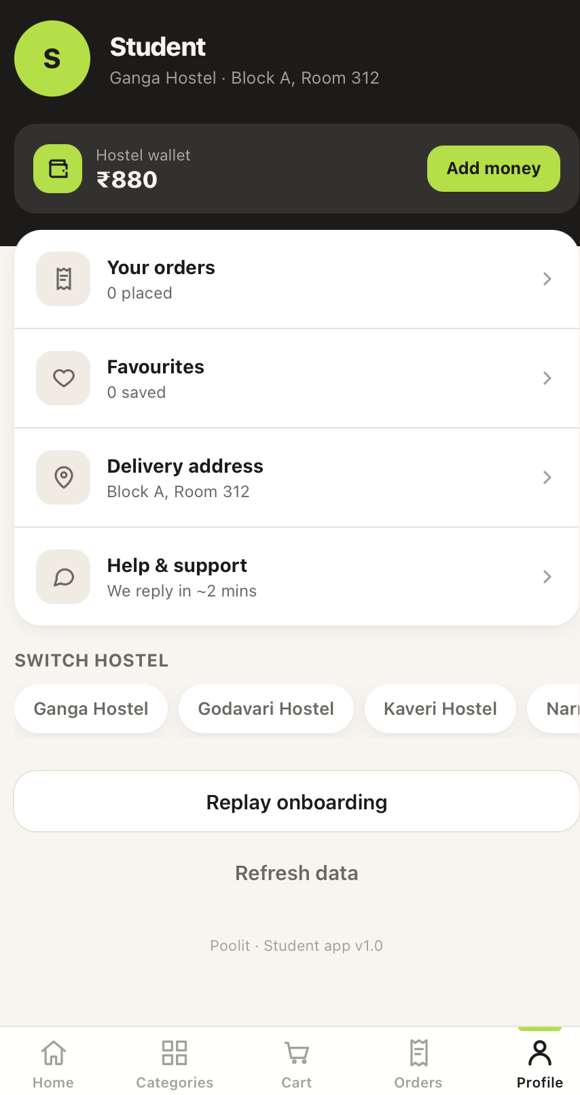
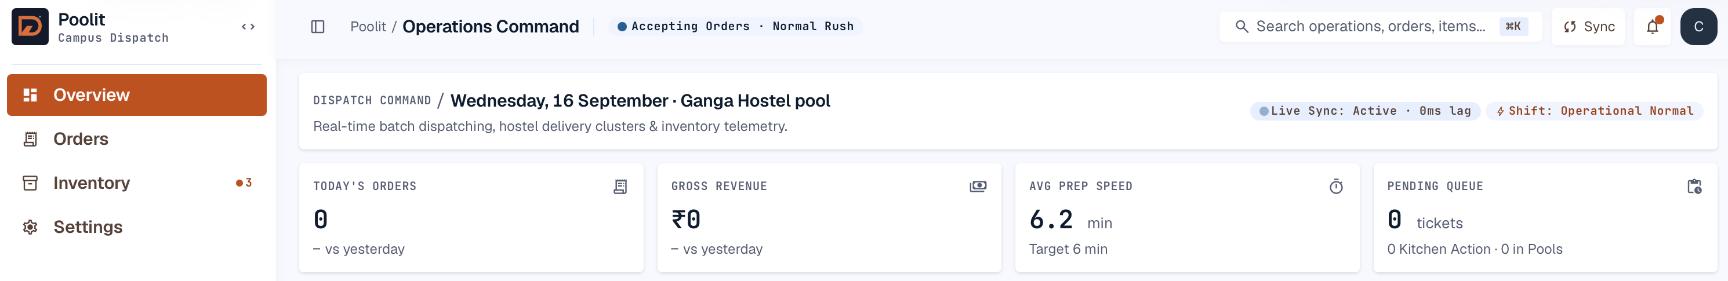
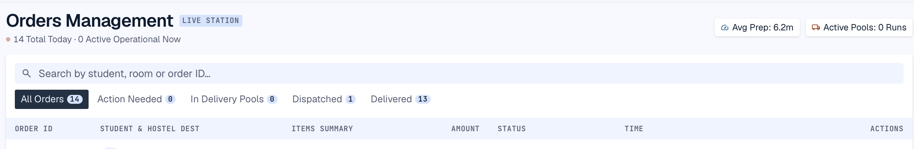
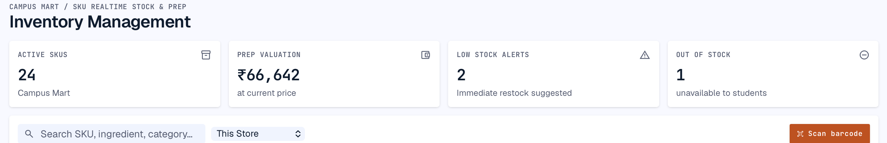
PRODUCT SCREENS
Student app & vendor console
Vendor console — Operations Command
Vendor console — Orders Management
Vendor console — Inventory Management
Student app — Profile & wallet
Notes:
Live screenshots of the student app and vendor console.

Slide 12
CHALLENGES & SOLUTIONS
Challenge
Solution
MongoDB lacked the relational integrity and built-in auth/RPC support the product needed
Migrated the backend to Supabase/Postgres, adding RPC functions for atomic operations
Concurrent orders risked overselling stock
Stock is decremented atomically inside a DB transaction on order placement
Race conditions, N+1 queries, and an open CORS policy surfaced as the system grew
Fixed during the hardening pass, alongside a CORS allowlist and formal internal documentation
Migrating physical stock counts into the digital inventory system was error-prone when entered manually
Added a barcode scanning system so vendors can check in stock directly against SKUs
Notes:
Migration, race conditions, and backend hardening were the main engineering challenges.

Slide 13
FUTURE SCOPE
Known Limitations
Planned Next
No real product photography yet (emoji-based placeholder tiles)
Checked-in DB schema / migrations
No per-store vendor account scoping — every vendor sees every hostel/store
Local JWT verification
Per-store vendor scoping
Delivery riders are static/simulated, no real courier integration
Pagination
Real product imagery & real dispatch integration
Notes:
Known limitations and what's planned next.

Slide 14
CONCLUSION
Poolit applies an iterative SDLC to a real hostel logistics problem — from an in-memory prototype to a deployed, authenticated, Supabase-backed product with a live-dropping fee as its core hook.
Dev Ariwala
Paryag Kakkar
Thank you
1024170433
1024170447
Notes:
Close with a summary and thank the audience.

