Slide 1


Team Details
Team name:
Team leader name:
Problem Statement: Digital Asset Protection

Slide 2
Brief:
This solution provides a functional MVP for ScanGuard, a digital asset protection tool for sports media. It's a Next.js 16 application featuring a Bento Box Grid UI. Users input a URL or content description, which is sent to a server-side Gemini AI endpoint. The AI analyzes the content for unauthorized use, returning a structured verdict. The application then parses and displays the risk level, confidence score, red flags, and recommended actions in an intuitive, responsive dashboard.

Slide 3
Opportunities:
• Differentiation
• The UI's distinctive Bento Box Grid style immediately sets it apart from typical analytics dashboards, offering a visually engaging and information-rich experience. The dedicated focus on "digital sports media" combined with direct, actionable AI insights creates a niche, high-value tool.
• Problem Solving Approach
• The solution tackles the visibility gap by centralizing an AI-powered analysis for diverse digital content (URLs, text snippets). It shifts organizations from reactive content discovery to proactive authentication and anomaly detection, streamlining IP enforcement efforts.
• USP
• ScanGuard's unique selling proposition lies in its combination of an intuitive, modern Bento Box UI with a powerful, specialized AI backend (Gemini) tailored specifically for digital sports media copyright detection, offering clear, actionable risk assessments.

Slide 4
Features:
• Intuitive Input Interface: A prominent, styled input field for URLs or content descriptions.
• AI-Powered Analysis: Server-side integration with Google's Gemini-2.5-Flash model for sophisticated content review.
• Structured Results Display: Clear presentation of risk level (HIGH/MEDIUM/LOW), confidence score, key red flags, and actionable recommendations.
• Dynamic Bento Box UI: Responsive grid layout with distinct, varying-sized cards for visual hierarchy and data organization.
• Real-time Feedback: Loading indicators and error handling ensure a smooth user experience.

Slide 5
Technologies:
• Frontend Framework: Next.js 16 (App Router)
• Language: TypeScript
• Styling: Tailwind CSS + Custom CSS Variables
• Icons: Lucide React
• AI Integration: Google Gemini-2.5-Flash

Slide 6
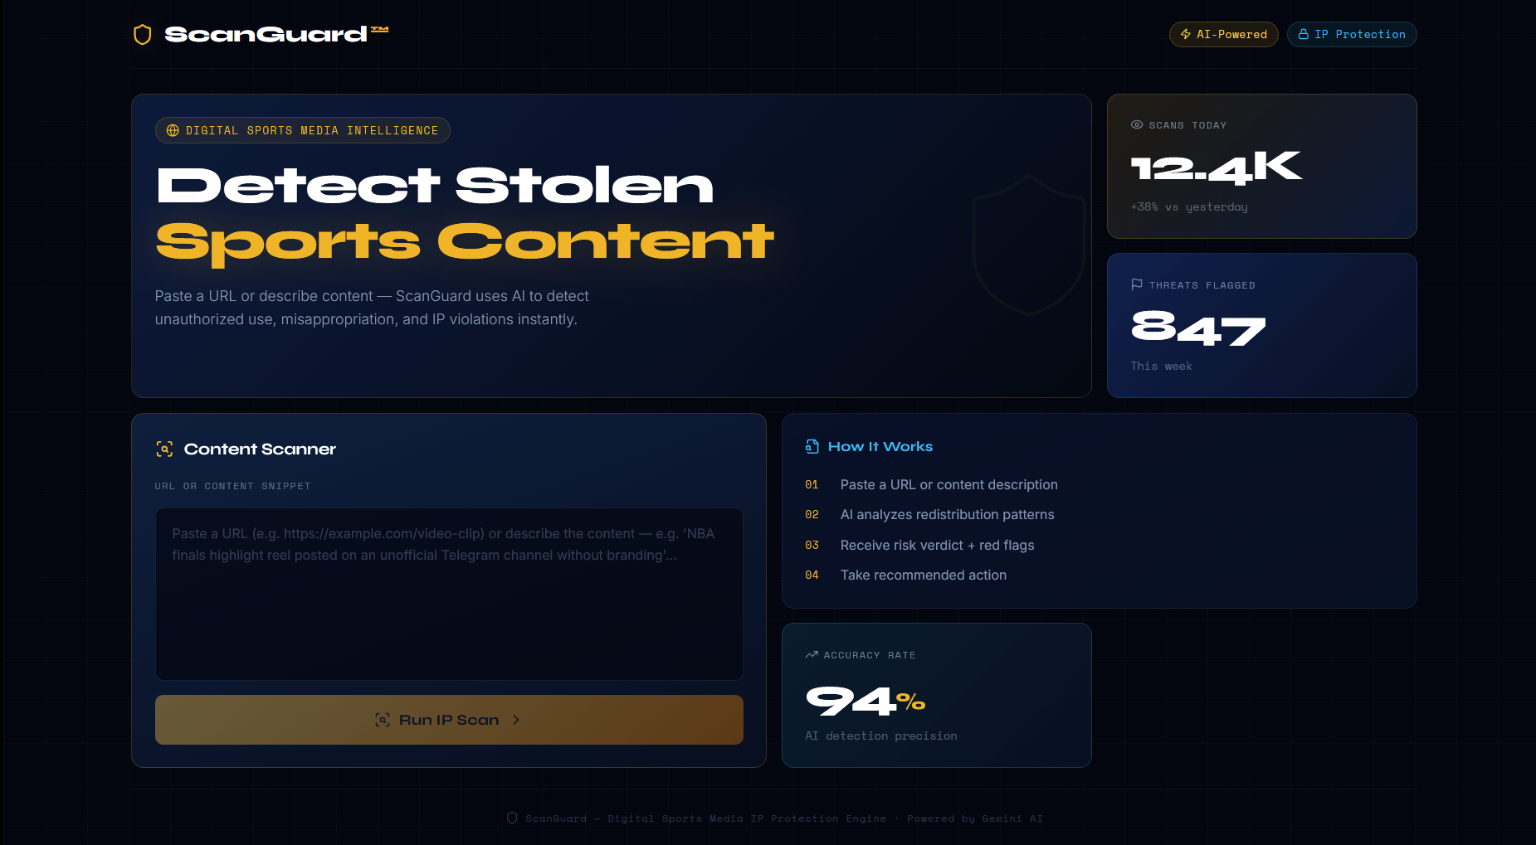
Snapshots of the MVP

Slide 7
Links:
GitHub Public Repository:
Working Prototype Link: https://scangaurd.vercel.app/

Slide 8


