Slide 1


Team Details
Team name:
Team leader name:
Problem Statement: Digital Asset Protection

Slide 2
Brief:
PropagationMap is a Next.js 16 web application designed to combat widespread digital misappropriation of high-value sports media. It empowers sports organizations to proactively authenticate their digital assets and detect anomalies in content propagation. Users describe a media asset, and the Gemini AI simulates its likely spread across global platforms, identifying high-risk channels, potential anomaly signals, and providing a comprehensive timeline narrative. This innovative solution transforms a vast visibility gap into actionable intelligence for IP protection.

Slide 3
Opportunities:
• Differentiation
• PropagationMap stands out through its specialized focus on digital sports media, leveraging an AI-powered propagation simulation engine. Its distinctive Glassmorphism UI offers a premium, intuitive user experience, while near real-time anomaly detection provides a critical advantage over traditional, reactive IP monitoring tools.
• Problem Solving Approach
• The solution adopts a proactive approach, moving beyond reactive takedowns. By simulating propagation, it offers predictive analytics for risk assessment. It enables organizations to authenticate their assets upfront and provides comprehensive insights into likely unauthorized spread, allowing for targeted intervention and strategic IP defense.
• USP
• The unique selling proposition of PropagationMap is its AI-driven predictive intelligence on media propagation, specifically tailored for the dynamic landscape of sports content. This, combined with an elegant and functional Glassmorphism interface, offers an unparalleled tool for digital asset security and IP rights enforcement.

Slide 4
Features:
• Interactive input form for detailing media assets (name, type, publish date, original platform).
• AI-generated propagation risk summary, detailing likely spread patterns.
• Identification of the top 3 high-risk platforms for unauthorized redistribution.
• Detection and flagging of specific anomaly signals indicative of misappropriation.
• A concise timeline narrative outlining the asset's expected spread and potential misuse.
• Visually stunning and responsive Glassmorphism UI with smooth animations.
• Robust loading and error handling for a seamless user experience.

Slide 5
Technologies:
• Next.js 16 (App Router) for a modern, performant web application.
• TypeScript for enhanced code quality and developer experience.
• Tailwind CSS combined with custom CSS for rapid, precise, and Glassmorphism-compliant styling.
• Lucide React for a comprehensive and lightweight icon set.
• Gemini 2.5 Flash API for advanced content propagation analysis and simulation.

Slide 6
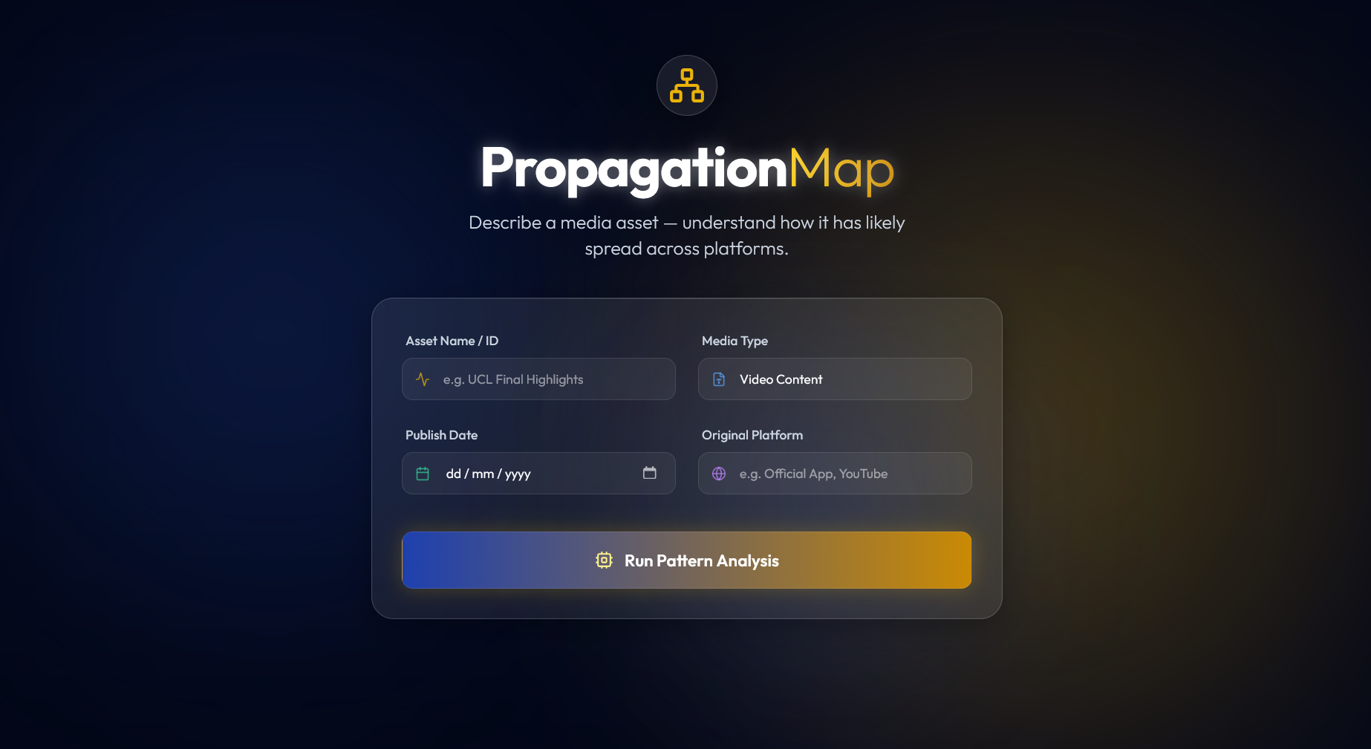
Snapshots of the MVP

Slide 7
Links:
GitHub Public Repository:
Working Prototype Link: https://propagationmap.vercel.app/

Slide 8


