Slide 1


Team Details
Team name:
Team leader name:
Problem Statement: Digital Asset Protection

Slide 2
Brief:
This solution delivers AuthentiProof, a Next.js 16 web application designed to protect digital sports media. It addresses the challenge of widespread digital misappropriation by allowing users to submit metadata about their digital assets. Gemini AI then analyzes this information to provide an authenticity score, identify originality signals, flag anomalies, and offer a concise verification summary, enabling proactive IP rights management.

Slide 3
Opportunities:
• Differentiation
• AuthentiProof offers a unique blend of AI-driven deep analysis for digital asset authentication specifically tailored for the high-volume, high-value sports media industry. Its minimalist UI distinguishes it from cluttered enterprise solutions, providing a clean, focused user experience.
• Problem Solving Approach
• The solution tackles content misappropriation by creating a digital fingerprint from metadata and comparing it against known patterns of authenticity. By providing a quantifiable authenticity score and detailed reports, it empowers sports organizations to take immediate action against unauthorized use.
• USP
• The core USP is the "Authenticity Confidence Score" combined with specific "Originality Signals" and "Suspicious Anomalies," all generated in near real-time through intelligent metadata reasoning by Gemini AI, presented in a highly intuitive, minimalist interface.

Slide 4
Features:
• Metadata Input Form: Users input key asset details (title, creator, date, format, platform, watermarks).
• AI-Powered Authentication: Gemini AI processes metadata to assess asset originality and integrity.
• Authenticity Confidence Score: A numerical score (0-100%) indicating the likelihood of authenticity.
• Detailed Verification Report: Includes lists of originality signals, suspicious anomalies, and a summary.
• Minimalist, Responsive UI: Clean design focusing on essential information and easy interaction across devices.
• Real-time Feedback: Provides immediate loading states and results display.

Slide 5
Technologies:
• Framework: Next.js 16 (App Router)
• Language: TypeScript
• Styling: Tailwind CSS + Custom CSS Variables
• AI Integration: Google Gemini 2.5 Flash API
• Icons: Lucide-React
• Constraints:
• No fluff
• No repetition
• Keep concise
• Bullet points where appropriate

Slide 6
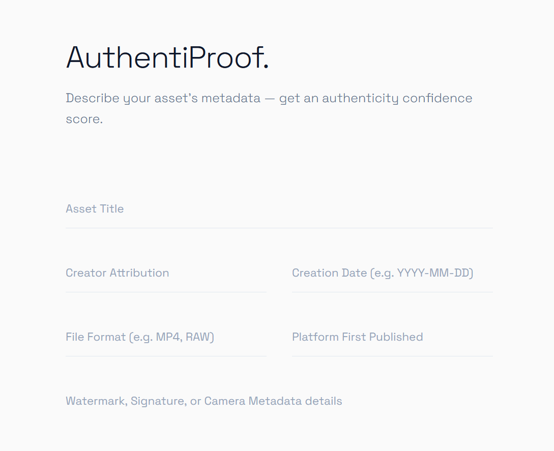
Snapshots of the MVP

Slide 7
Links:
GitHub Public Repository
Working Prototype Link

Slide 8


