Slide 1


Team Details
Team name:
Team leader name:
Problem Statement: Digital Asset Protection

Slide 2
Brief:
TamperLens is an AI-powered Next.js application designed to safeguard digital sports media integrity. It enables sports organizations to combat content misappropriation by analyzing file properties for signs of tampering or cloning. By leveraging Gemini AI for forensic analysis, TamperLens provides specific tampering indicators, a clone likelihood score, and actionable next steps, allowing for proactive authentication and near real-time detection of unauthorized media usage across global platforms.

Slide 3
Opportunities:
• Differentiation
• TamperLens specializes in AI-driven forensic analysis for the unique domain of digital sports media, providing granular tampering indicators, clone likelihood scores, and actionable recommendations. Its focus on near real-time anomaly detection and proactive authentication offers a distinct advantage in protecting proprietary content across diverse platforms.
• Problem Solving Approach
• The solution empowers users to describe a media file's characteristics (e.g., type, resolution, encoding, watermarks). Gemini AI then analyzes this detailed description for inconsistencies or anomalies indicative of manipulation. The output clearly delineates tampering signals, assesses clone likelihood, identifies manipulation types, and suggests concrete verification steps, moving beyond simple detection to active incident response.
• USP
• TamperLens's unique selling proposition lies in its specialized AI-powered forensic analysis tailored for digital sports media, delivering precise tampering detection and actionable insights for robust IP protection. It offers proactive, near real-time monitoring capabilities, empowering sports organizations to maintain control and authenticity of their digital assets.

Slide 4
Features:
• File Property Input: Users describe media file attributes such as type, resolution, size, encoding details, visible watermarks, and platform source.
• AI-Powered Analysis: Utilizes Gemini AI to forensically analyze file property descriptions for tampering signals, encoding inconsistencies, resolution mismatches, and metadata anomalies.
• Tampering & Cloning Detection: Identifies specific tampering indicators with severity ratings (HIGH/MEDIUM/LOW) and provides an overall clone likelihood score.
• Manipulation Type Identification: Detects and specifies the type of manipulation or unauthorized modification found in the media.
• Recommended Next Steps: Offers clear, actionable recommendations for verification and response based on the analysis results.
• Professional User Interface: Provides a clean, professional, and responsive UI with clear loading states and graceful error handling.

Slide 5
Technologies:
• Framework: Next.js 16 (App Router)
• Language: TypeScript
• Styling: Tailwind CSS + Custom CSS
• Icons: lucide-react
• AI Integration: Google Gemini API (`gemini-2.5-flash` model)

Slide 6
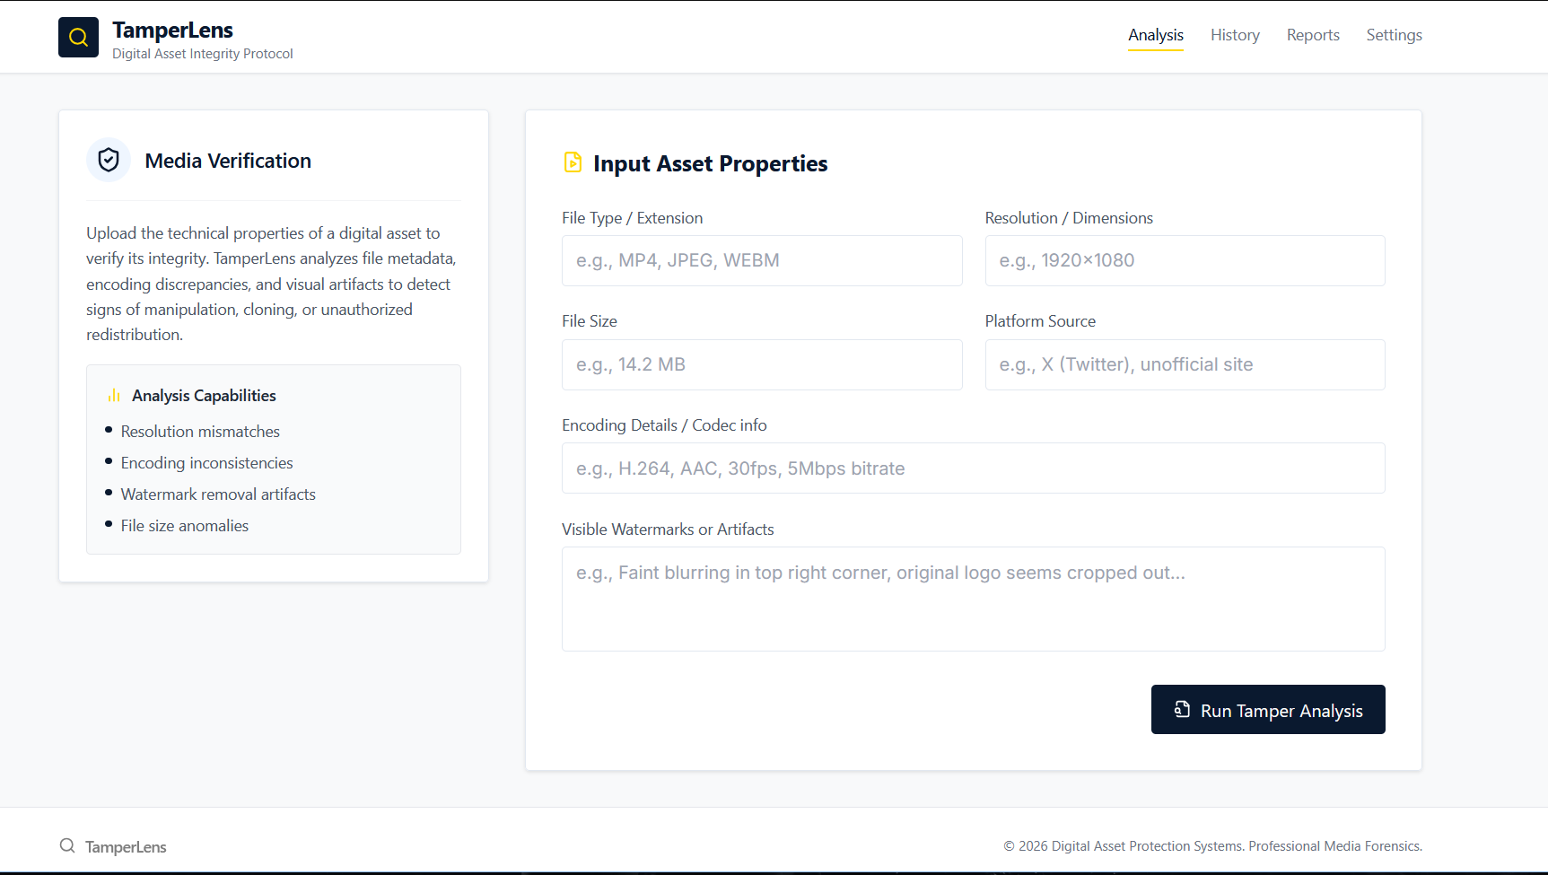
Snapshots of the MVP

Slide 7
Links:
GitHub Public Repository
Working Prototype Link: https://tamperlens.vercel.app/

Slide 8


