Slide 1


Team Details
Team name:
Team leader name:
Problem Statement: Digital Asset Protection

Slide 2
Brief:
The RightsDesk application is a Next.js 16 web platform designed to assist sports organizations in managing and protecting their digital media assets. It allows users to register asset details or ask natural language questions about their IP rights. Leveraging Gemini AI, the system acts as a digital rights advisor, providing instant insights into ownership status, applicable protections, licensing options, and recommended actions, displayed in a professional Glass UI.

Slide 3
Opportunities:
• Differentiation
• RightsDesk differentiates itself through its innovative use of AI as a 'digital rights advisor' for sports media, offering near real-time insights and actionable recommendations, which is a significant advancement over traditional, reactive IP management systems.
• Problem Solving Approach
• The solution centralizes IP rights management by enabling organizations to register assets and query rights status through a natural language interface. Gemini AI processes these queries and asset details, providing comprehensive assessments and protection strategies, thus closing the visibility gap and empowering proactive defense against misappropriation.
• USP
• The unique selling proposition is its intelligent, AI-powered "digital rights advisor" capability, providing immediate, context-aware legal and strategic guidance for sports media assets within a sleek, intuitive Glass UI.

Slide 4
Features:
• AI-Powered Rights Consultation: Users can submit asset details or natural language questions to receive immediate rights assessments and strategic recommendations from a Gemini AI advisor.
• Glass UI Design: A premium, dark-mode interface with translucent glass cards, defined borders, and glowing accents, providing a modern and professional user experience.
• Structured Output Display: Gemini AI responses are parsed and presented with a clear visual hierarchy, breaking down complex information into digestible sections like ownership, protections, licensing, and recommended actions.
• Responsive Design: The application is fully responsive, ensuring optimal usability across desktop and mobile devices.

Slide 5
Technologies:
• Frontend Framework: Next.js 16 (App Router)
• Language: TypeScript
• Styling: Tailwind CSS + Custom CSS (Glass UI, variables)
• Icons: Lucide-React
• AI Integration: Google Gemini API (`gemini-2.5-flash`)

Slide 6
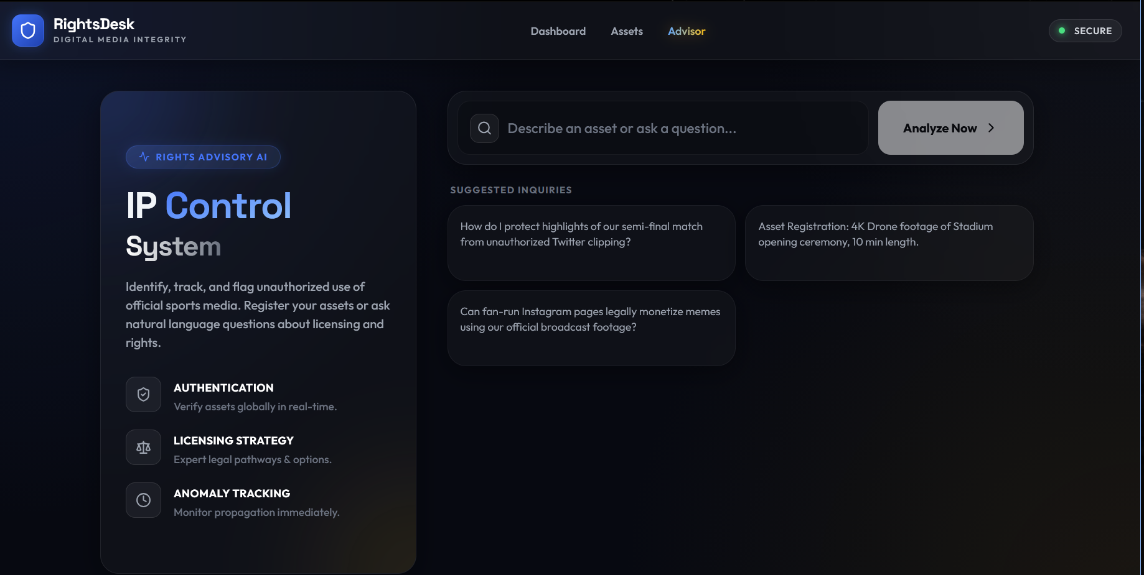
Snapshots of the MVP

Slide 7
Links:
GitHub Public Repository
Working Prototype Link: https://rightsdesk.vercel.app/

Slide 8


