Slide 1


Team Details
Team name:
Team leader name:
Problem Statement: Rapid Crisis Response

Slide 2
Brief:
AlertBridge is a Next.js 16 MVP for rapid crisis response in hospitality. It provides a user-friendly interface to report emergencies, instantly generating structured, role-specific alerts for security, medical, management, and guest communications. Leveraging Gemini AI for intelligent summarization, it ensures clear, actionable information during high-pressure situations, unifying communication across stakeholders.

Slide 3
Opportunities:
• Differentiation
• AI-powered, role-specific alert generation for maximum clarity.
• Bento Box UI for dense, hierarchical information display.
• Seamless integration for immediate use in high-stakes environments.
• Problem Solving Approach
• The solution employs a client-side form for user input, a server-side API route for secure Gemini AI integration, and a dynamic, grid-based UI to present both input and output information effectively. Tailwind CSS and custom variables ensure a polished, consistent visual style.
• USP
• Instantaneous, AI-curated emergency alerts delivered in a structured, role-specific format, drastically reducing response time and improving coordination during hospitality crises.

Slide 4
Features:
• Crisis reporting form with fields for type, location, affected individuals, severity, and description.
• Dynamic loading state indicator.
• AI-generated, structured alert output with distinct summaries for Security, Medical, Management, and Guest Comms.
• Responsive Bento Box Grid UI design.
• Prominent display of "AlertBridge" branding.

Slide 5
Technologies:
• Next.js 16 (App Router)
• React 19
• TypeScript
• Tailwind CSS
• Gemini 2.5 Flash API
• Lucide React Icons
• Constraints:
• No additional npm packages beyond specified core dependencies.
• Strict adherence to the Bento Box UI style guide.
• Server-side API key management.
• Hydration error mitigation for dynamic button states.

Slide 6
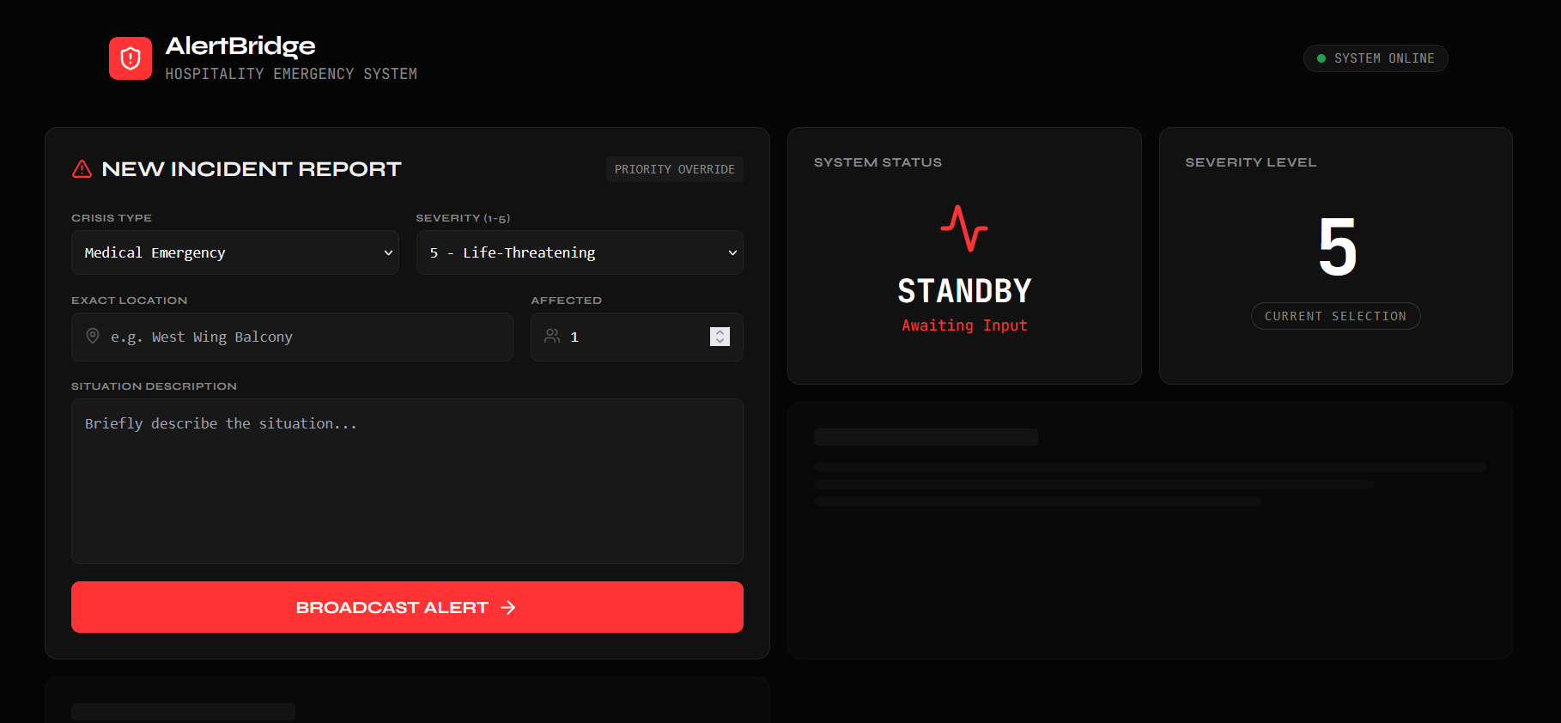
Snapshots of the MVP

Slide 7
Links:
GitHub Public Repository
Working Prototype Link: https://alertbridge-sc.vercel.app/

Slide 8


