Slide 1


Team Details
Team name:
Team leader name:
Problem Statement: Rapid Crisis Response

Slide 2
Brief:
CrisisSync is a Next.js 16 web application designed for rapid, coordinated emergency response in hospitality venues. It eliminates fragmented communication during high-stakes incidents by generating real-time, role-specific crisis coordination checklists. Users input incident details, and Gemini AI instantly provides prioritized actions, assigned responsibilities, and escalation triggers, bridging the gap between distressed individuals, staff, and emergency services. The UI features a polished Glassmorphism design with an urgent red and cool white palette for intuitive and efficient crisis management.

Slide 3
Opportunities:
• Differentiation
• CrisisSync differentiates itself by offering dynamic, AI-generated, role-specific checklists tailored to real-time incident parameters, rather than static protocols. Its intuitive Glassmorphism UI enhances user experience under pressure, providing clarity and focus.
• Problem Solving Approach
• The solution centralizes crisis information and decentralizes action. By integrating user input on venue, crisis, status, and available teams, CrisisSync generates a live operational plan. This eliminates communication silos, enabling rapid, coordinated responses that protect lives and property more effectively.
• USP
• The unique selling proposition of CrisisSync is its ability to deliver dynamic, AI-powered, real-time crisis coordination checklists that adapt to specific, evolving emergency scenarios in hospitality, ensuring immediate and precise team response.

Slide 4
Features:
• AI-Powered Dynamic Checklists: Generate immediate, short-term, and escalation actions based on live incident data.
• Role Assignment & Urgency Flagging: Clearly assign tasks to specific roles and highlight time-critical actions.
• Intuitive Glassmorphism UI: A visually distinct and user-friendly interface designed for high-stress environments.
• Responsive Design: Accessible and fully functional across mobile and desktop devices.
• Seamless Gemini API Integration: Leverages `gemini-2.5-flash` for intelligent crisis response generation.

Slide 5
Technologies:
• Frontend Framework: Next.js 16 (App Router)
• Language: TypeScript
• Styling: Tailwind CSS + Custom CSS Variables
• Icons: Lucide-React
• AI Integration: Google Gemini API (`gemini-2.5-flash`)
• Constraints:
• No fluff
• No repetition
• Keep concise
• Bullet points where appropriate

Slide 6
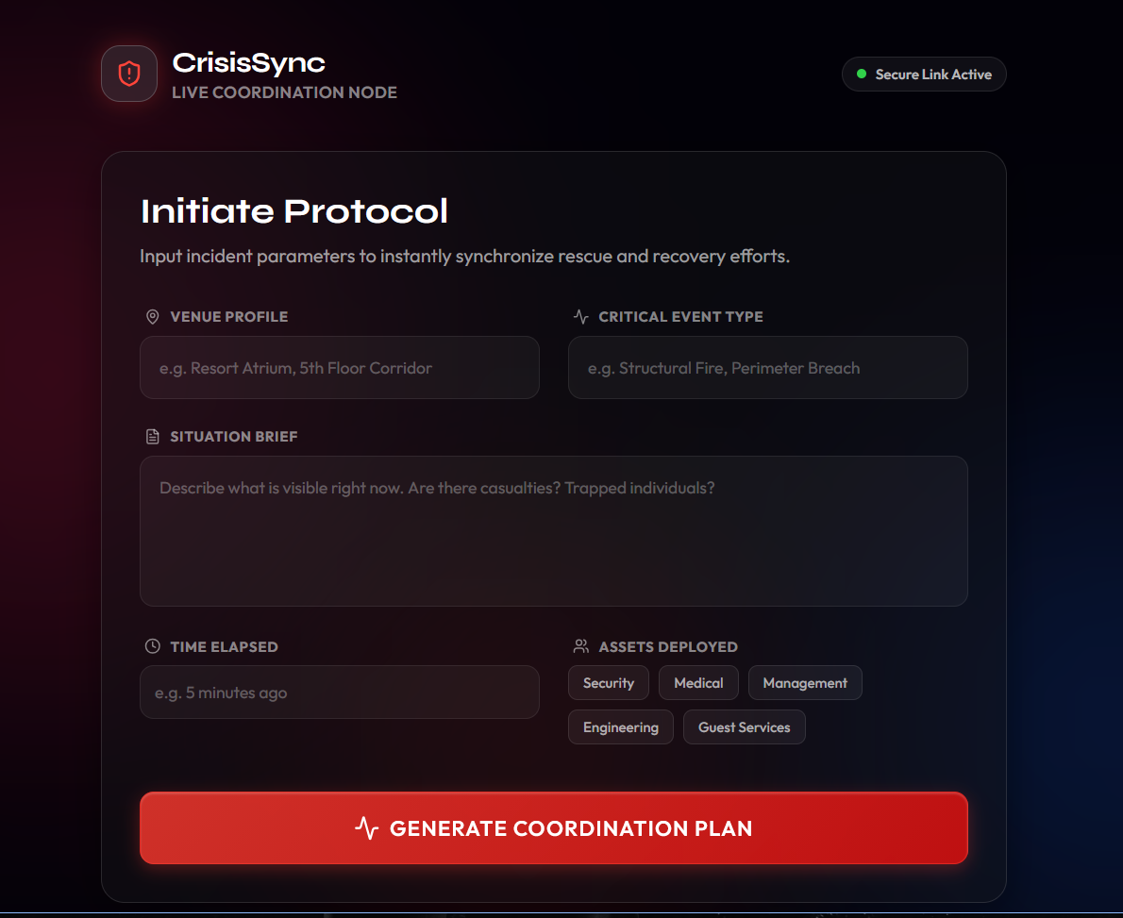
Snapshots of the MVP

Slide 7
Links:
GitHub Public Repository
Working Prototype Link: https://crisissync-sc.vercel.app/

Slide 8


