Slide 1


Team Details
Team name:
Team leader name:
Problem Statement: Rapid Crisis Response

Slide 2
Brief:
EvacuGuide is a Next.js 16 web application designed for rapid crisis response in hospitality venues. It leverages Gemini AI to instantly generate comprehensive, venue-specific evacuation plans based on user input regarding venue details and crisis type. This solution eliminates fragmented communication during emergencies, providing coordinated, step-by-step instructions for guests, staff, and first responders to protect lives and property.

Slide 3
Opportunities:
• Differentiation
• EvacuGuide offers highly customized, AI-generated evacuation plans tailored to specific venue types, occupancy, and crisis scenarios, differentiating it from generic emergency protocols. Its focus on real-time, actionable intelligence streamlines crisis management.
• Problem Solving Approach
• The application uses Gemini AI to synthesize user-defined venue parameters and crisis types into comprehensive, actionable evacuation plans. This approach eliminates manual plan creation, standardizes critical information flow, and ensures coordinated response efforts by providing clear roles, routes, and communication scripts.
• USP
• Instant, AI-powered, venue-specific evacuation plan generation for hospitality, ensuring coordinated, reliable crisis response and minimizing risk and communication breakdown during critical incidents.

Slide 4
Features:
• User input form for venue type (hotel/restaurant/event hall), number of floors, estimated occupancy, and crisis type (fire/flood/security/medical mass casualty).
• AI-powered generation of detailed, venue-specific evacuation plans using Google Gemini-2.5-flash.
• Output includes primary and backup evacuation routes, staff role assignments, guest announcement scripts, and special needs guest protocols.
• Clear visual display of results with hierarchy, not just raw text.
• Visually clear loading states during AI processing.
• Professional, polished, and responsive Flat Design UI.
• Graceful error handling for API calls.

Slide 5
Technologies:
• Framework: Next.js 16 (App Router)
• Language: TypeScript (.tsx)
• Styling: Tailwind CSS + custom CSS variables
• Icons: lucide-react
• AI Integration: Google Gemini-2.5-flash API (`gemini-2.5-flash`)
• Node Engine: 24.x

Slide 6
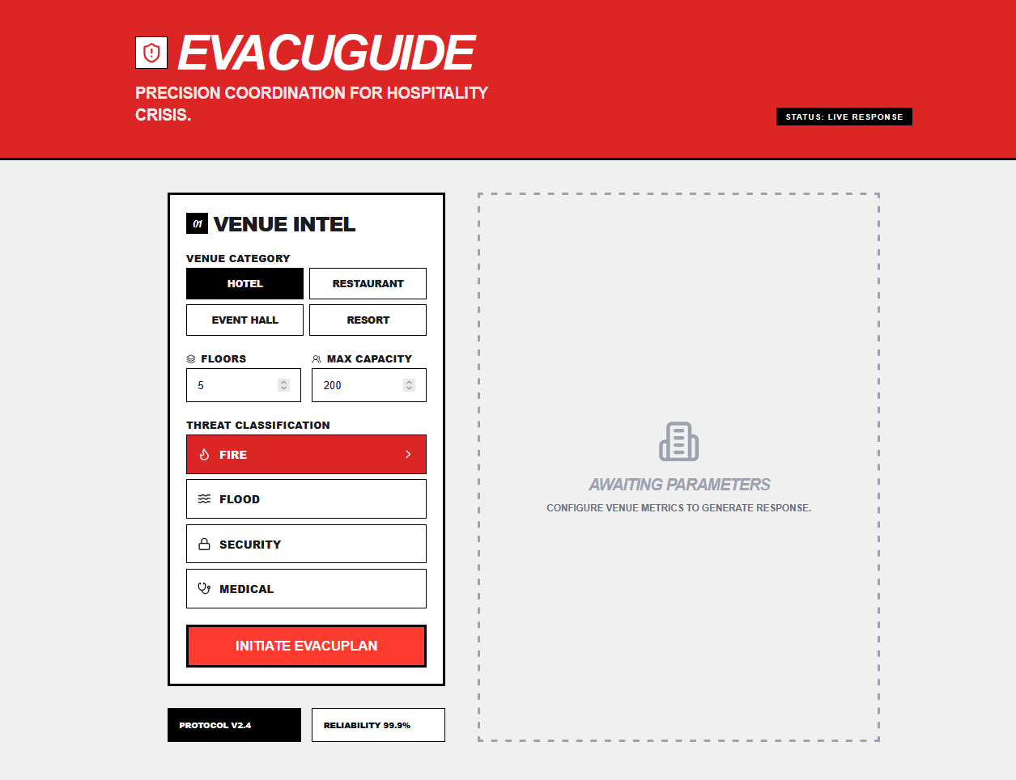
Snapshots of the MVP

Slide 7
Links:
GitHub Public Repository
Working Prototype Link: https://evacuguide.vercel.app/

Slide 8


