Slide 1


Team Details
Team name:
Team leader name:
Problem Statement: Rapid Crisis Response

Slide 2
Brief:
FirstContact is a rapid crisis response application for the hospitality sector. It provides distressed guests with immediate, AI-guided safety instructions and reassurance during emergencies. By eliminating fragmented communication and acting as a reliable bridge between guests, on-site staff, and emergency services, it ensures instantaneous, coordinated reactions to protect lives and property.

Slide 3
Opportunities:
• Differentiation
• FirstContact differentiates itself by focusing on the immediate needs of a distressed guest, providing AI-driven, calming, step-by-step guidance directly at the point of crisis, a feature often missing in traditional staff-centric emergency systems.
• Problem Solving Approach
• The solution tackles fragmented communication by creating a central, intelligent hub where guest-reported emergencies are instantly processed by AI for immediate guidance and simultaneously dispatched to human responders, ensuring a unified and swift reaction.
• USP
• FirstContact's unique selling proposition is its ability to provide instantaneous, personalized, and calming first-response guidance directly to individuals in high-stress situations, making it the essential "first contact" point that bridges the gap until human help arrives.

Slide 4
Features:
• AI-powered immediate safety instructions tailored to the reported emergency.
• Real-time guest reporting of emergency type, location, and immediate dangers.
• Generation of clear, numbered steps for "what to do RIGHT NOW" and "what NOT to do".
• Reassurance messaging confirming help is being dispatched.
• Minimalist, intuitive UI for ease of use under pressure.

Slide 5
Technologies:
• Next.js 16 (App Router)
• TypeScript
• Tailwind CSS
• Gemini API (gemini-2.5-flash)
• Lucide React (for minimal iconography)

Slide 6
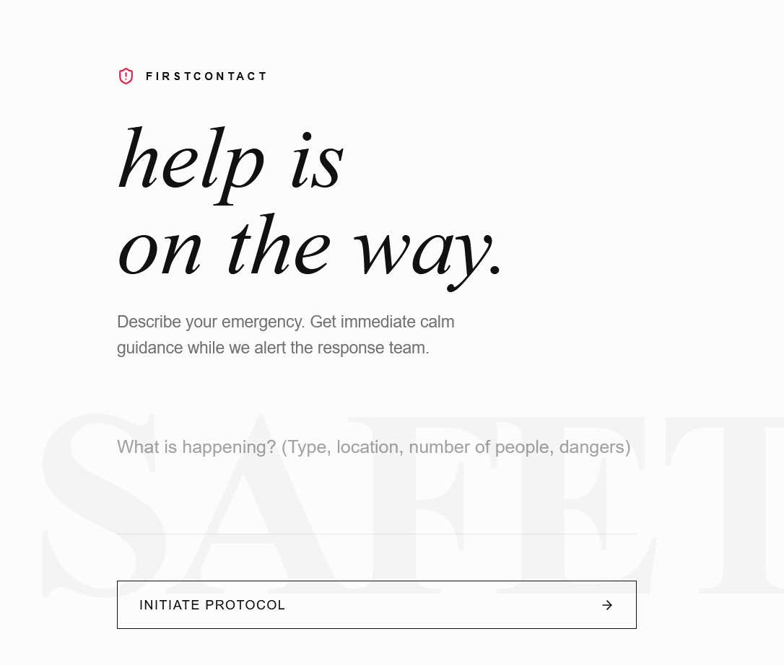
Snapshots of the MVP

Slide 7
Links:
GitHub Public Repository
Working Prototype Link: https://firstcontact.vercel.app/

Slide 8


