Slide 1


Team Details
Team name:
Team leader name:
Problem Statement: Rapid Crisis Response

Slide 2
Brief:
This solution delivers a "Rapid Crisis Response" system for hospitality venues, centered on immediate incident logging and structured reporting. The `IncidentLog` tool leverages Gemini AI to transform chaotic, plain-language incident descriptions into professional, standardized reports. This ensures critical information is instantly captured, categorized, and accessible, thereby enabling coordinated emergency efforts and bridging communication gaps between distressed guests, on-site staff, and first responders.

Slide 3
Opportunities:
• Differentiation
• The solution offers a unique AI-driven approach to standardizing incident reporting, moving beyond manual or template-based systems. By automatically extracting and formatting critical details from free-text input, it provides a significant efficiency and accuracy advantage in high-stress, time-sensitive situations.
• Problem Solving Approach
• It tackles fragmented communication and slow information dissemination during crises by establishing a single, reliable point for incident reporting. By automating report generation, the system reduces human error, speeds up communication flows, and ensures compliance with industry standards, thereby enhancing safety and operational resilience.
• USP
• The unique selling proposition is the instant, AI-powered transformation of unstructured field notes into comprehensive, professionally formatted incident reports, specifically tailored for hospitality emergency management. It acts as an intelligent communication hub, ensuring no critical detail is missed and all stakeholders receive standardized, actionable information.

Slide 4
Features:
• Plain-Language Input: Users can describe incidents naturally without needing to navigate complex forms or predefined categories.
• AI-Powered Report Generation: Gemini AI extracts key facts, categorizes the incident, and generates a structured, official report.
• Standardized Output: Reports adhere to hospitality industry standards, including sections for timestamp, location, parties involved, narrative, immediate actions, and required follow-up.
• Missing Information Flagging: The AI identifies and flags any critical details that are absent from the user's initial description.
• Professional UI: A clean, intuitive, and responsive interface designed for rapid and reliable use during emergency scenarios.

Slide 5
Technologies:
• Framework: Next.js 16 (App Router)
• Language: TypeScript
• Styling: Tailwind CSS + Custom CSS Variables
• Icons: Lucide React
• AI Integration: Google Gemini-2.5-flash API
• Constraints:
• No additional npm packages beyond next, react, react-dom, lucide-react, tailwindcss.
• Gemini API key strictly server-side (environment variable).
• Strict output format for generated code files.
• `suppressHydrationWarning` must be used for dynamic `disabled` attributes to prevent hydration errors.

Slide 6
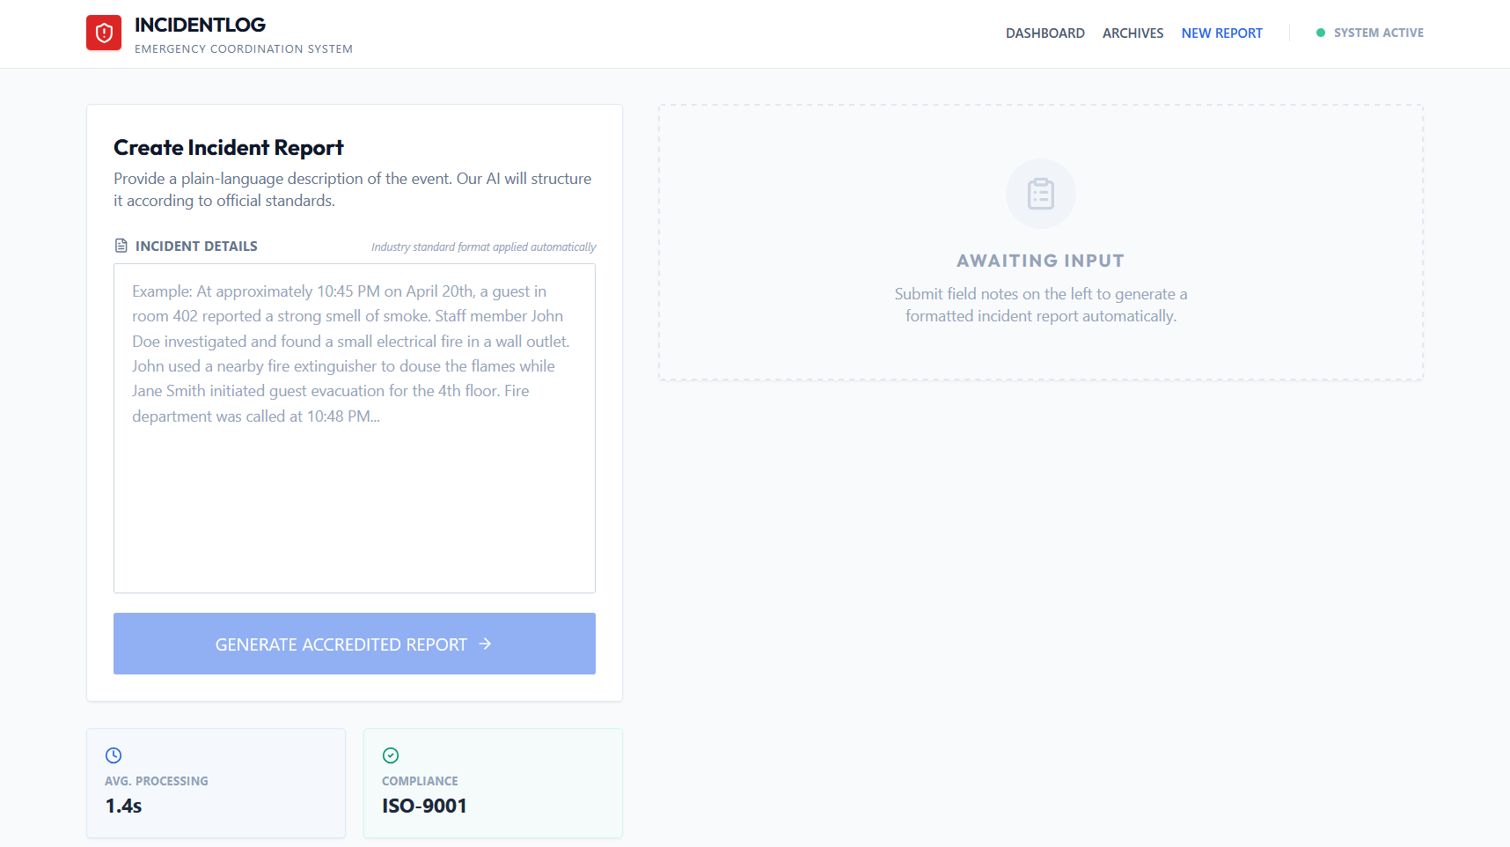
Snapshots of the MVP

Slide 7
Links:
GitHub Public Repository
Working Prototype Link: https://incidentlog.vercel.app/

Slide 8


