Slide 1


Team Details
Team name:
Team leader name:
Problem Statement: Rapid Crisis Response

Slide 2
Brief:
ResponderBrief is a Next.js application designed for accelerated emergency response and crisis coordination in hospitality. It provides a robust solution to instantly detect, report, and synchronize crisis response efforts by generating concise, AI-powered first responder handoff briefs. This tool eliminates fragmented communication, ensuring critical information reaches emergency services promptly to protect lives and property.

Slide 3
Opportunities:
• Differentiation
• Specialized for hospitality emergency management and crisis coordination.
• AI-powered generation of structured, emergency services-specific briefs.
• Distinctive, premium Glass UI optimized for high-stress environments.
• Focus on factual, concise information delivery to enhance response speed.
• Problem Solving Approach
• Centralizes critical incident data (venue, crisis type, casualties, access).
• Leverages Gemini AI to synthesize input into a professional, actionable brief.
• Establishes a clear, reliable communication channel for incoming responders.
• Eliminates manual report generation and potential information loss during crises.
• USP
• Instant, AI-powered, structured first responder handoff briefs for hospitality emergencies, drastically reducing response times and improving coordination through a specialized, intuitive interface.

Slide 4
Features:
• User input form for key crisis details: venue, crisis type, status, casualties, access.
• AI-driven (Gemini 2.5 Flash) generation of SBAR-formatted emergency briefs.
• Clear loading states and graceful error handling for robust user experience.
• Visually hierarchical display of AI-generated content within glass panels.
• Fully responsive design, optimized for mobile and desktop use.
• Professional Glass UI with dark mode, blur, neon accents, and distinct typography.

Slide 5
Technologies:
• Frontend: Next.js 16, React, TypeScript (App Router).
• Styling: Tailwind CSS with custom CSS variables (Glass UI).
• Icons: Lucide-React for a clean, functional icon set.
• AI Integration: Google Gemini 2.5 Flash API for brief generation.
• Backend: Node.js 24.x environment for API route.

Slide 6
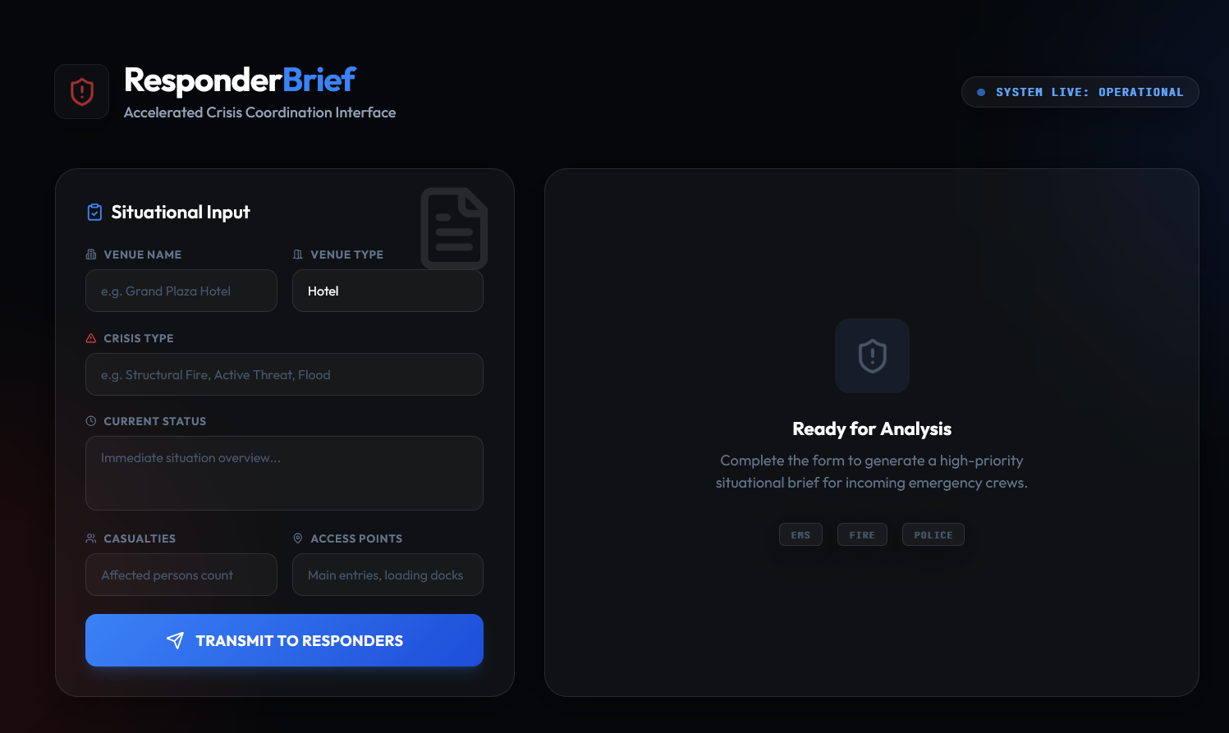
Snapshots of the MVP

Slide 7
Links:
GitHub Public Repository
Working Prototype Link: https://responderbrief.vercel.app/

Slide 8


