Slide 1


Team Details
Team name:
Team leader name:
Problem Statement: Smart Supply Chains

Slide 2
Brief:
DisruptRadar is a Next.js 16 web application designed to preemptively detect and mitigate supply chain disruptions. It provides users with a disruption risk score, identifies top risk factors, and offers specific mitigation recommendations for their shipment routes. By leveraging Gemini AI to analyze complex transit data, the system aims to prevent localized bottlenecks from escalating into broader delays, ensuring more resilient and dynamic logistics. The interface utilizes a modern, information-dense Bento Box Grid UI for optimal clarity.

Slide 3
Opportunities:
• Differentiation
• DisruptRadar differentiates itself through its AI-powered preemptive detection and specific, actionable mitigation recommendations, moving beyond reactive disruption management. The unique Bento Box Grid UI offers a visually engaging and information-rich user experience, unlike standard dashboard layouts.
• Problem Solving Approach
• The system continuously analyzes multifaceted transit data, including weather patterns, geopolitical factors, infrastructure reliability, seasonal demand, and historical disruption data. It formulates dynamic mechanisms to instantly execute or recommend highly optimized route adjustments, preventing localized issues from cascading.
• USP
• "Input your shipment route — get a disruption risk score before it happens." DisruptRadar's core USP is its comprehensive, AI-driven, real-time disruption prediction coupled with actionable, data-driven mitigation strategies, all presented within an intuitive and information-dense interface.

Slide 4
Features:
• User input form for origin, destination, cargo type, departure date, and transport mode.
• AI-generated disruption probability score (0-100%) for specific routes.
• Identification and scoring of top 3 risk factors.
• Severity breakdown by categories (weather, geopolitical, infrastructure, demand).
• 2-3 specific and actionable mitigation recommendations.
• Dynamic loading states during AI analysis.
• Graceful error handling for API calls.
• Fully responsive Bento Box Grid UI for desktop and mobile.

Slide 5
Technologies:
• Next.js 16 (App Router)
• TypeScript
• Tailwind CSS (with custom CSS variables)
• lucide-react (for icons)
• Google Gemini API (`gemini-2.5-flash`)
• Node.js 24.x

Slide 6
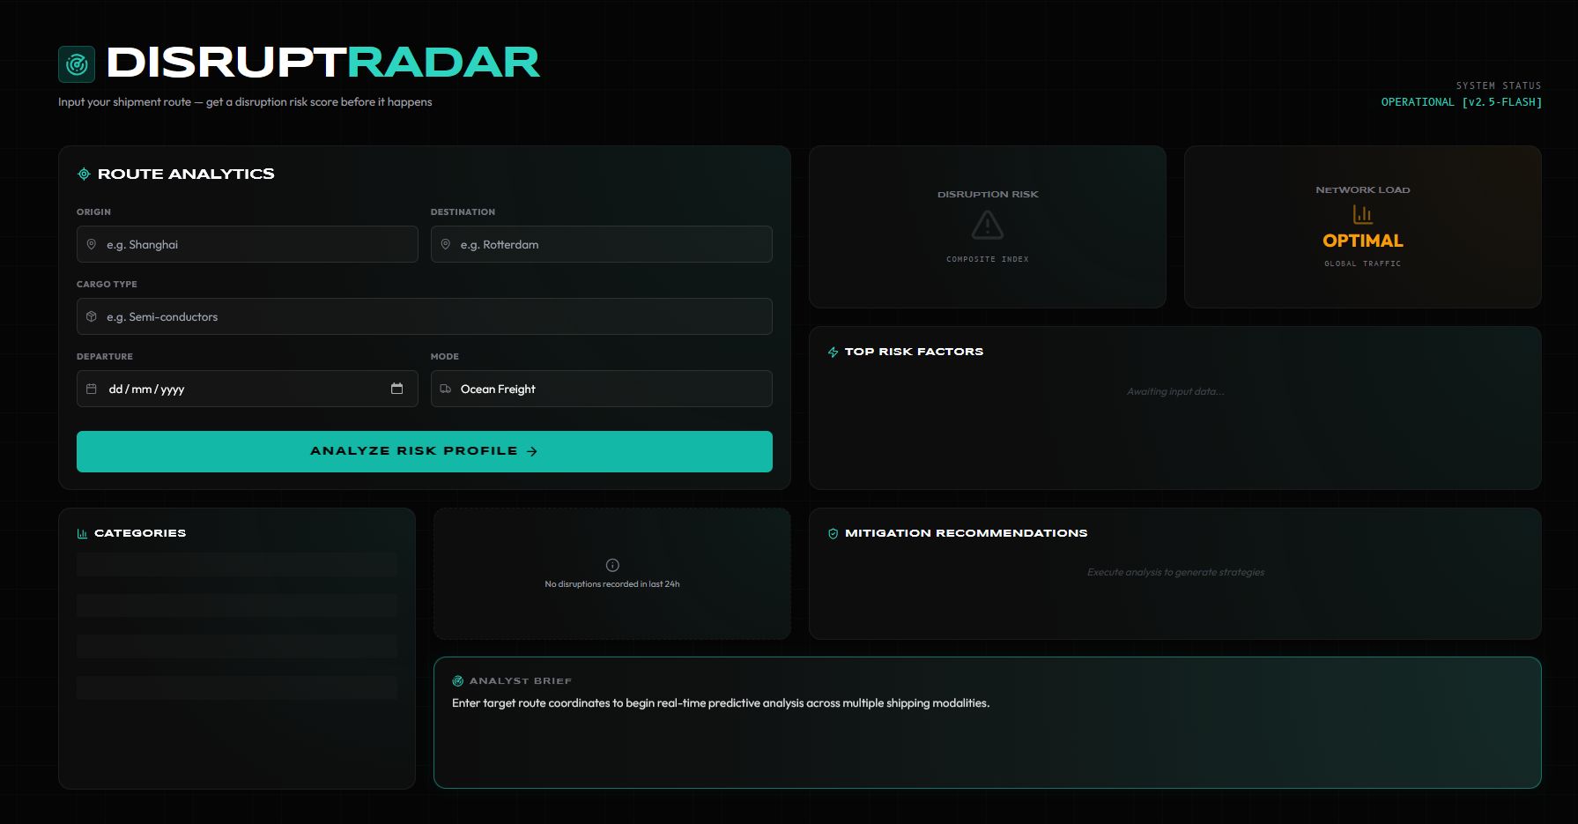
Snapshots of the MVP

Slide 7
Links:
GitHub Public Repository
Working Prototype Link: https://disruptradar.vercel.app/

Slide 8


