Slide 1


Team Details
Team name:
Team leader name:
Problem Statement: Smart Supply Chains

Slide 2
Brief:
RouteRethink is a Next.js 16 web application designed to proactively address supply chain disruptions. It enables users to input details of a blocked route and instantly receive three AI-optimized alternative routes, each with detailed cost, time, and risk analyses. Leveraging Gemini AI, the tool provides dynamic rerouting options presented through a modern Glassmorphism UI, ensuring resilient logistics and informed decision-making.

Slide 3
Opportunities:
• Differentiation
• Real-time, AI-powered generation of three distinct, optimized route alternatives.
• Comprehensive trade-off analysis (cost, time, risk, best-for scenario) for each option.
• Professional, intuitive Glassmorphism UI enhances user experience and decision-making.
• Problem Solving Approach
• User inputs specific details of a blocked route, cargo, and operational constraints.
• Gemini AI dynamically formulates highly optimized alternative routes based on input context.
• Presents actionable, ranked alternatives with justifications for rapid strategic adjustment.
• USP
• "Describe a blocked or delayed route — get 3 optimized alternative routes instantly."
• Proactive, AI-powered disruption mitigation with immediate, context-aware routing solutions.
• Informed decision-making through clear, ranked trade-off analysis and trade-off summaries.

Slide 4
Features:
• Interactive input form for blocked route details, cargo specifications, urgency, and budget.
• Dynamic generation of three distinct alternative route options using Gemini AI.
• Detailed output for each option: estimated time impact, cost delta, risk rating, and key trade-offs.
• Visual loading states during AI processing and graceful error handling.
• Fully responsive design with a distinctive Glassmorphism UI style.

Slide 5
Technologies:
• Frontend Framework: Next.js 16 (App Router)
• Language: TypeScript
• Styling: Tailwind CSS with custom CSS variables (Glassmorphism)
• AI Integration: Google Gemini 2.5 Flash API (server-side via `/api/generate`)
• Icons: lucide-react

Slide 6
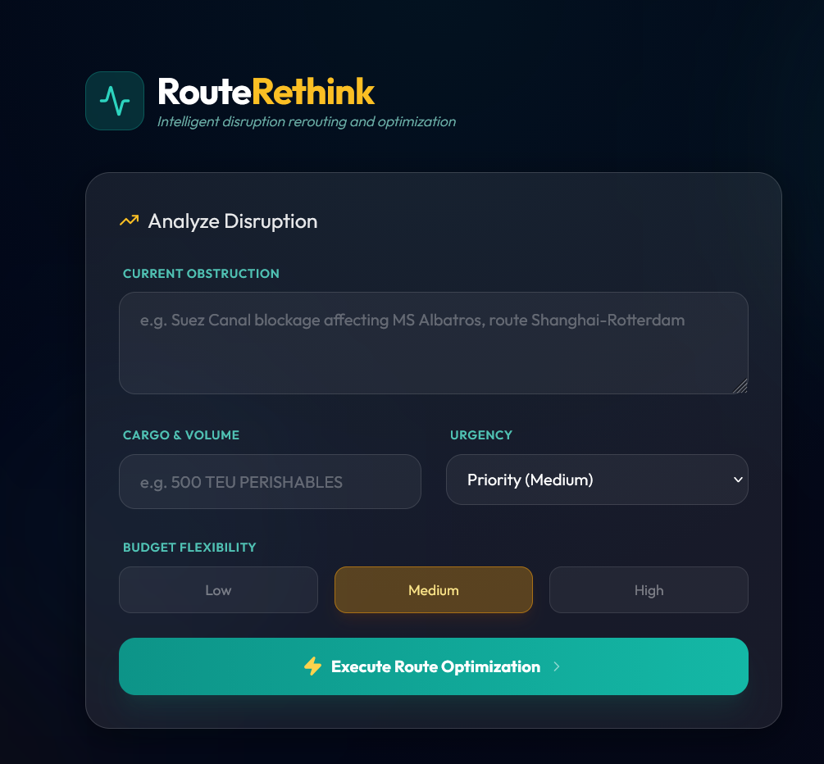
Snapshots of the MVP

Slide 7
Links:
GitHub Public Repository
Working Prototype Link: https://routerethink.vercel.app/

Slide 8


