Slide 1


Team Details
Team name:
Team leader name:
Problem Statement: Smart Supply Chains

Slide 2
Brief:
BottleneckBot is a Next.js 16 application leveraging Google Gemini AI to transform supply chain management. It enables users to input transit data or delay descriptions, receiving instant, AI-driven diagnoses of supply chain bottlenecks. The system pinpoints root causes, assesses cascade risks, and provides targeted, actionable fix recommendations, ensuring resilient logistics and dynamic optimization.

Slide 3
Opportunities:
• Differentiation
• BottleneckBot distinguishes itself through its real-time, AI-powered diagnostic capabilities, offering a proactive approach to supply chain management. Its flat design UI prioritizes clarity and efficiency, embodying a logistics-precision aesthetic with bold industrial teal and amber, contrasting with cluttered, legacy systems.
• Problem Solving Approach
• The application utilizes a sophisticated AI model to analyze multifaceted transit data and user input. It formulates precise diagnoses of bottlenecks, identifies root causes, quantifies cascade risks, and generates highly optimized route adjustments or interventions before disruptions compromise delivery timelines.
• USP
• Pinpoint accuracy in identifying and localizing supply chain bottlenecks, coupled with proactive, AI-driven prescriptive interventions. The intuitive flat design interface ensures immediate understanding and actionability of complex diagnostic information.

Slide 4
Features:
• AI-powered root cause analysis for supply chain delays.
• Precise bottleneck location identification.
• Cascade risk assessment for downstream operations (HIGH/MEDIUM/LOW).
• Targeted, actionable fix recommendations ordered by impact.
• Responsive, clean user interface with a distinctive flat design aesthetic.
• Secure server-side Gemini API integration for robust performance.

Slide 5
Technologies:
• Framework: Next.js 16 (App Router)
• Language: TypeScript
• Styling: Tailwind CSS + Custom CSS Variables
• Icons: lucide-react
• AI: Google Gemini 2.5 Flash API (via `gemini-2.5-flash`)

Slide 6
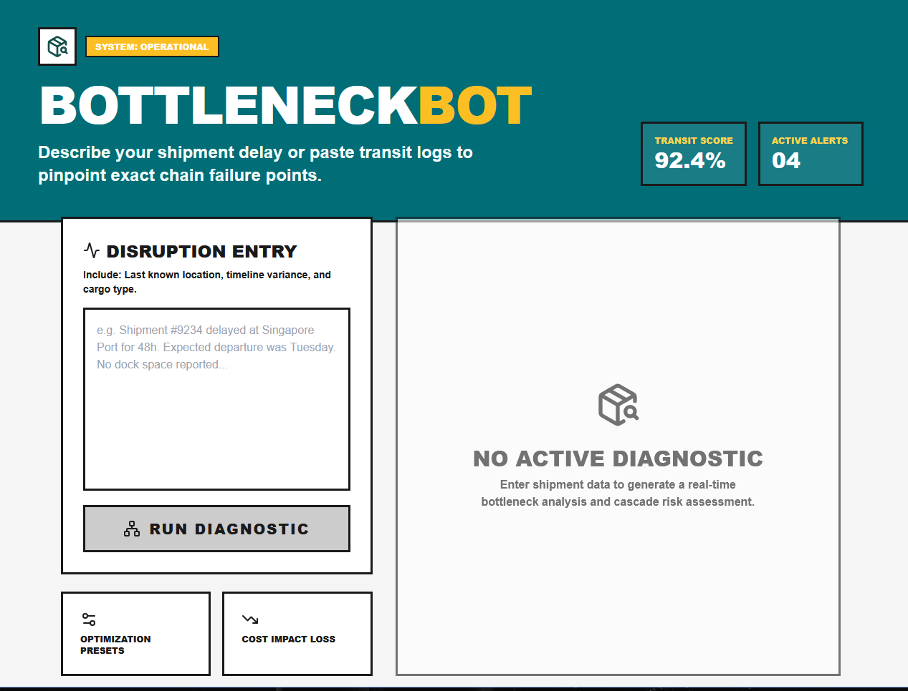
Snapshots of the MVP

Slide 7
Links:
GitHub Public Repository
Working Prototype Link: https://bottleneckbot.vercel.app/

Slide 8


