Slide 1


Team Details
Team name:
Team leader name:
Problem Statement: Smart Supply Chains

Slide 2
Brief:
The SupplierPulse application is a Next.js 16 web application designed to assess supplier dependency risk. Users input supplier details, and the system leverages Google Gemini AI to analyze the relationship for concentration risk, reliability, and strategic vulnerability. It provides a dependency risk score, highlights key vulnerability factors, rates single-source risk, and offers a tailored 3-step diversification action plan with alternative supplier types.

Slide 3
Opportunities:
• Differentiation
• SupplierPulse differentiates itself by offering real-time, AI-powered risk assessment and actionable diversification strategies, going beyond static risk scores to provide dynamic, situation-specific recommendations. Its focus on a professional, trustworthy UI enhances user confidence in the AI's analytical capabilities.
• Problem Solving Approach
• The application addresses the problem of reactive supply chain management by enabling proactive risk identification. It uses AI to synthesize complex supplier data into clear vulnerability factors and concrete action plans, allowing managers to mitigate risks *before* they escalate into significant disruptions.
• USP
• The unique selling proposition of SupplierPulse is its combination of a user-friendly, professional interface with sophisticated Gemini AI-driven risk analytics, delivering not just a score but a pragmatic, multi-step plan for enhancing supply chain security and resilience.

Slide 4
Features:
• AI-powered supplier dependency risk assessment (0-100%).
• Identification of top 3 vulnerability factors.
• Single-source risk rating (CRITICAL/HIGH/MEDIUM/LOW).
• Personalized 3-step diversification action plan, including alternative supplier types.
• Clean, professional UI with clear input forms and visually hierarchical results.
• Responsive design for desktop and mobile use.

Slide 5
Technologies:
• Framework: Next.js 16 (App Router)
• Language: TypeScript
• Styling: Tailwind CSS + Custom CSS Variables
• Icons: Lucide React
• AI Integration: Google Gemini 2.5 Flash API

Slide 6
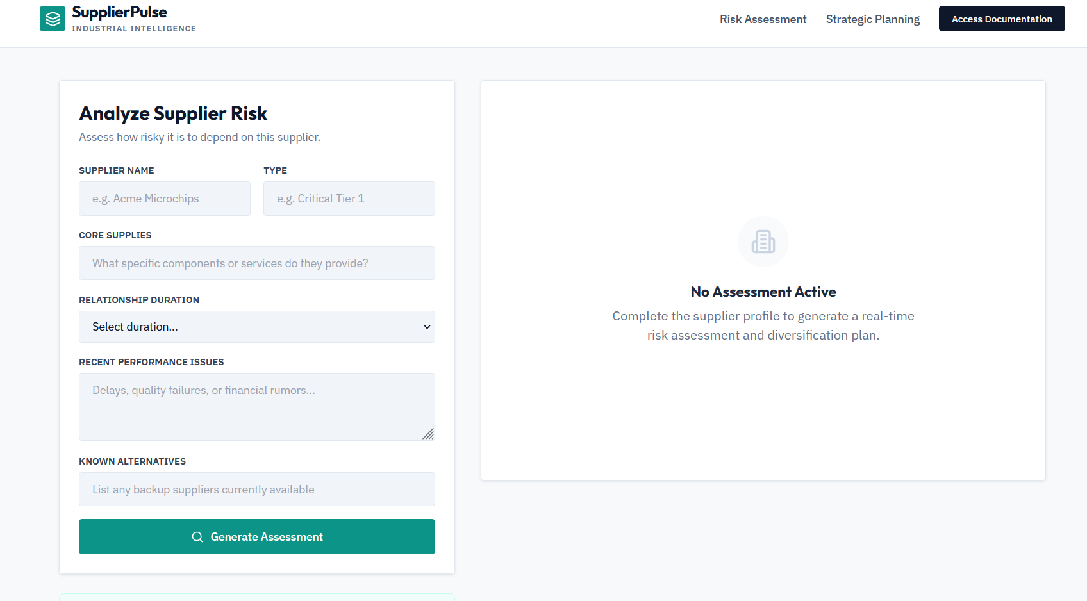
Snapshots of the MVP

Slide 7
Links:
GitHub Public Repository
Working Prototype Link: https://supplierpulse-sc.vercel.app/

Slide 8


