Slide 1


Team Details
Team name:
Team leader name:
Problem Statement: Smart Supply Chains

Slide 2
Brief:
CargoDebrief is a Next.js 16 application designed to conduct forensic post-mortem analysis of supply chain disruptions. Leveraging Google Gemini AI, it generates comprehensive reports including root cause analysis, systemic weaknesses, lessons learned, and a prioritized prevention checklist, helping organizations swiftly mitigate future delays and enhance logistics resilience. The system provides a premium, "Glass UI" experience, making complex data actionable and visually accessible.

Slide 3
Opportunities:
• Differentiation
• CargoDebrief stands out by offering an AI-powered, forensic analysis of supply chain incidents, moving beyond mere incident logging to generate proactive prevention strategies. Its "Glass UI" provides a premium, intuitive user experience, distinct from typical enterprise tools.
• Problem Solving Approach
• The tool addresses the chronic issue of reactive responses to supply chain disruptions by providing an objective, AI-driven root cause analysis and a concrete, prioritized prevention checklist. It translates complex incident data into clear, actionable intelligence, fostering continuous improvement.
• USP
• Its Unique Selling Proposition is the combination of an advanced AI post-mortem engine with a modern, high-fidelity Glass UI, delivering both deep analytical insight and an exceptional user experience for critical supply chain incident management.

Slide 4
Features:
• AI-powered forensic post-mortem analysis of supply chain incidents.
• Structured output including timeline, 5-Why root cause analysis, and systemic weaknesses.
• Generates key lessons learned and a prioritized, actionable prevention checklist.
• Intuitive and responsive Glass UI design with dark mode and accent glows.
• Real-time loading states and graceful error handling.

Slide 5
Technologies:
• Frontend: Next.js 16 (App Router), React 19, TypeScript
• Styling: Tailwind CSS with custom Glass UI variables, Google Fonts
• Icons: Lucide React
• Backend: Next.js API Routes (server-side)
• AI Integration: Google Gemini 2.5 Flash

Slide 6
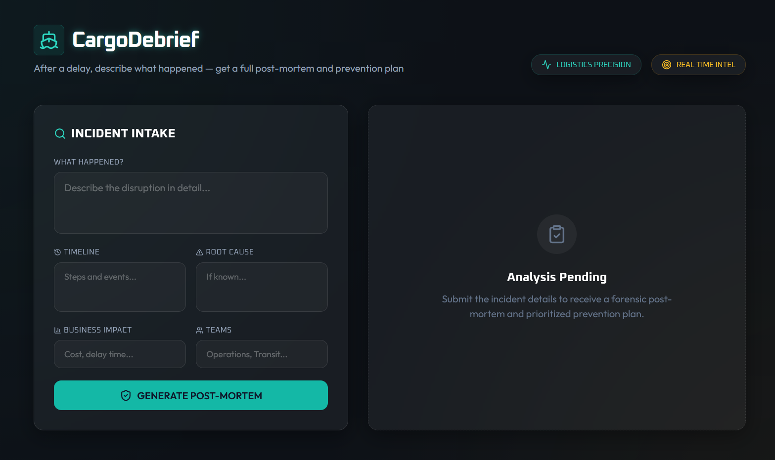
Snapshots of the MVP

Slide 7
Links:
GitHub Public Repository
Working Prototype Link: https://cargodebrief.vercel.app/

Slide 8


