Slide 1


Team Details
Team name:
Team leader name:
Problem Statement: Unbiased AI Decision

Slide 2
Brief:
BiasScope is an AI-powered web application designed to combat algorithmic discrimination. It enables organizations to instantly assess bias risk in datasets and AI model outputs by providing comprehensive analysis, identifying affected demographic groups, and offering actionable audit recommendations. This solution ensures fairness and accountability in automated decision-making processes.

Slide 3
Opportunities:
• Differentiation
• BiasScope stands out with its unique Bento Box Grid UI, offering a visually distinct and intuitive display of complex bias analysis results. Its core differentiation lies in leveraging Gemini AI for instant, deep, and structured bias risk assessments, moving beyond generic checks to provide specific bias types, severity scores, and targeted audit recommendations.
• Problem Solving Approach
• Users input a dataset description or model output, along with its use case and target population. BiasScope then utilizes Gemini AI to analyze this input for various bias risk vectors. The AI identifies specific bias types (historical, representation, measurement, aggregation), pinpoints affected demographic groups, assigns severity scores, and generates top 3 recommended audit actions, providing a comprehensive and actionable report.
• USP
• "Paste a dataset description or model output — get a a bias risk assessment instantly." BiasScope offers an unparalleled combination of immediate, AI-driven, and highly detailed bias detection with clear, actionable recommendations, making algorithmic accountability accessible and efficient for any organization.

Slide 4
Features:
• Intuitive Bento Box Grid UI for submitting dataset/model output, use case, and target population.
• Instant AI-powered bias risk assessment, leveraging Gemini 2.5 Flash.
• Structured output including overall bias risk rating, specific bias types, affected demographic groups, severity scores, and recommended audit actions.
• Clear visual hierarchy for presenting complex analysis results.
• Robust loading and error state handling for a seamless user experience.
• Fully responsive design for desktop and mobile access.

Slide 5
Technologies:
• Frontend Framework: Next.js 16 (App Router)
• Language: TypeScript
• Styling: Tailwind CSS, custom CSS variables
• Icons: lucide-react
• AI Integration: Google Gemini 2.5 Flash API

Slide 6
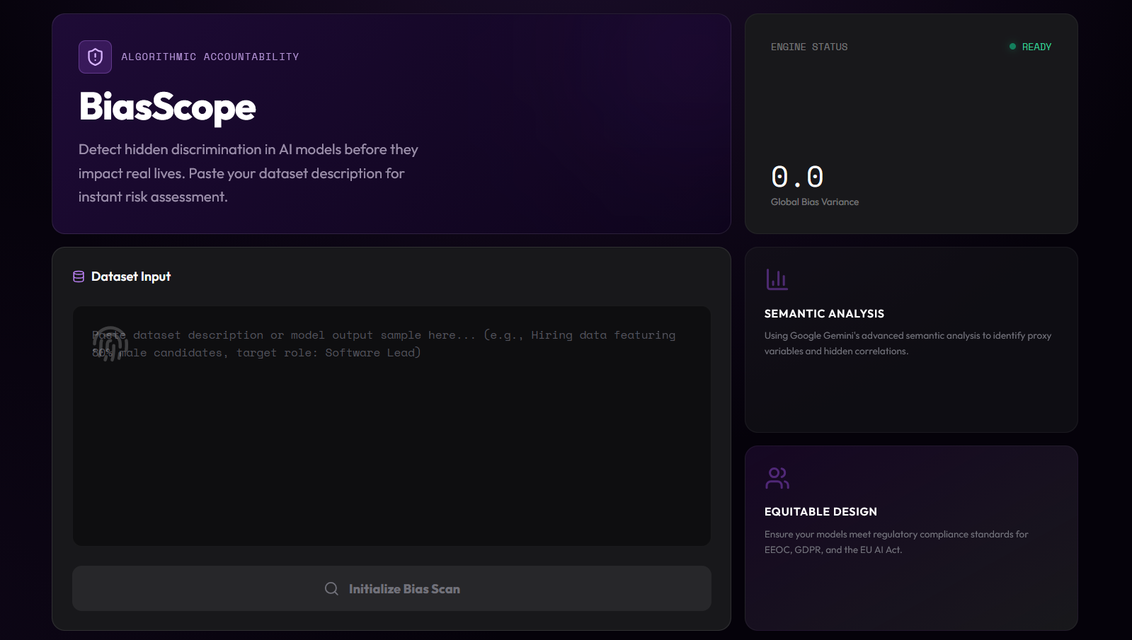
Snapshots of the MVP

Slide 7
Links:
GitHub Public Repository
Working Prototype Link: https://biasscope-sc.vercel.app/

Slide 8


