Slide 1


Team Details
Team name:
Team leader name:
Problem Statement: Unbiased AI Decision

Slide 2
Brief:
This solution delivers an AI fairness auditing tool, "FairnessAudit," built with Next.js 16 and Tailwind CSS, styled using Glassmorphism. Users describe their ML models and training data, which is then sent to Google's Gemini AI. Gemini generates a comprehensive fairness audit report, displayed in a structured, accessible, and visually appealing format, empowering organizations to proactively identify and mitigate algorithmic bias.

Slide 3
Opportunities:
• Differentiation
• This tool distinguishes itself through its intuitive Glassmorphism UI, making complex AI ethics accessible and engaging. Leveraging Gemini AI for deep, comprehensive audits provides a powerful, intelligent backend, delivering nuanced reports beyond basic statistical checks.
• Problem Solving Approach
• The approach is proactive and preventive. By allowing comprehensive auditing *before* deployment, it helps organizations prevent discriminatory outcomes, maintain trust, and adhere to ethical AI standards, rather than reactively addressing issues post-impact.
• USP
• The unique selling proposition is the combination of an aesthetically pleasing and highly functional Glassmorphism interface with the powerful, intelligent auditing capabilities of Gemini AI, offering a comprehensive and user-friendly solution for algorithmic accountability.

Slide 4
Features:
• Intuitive Input Form: Users easily describe ML model purpose, training data, features, decision types, and deployment context.
• AI-Powered Fairness Audit: Utilizes Gemini AI to generate detailed reports on disparate impact, proxy discrimination, fairness metrics, and remediation priorities.
• Structured Report Display: Presents audit findings in a clear, visually hierarchical format across multiple, layered glass panels.
• Glassmorphism UI: Features a modern, translucent design with rich gradients, blur effects, and ethereal floating elements for a premium user experience.
• Responsive Design: Ensures optimal usability and aesthetic consistency across all devices (mobile, tablet, desktop).

Slide 5
Technologies:
• Frontend Framework: Next.js 16 (App Router)
• Language: TypeScript
• Styling: Tailwind CSS + Custom CSS (for Glassmorphism effects)
• Icons: Lucide-React
• AI Integration: Google Gemini 2.5 Flash API (server-side via Next.js API route)
• Constraints:
• No fluff
• No repetition
• Keep concise
• Bullet points where appropriate

Slide 6
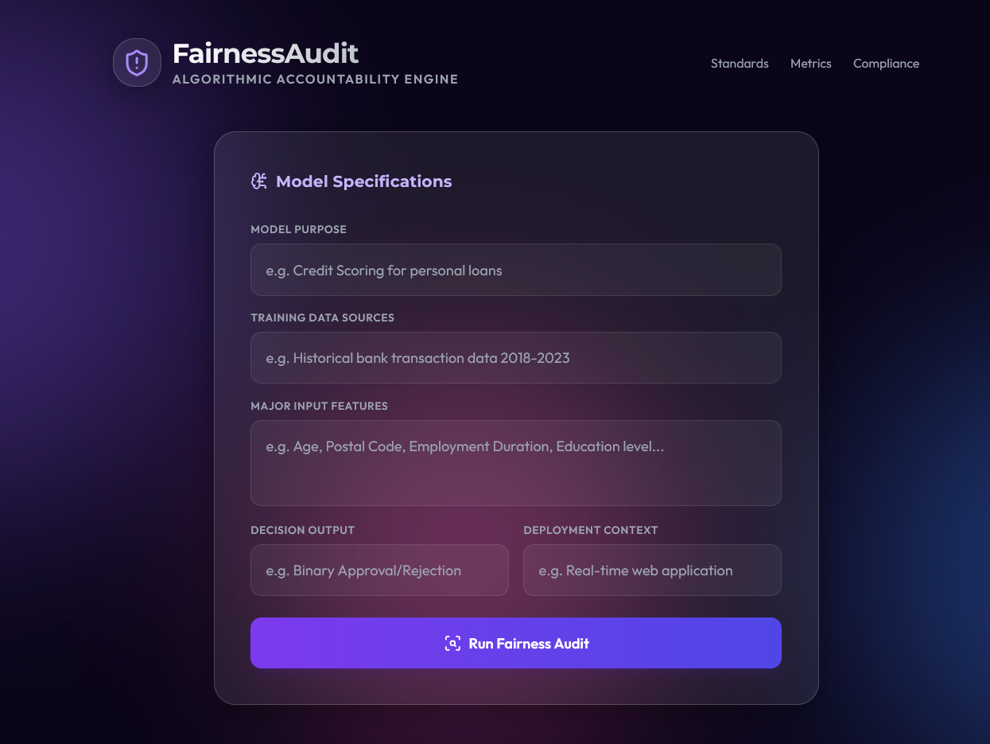
Snapshots of the MVP

Slide 7
Links:
GitHub Public Repository
Working Prototype Link: https://fairnessaudit.vercel.app/

Slide 8


