Slide 1


Team Details
Team name:
Team leader name:
Problem Statement: Unbiased AI Decision

Slide 2
Brief:
DataMirror is a Next.js 16 application built with a Flat Design UI that empowers users to detect discriminatory proxy features within their datasets. By analyzing column names and sample values, it leverages Gemini AI to identify correlations with protected attributes, assess risk levels, and suggest data transformations, promoting fairness and algorithmic accountability.

Slide 3
Opportunities:
• Differentiation
• A pure Flat Design aesthetic, strict adherence to Next.js 16 and modern frontend practices, and direct Gemini AI integration for bias detection differentiate DataMirror from generic data analysis tools.
• Problem Solving Approach
• The tool addresses the critical issue of algorithmic bias by proactively identifying hidden discriminatory proxies before models are deployed. It translates complex AI fairness concepts into an accessible user experience.
• USP
• DataMirror's unique selling proposition lies in its focused approach to proxy detection with a visually distinct, high-contrast Flat Design UI, coupled with AI-driven analysis and specific mitigation suggestions.

Slide 4
Features:
• Dataset input form for column names and sample values.
• Real-time loading indicator during AI analysis.
• Clearly displayed results categorizing proxy features, protected attributes, risk levels, and suggested transformations.
• Flat Design UI with bold typography and color-blocking.
• Responsive design for accessibility across devices.

Slide 5
Technologies:
• Framework: Next.js 16 (App Router)
• Language: TypeScript
• Styling: Tailwind CSS, Custom CSS Variables
• Icons: lucide-react
• AI Integration: Gemini AI (gemini-2.5-flash) via server-side API route

Slide 6
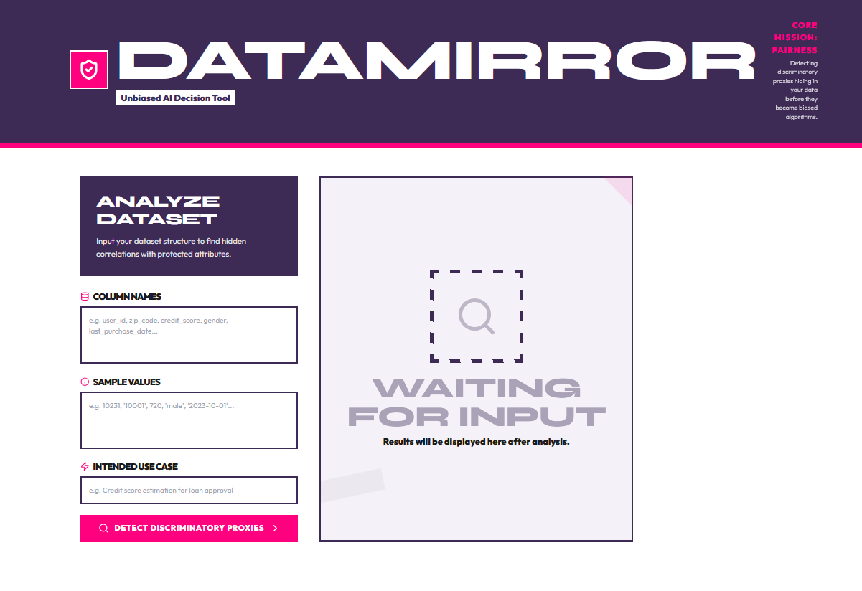
Snapshots of the MVP

Slide 7
Links:
GitHub Public Repository
Working Prototype Link: https://datamirror-sc.vercel.app/

Slide 8


