Slide 1


Team Details
Team name:
Team leader name:
Problem Statement: Unbiased AI Decision

Slide 2
Brief:
DecisionTrace is a Next.js 16 application designed to promote algorithmic accountability by translating complex automated decisions into plain language. Users input details of an automated decision, and the tool leverages Gemini AI to provide clear explanations of the decision's logic, key influencing factors, potential changes for a different outcome, and the user's rights. This ensures fairness and transparency in AI-driven processes, making critical decisions understandable to everyone.

Slide 3
Opportunities:
• Differentiation
• DecisionTrace stands out by offering a hyper-minimalist, typography-first UI that prioritizes clarity and ease of use over visual clutter. Its focus on translating opaque AI decisions into actionable, plain-language insights addresses a critical gap in algorithmic accountability.
• Problem Solving Approach
• The solution tackles the problem of biased AI by providing a direct interface for users to understand *why* an automated decision was made. By surfacing the factors influencing a decision and potential avenues for recourse, it empowers individuals and encourages organizations to address biases proactively.
• USP
• Plain-language explanation of complex AI decisions, delivered through an ultra-minimalist, accessible UI, fostering transparency and accountability.

Slide 4
Features:
• User-friendly form for inputting automated decision details.
• Real-time loading state for AI analysis.
• Clear, hierarchical display of Gemini AI-generated explanations.
• Comprehensive plain-language breakdown: decision logic, key factors, outcome modifiers, and user rights.
• Fully responsive design adhering to minimalist principles.
• Error handling for a robust user experience.

Slide 5
Technologies:
• Framework: Next.js 16 (App Router)
• Language: TypeScript
• Styling: Tailwind CSS
• AI Integration: Gemini API (`gemini-2.5-flash`)
• Icons: Lucide React

Slide 6
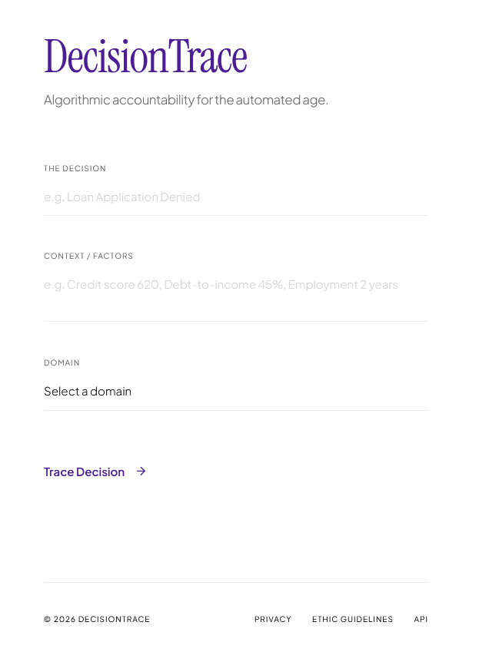
Snapshots of the MVP

Slide 7
Links:
GitHub Public Repository
Working Prototype Link: https://decisiontrace-sc.vercel.app/

Slide 8


