Slide 1


Team Details
Team name:
Team leader name:
Problem Statement: Unbiased AI Decision

Slide 2
Brief:
FixItFlow is a Next.js 16 web application designed to combat algorithmic bias in AI systems. It provides a clear, accessible solution for organizations to input details about observed biased model outcomes. Leveraging Gemini AI, the tool generates a concrete, prioritized action plan to debias their models, ensuring fairness and ethical decision-making in automated processes.

Slide 3
Opportunities:
• Differentiation
• FixItFlow differentiates itself by offering a highly prescriptive, step-by-step debiasing action plan tailored to specific bias scenarios, rather than merely flagging bias. This actionable, AI-driven guidance provides immediate, practical value beyond generic recommendations, making complex ethical problems solvable.
• Problem Solving Approach
• The tool employs a systematic approach: users describe the observed biased outcome, disadvantaged groups, model type, and available interventions. Gemini AI then analyzes this input to generate a prioritized 5-step action plan, detailing specific techniques, implementation steps, estimated effort, and expected bias reduction. This translates abstract ethical concerns into concrete technical tasks.
• USP
• FixItFlow's unique selling proposition is its ability to instantly convert a description of observed algorithmic bias into a concrete, prioritized, and actionable debiasing plan, powered by advanced AI, thereby simplifying the journey towards ethical and fair AI deployment.

Slide 4
Features:
• Intuitive input form to capture biased outcomes, affected groups, model types, and intervention preferences.
• Dynamic loading states and error handling for a robust user experience.
• AI-powered generation of a 5-step, prioritized debiasing action plan.
• Detailed output specifying debiasing techniques (e.g., reweighting, resampling), implementation steps, effort, and expected impact.
• Professional, clean, and responsive user interface adhering to a deep purple and white color palette.
• Integration with Gemini API for intelligent action plan prescription.

Slide 5
Technologies:
• Frontend Framework: Next.js 16 (App Router)
• Language: TypeScript
• Styling: Tailwind CSS with custom CSS variables
• Icons: lucide-react
• AI Integration: Google Gemini API (`gemini-2.5-flash`) for debiasing plan generation.

Slide 6
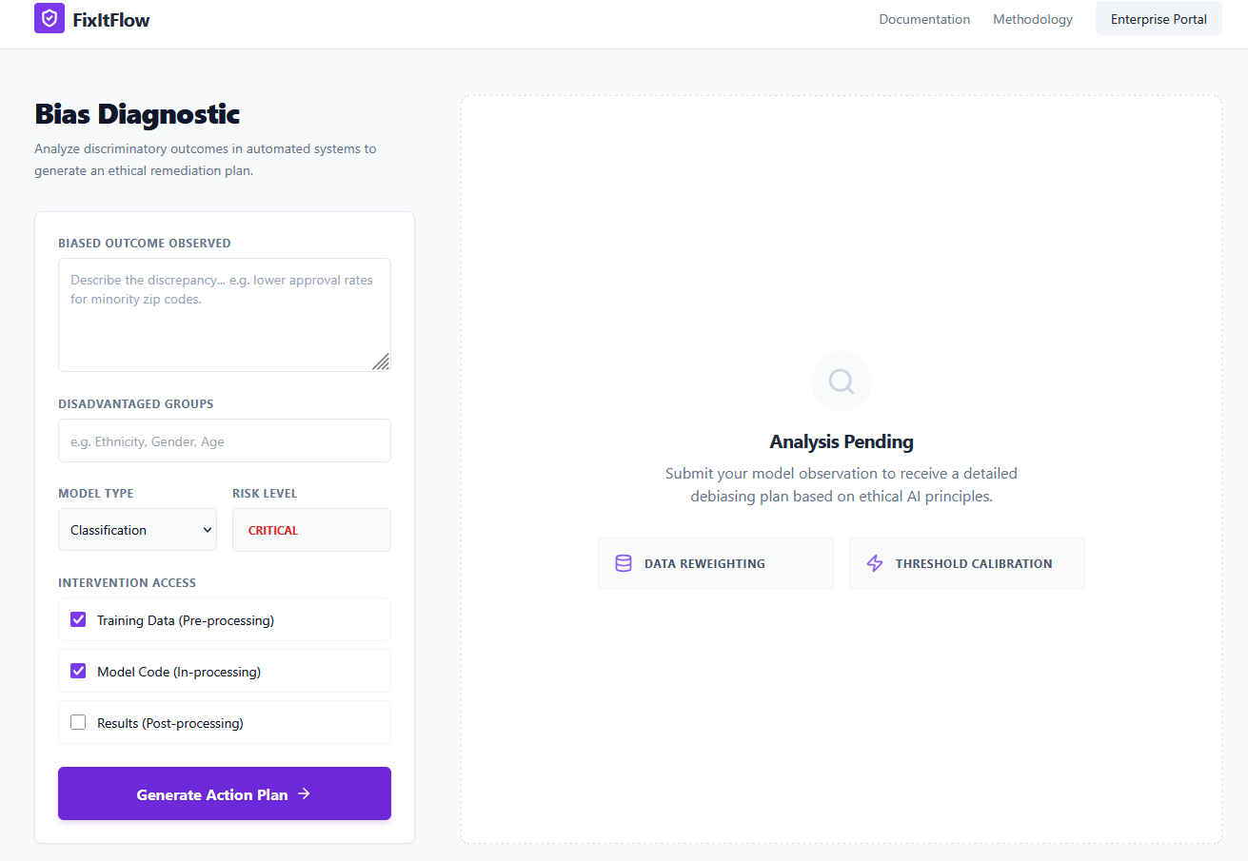
Snapshots of the MVP

Slide 7
Links:
GitHub Public Repository
Working Prototype Link: https://fixitflow-sc.vercel.app/

Slide 8


