Slide 1


Team Details
Team name:
Team leader name:
Problem Statement: Unbiased AI Decision

Slide 2
Brief:
EthicsCheck is an AI ethics compliance auditor designed to identify and mitigate bias in automated decision-making systems. It allows organizations to describe their AI system, then leverages Gemini AI to generate a detailed compliance checklist mapped to key standards like the EU AI Act, NIST AI RMF, and IEEE 7010. This solution provides clear status indicators (pass/fail/needs-review) to proactively measure, flag, and fix harmful bias before AI systems impact real people.

Slide 3
Opportunities:
• Differentiation
• EthicsCheck differentiates itself through its unique Glass UI styling, its direct mapping of compliance checks to specific, recognized global standards (EU AI Act, NIST AI RMF, IEEE 7010), and its integration of Gemini AI to generate context-aware, tailored ethics checklists. This positions it as a premium, analytically precise tool in the AI governance space.
• Problem Solving Approach
• The tool addresses the problem by empowering users to provide a comprehensive description of their AI system, including its purpose, data, decisions, and affected populations. Gemini AI then processes this information to dynamically generate a compliance checklist, assessing each item's status (LIKELY COMPLIANT / NEEDS REVIEW / LIKELY NON-COMPLIANT) and highlighting critical risk gaps. This proactive and structured approach enables organizations to identify and rectify ethical issues before deployment.
• USP
• "Describe your AI system — get an ethics compliance checklist mapped to real standards." EthicsCheck offers an unparalleled, AI-driven capability to instantly audit AI systems against global ethical guidelines, providing actionable insights for fairness and accountability.

Slide 4
Features:
• Intuitive Glass UI for describing AI system purpose, data, decisions, and impact.
• AI-powered generation of a tailored ethics compliance checklist using Gemini (`gemini-2.5-flash`).
• Compliance checks mapped to EU AI Act, NIST AI Risk Management Framework, and IEEE 7010.
• Clear status indicators for each checklist item: LIKELY COMPLIANT, NEEDS REVIEW, LIKELY NON-COMPLIANT.
• Identification and highlighting of the top 3 highest-risk compliance gaps.
• Responsive design for seamless use across desktop and mobile devices.
• Robust loading and error state handling for a smooth user experience.

Slide 5
Technologies:
• Framework: Next.js 16 (App Router)
• Language: TypeScript
• Styling: Tailwind CSS with custom CSS variables (Glass UI)
• Icons: lucide-react
• AI Integration: Google Gemini API (`gemini-2.5-flash`) via server-side route

Slide 6
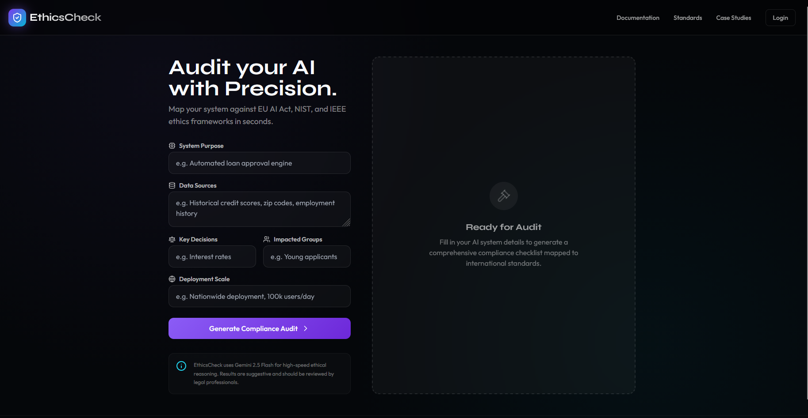
Snapshots of the MVP

Slide 7
Links:
GitHub Public Repository
Working Prototype Link: https://ethicscheck.vercel.app/

Slide 8


