Slide 1


Team Details
Team name:
Team leader name:
Problem Statement: Smart Resource Allocation

Slide 2
Brief:
NeedMapper is a Next.js 16 web application designed for NGOs to transform scattered community survey data into actionable insights. It leverages Google Gemini AI to analyze unstructured text, identify urgent local needs, and present them in a clear, prioritized format, facilitating efficient volunteer coordination and social impact. The application features an intuitive Bento Box Grid UI for displaying complex information.

Slide 3
Opportunities:
• Differentiation
• NeedMapper stands out by combining an advanced AI-driven analysis engine with a highly visual and intuitive Bento Box Grid UI. Unlike manual methods or generic data entry systems, it specifically extracts, ranks, and categorizes urgent needs from raw text, providing a dynamic and comprehensive overview that traditional tools cannot match. Its focus on linking needs to volunteer coordination through clear, actionable data is unique.
• Problem Solving Approach
• The system addresses the core problem by:
• 1. Centralizing Data: Providing a single point for ingesting diverse, unstructured community data.
• 2. AI-Powered Analysis: Utilizing Gemini AI to intelligently parse text, identify urgency signals, and structure information.
• 3. Prioritization & Visualization: Presenting extracted needs with urgency scores, affected populations, and geographic clustering in a visually hierarchical Bento Box Grid, making complex data immediately digestible.
• 4. Actionable Insights: Enabling NGOs to quickly understand critical areas and efficiently match volunteers to specific tasks.
• USP
• Smart Resource Allocation — Data-Driven Volunteer Coordination for Social Impact. NeedMapper's unique selling proposition is its ability to rapidly convert chaotic, unstructured community data into precise, prioritized, and visually accessible information, empowering NGOs to make immediate, impactful decisions regarding volunteer deployment and resource allocation.

Slide 4
Features:
• Unstructured text input for community surveys and field notes.
• AI-powered extraction, categorization, and ranking of top 10 urgent needs.
• Output includes urgency scores (1-10), estimated affected populations, and priority categories.
• Geographic clustering and key urgency signal identification.
• Interactive Bento Box Grid UI for dynamic display of results.
• Responsive design for desktop and mobile access.
• Clear loading indicators and robust error handling.

Slide 5
Technologies:
• Next.js 16 (App Router)
• TypeScript
• Tailwind CSS with custom CSS variables
• lucide-react for icons
• Google Gemini API (`gemini-2.5-flash`)

Slide 6
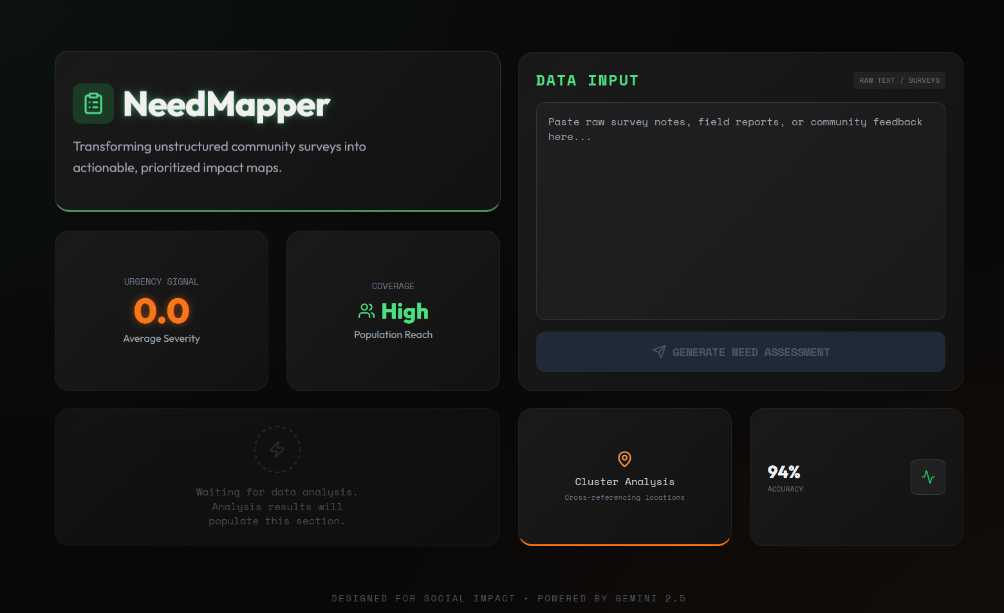
Snapshots of the MVP

Slide 7
Links:
GitHub Public Repository
Working Prototype Link: https://needmapper.vercel.app/

Slide 8


